Slide 1
Information Retriveal
1)Introduction , Basic techniques, &Token
2)Static Inverted Indices and Query Processing
3)Index Compression and Dynamic Inverted Indices
4)Probabilistic Retrieval and Language Modeling & Related Methods , Categorization & Filtering
5)Measuring Effectiveness and Measuring Efficiency
6)Parallel Information retrieval , Web Search

Slide 2
UNIT NO-II
Static Inverted Indices and Query Processing

Slide 3
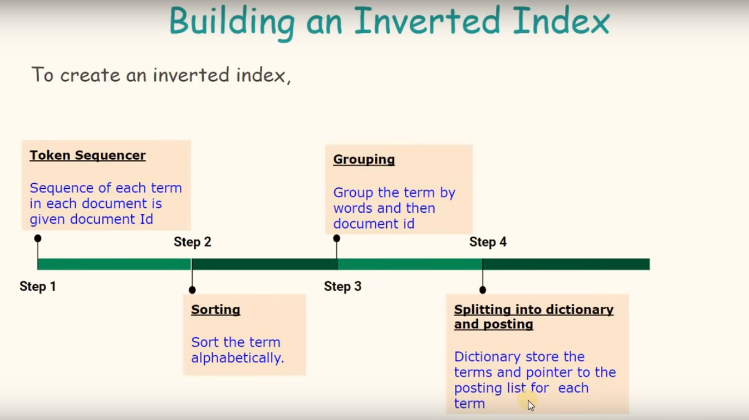
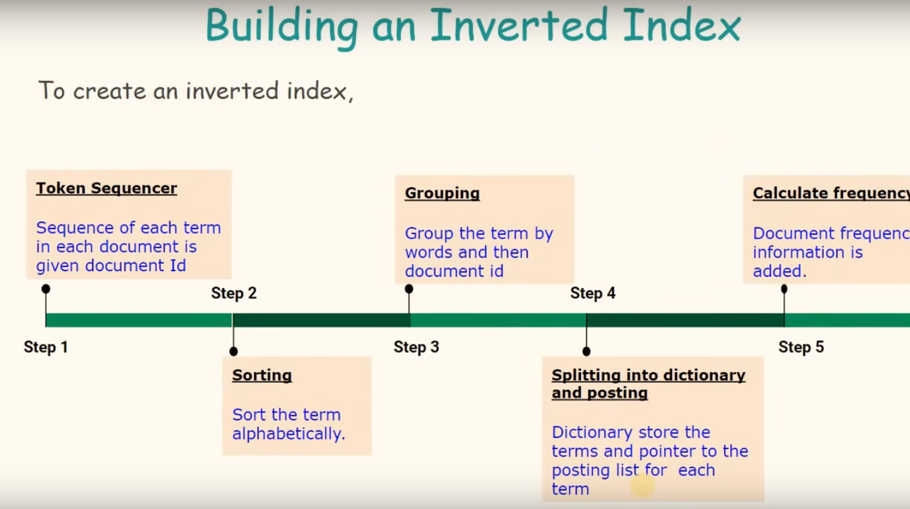

Slide 4
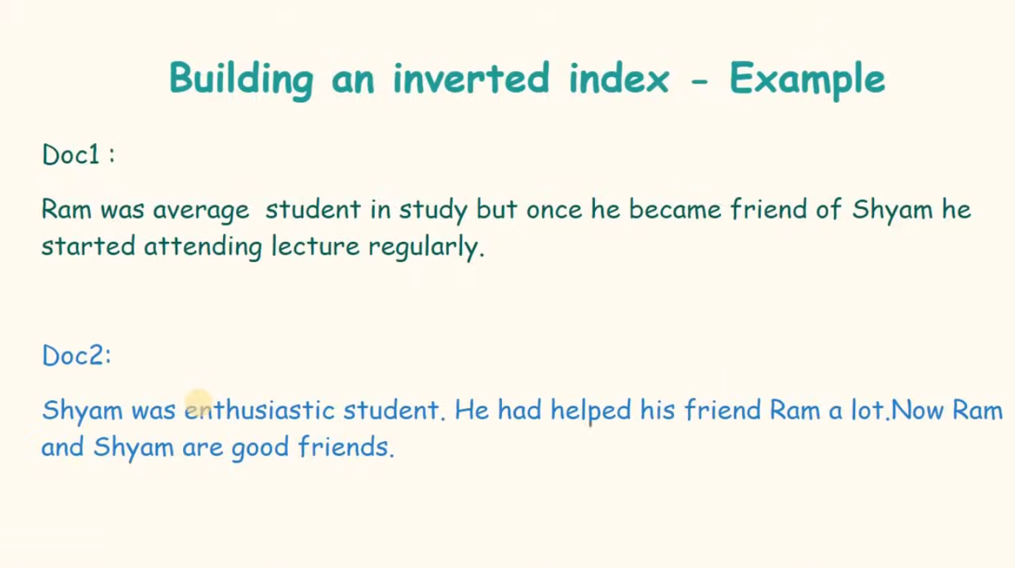

Slide 5
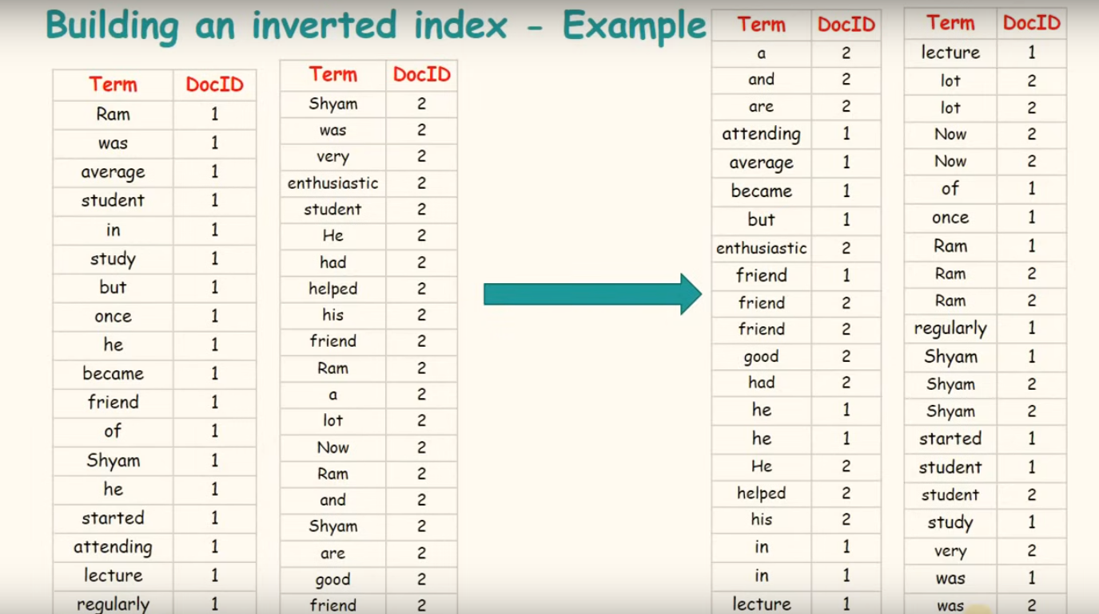

Slide 6
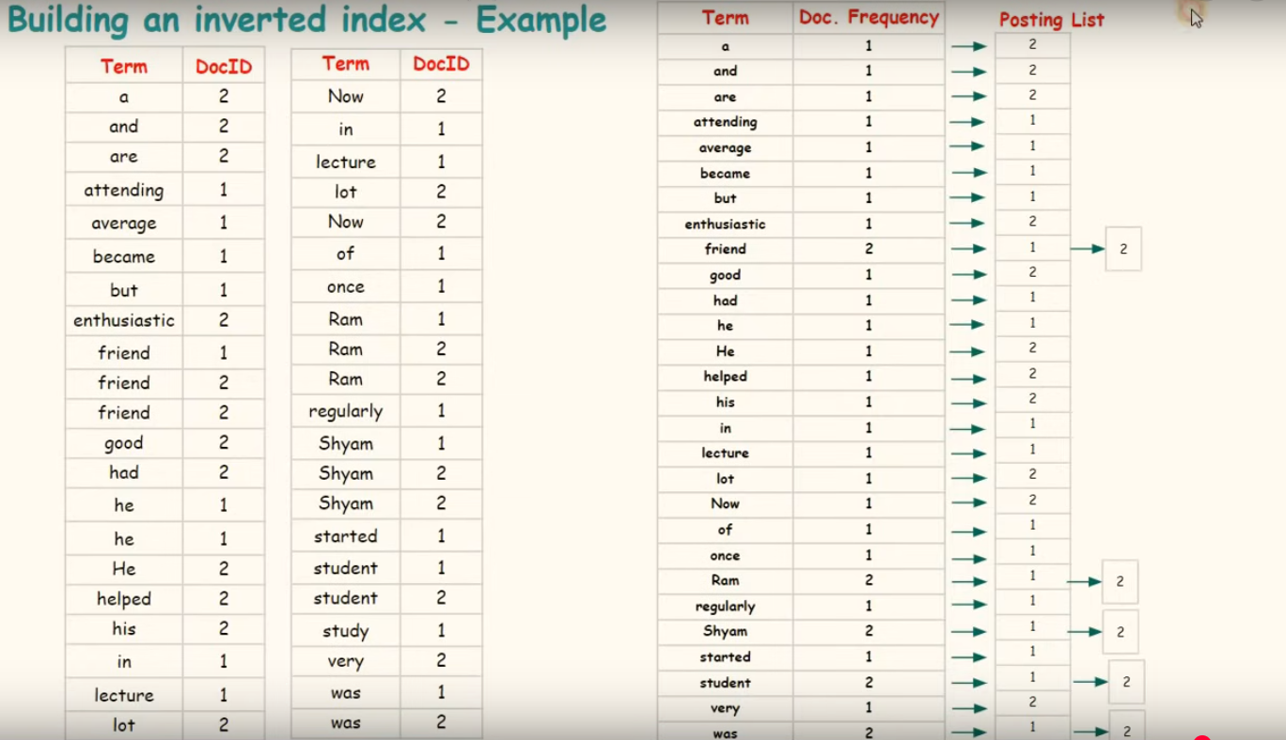

Slide 7
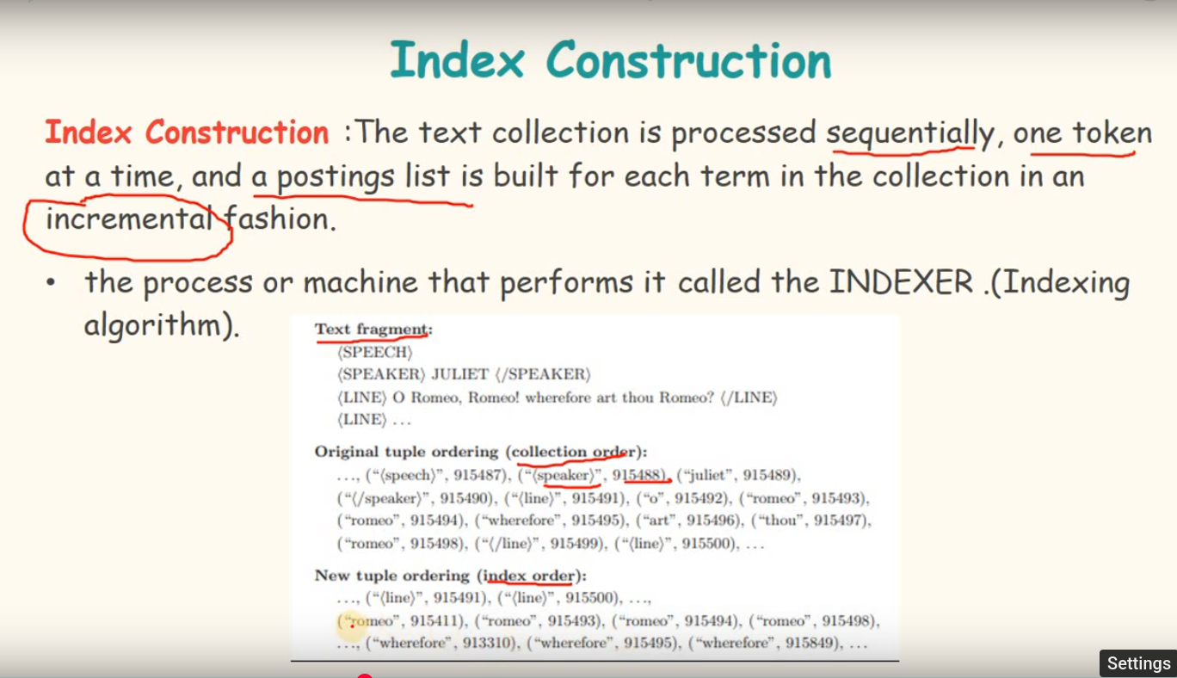

Slide 8
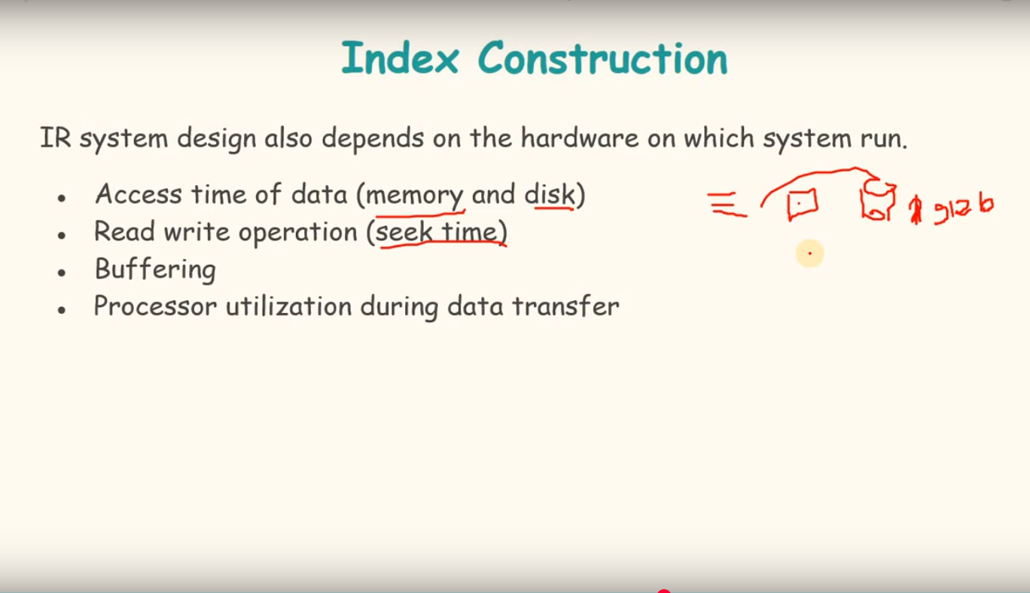

Slide 9
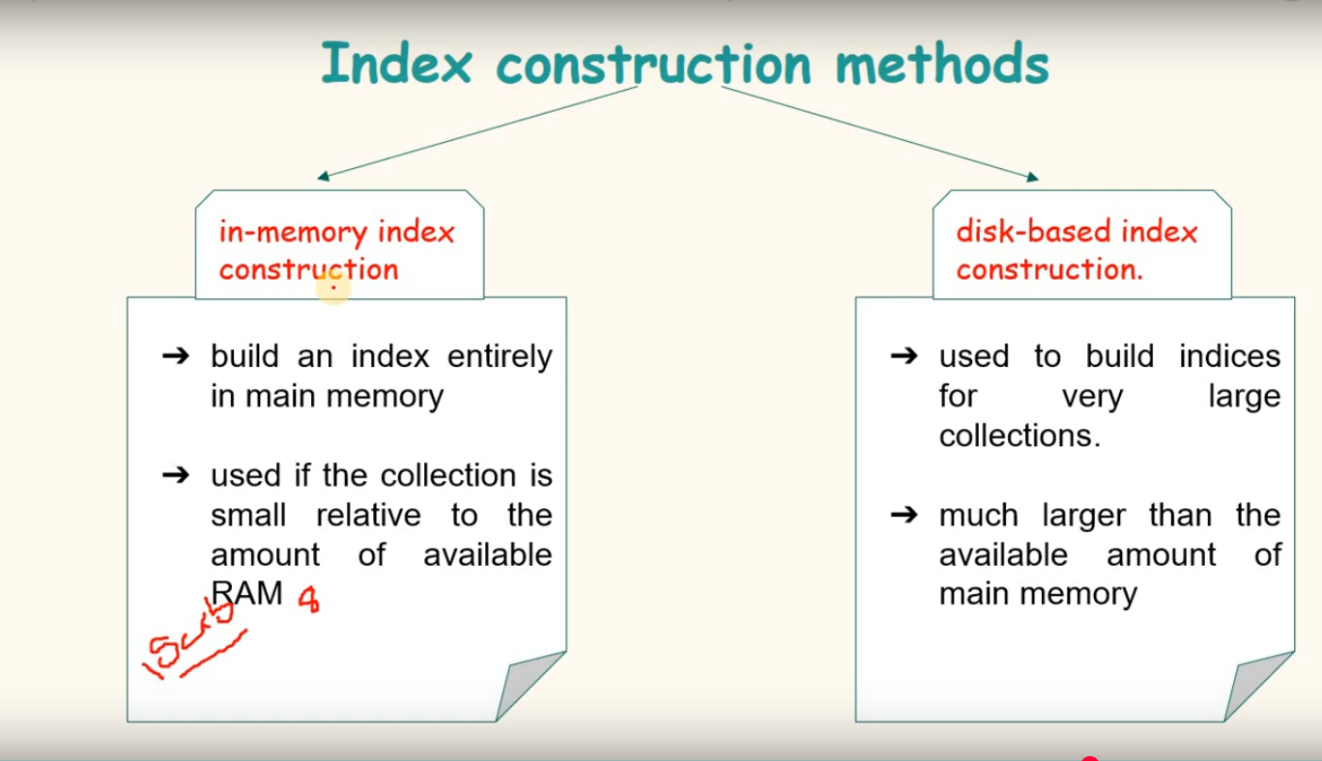

Slide 10
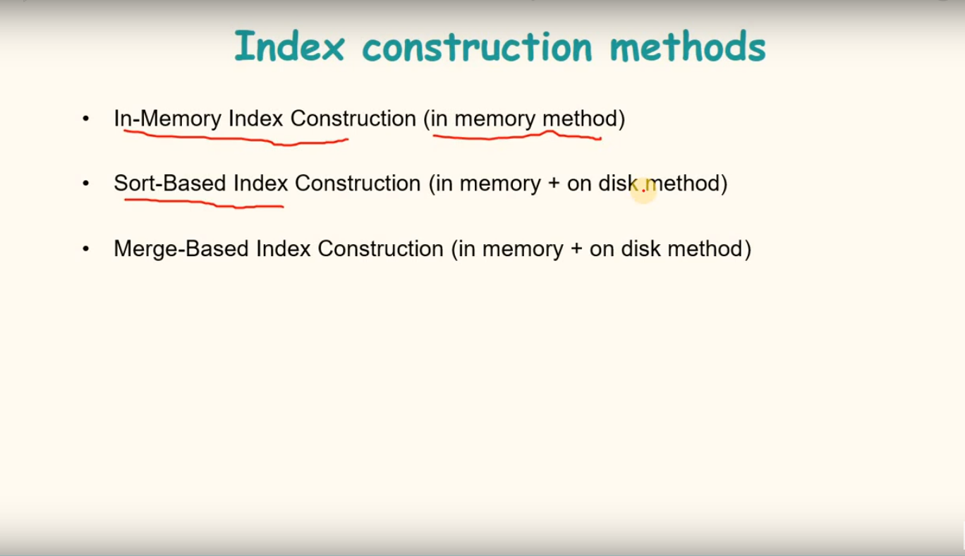

Slide 11
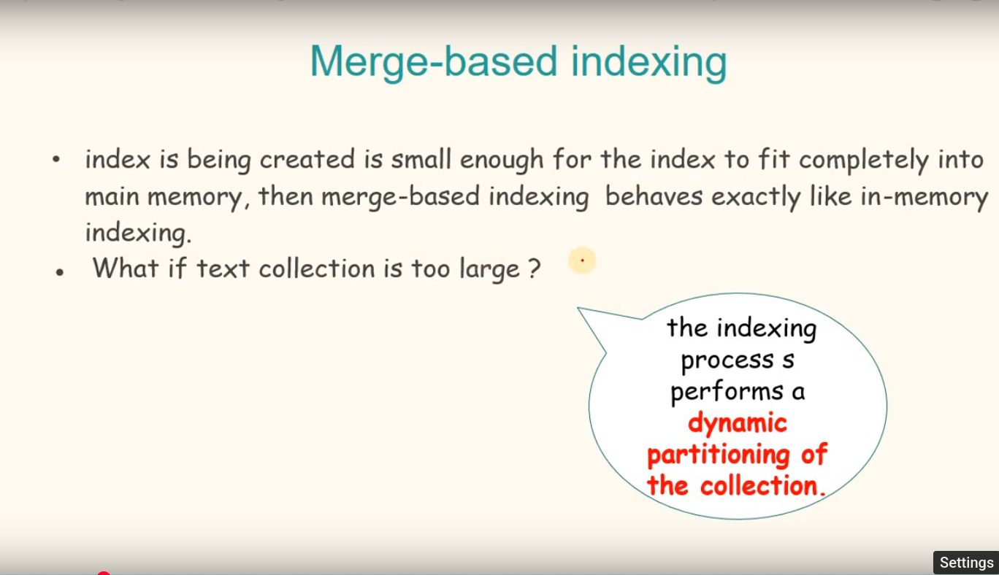

Slide 12
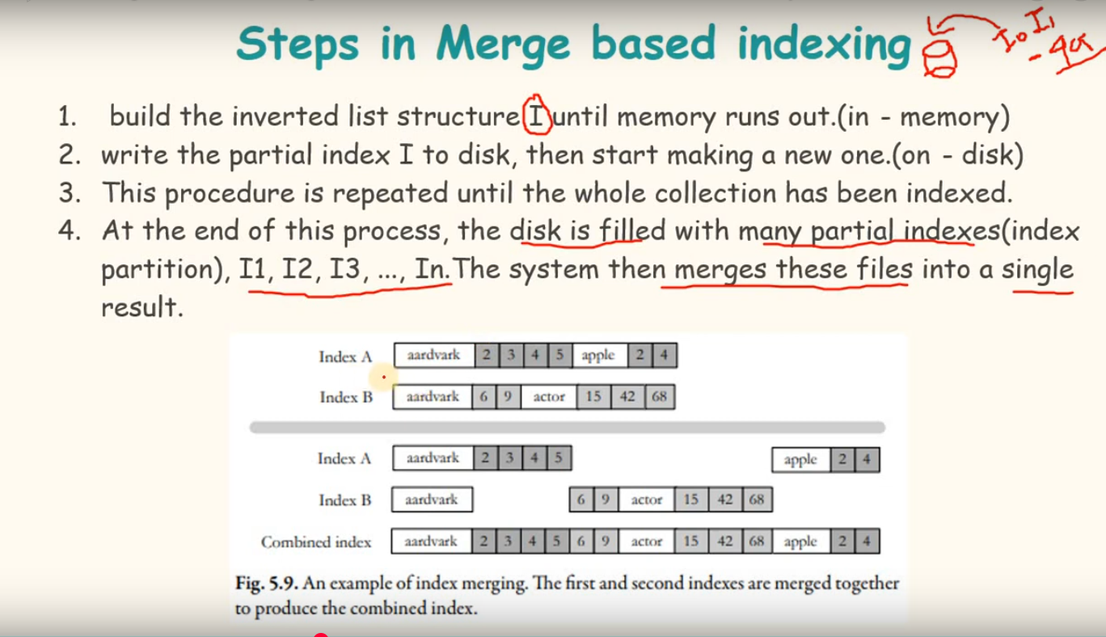

Slide 13
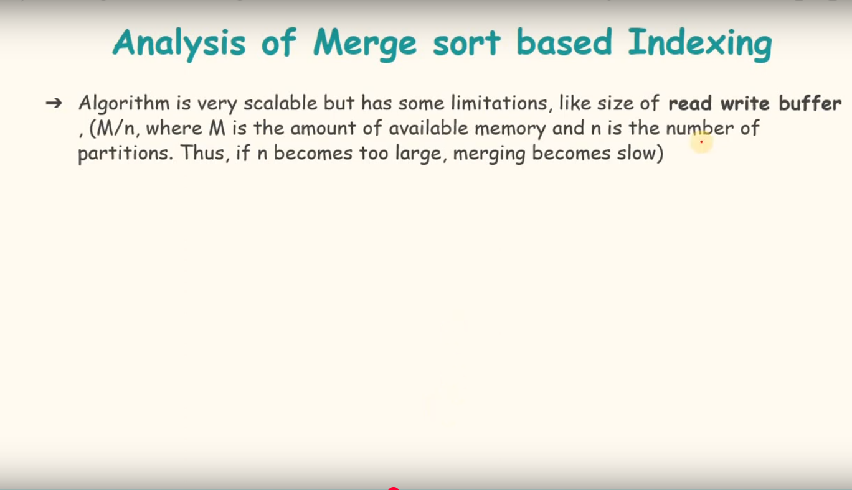

Slide 14
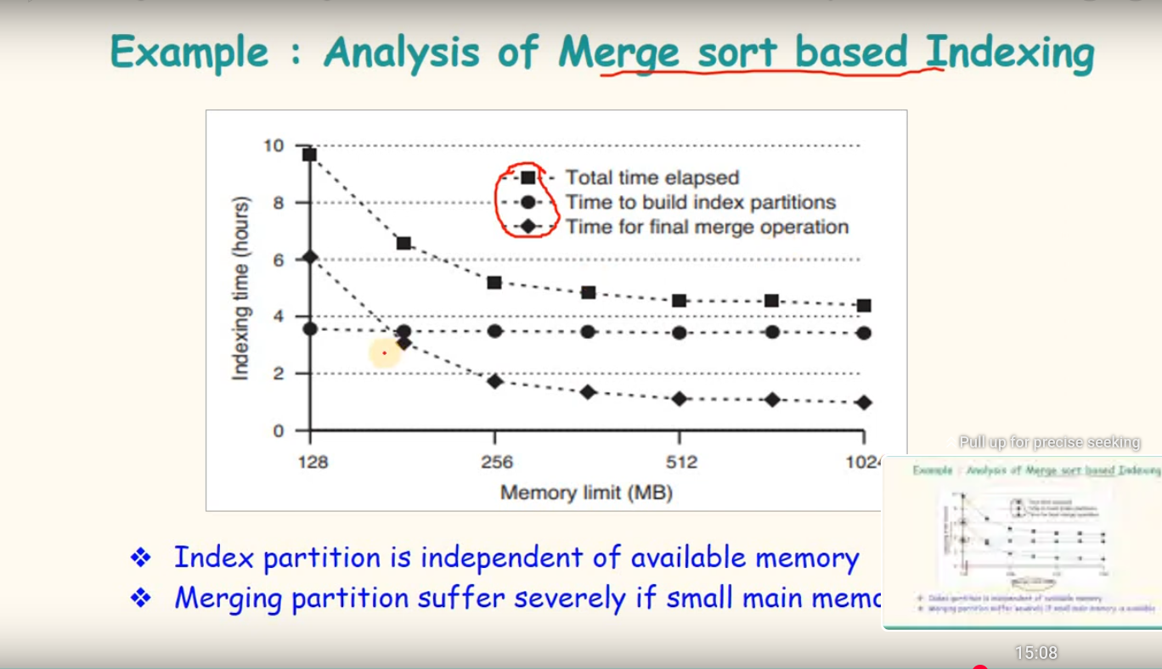

Slide 15
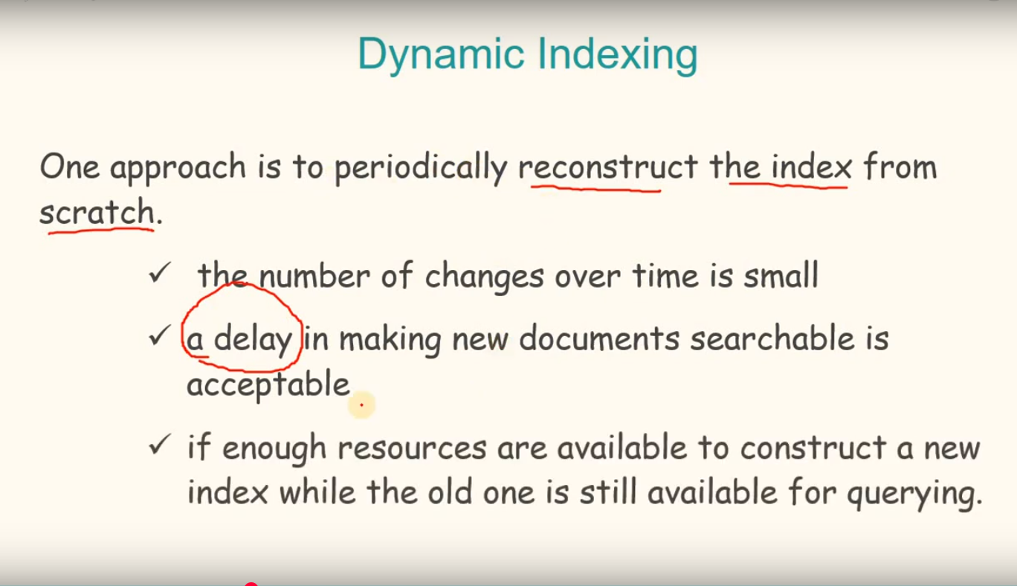

Slide 16
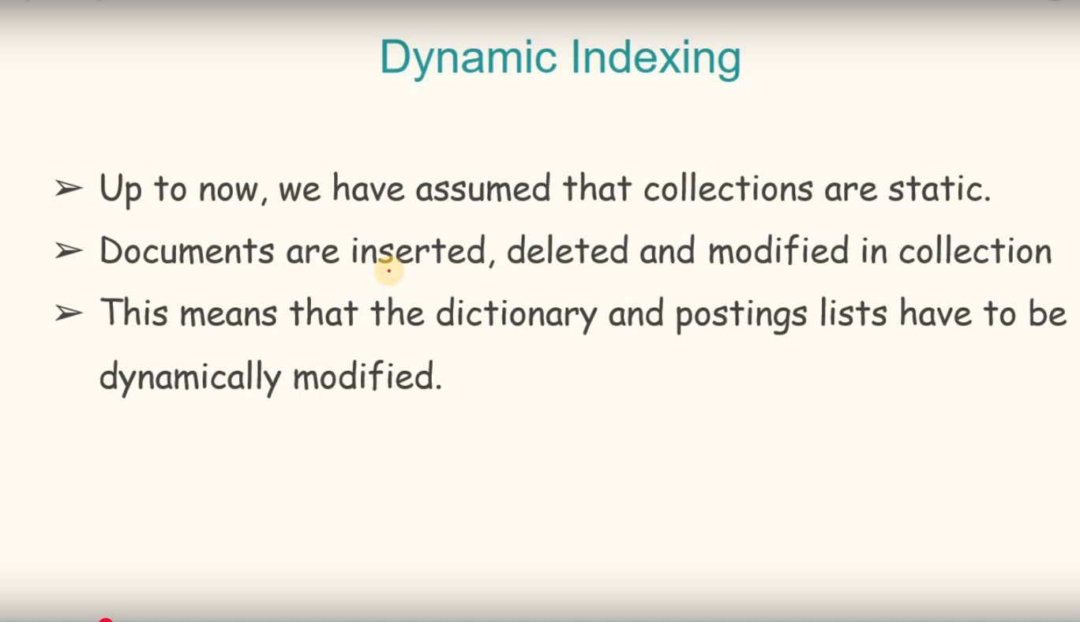

Slide 17
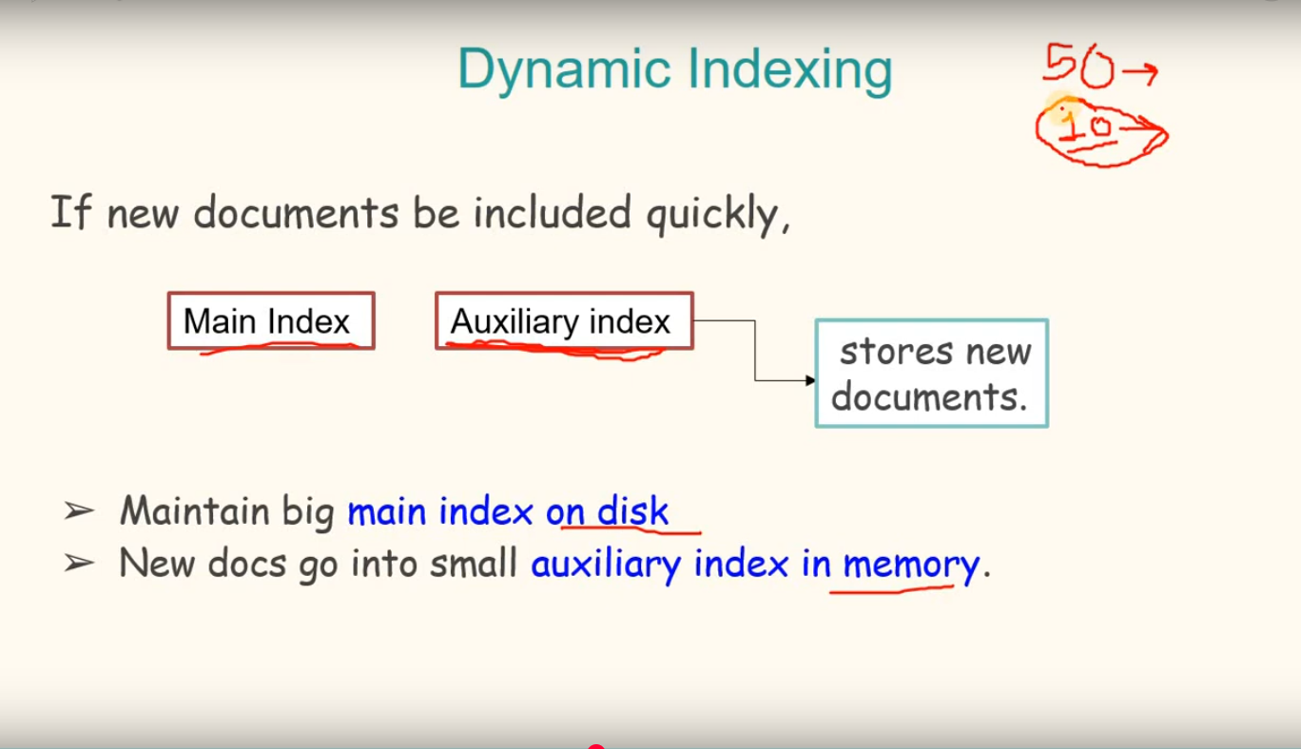

Slide 18
