Slide 1
Information Retriveal
1)Introduction , Basic techniques, &Token
2)Static Inverted Indices and Query Processing
3)Index Compression and Dynamic Inverted Indices
4)Probabilistic Retrieval and Language Modeling & Related Methods , Categorization & Filtering
5)Measuring Effectiveness and Measuring Efficiency
6)Parallel Information retrieval , Web Search

Slide 2
UNIT NO-I
Introduction, Basic techniques & tokens

Slide 3
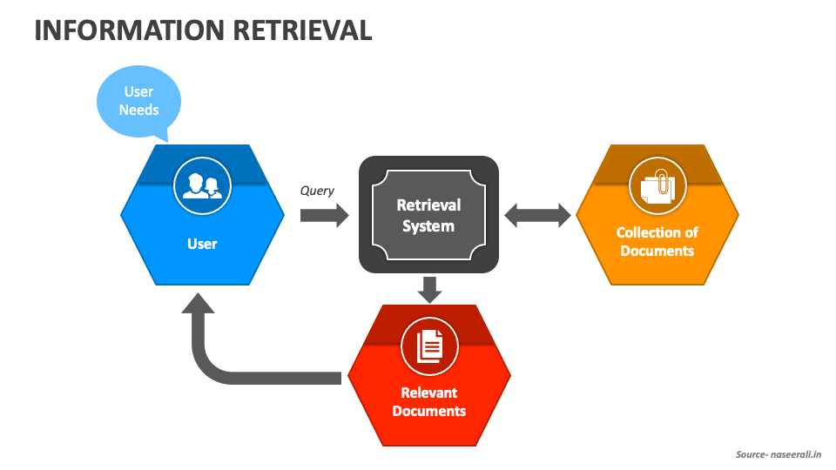
Introduction
IR-An Information retrieval system(IRS) is a software system helps to locate & retrieve relevant information from a large collection of database or a document collection. ex-google, e-mails

Slide 4
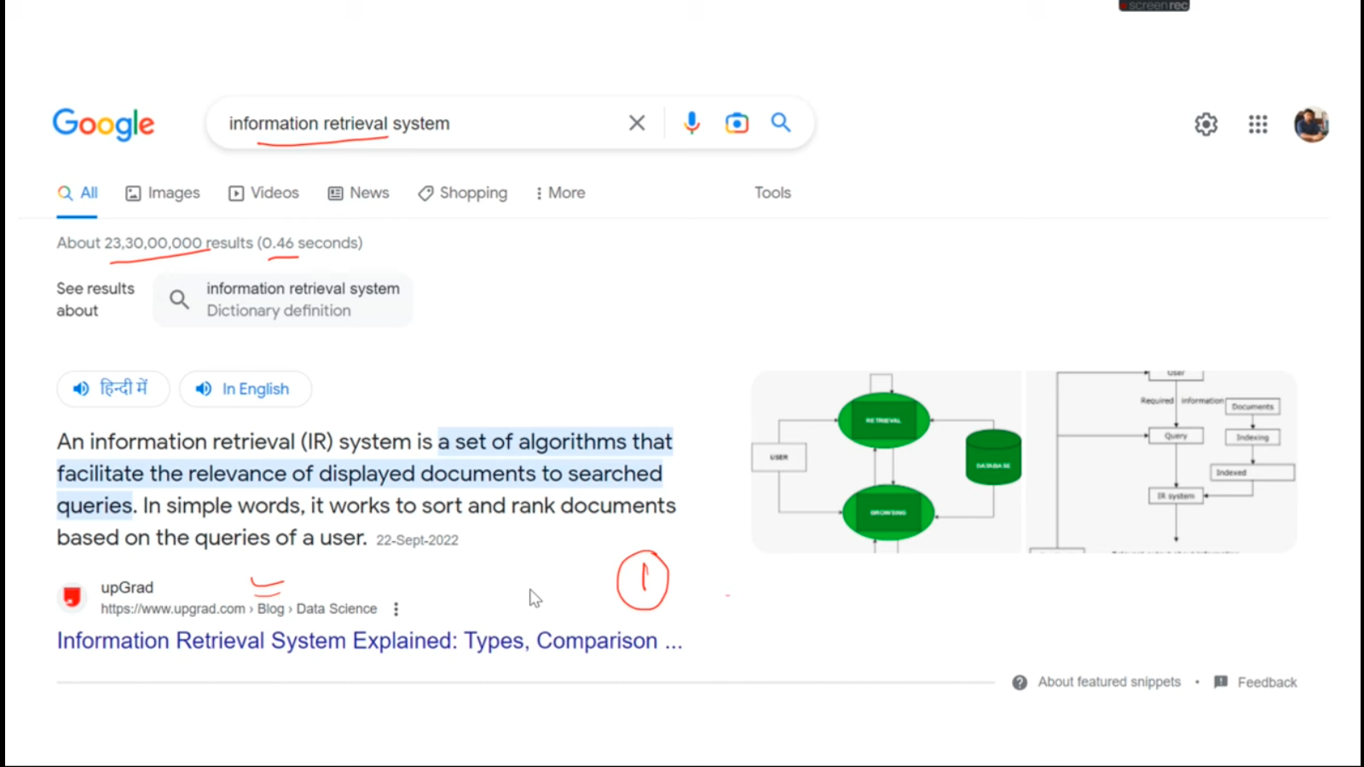

Slide 5
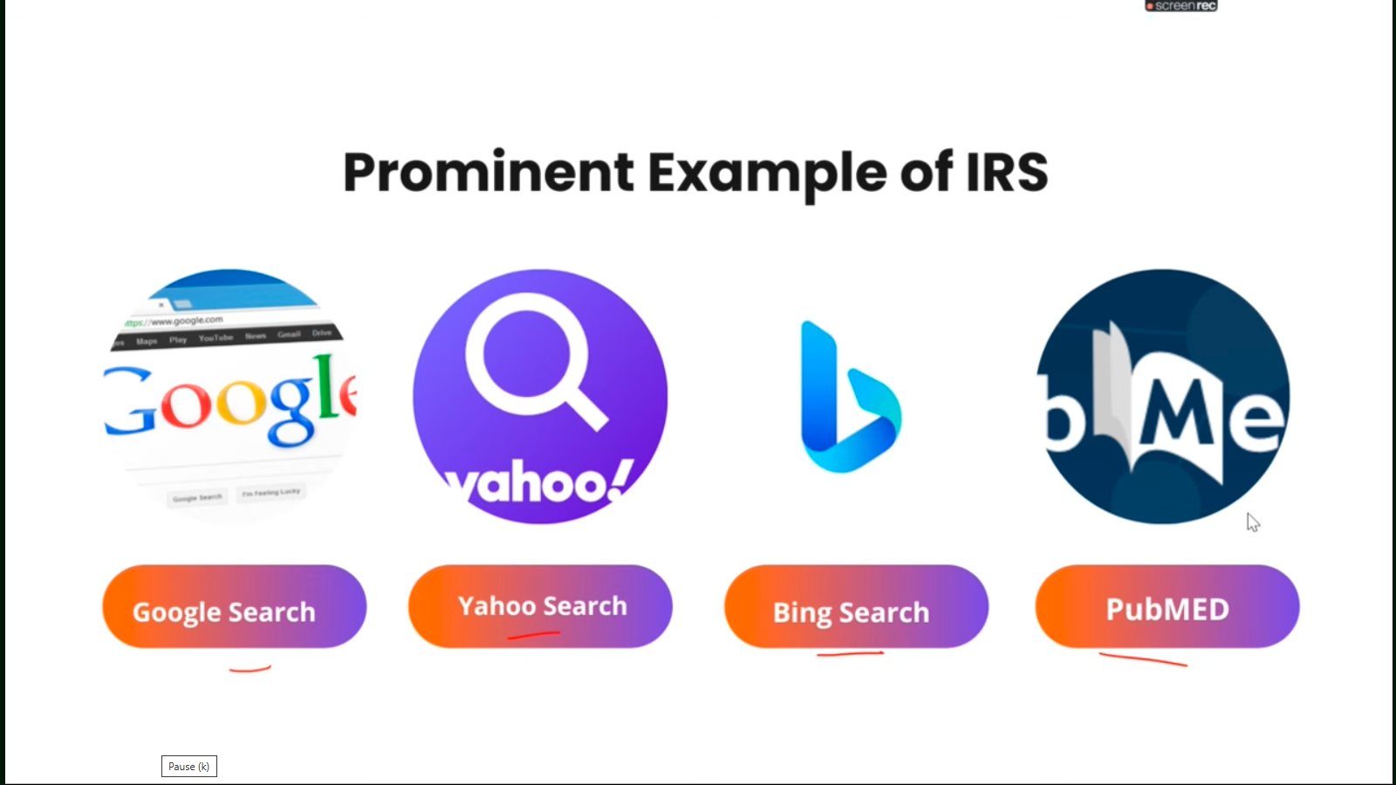

Slide 6
Searching Capabilities
1)Boolean Logic
2)Proximity
3)Contigous word Pharse
4)Fuzzy Logic
5)Term Masking
6)Numeric & Data Range
7)concepts /Thesaurus Expansion
8)NLP
9)Multimedia queries

Slide 7
Boolean Logic
A | NOT A
True | False
False | True
Values- True and False
Operator-Not,And,OR
OR Table
A | B | A OR B
True | True | True
True | False | True
False | True | True
False | False | False
A | B | A AND B
True | True | True
True | False | False
False | True | False
False | False | False

Slide 8
Mobile OR Laptop
Mobile | Laptop | Mobile OR Laptop
True | True | True
True | False | True
False | True | True
False | False | False

Slide 9
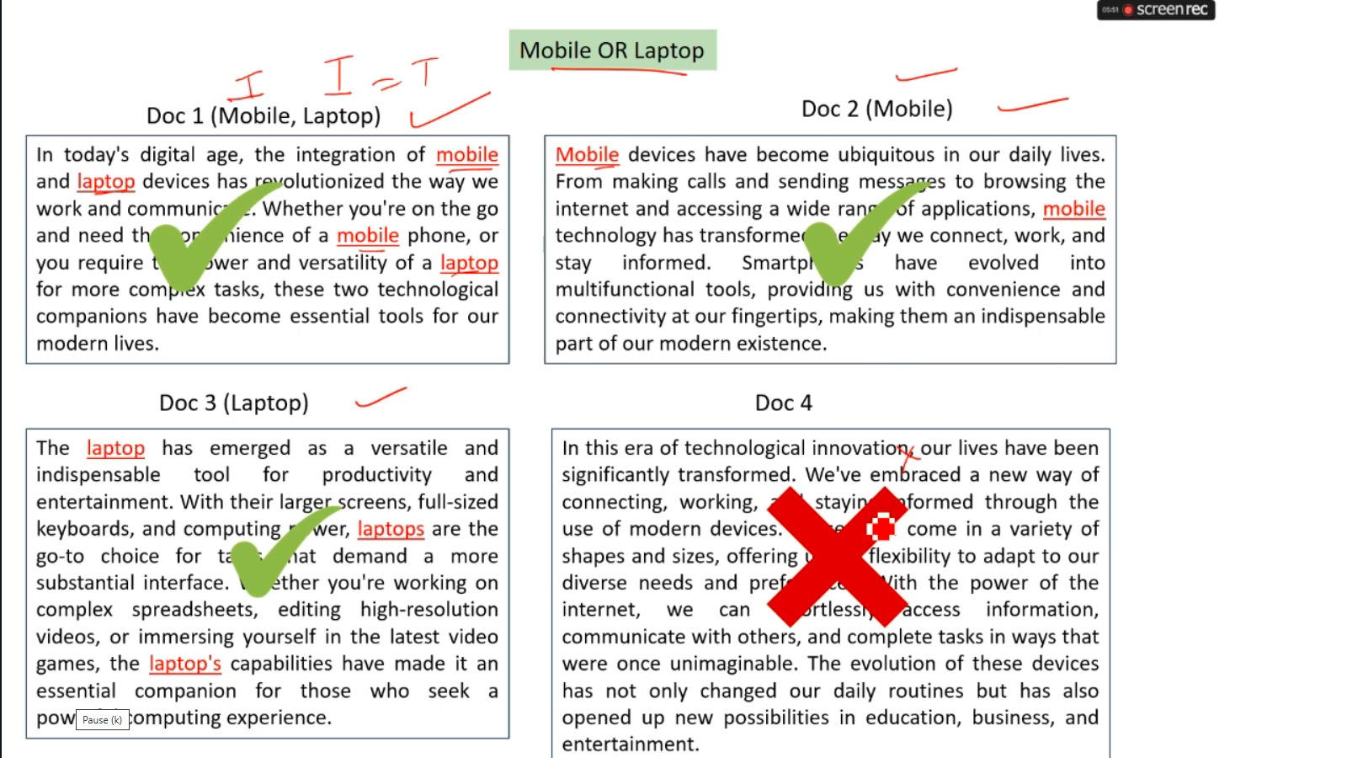
Mobile OR Laptop

Slide 10
Mobile AND Laptop
Mobile | Laptop | Mobile AND Laptop
True | True | True
True | False | True
False | True | True
False | False | False

Slide 11
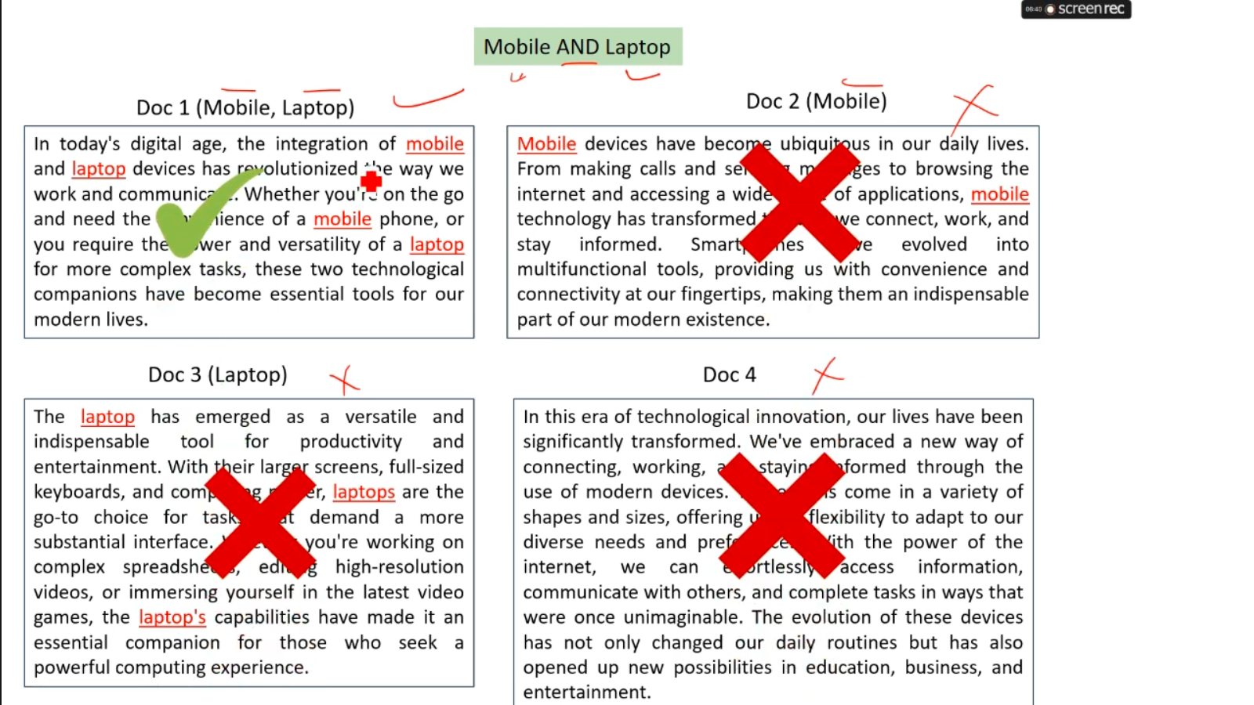

Slide 12
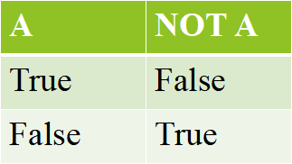
Mobile NOT Laptop

Slide 13
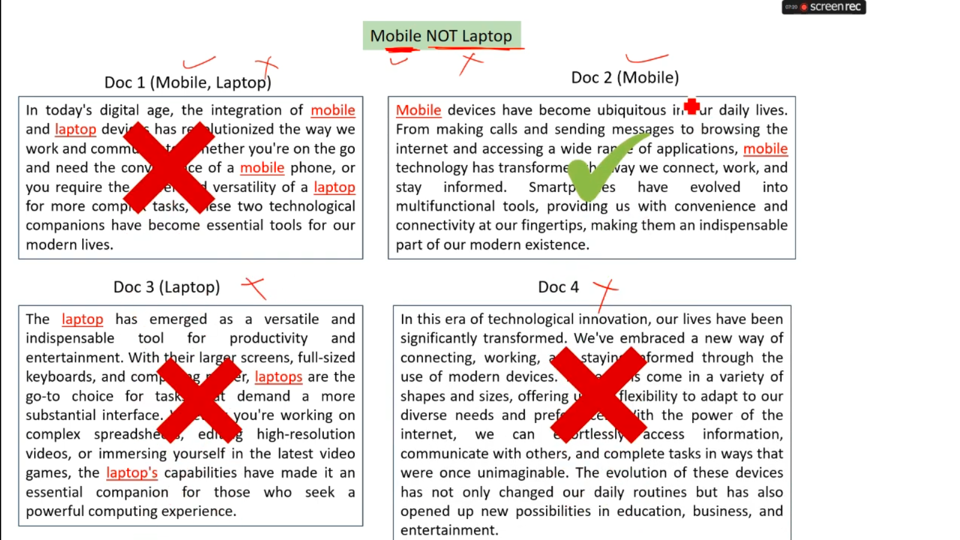
Mobile NOT Laptop

Slide 14
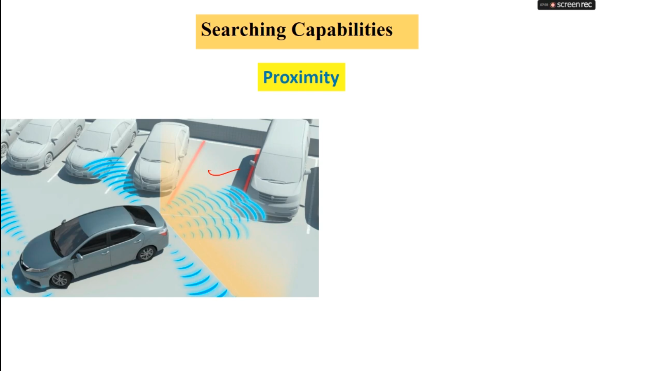

Slide 15
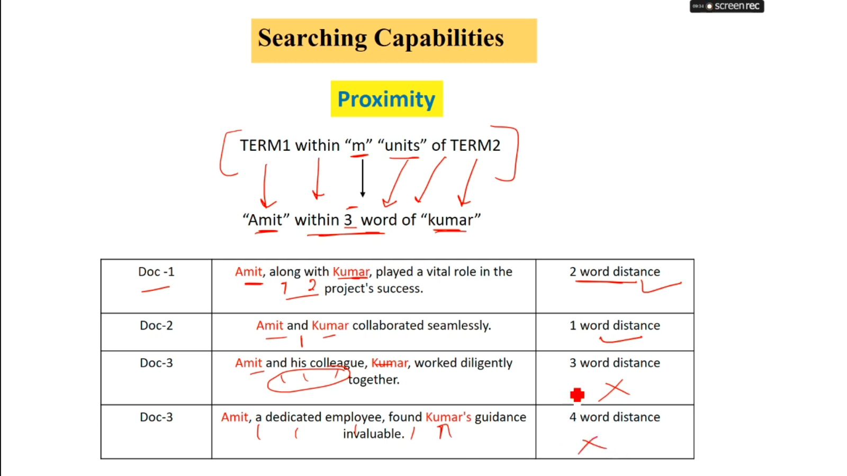

Slide 16
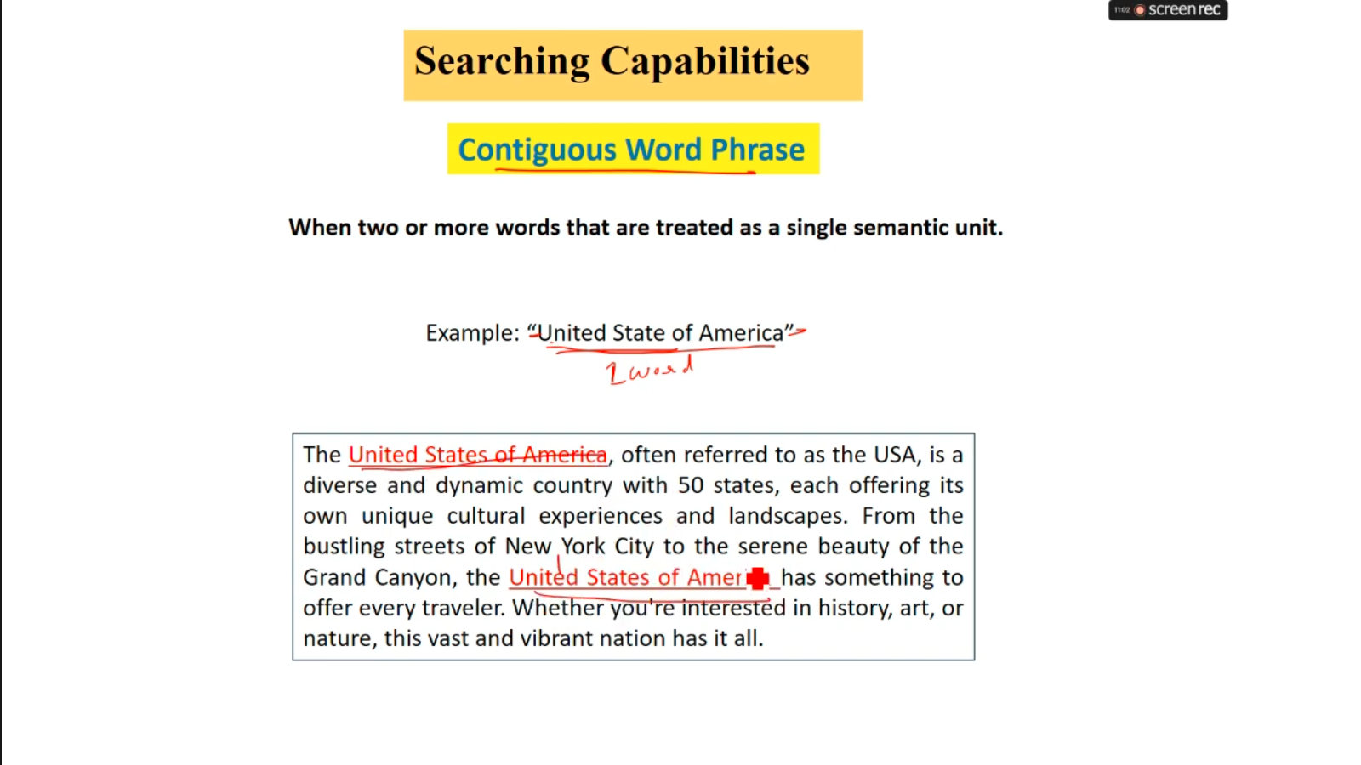

Slide 17
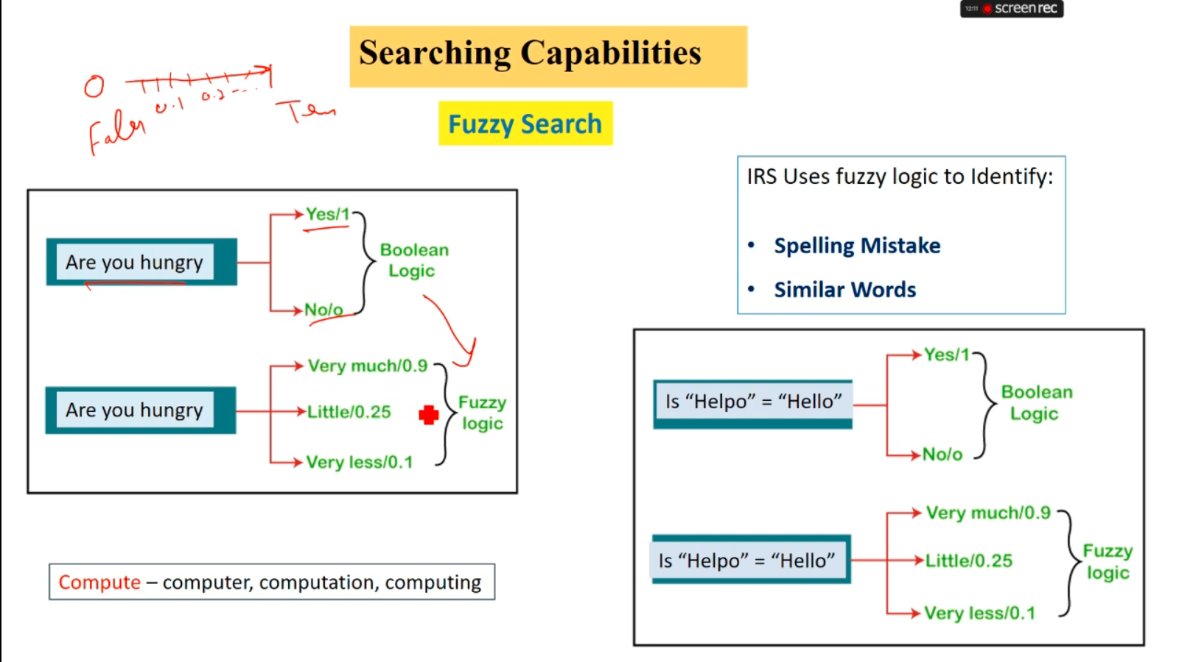

Slide 18
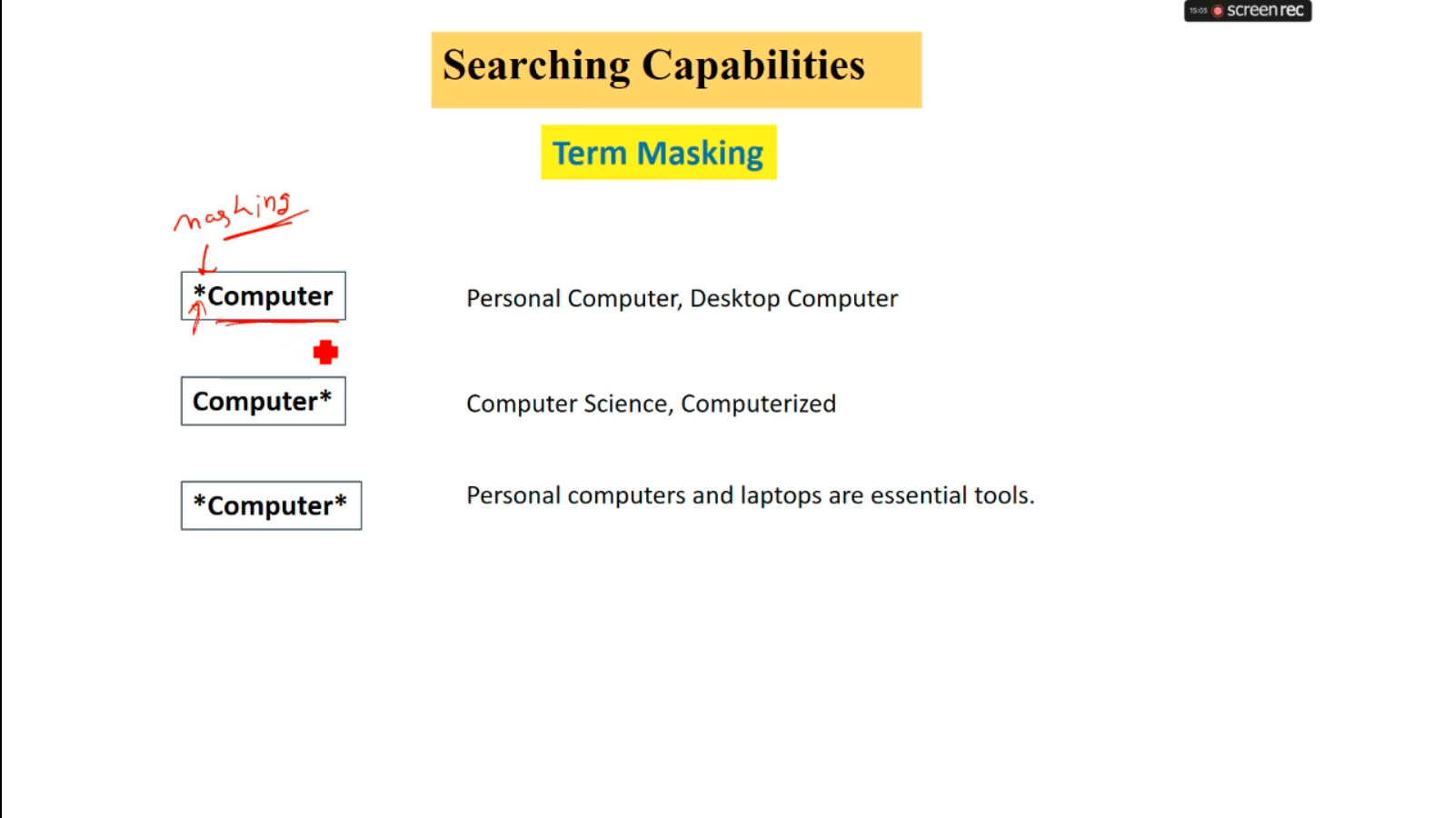

Slide 19
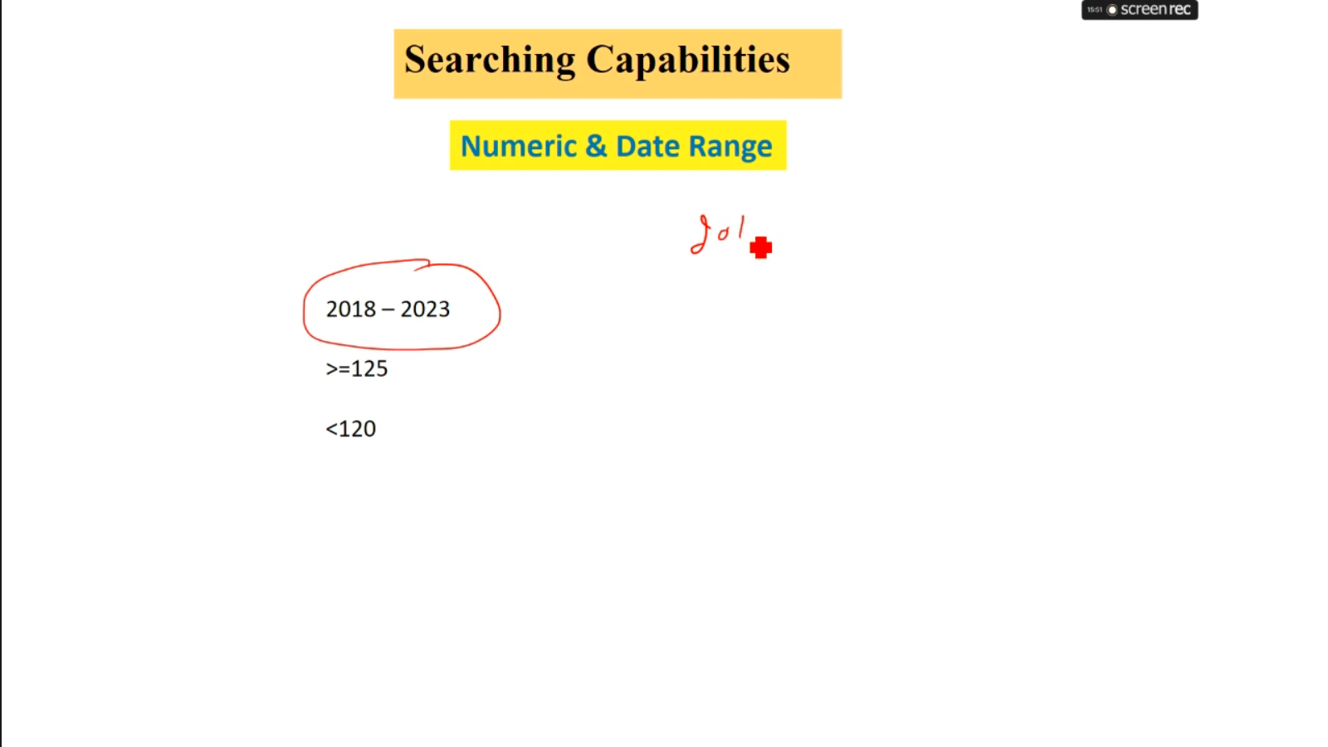

Slide 20
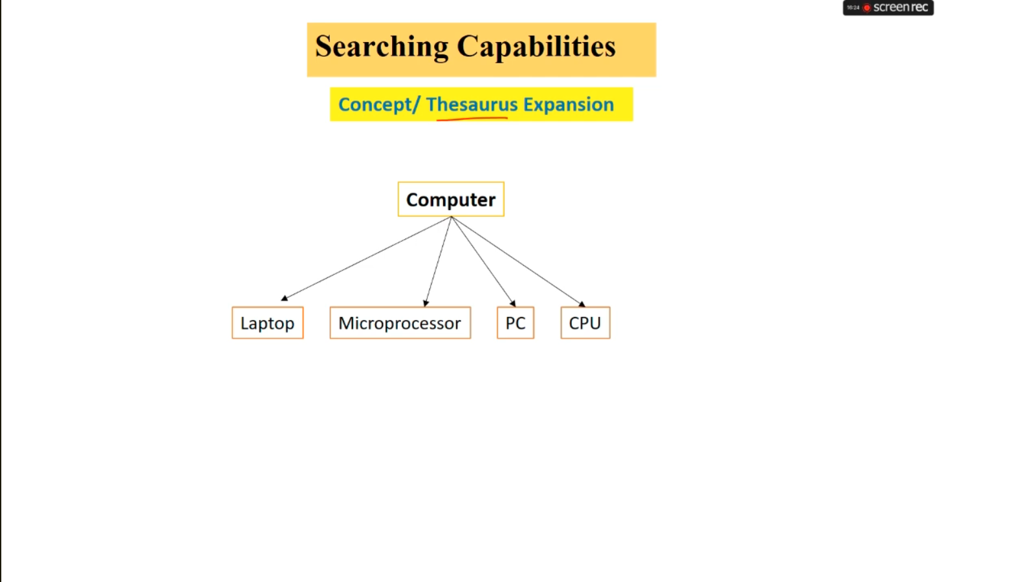

Slide 21
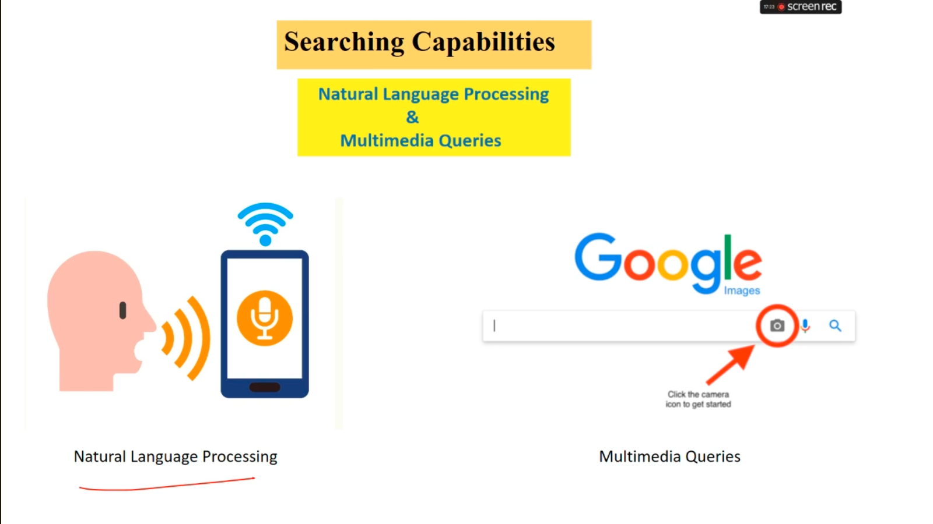

Slide 22
OBJECTIVES
Precision= number of relevant retrieved document
Total number of retrieved document
Recall= number of relevant retrieved document
Total number of possible relevant document
Relevant Retrieved
Relevant Not Retrieved
Non Relevant Retrieved
Non Relevant
Not Retrieved

Slide 23
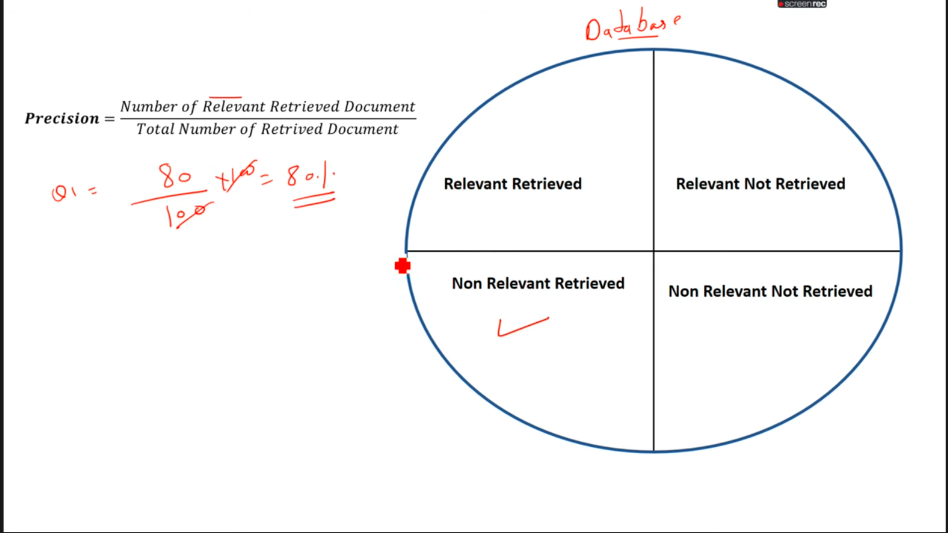

Slide 24
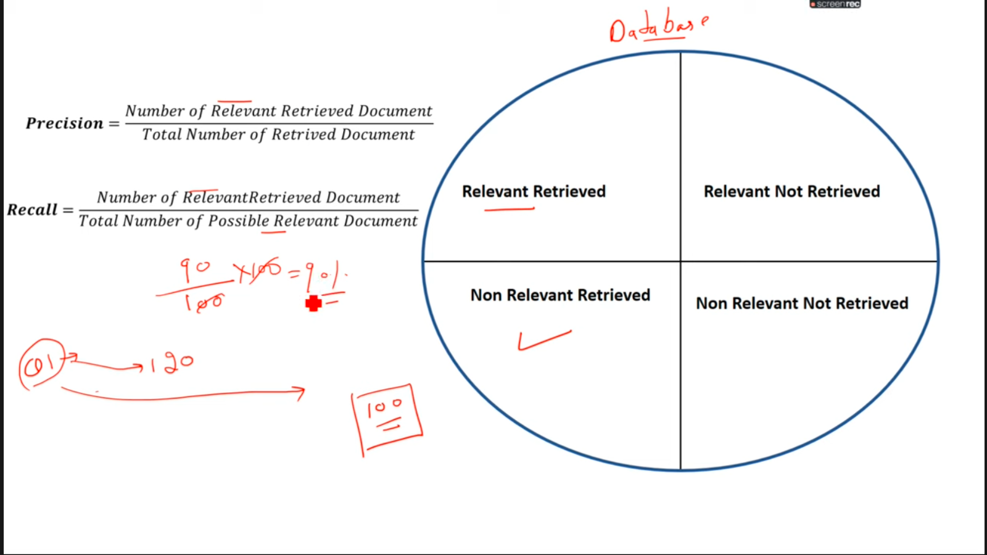

Slide 25
FUNCTIONAL OVERVIEW OF IRS
Item Normalization
Selective Dissemination of Information(SDI)
Document Database Search
Index Database

Slide 26
1)Item Normalization
Query is converted into the standard format so IRS can understand it.
It consist of some operations:
Identifying Processing Tokens: Identify the valid & invalid tokens
Characterization of tokens: symbols converted into character(?-> what)
Apply stop Lists: Reduce word in a query & reduce processing time
Apply stemming Algorithm:(connection,connecting,connected)-> connect
Zoning: flipkart->flipkart mobile->samsung
Query1
Query2
Query3
.
;
Query N
IRS
Item Normalization
Standard Format

Slide 27
2) Selective Dissemination(spread) of Information(SDI):
Whatever information you have to search those notification can occur continuously in your mobile.without any search
Ex-Newspaper vendor
3) Document Database Search & Index:
Ex-If you want to search functional overview in IR book.Instead of goining one by one search of pages.you have to check the index & access the page

Slide 28
IR Models
Classic Models
1)TF-IDF Model
2)Boolean Model
3)Vector Model
4)Probabilistic Model

Slide 29
1)TF-IDF Model
TF-IDF stands for term frequency & inverse document frequency
IT is used to find out the importance of word in a document.
TF Formula= No of repetative word in a sentence
IDF Formula= Log(No. Of sentences/no. Of sentence contaning words )
Sentence 1- good boy.
Sentence 2- good girl sentence 3- boy girl good.
T1D1 TF_IDF=1*log(3/3)=0
T2D1 TF-IDF=1*log(3/2)=0.17
T3D3 TF-IDF=0 * log(3/2)=0
Document/Term | Good T1 | Boy T2 | Girl T3
D1 | 1(0) | 1(0.17) | 0(0)
D2 | 1(0) | 0(0) | 1(0.17)
D3 | 1 | 1 | 1

Slide 30
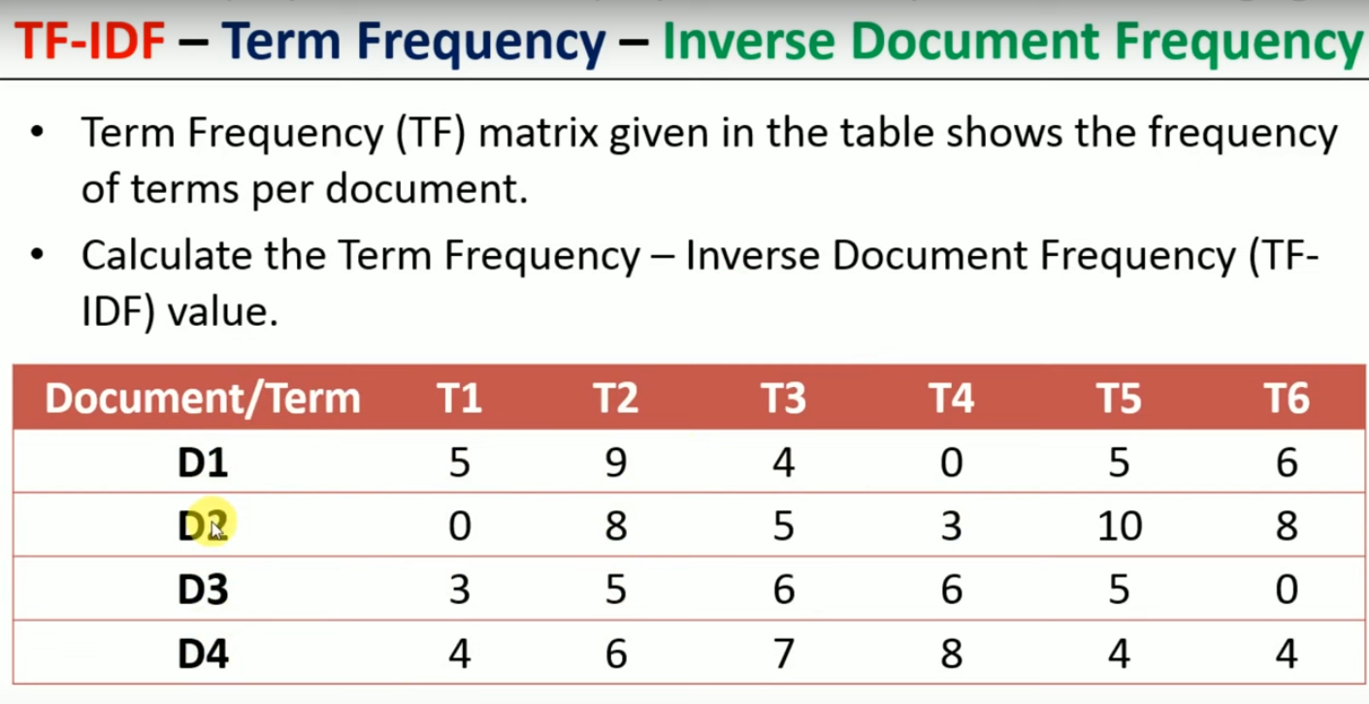

Slide 31
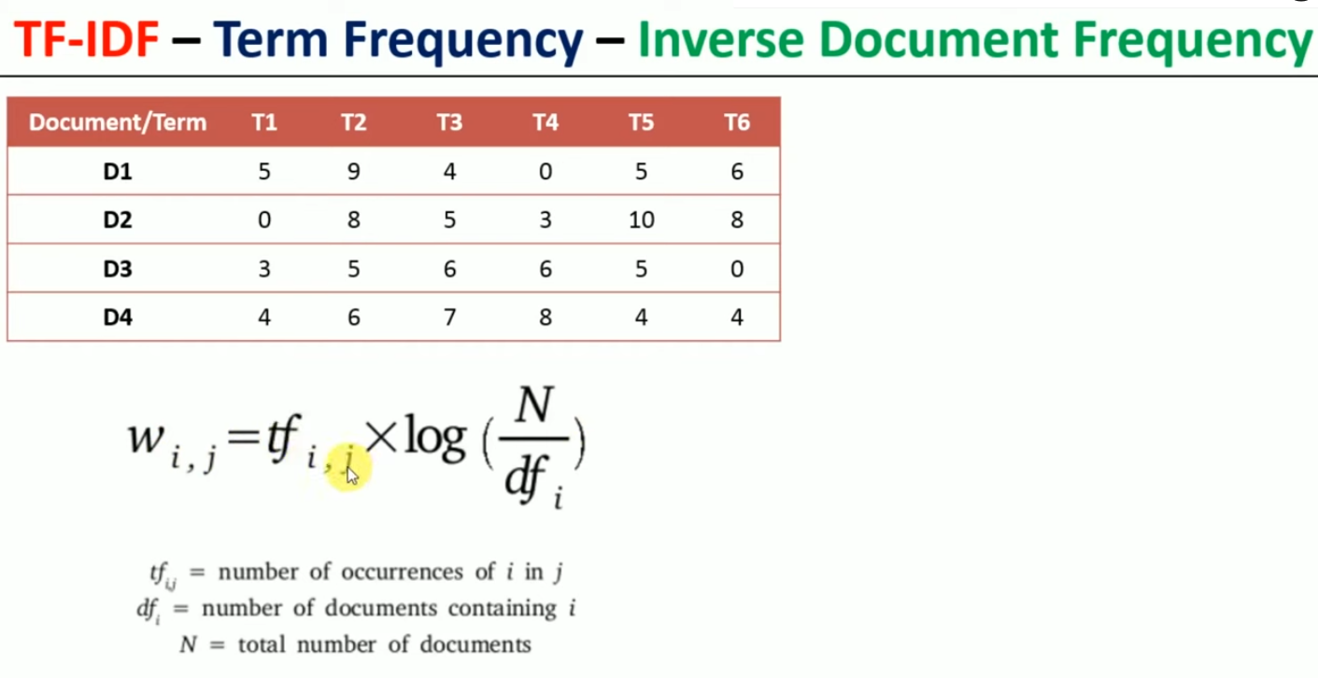

Slide 32
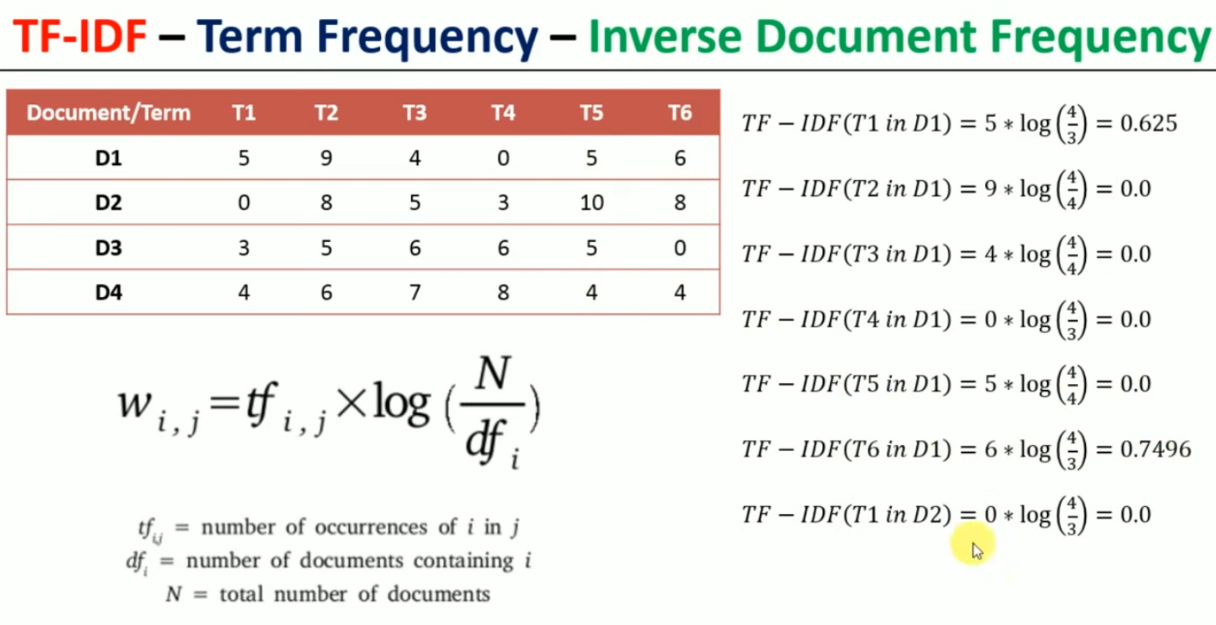

Slide 33
Basic IR Model
1)Boolean Model
The Boolean retrieval model can answer any query that is a Boolean.
Boolean queries are queries using AND,OR,NOT to join query terms.
View each document as a set of terms.
Query Q=ti ^ tj Here ti and tj are key terms both ti and tj are retrieved
Q=ti V tj Documents with either ti or tj are retrieved
Q=˜ ti Documents without ti are retrieved.

Slide 34
Formal characterization Boolean Model
Terms | Notation & formula
q | User information need (query)
Document representation | dj
Index term weight for document | i-keywords, t-total keywords , j-document Wij € {0,1}
Query is expressed in DNF
Each part of query is represented by | qcc
Similarity function is given by | Sim(dj,q)=1 if Ɛ Qdnf) ^(v,gi(dj)=gi(qcc))

Slide 35
If query is in Disjunctive Normal Form(DNF) we can directly find out similarity between document & query.
If query is in CNF first we convert CNF to DNF. converting formulas consist of De morgans Laws & The distributive law.

Slide 36
Exercise 1
Step 1:Stemming(repeatitive world) and stop removal(stop world-are,and,than,of,not)
Step 2:Formation of term * document Matrix check user query is in DNF form.If not convert to DNF.
Step 3:check user query is in DNF form.If not convert to DNF.
Step 4:find similarity between query and each document by applying similarity function.
Document | Content
D1 | Big cats are nice and funny
D2 | Small dogs are better than big dog
D3 | Small cats are afraid of small dogs
D4 | Big cats are not afraid of small dogs
D5 | Funny cats are not afraid of small dogs

Slide 37
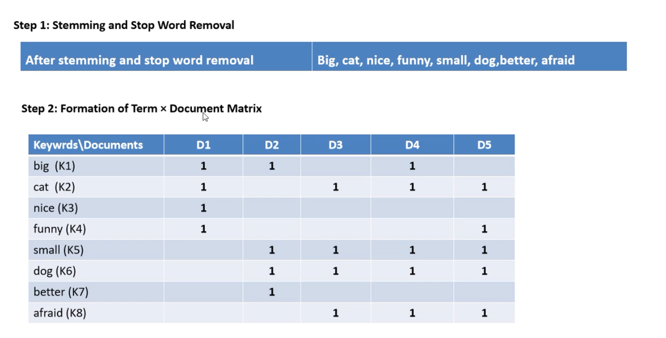
Document | Content
D1 | Big cats are nice and funny
D2 | Small dogs are better than big dog
D3 | Small cats are afraid of small dogs
D4 | Big cats are not afraid of small dogs
D5 | Funny cats are not afraid of small dogs

Slide 38
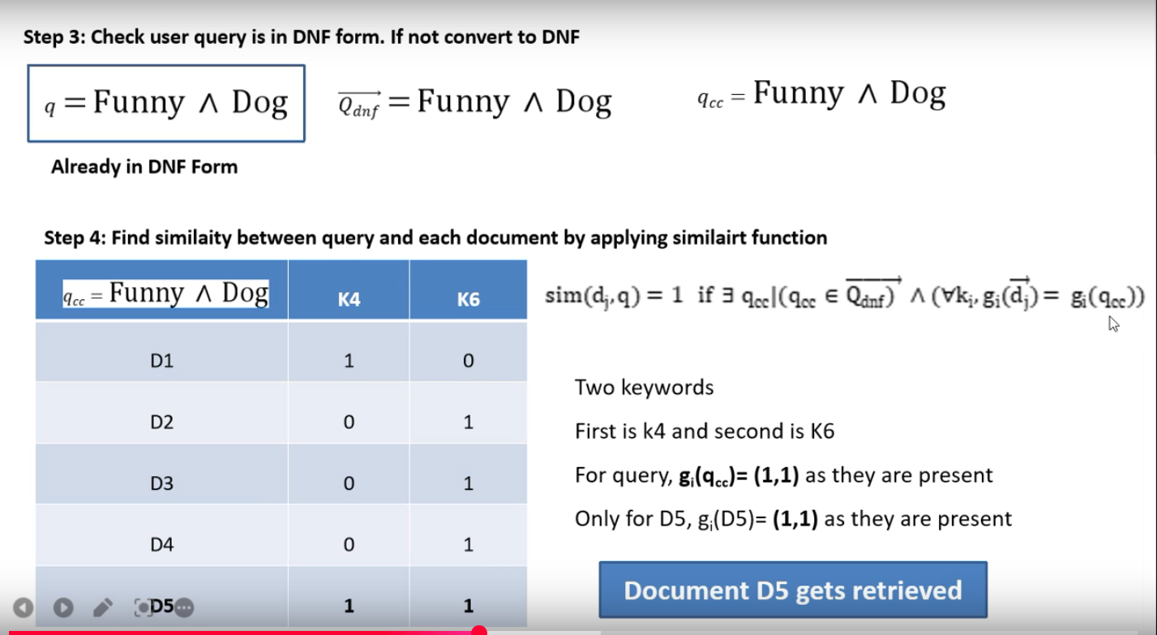
 | D1 | D2 | D3 | D4 | D5
Funny(K4) | 1 | 0 | 0 | 0 | 1
Dog(K6) | 0 | 1 | 1 | 1 | 1

Slide 39
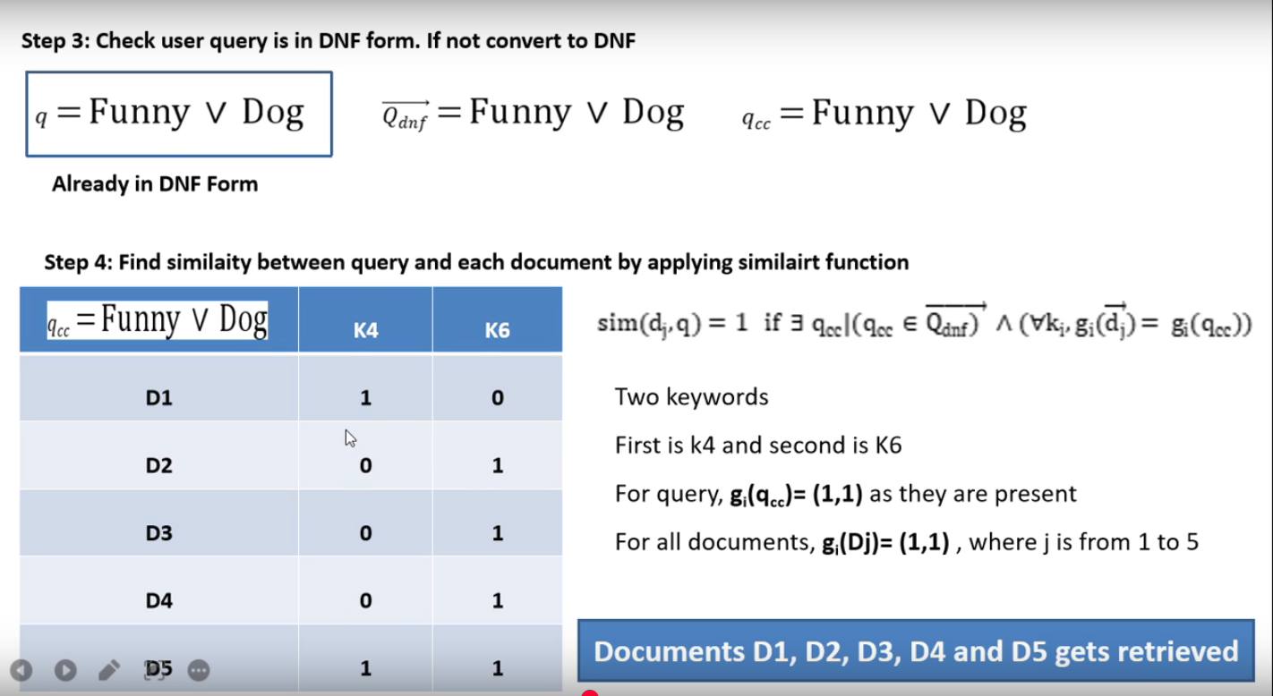
 | D1 | D2 | D3 | D4 | D5
Funny(K4) | 1 | 0 | 0 | 0 | 1
Dog(K6) | 0 | 1 | 1 | 1 | 1

Slide 40
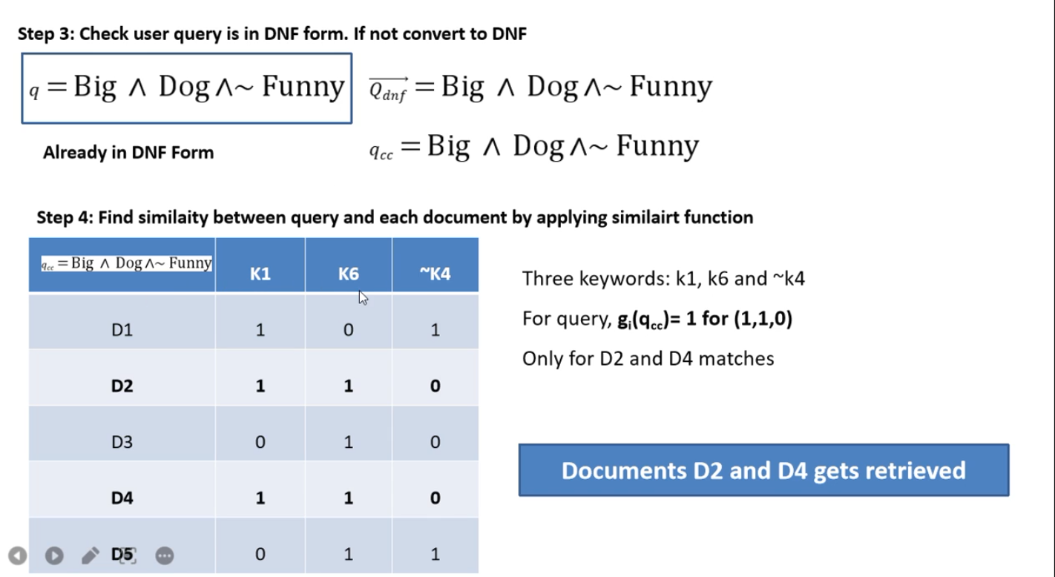
K1 | 1 | 1 | 0 | 1 | 0
K6 | 0 | 1 | 1 | 1 | 1
K4 | 1 | 0 | 0 | 0 | 1

Slide 41
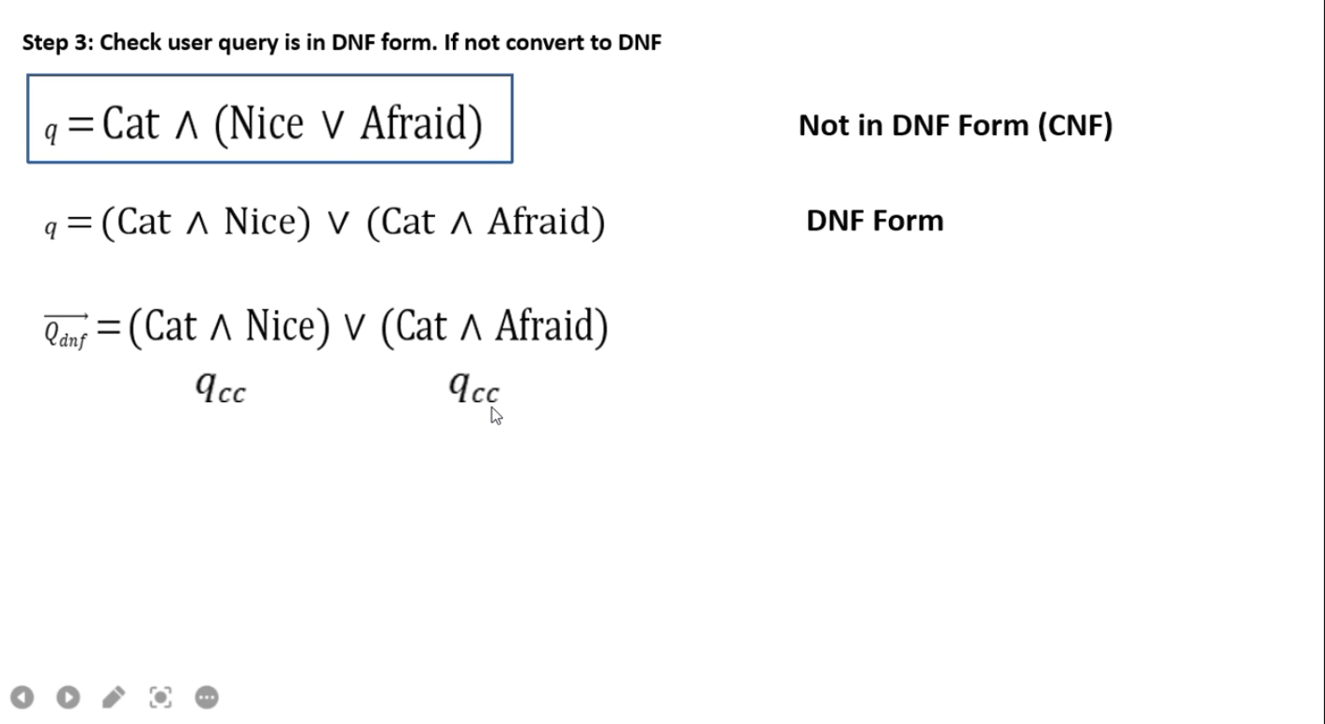

Slide 42
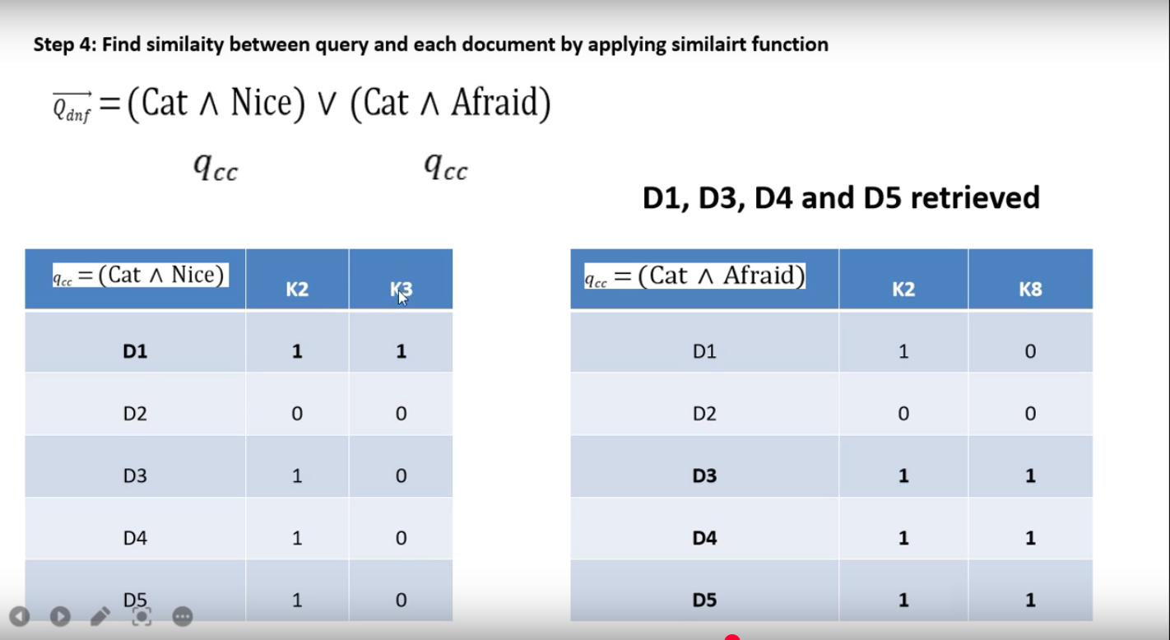

Slide 43
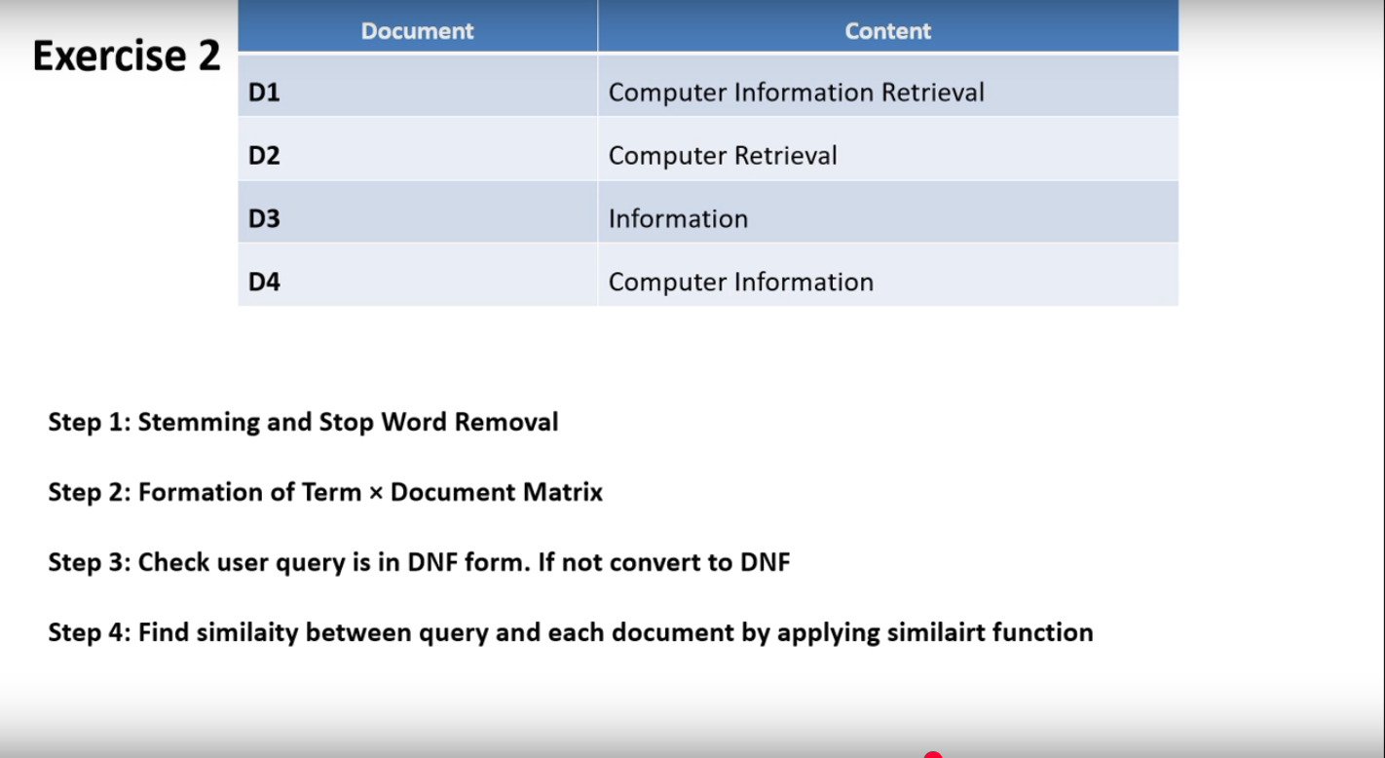

Slide 44
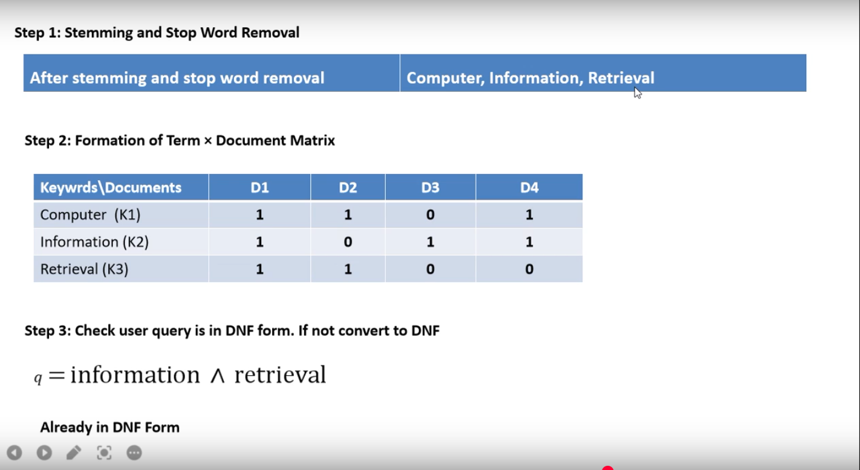

Slide 45
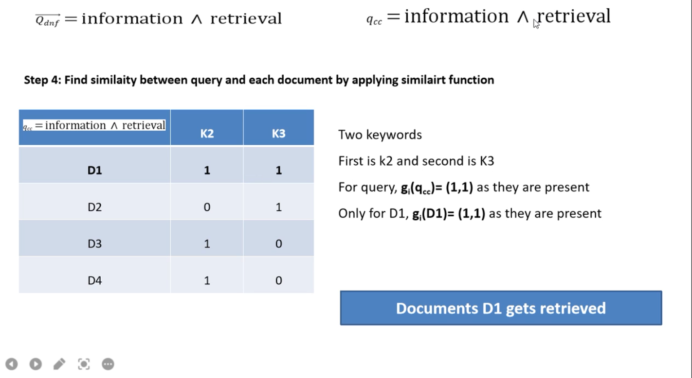

Slide 46
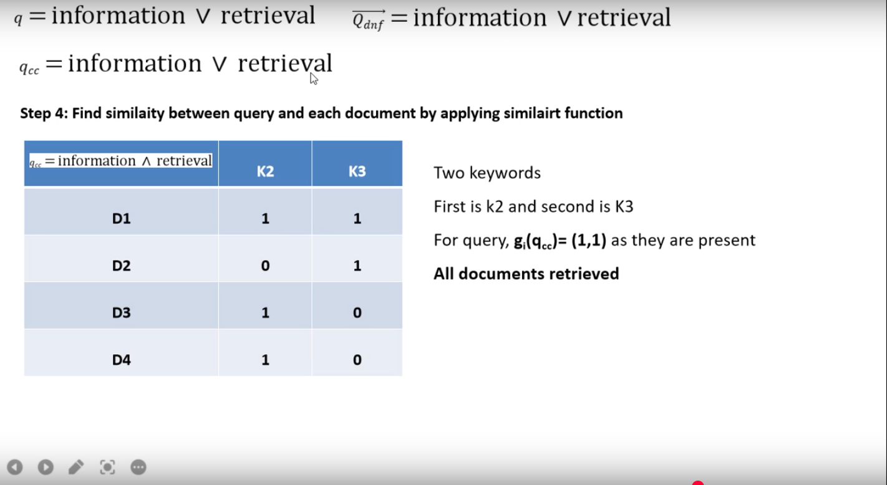

Slide 47
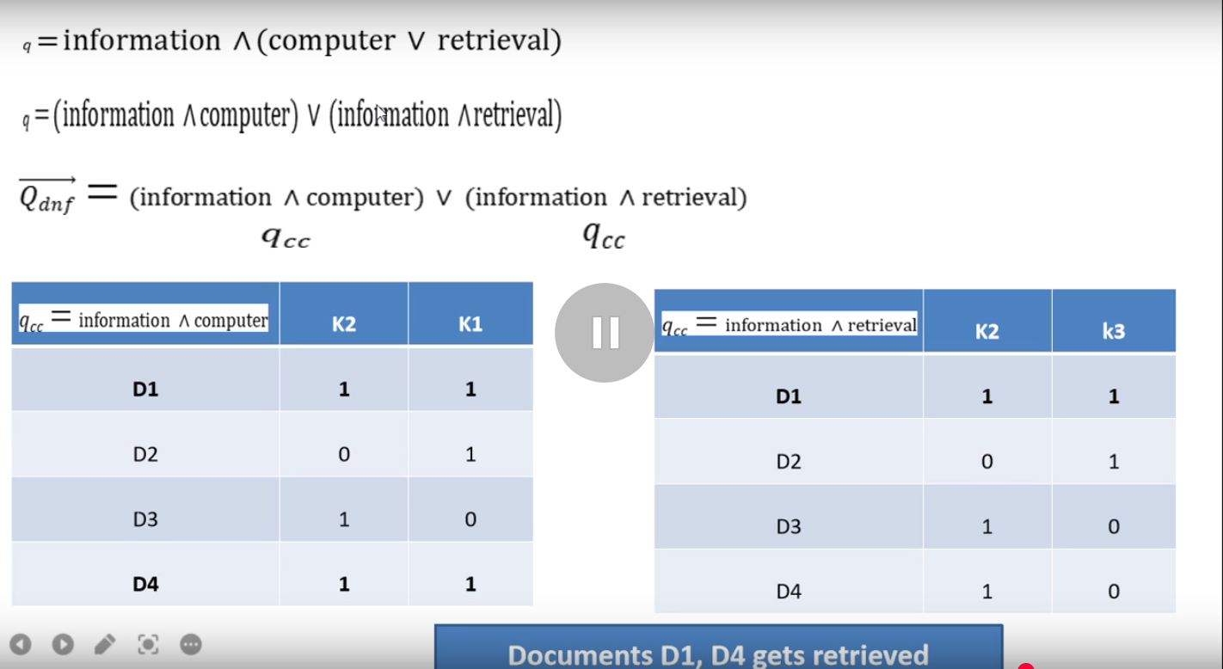

Slide 48
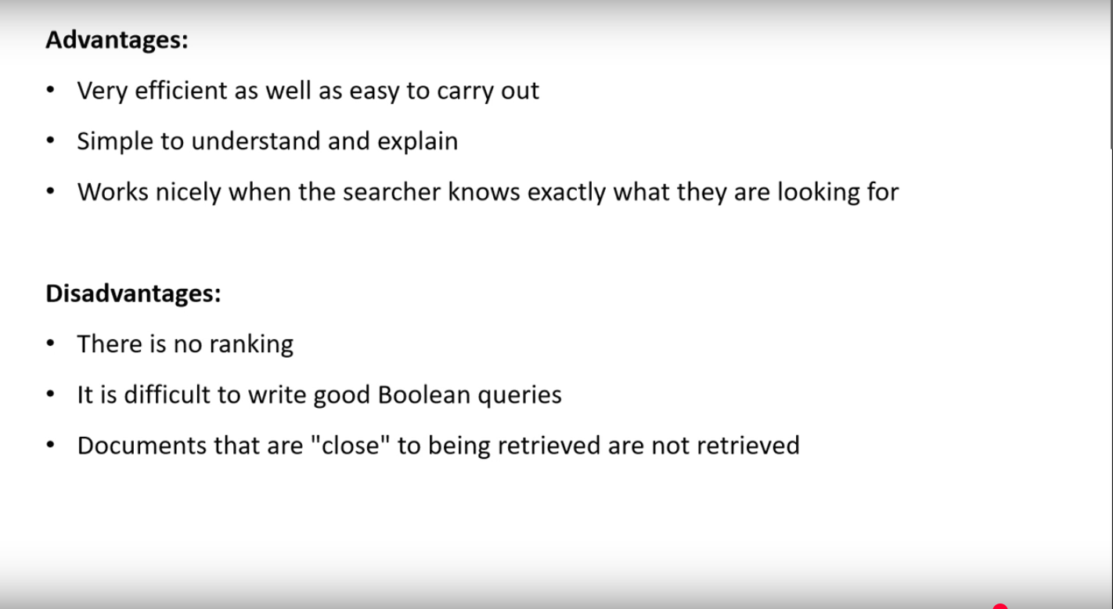

Slide 49
D1 | Big cats are nice and funny
D2 | Small dogs are better than big dog
D3 | Small cats are afraid of small dogs
D4 | Big cats are not afraid of small dogs
D5 | Funny cats are not afraid of small dogs
Step 1:Stemming & Stop Removal Q-Funny ^Dog
After stemming & stop word removal:
Big, cat, nice, funny, small, dog,better,afraid
Step 2:formation of term * document matrix
Keywords/ documents | D1 | D2 | D3 | D4 | D5
Big(K1) | 1 | 1 | 0 | 1 | 0
Cat(K2) | 1 | 0 | 1 | 1 | 1
Nice(K3) | 1 | 0 | 0 | 0 | 0
Funny(K4) | 1 | 0 | 0 | 0 | 1
Small(K5) | 0 | 1 | 1 | 1 | 1
Dog(K6) | 0 | 1 | 1 | 1 | 1
Better(K7) | 0 | 1 | 0 | 0 | 0
Afraid(K8) | 0 | 0 | 1 | 1 | 1

Slide 50
Step 3:check query if it is not in DNF convert it to DNF
q=Funny ^ Dog Qdnf=Funny ^ Dog qcc=Funny ^ Dog
Already in DNF Form
Step4:Find similarity between query & each document by applying similarity function
Sim(dj,q)=1 if Ɛ Qdnf) ^(v,gi(dj)=gi(qcc))
Two Keywords
First is k4 and second is k6
For query gi(qcc)=(1,1) as they are present
Only for D5,gi(D5)=(1,1) as they are present
document D5 is get retrieved
qcc=Funny^ Dog | K4 | K6
D1 | 1 | 0
D2 | 0 | 1
D3 | 0 | 1
D4 | 0 | 1
D5 | 1 | 1
 | D1 | D2 | D3 | D4 | D5
Funny(K4) | 1 | 0 | 0 | 0 | 1
Dog(K6) | 0 | 1 | 1 | 1 | 1

Slide 51
Step 3:Check user query is in DNF form If not convert to DNF
q=Big ^ Dog^˜Funny
Qdnf=Big ^ Dog ^ ˜Funny
Step 4:Find similarity between query & each document by applying similarity function
Three keywords: k1,K6,& ~K4
For query gi(qcc)=1 for (1,1,0)
Only for D2 and D4 matches
Document D2 and D4 gets retrieved
q=Big ^Dog^˜Funny | K1 | K6 | ˜K4
D1 | 1 | 0 | 1
D2 | 1 | 1 | 0
D3 | 0 | 1 | 0
D4 | 1 | 1 | 0
D5 | 0 | 1 | 1
K1 | 1 | 1 | 0 | 1 | 0
K6 | 0 | 1 | 1 | 1 | 1
K4 | 1 | 0 | 0 | 0 | 1

Slide 52
Step 3:Check user query is in DNF form .If not convert to DNF
Q=Cat ^ (Nice V Afraid)
Q=(Cat^ Nice) V (Cat ^ Afraid)
qcc qcc
qcc =(Cat^ Nice) | K2 | K3
D1 | 1 | 1
D2 | 0 | 0
D3 | 1 | 0
D4 | 1 | 0
D5 | 1 | 0
qcc=(Cat ^ Afraid) | K2 | k8
D1 | 1 | 0
D2 | 0 | 0
D3 | 1 | 1
D4 | 1 | 1
D5 | 1 | 1
Cat(K2) | 1 | 0 | 1 | 1 | 1
Nice(K3) | 1 | 0 | 0 | 0 | 0
Dog(K6) | 0 | 1 | 1 | 1 | 1

Slide 53
Exercise 2
Step 1:Stemming(repeatitive world) and stop removal(stop world-are,and,than,of,not)
Step 2:Formation of term * document Matrix check user query is in DNF form.If not convert to DNF.
Step 3:check user query is in DNF form.If not convert to DNF.
Step 4:find similarity between query and each document by applying similarity function.
Document | Contents
D1 | Computer Information Retrieval
D2 | Computer Retrieval
D3 | Information
D4 | Computer Information

Slide 54
Step 1:Stemming & Stop word Removal
After stemming & stop word:Computer,Information,Retrieval
Step 2:Formation of term * Document Matrix
Step 3:check user query in DNF.If not convert DNF
q=Information ^ retrieval
Step 4: find similarity
Between query & document
D5 get selected
Keywords/ Documents | D1 | D2 | D3 | D4
Computer k1 | 1 | 1 | 0 | 1
Information k2 | 1 | 0 | 1 | 1
Retrieval k3 | 1 | 1 | 0 | 0
qcc=information ^ retrieval | K2 | k3
D1 | 1 | 1
D2 | 0 | 1
D3 | 1 | 0
D4 | 1 | 0

Slide 55
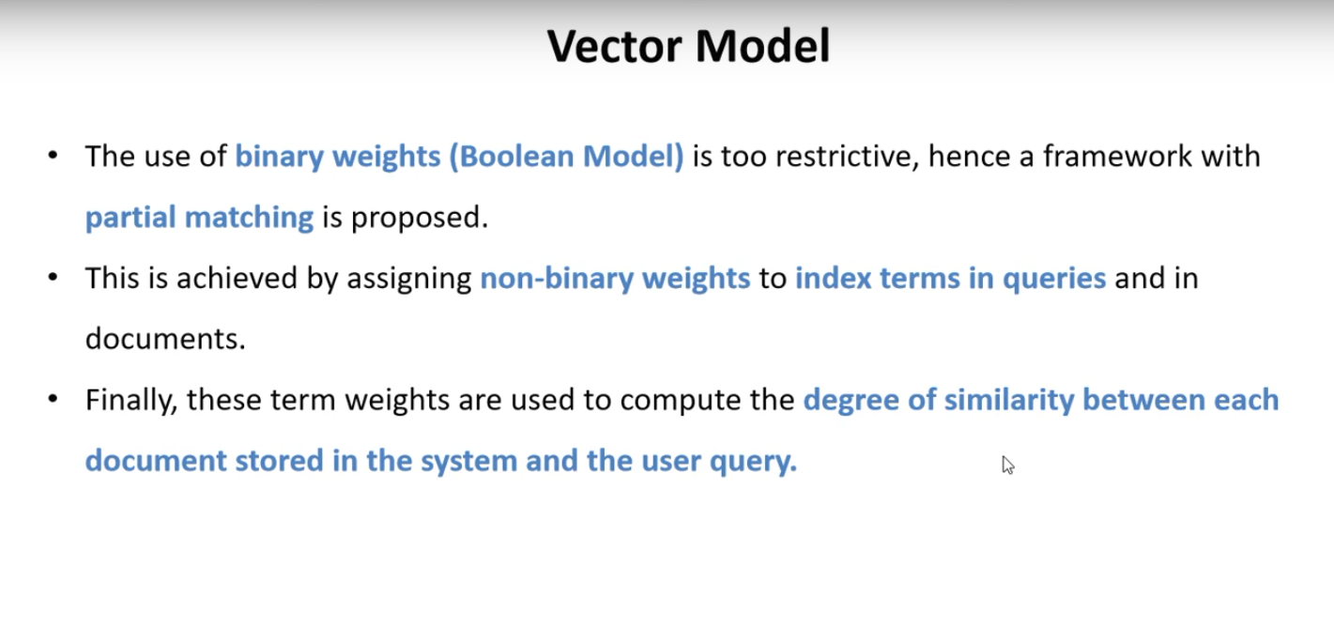

Slide 56
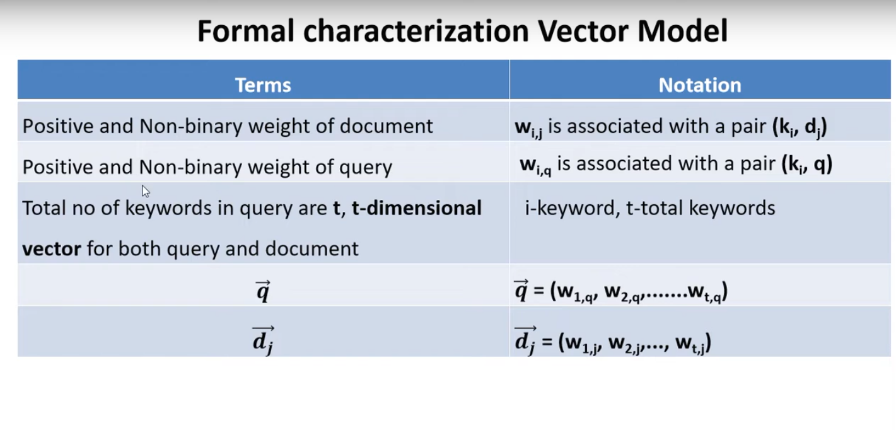

Slide 57
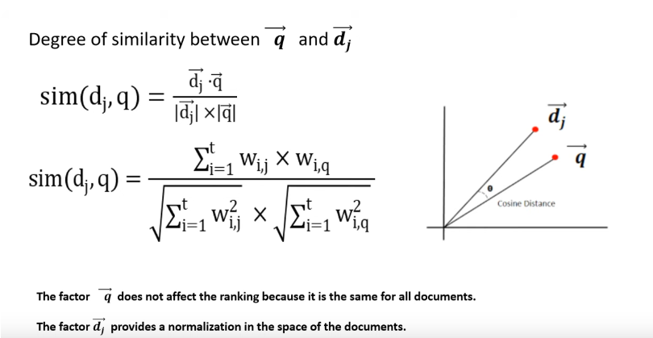
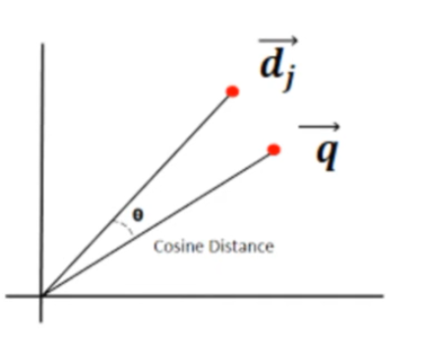

Slide 58
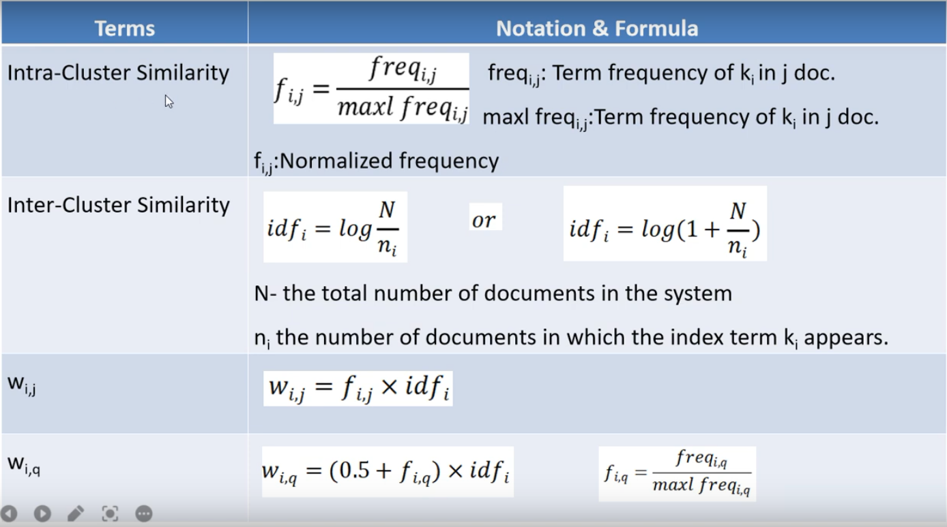

Slide 59
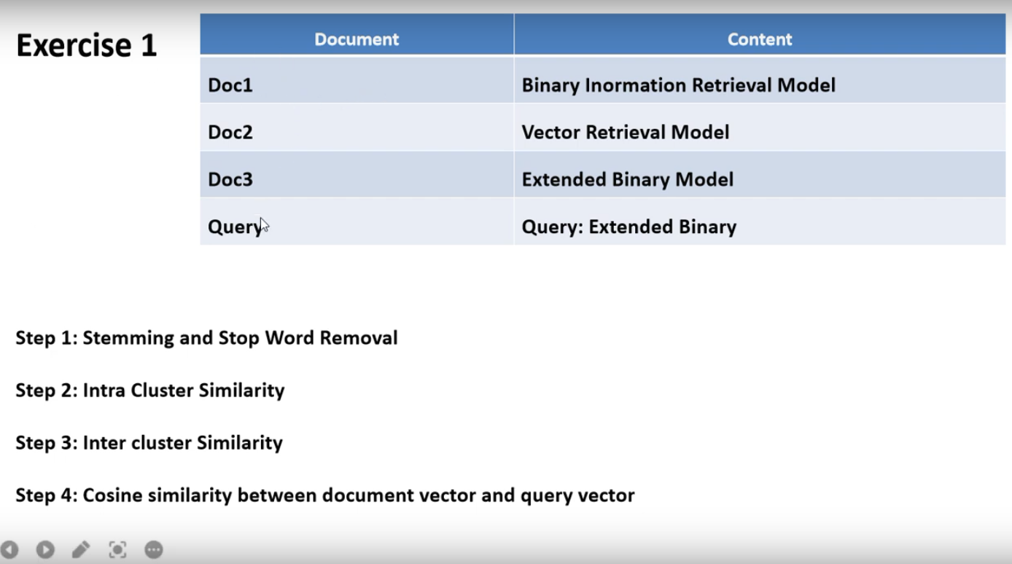

Slide 60
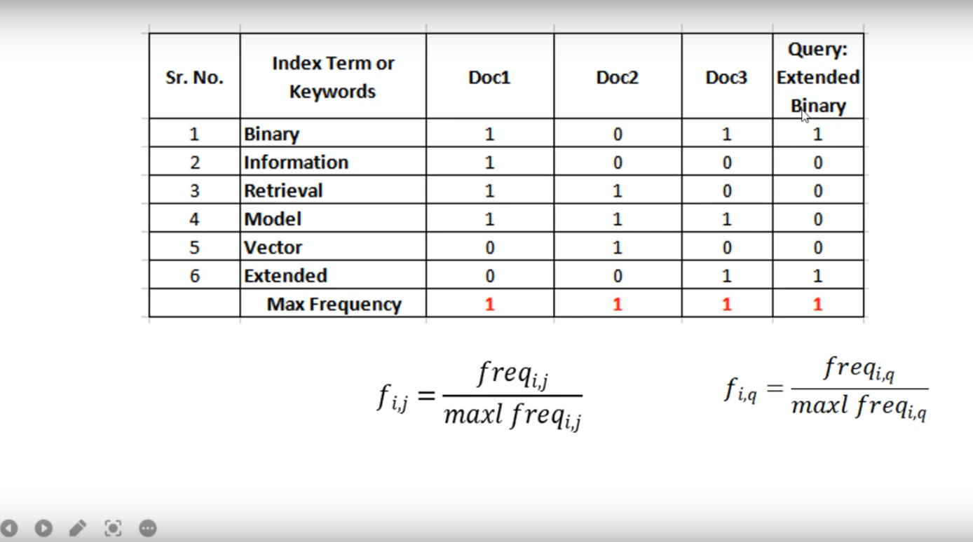

Slide 61
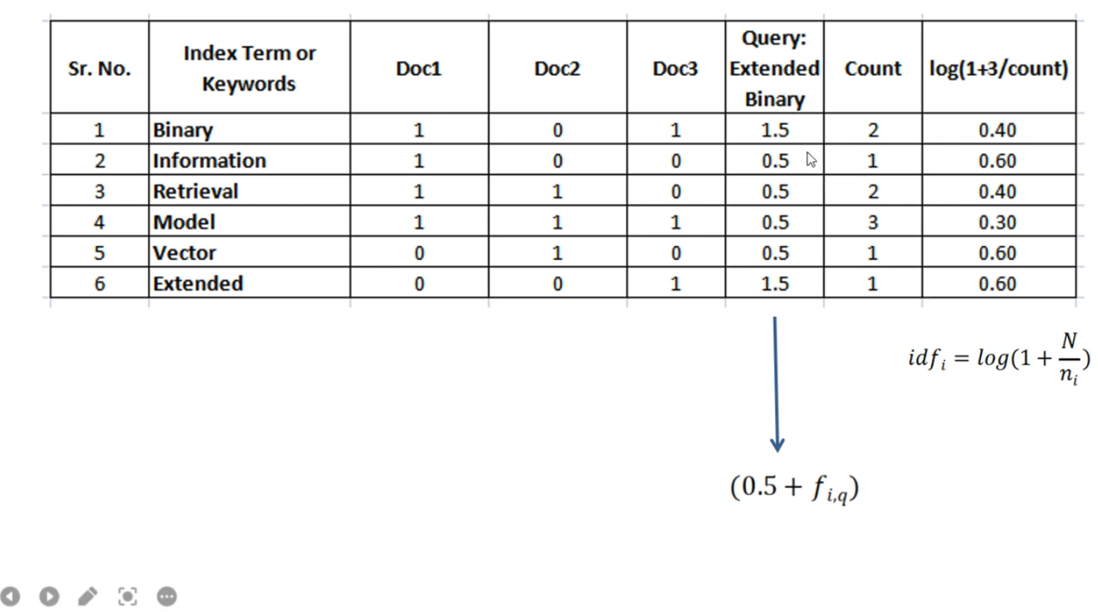
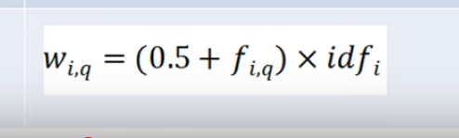

Slide 62
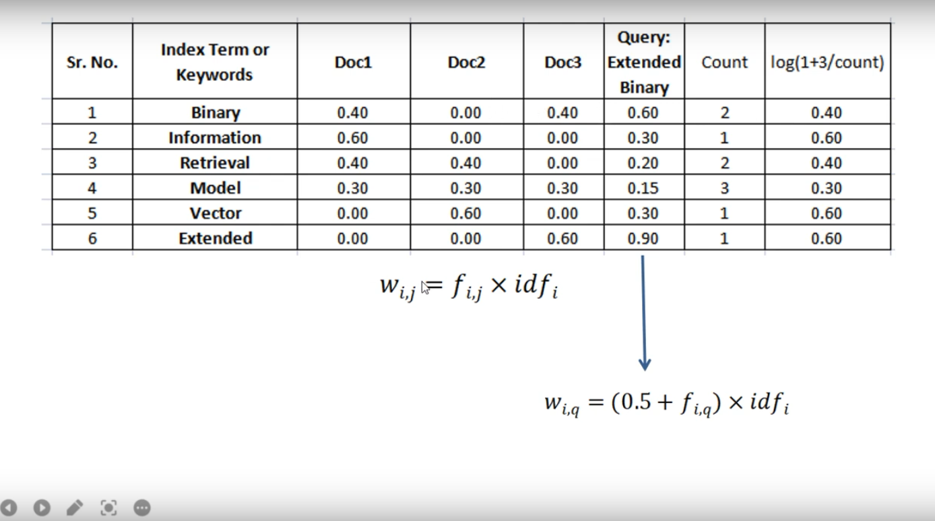

Slide 63
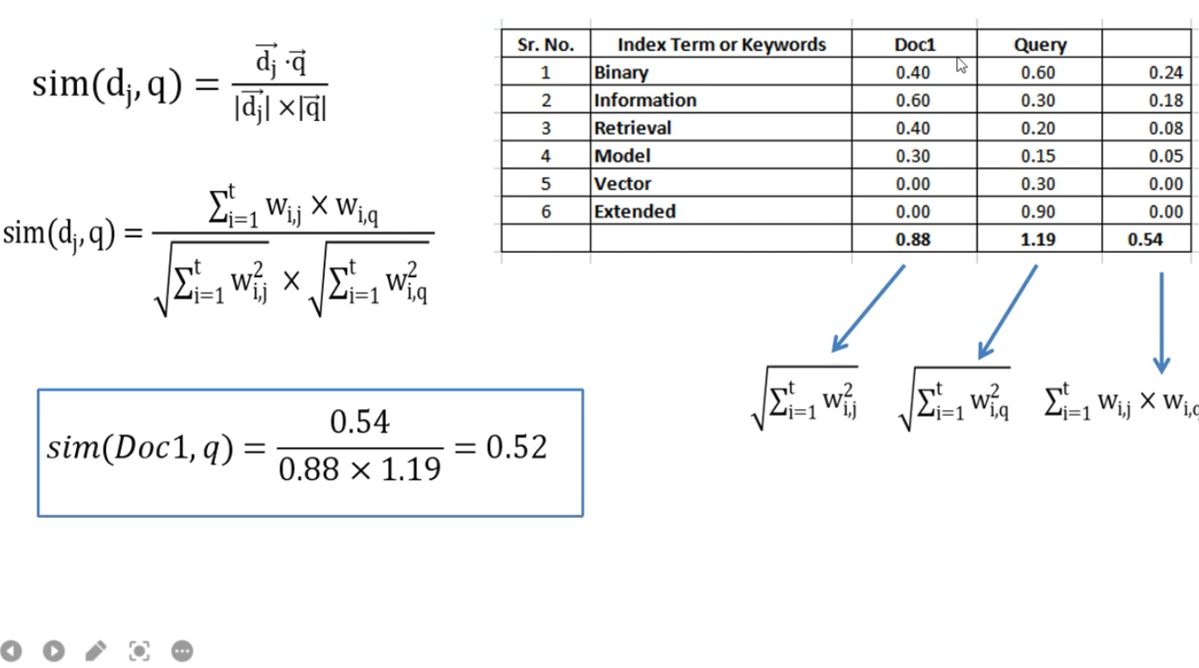

Slide 64
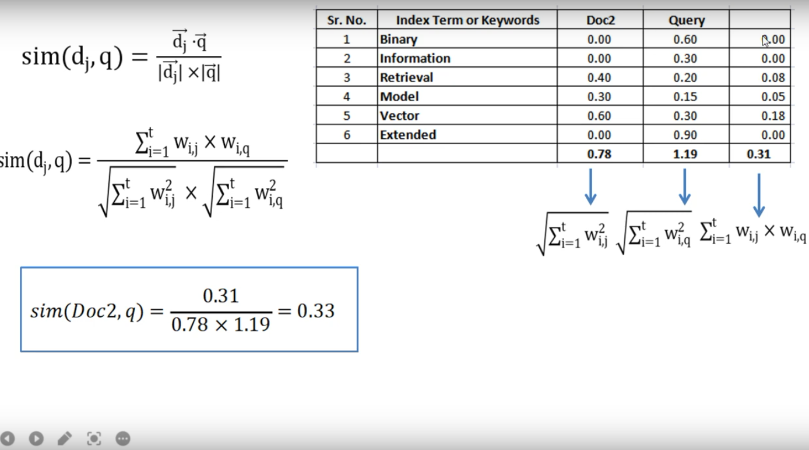

Slide 65
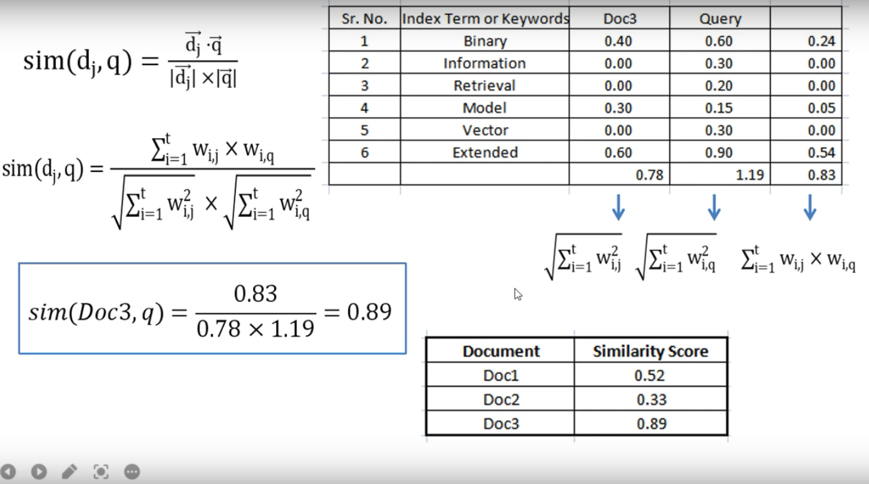

Slide 66
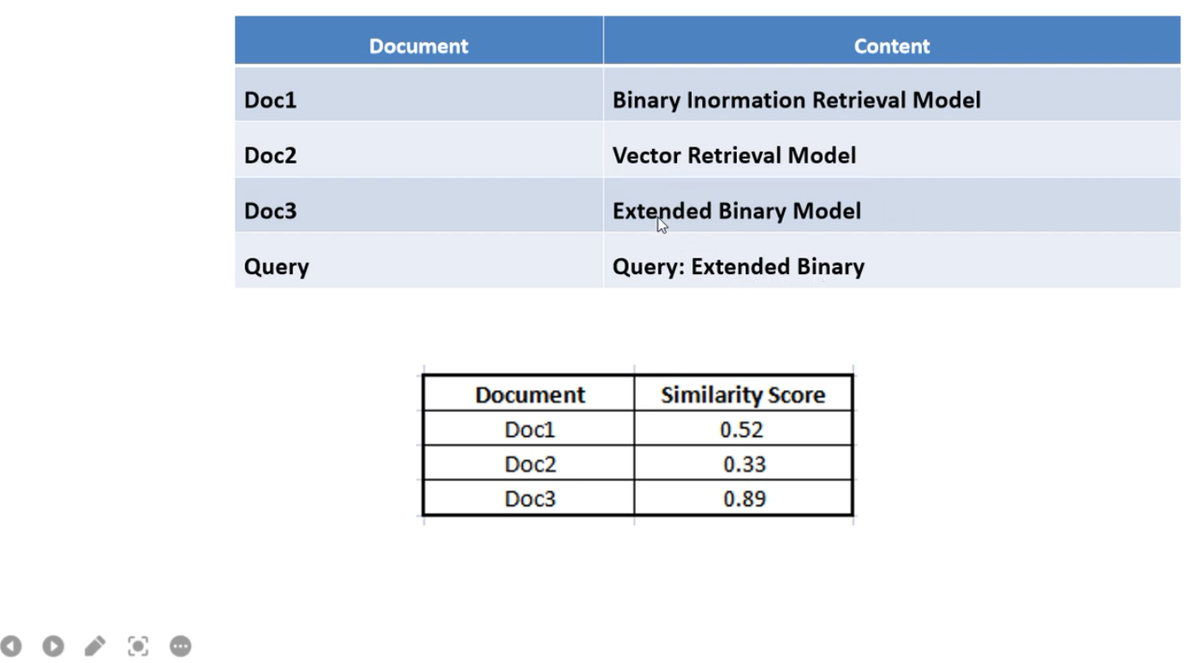

Slide 67
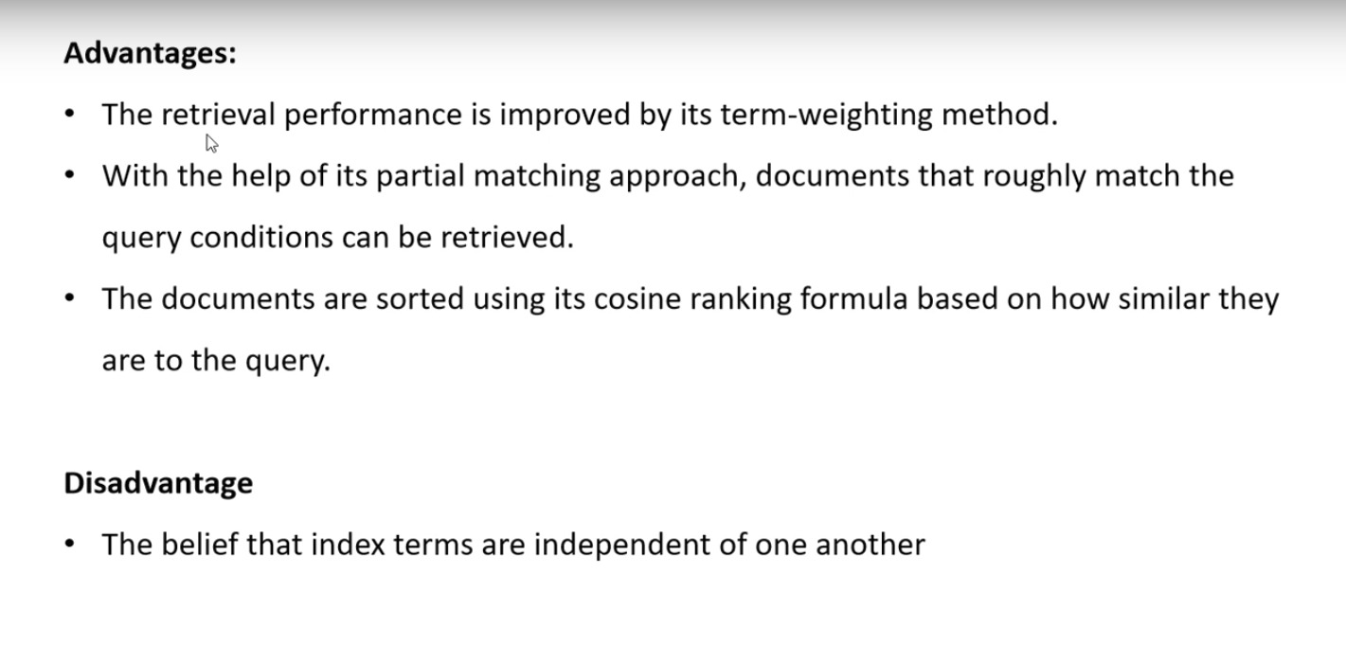

Slide 68
Consider a small document collection and a query:
Document 1: "The cat sat on the mat."
Document 2: "The dog chased the cat."
Query: "cat and dog"

