Slide 1
Information Retrieval
Presented By :
Prof. Sarika M. Shinde

Slide 2
Teaching & Credit Examination Scheme
410245(A): Information Retrieval
Credits: 3 3 Hours/Week
End Semester(TH): 70 Marks
Total: 100 Marks
INSEM: 30 Marks
Prerequisite Courses
Companion Course
Laboratory Practice IV(410247)
Database Management Systems(310241)

Slide 3
Course Objectives:
To study basic concepts of Information Retrieval.
To study concepts of Indexing for Information Retrieval.
To analyze the performance of information retrieval using advanced techniques such as classification, clustering, and filtering over multimedia.
To provide comprehensive details about various Evaluation methods.
To understand the changes necessary to transfer a Basic IR system into large scale search service system.
To understand Parallel Information retrieval and Web structures .

Slide 4
Course Outcomes:
CO1:Implement the concept of Information Retrieval
CO2:Generate quality information out of retrieved information
CO3:Apply techniques such as classification, clustering, and filtering over multimedia to analyze the information
CO4:Evaluate and analyze retrieved information
CO5:Understand the data in various Application and Extensions of information retrieval
CO6: Understand Parallel information retrieving and web structure.

Slide 5
UNIT 1 to 6
UNIT-I : Introduction , Basic techniques, &Token(07 Hours)
UNIT-II : Static Inverted Indices and Query Processing(07 Hours)
UNIT-III : Index Compression and Dynamic Inverted Indices(07 Hours)
UNIT-IV : Probabilistic Retrieval and Language Modeling & Related Methods , Categorization & Filtering(07 Hours)
UNIT-V : Measuring Effectiveness and Measuring Efficiency(07 Hours)
UNIT-VI : Parallel Information retrieval , Web Search(07 Hours)

Slide 6
UNIT-I
Introduction: The IR System, The Software Architecture Of The IR System.
Basic IR Models: Boolean Model, TF-IDF (Term Frequency/Inverse Document Frequency) Weighting, Vector Model, Probabilistic Model and Latent Semantic Indexing Model.
Basic Tokenizing: Simple Tokenizing, Stop-Word Removal and Stemming.
Introduction , Basic techniques, &Token

Slide 7

INTRODUCTION
What is Information Retrieval?

Slide 8
INTRODUCTION Cont...
Information Retrieval(IR) is concerned with representing, searching, and manipulating large collections of electronic text and other human language data.
Information Retrieval (IR) is the process of obtaining relevant information from a large repository (like the web or a document collection) based on user queries.

Slide 9
The IR System :
Definition: An Information retrieval system(IRS) is a software system helps to locate & retrieve relevant information from a large collection of database or a document collection. ex-google, e-mails
Goal: Provide the most relevant documents to a user's information need (query).
Examples: Search engines (Google, Bing), digital libraries, and enterprise search systems.

Slide 10
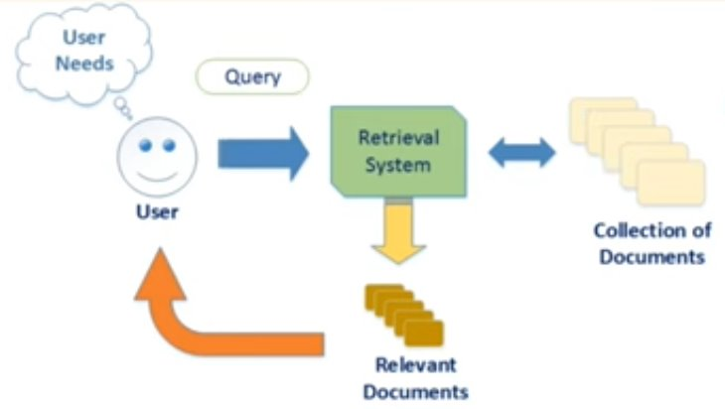
The IR System :

Slide 11
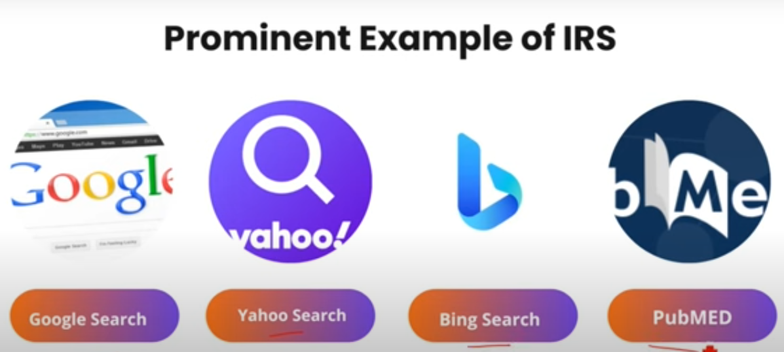
The IR System Cont...:

Slide 12
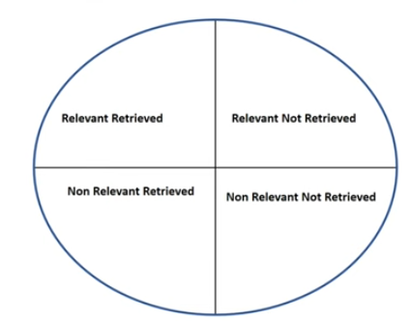

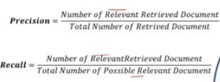
The IR System Cont...:

Slide 13
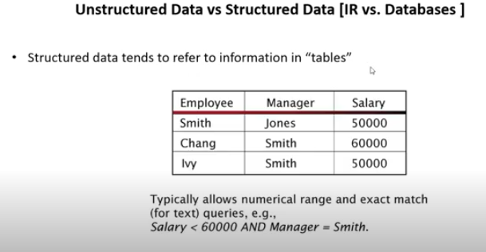
The IR System Cont...:

Slide 14
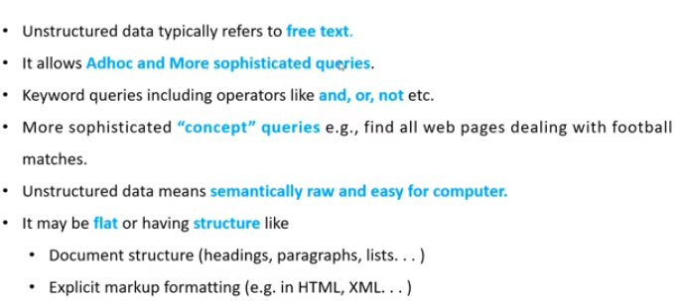
The IR System Cont...:

Slide 15
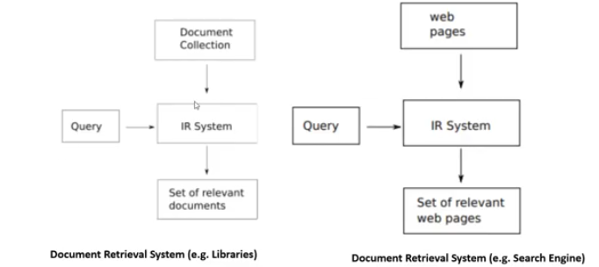
The IR System Cont...:

Slide 16
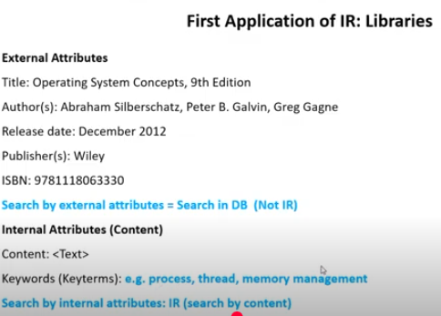
The IR System Cont...:

Slide 17
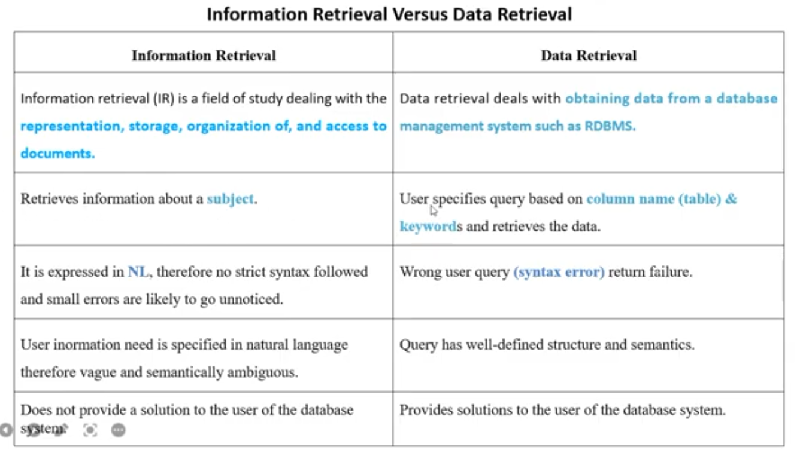

Slide 18
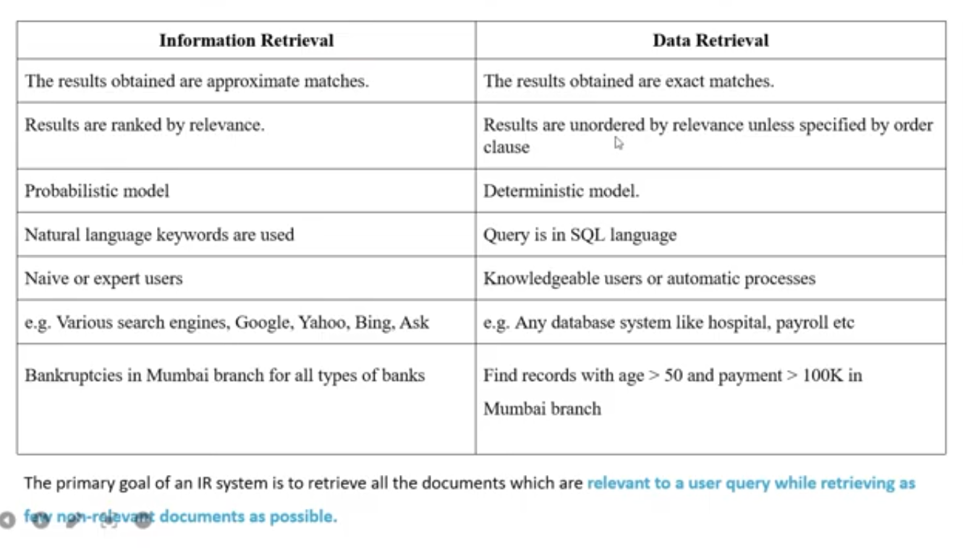

Slide 19
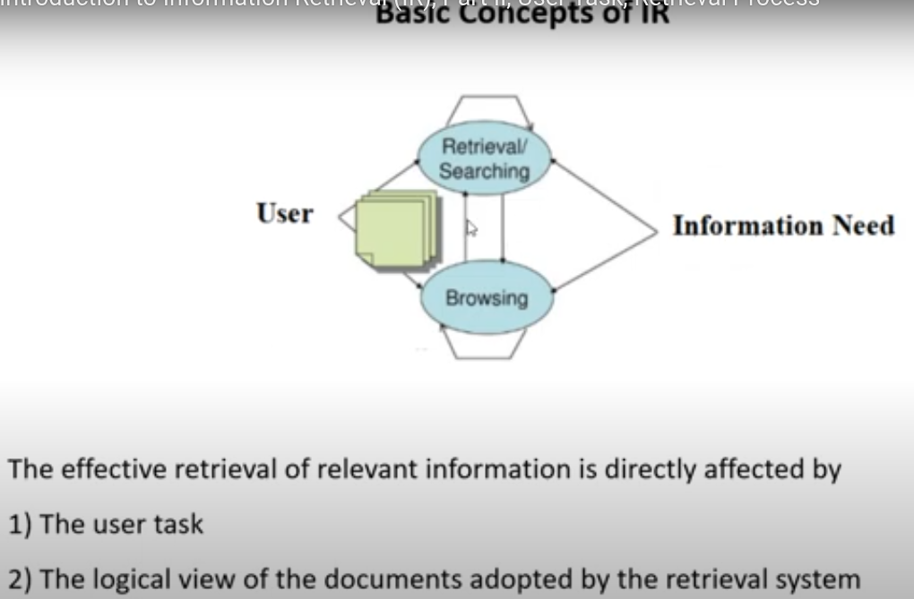

Slide 20
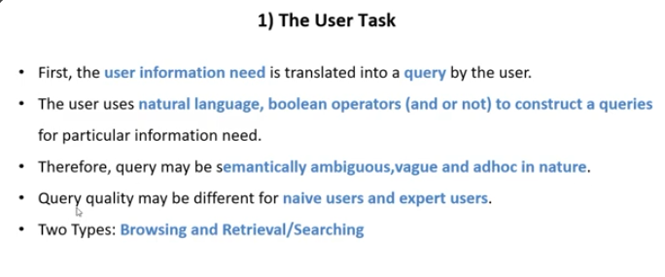

Slide 21
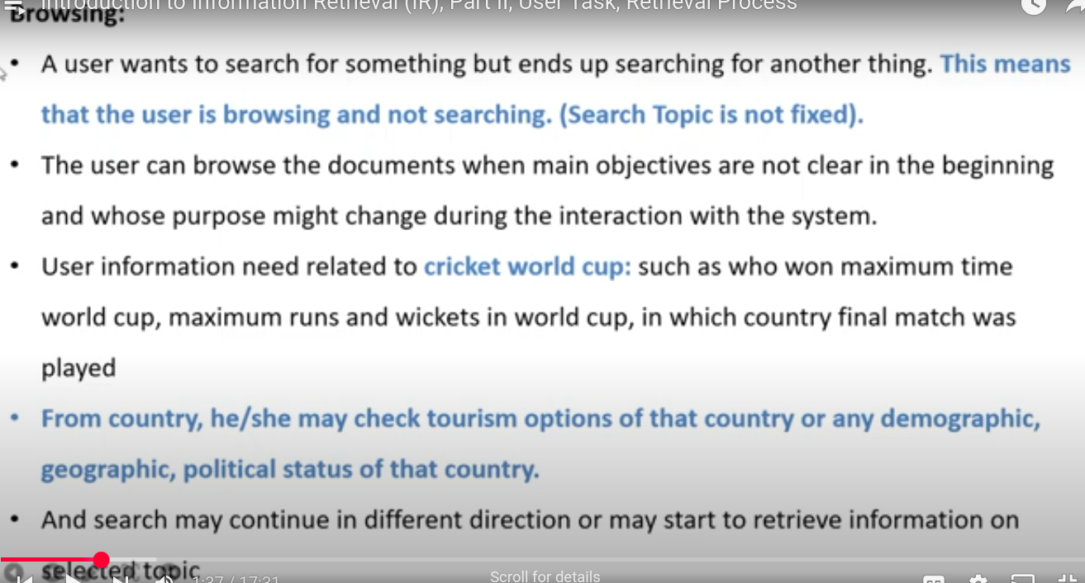

Slide 22
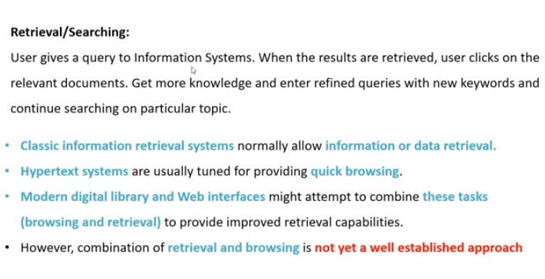

Slide 23
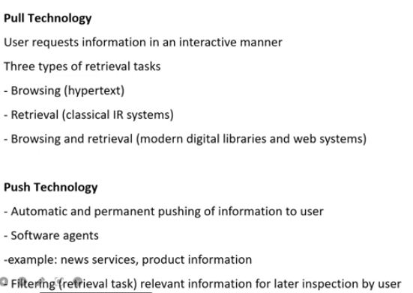

Slide 24
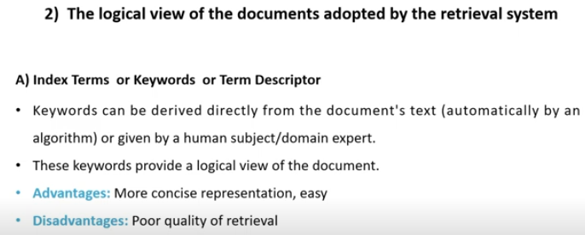

Slide 25
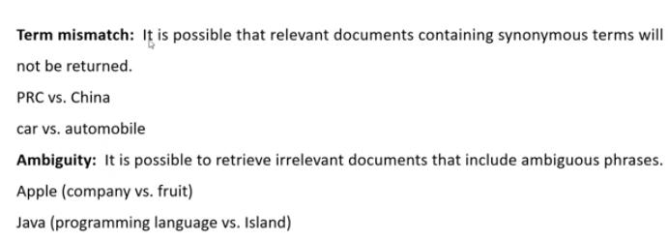

Slide 26
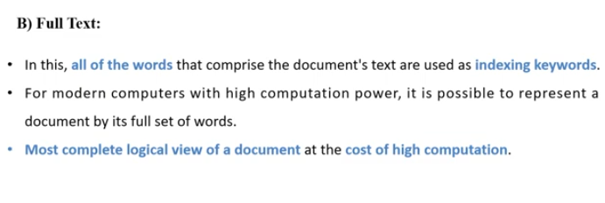

Slide 27
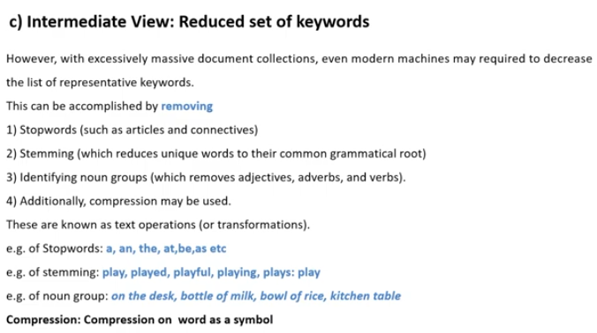

Slide 28
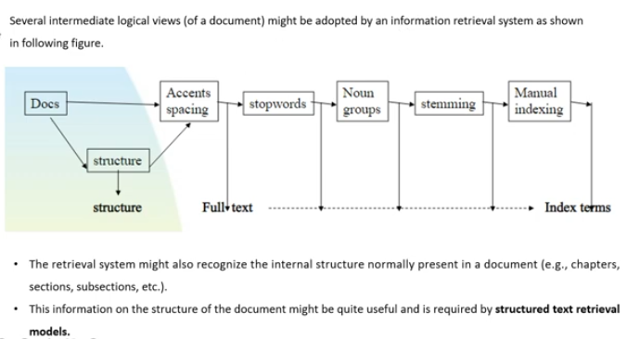

Slide 29
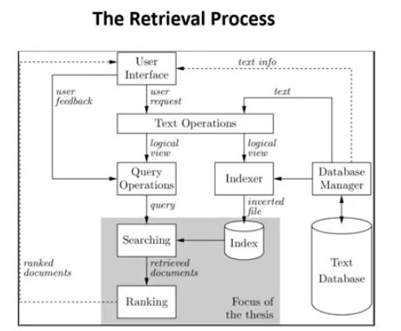

Slide 30
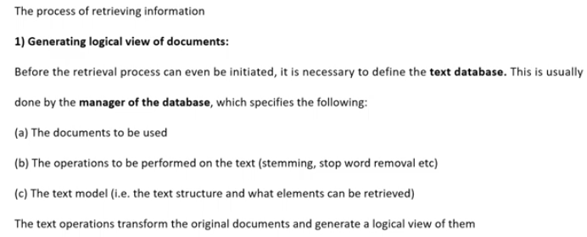

Slide 31
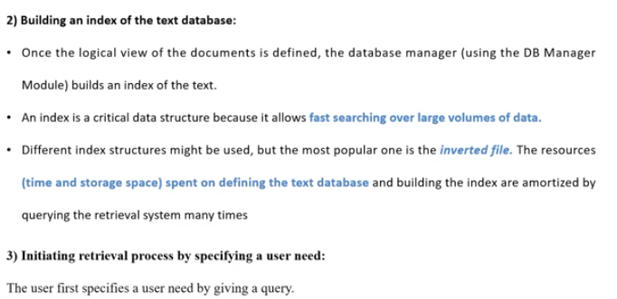

Slide 32
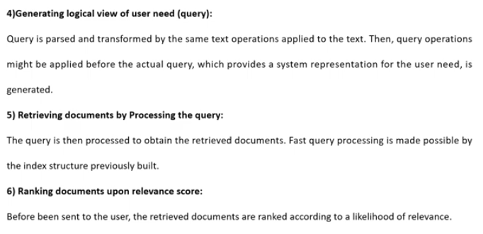

Slide 33
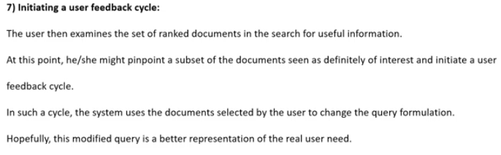

Slide 34
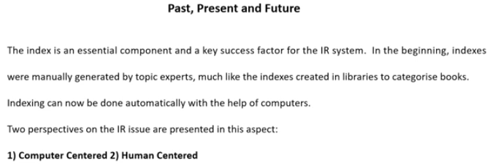

Slide 35
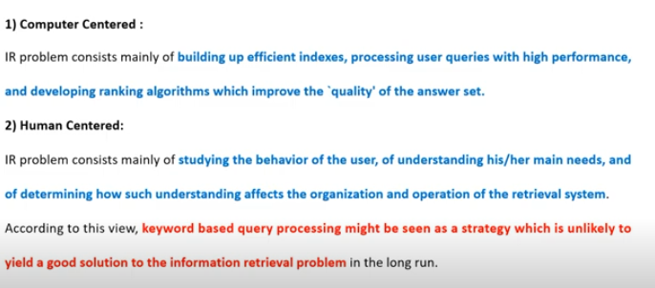

Slide 36
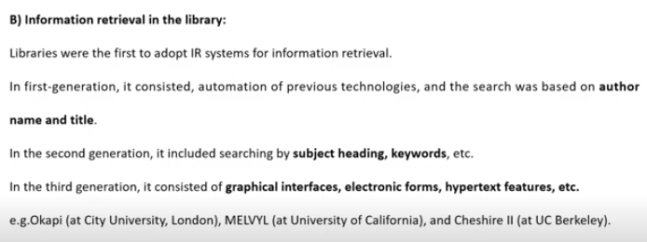

Slide 37
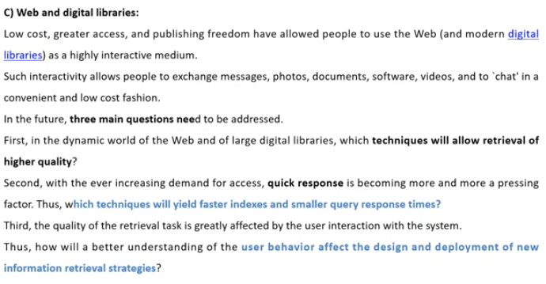

Slide 38
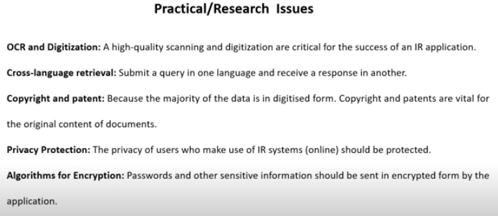

Slide 39
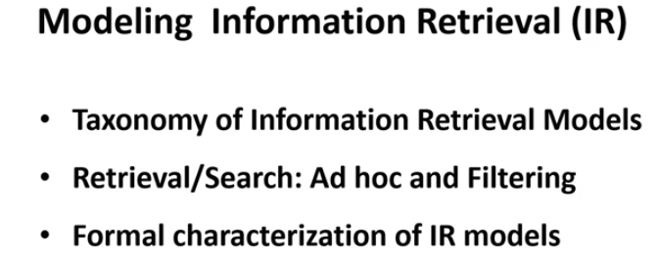

Slide 40
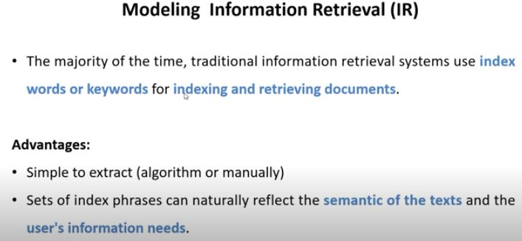

Slide 41
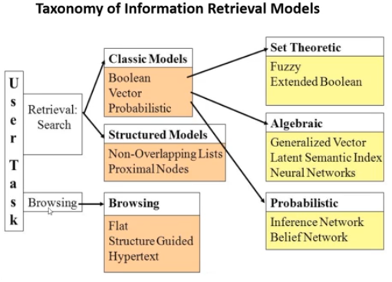

Slide 42
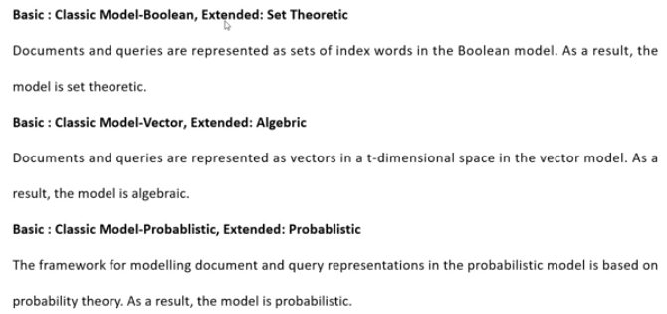

Slide 43
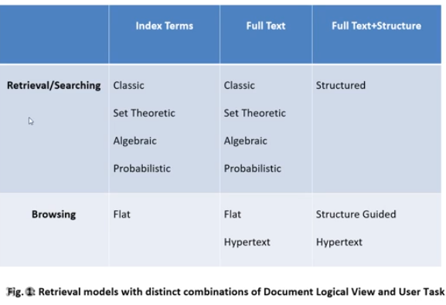

Slide 44
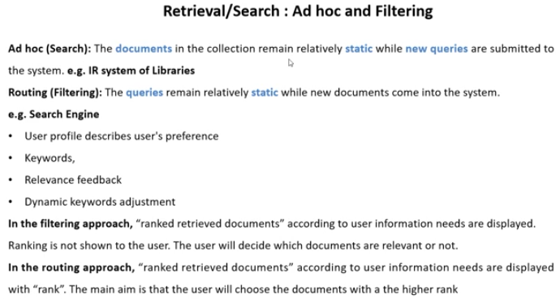

Slide 45
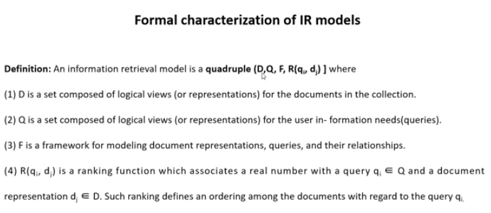

Slide 46
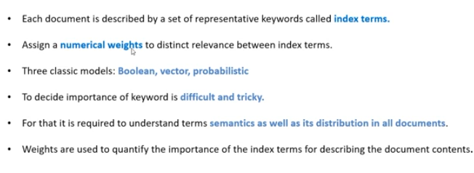

Slide 47
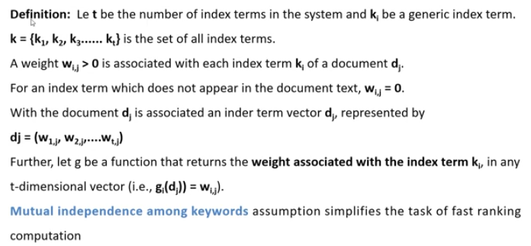

Slide 48
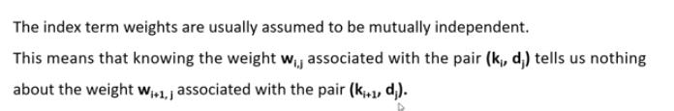

Slide 49
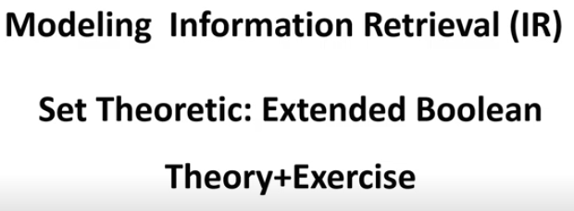

Slide 51
Basic IR Models:
Boolean Model
TF-IDF (Term Frequency/Inverse Document Frequency) Weighting
Vector Model, Probabilistic Model and
Latent Semantic Indexing Model.

Slide 52
Boolean Model
Each document is represented as a set of keywords.
Queries are Boolean expressions using operators:
  AND: both terms must be present
  OR: either term can be present
  NOT: exclude documents containing the term
A document either satisfies the query or it doesn't. No ranking is done.

Slide 53
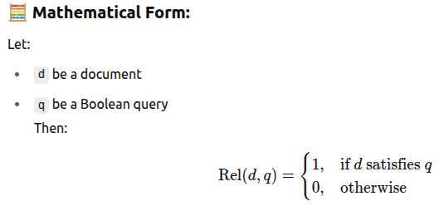
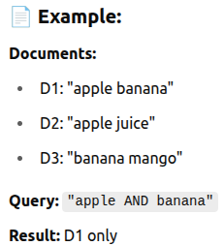
Boolean Model Cont...

Slide 54
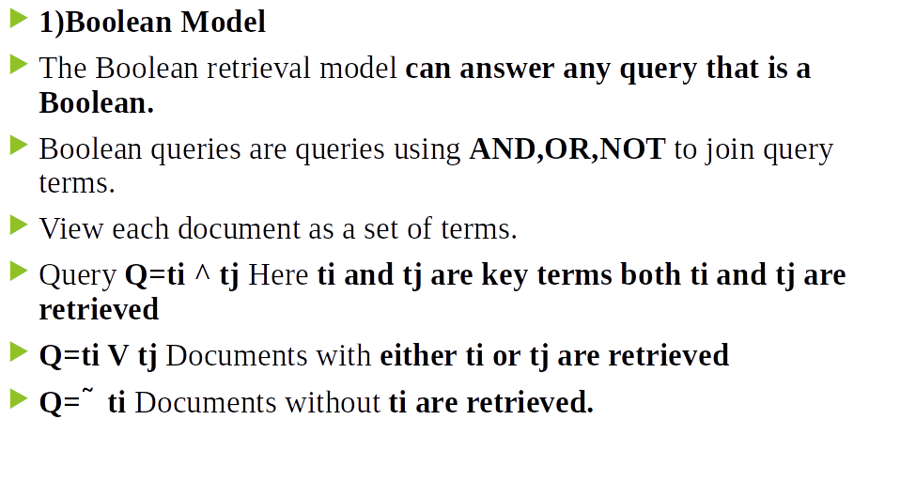

Slide 55
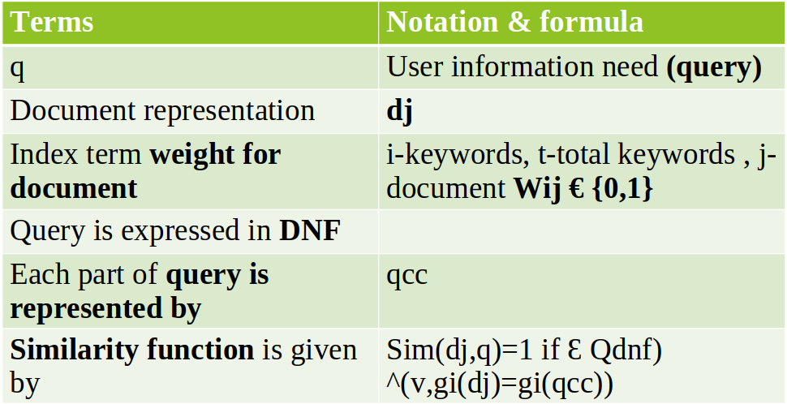
Formal characterization Boolean Model

Slide 56
If query is in Disjunctive Normal Form(DNF) we can directly find out similarity between document & query.
If query is in CNF first we convert CNF to DNF. converting formulas consist of De morgans Laws & The distributive law.

Slide 57
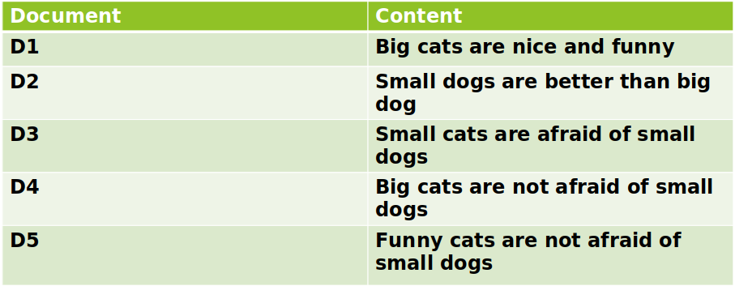
Exercise 1
Step 1:Stemming(repeatitive world) and stop removal(stop world-are,and,than,of,not)
Step 2:Formation of term * document Matrix
Step 3:check user query is in DNF form. If not convert to DNF.
Step 4:find similarity between query and each document by applying similarity function.

Slide 58
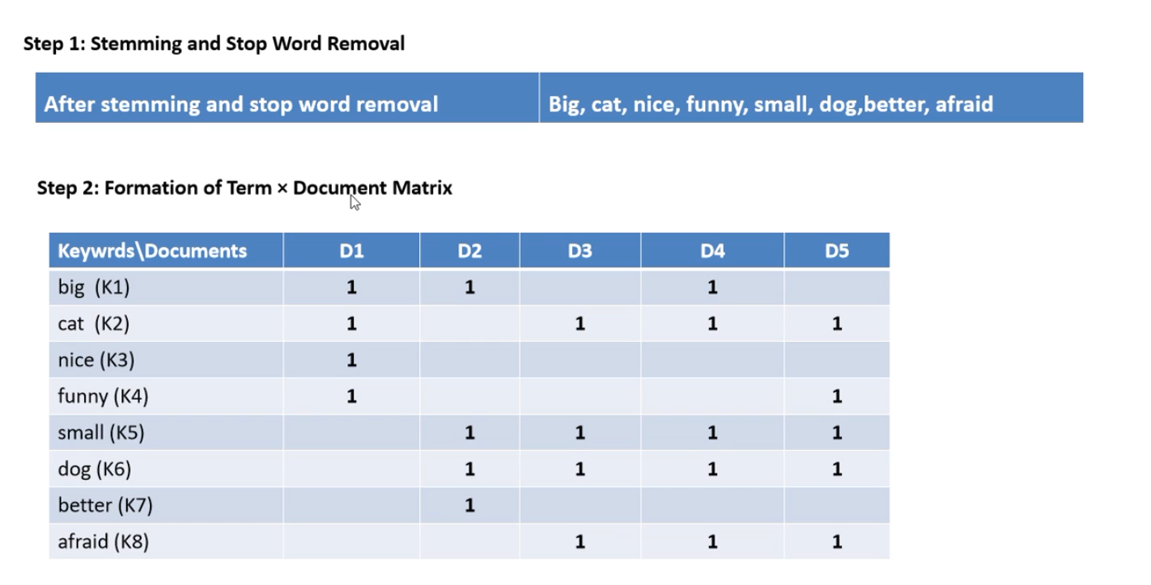

Slide 59
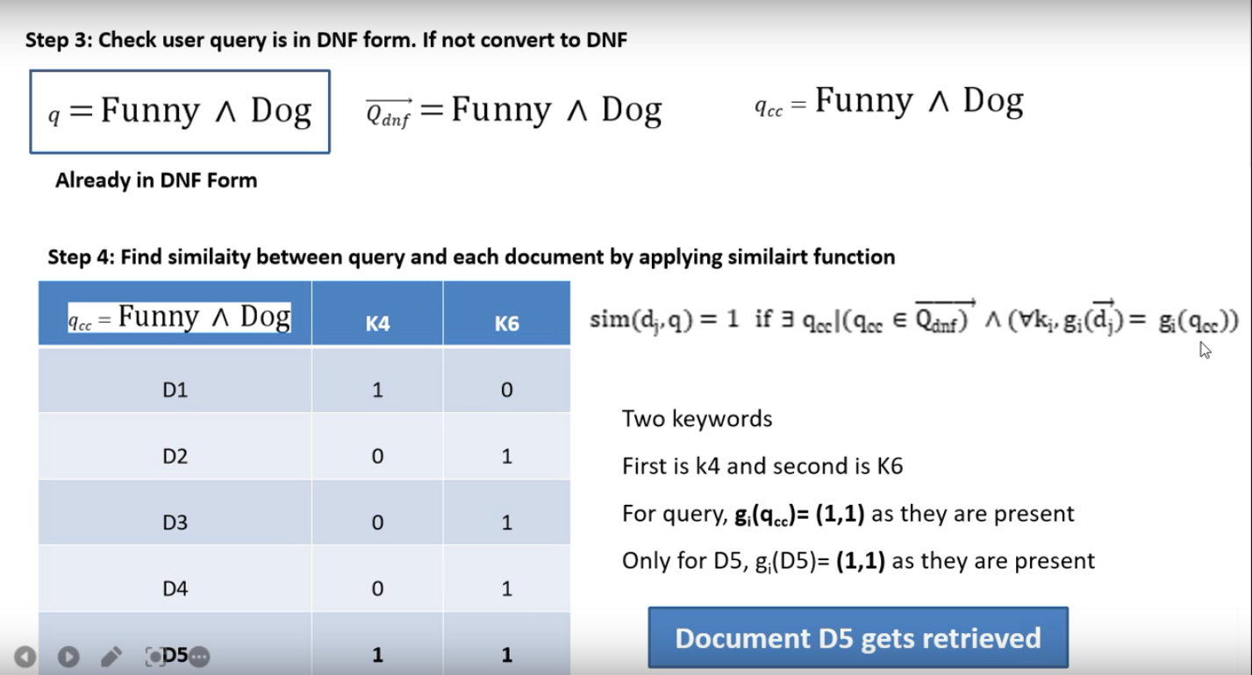

Slide 60
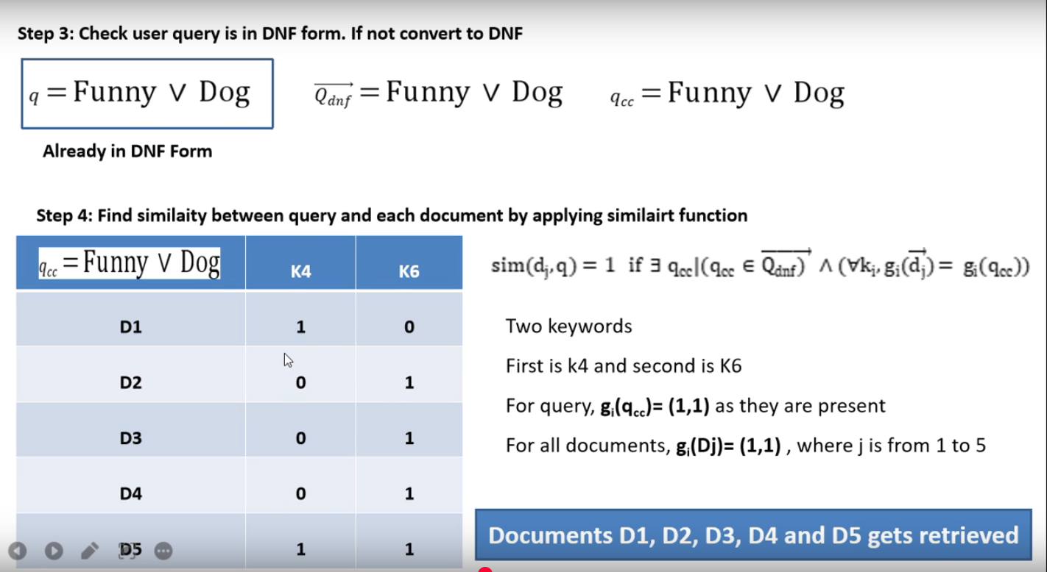

Slide 61
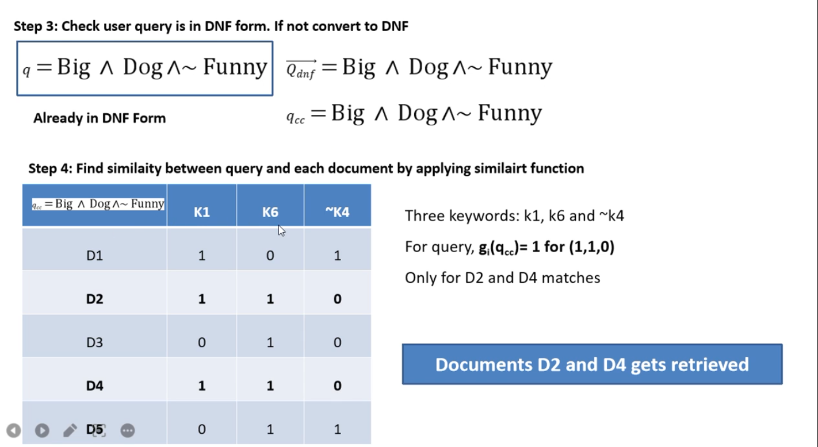

Slide 62


Slide 63


Slide 64


Slide 65


Slide 66


Slide 67


Slide 68

If query is in Disjunctive Normal Form(DNF) we can directly find out similarity between document & query.
If query is in CNF first we convert CNF to DNF. converting formulas consist of De morgans Laws & The distributive law.

Slide 69
Advantages
Boolean Model Cont...
Simple and intuitive
Fast for small datasets
Disadvantages
No ranking of results
All or nothing match (rigid)
Cannot handle term weighting or partial matches

Slide 70
TF-IDF (Term Frequency-Inverse Document Frequency) Model
Weighs terms based on their importance.
  TF (Term Frequency): Term’s frequency in the document.
  IDF (Inverse Document Frequency): Measures how rare or informative the term is across the corpus.

Slide 71

TF-IDF (Term Frequency-Inverse Document Frequency) Model Cont...

Slide 72

TF-IDF (Term Frequency-Inverse Document Frequency) Model Cont...

Slide 73


Slide 74


Slide 75


Slide 76


Slide 77
Advantages
TF-IDF (Term Frequency-Inverse Document Frequency) Model Cont...
Captures term importance
Simple to implement
Useful for ranking
Disadvantages
Doesn’t consider semantic meaning
Long documents can dominate

Slide 78

Vector Space Model
Represents documents and queries as vectors in a high-dimensional space (each dimension = a term).
Measures cosine similarity between query and document vectors.

Slide 79

Vector Space Model Cont...

Slide 80


Slide 81


Slide 82


Slide 83


Slide 84


Slide 85


Slide 86


Slide 87


Slide 88


Slide 89


Slide 90


Slide 91


Slide 92


Slide 93


Slide 94


Slide 95


Slide 96


Slide 97
Advantages
Vector Space Model Cont...
Supports partial matching
Ranks documents based on relevance
Disadvantages
High dimensional space (sparse)
No semantic understanding

Slide 98
Probabilistic Model (Binary Independence Model - BIM)
Assumes:
  Documents are either relevant or not.
  Terms occur independently in documents.
Calculates probability that a document is relevant to a query.

Slide 99

Probabilistic Model (Binary Independence Model - BIM) Cont...

Slide 100

Probabilistic Model (Binary Independence Model - BIM) Cont...

Slide 101
Advantages
Probabilistic Model (Binary Independence Model - BIM) Cont...
Strong theoretical foundation
Supports probabilistic ranking
Disadvantages
Assumes term independence
Needs relevance feedback to work well

Slide 102

Latent Semantic Indexing (LSI / LSA)
Documents and terms are represented in lower-dimensional space using Singular Value Decomposition (SVD).
Captures latent (hidden) semantic structure.
Reduces noise and captures term co-occurrence patterns.

Slide 103

Latent Semantic Indexing (LSI / LSA) Cont...

Slide 104
Advantages
Latent Semantic Indexing (LSI / LSA) Cont...
Solves synonymy and polysemy
Captures deeper meaning
Disadvantages
Computationally expensive (SVD)
Difficult to interpret reduced dimensions

Slide 105
Summary Comparison Table
Feature | Boolean | TF-IDF | Vector Space | Probabilistic | LSI
Model Type | Exact match | Statistical | Geometric | Probabilistic | Semantic/Statistical
Ranking | ❌ No | ✅ Yes | ✅ Yes | ✅ Yes | ✅ Yes
Term Weighting | ❌ No | ✅ Yes | ✅ Yes | ✅ (via RSV) | ✅ (via latent space)
Handles Synonyms | ❌ No | ❌ No | ❌ No | ❌ No | ✅ Yes
Handles Partial Match | ❌ No | ✅ Yes | ✅ Yes | ✅ Yes | ✅ Yes
Semantic Understanding | ❌ No | ❌ No | ❌ No | ❌ No | ✅ Yes
Complexity | Low | Moderate | Moderate | High (needs feedback) | Very High

