Slide 1
Fundamentals of Data Structures
UNIT III Searching and Sorting

Slide 2
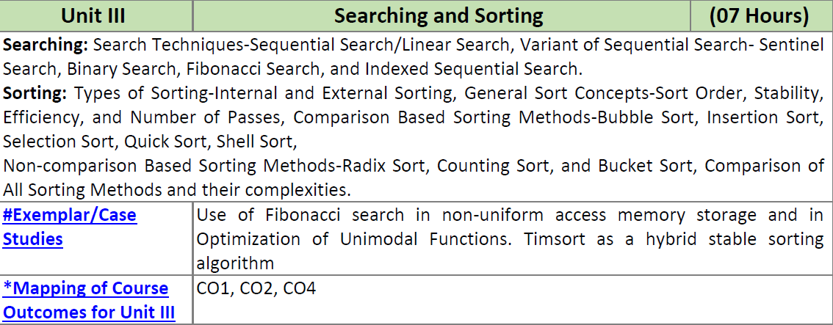
UNIT III Searching and Sorting

Slide 3
Revision
Sequential/ Linear Search
  Example
  Algorithm
  Program
Binary Search
  Example
  Algorithm
  Program

Slide 4

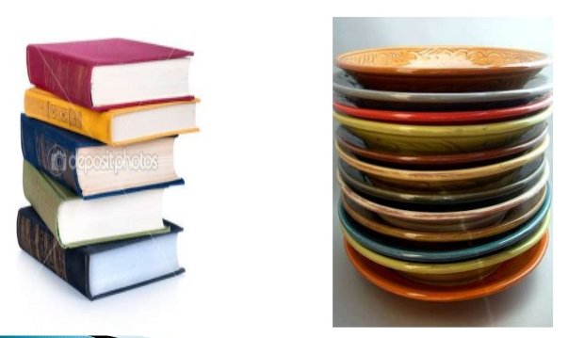
Data
Notes:
<number>

Slide 5
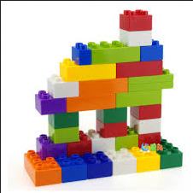
Data Structure
Notes:
<number>

Slide 6
What is Data Structures?
Data structure is a representation of data and the operations allowed on that data.
  A data structure is a way to store and organize data in order to facilitate the access and modifications.
  Data Structures are the method of representing of logical relationships between individual data elements related to the solution of a given problem.
Notes:
<number>

Slide 7
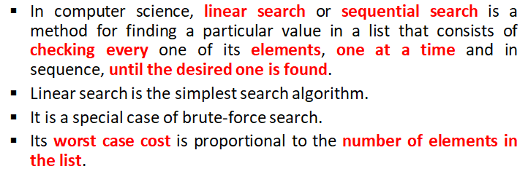
Linear/Sequential Search

Slide 8
Linear/Sequential Search

Slide 9
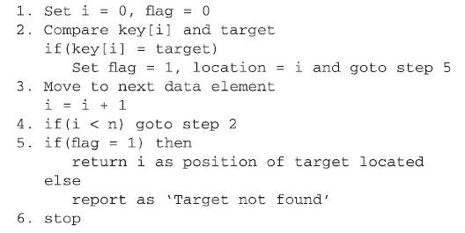
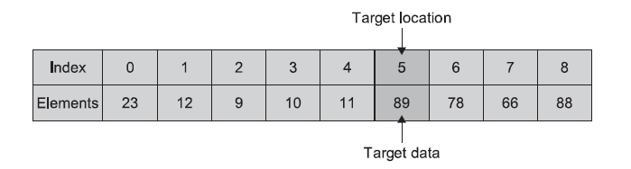
Algorithm - Linear Search

Slide 10
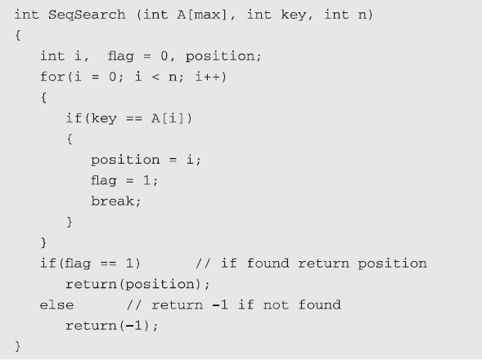
Function - Linear Search

Slide 11
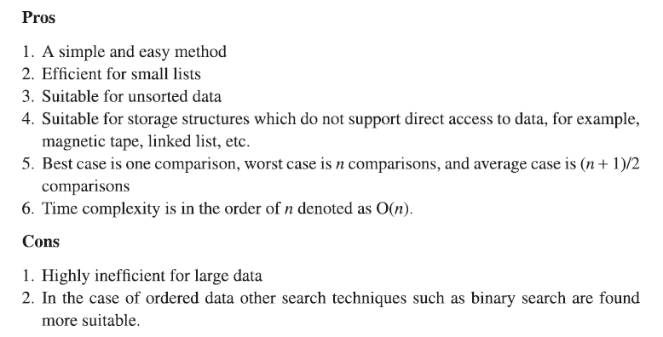
Pros and Cons of Linear Search

Slide 12
Time complexity:
Best case=O(1)
Average case=(n+1)/2=O(n)
Worst case=O(n)
Space complexity=O(1)

Slide 13
Find position of element 30 using linear search algorithm in given sequence and print its index
10,5,20,25,8,30,40

Slide 14
Write C++ Program for Linear Search

Slide 15
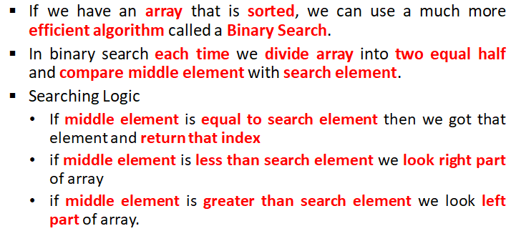
Binary Search

Slide 16
Find the position of element 88 using binary search method in an array given below
A={77,33,44,11,88,22,66,55}

Slide 17
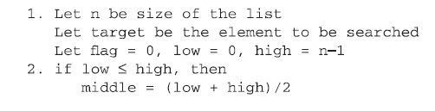
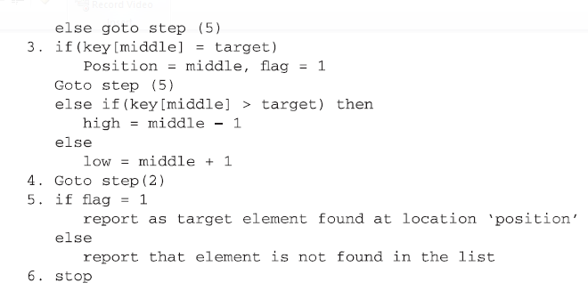
Binary Search Algorithm

Slide 18
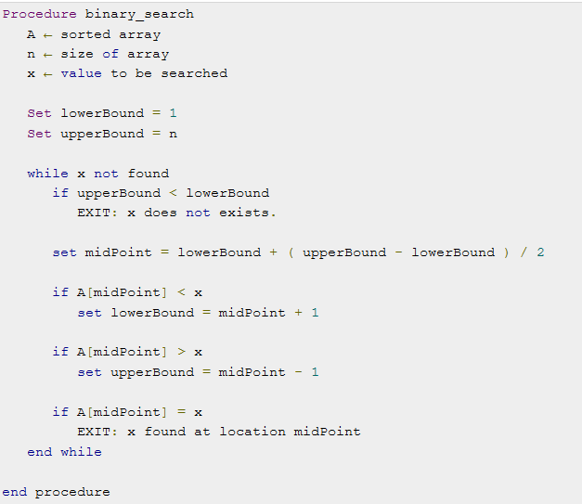
Binary Search

Slide 19
Binary Search
If we have an array that is sorted, we can use a much more efficient algorithm called a Binary Search.
In binary search each time we divide array into two equal half and compare middle element with search element.
If middle element is equal to search element then we got that element and return that index otherwise if middle element is less than search element we look right part of array and if middle element is greater than search element we look left part of array.

Slide 20
Binary Search
Algorithm: Binary_Search (A, left, right)
while left <= right
middle = index halfway between left, right
if D[middle] matches key
return middle
else if key less than A[middle]
right = middle -1
else
left = middle + 1
return -1

Slide 21
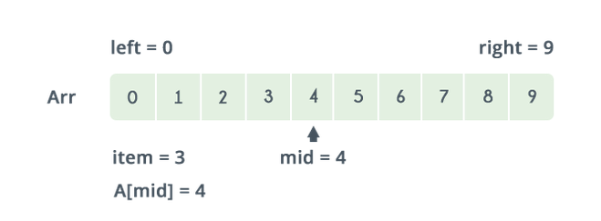
Binary Search
Example : Find 7

Slide 22
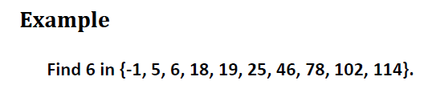
Binary Search

Slide 24
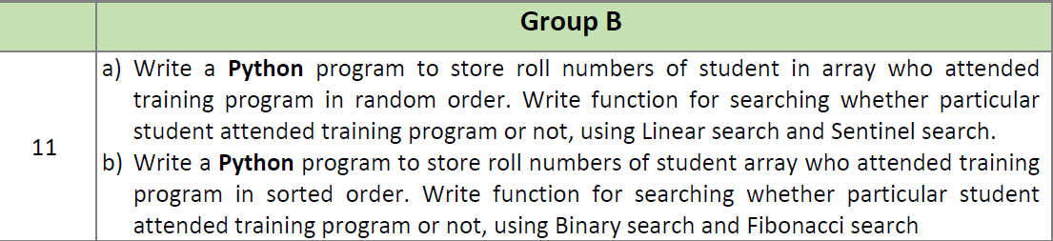
DSL B11

Slide 25
UNIT III Searching and Sorting

Slide 26
Variant of Sequential Search
Binary Search
Fibonacci Search
Sentinel Search
Indexed Sequential Search

Slide 27
Fibonacci Search – Basic Concept

Slide 28
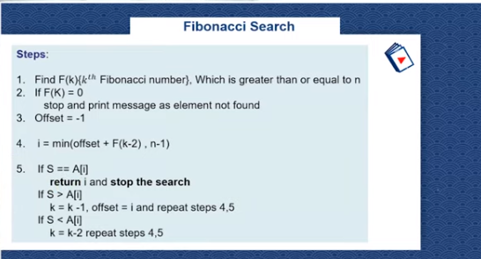
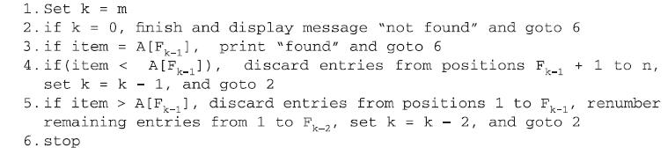
Fibonacci Search - Algorithm

Slide 29
Fibonacci Search - Function
int fib(int n)
{
if(n==0)
return 0;
if(n==1)
return 1;
return(fib(n-1) + fib(n-2));
}

Slide 30
Fibonacci Search - Function
int fibsearch(int a[20],int key,int mid,int p,int q)
{
int temp;
if(key==a[mid])
return mid;
if(key > a[mid])
{
if(p==1)
return -1;
mid=mid+q;
p=p-q;
q=q-p;
return(fibsearch(a,key,mid,p,q));
}
else
{
if(q==0)
return -1;
mid=mid-q;
temp=p-q;
p=q;
q=temp;
return(fibsearch(a,key,mid,p,q));
}
}

Slide 31
Fibonacci Search - Example
9 15 22 27 30 42 45
1 2 3 4 5 6 7

Slide 32
Fibonacci Search - Example
n=f=7
A=3
B=5
9 15 22 27 30 42 45
1 2 3 4 5 6 7

Slide 33
Variant of Sequential Search
Binary Search
Fibonacci Search
Sentinel Search
Indexed Sequential Search

Slide 34
Sentinel Search – Basic Concept
The idea is to reduce the number of comparisons required to find an element in a list.
The last element of the list is the search element itself and run a while loop to see if there exists any copy of the search element in the list and quit the loop as soon as we find the search element.

Slide 35
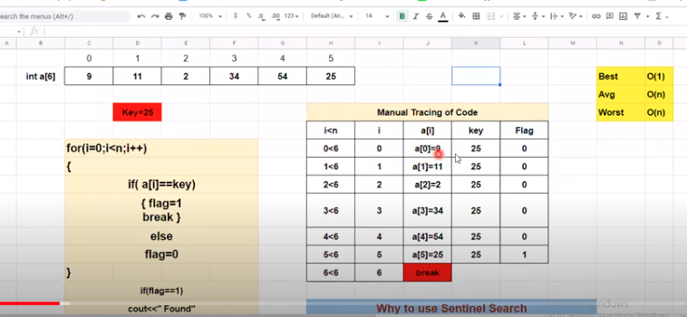
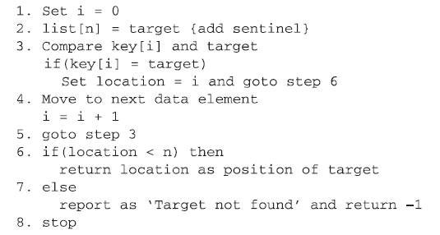
linear Search - example

Slide 36
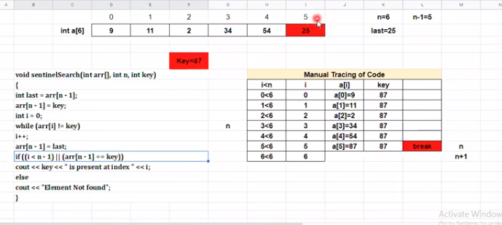
Sentinel Search - Function
int sentinal(int a[20],int n,int key)
{
int i;
a[n]=key;
i=0;
while(a[i]!=key)
i++;
if(i!=n)
return i;
return -1;
}

Slide 37
Variant of Sequential Search
Binary Search
Fibonacci Search
Sentinel Search
Indexed Sequential Search

Slide 38
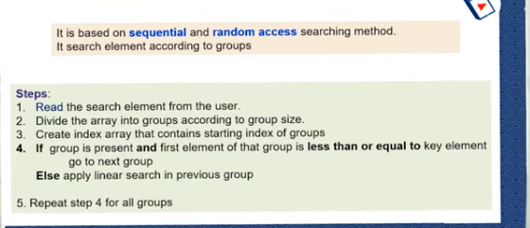
Indexed Sequential Search
Suitable for sequential file which associated with index

Slide 39
UNIT III Searching and Sorting

Slide 40

Sorting
Types of Sorting
  External
  Internal

Slide 41
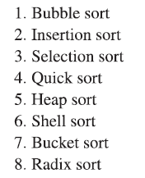
Types of Sorting
Internal Sorting
  Any sort algorithm that uses main memory exclusively during the sorting
  High speed and random access to all data members
  Faster than External Sorting
External Sorting
  Uses External Memory
  Merge Sort

Slide 42
UNIT III Searching and Sorting

Slide 43
General Sort Concept
Sort Order
Stability
Efficiency – measure of the relative efficiency of the sort
Number of Passes

Slide 44
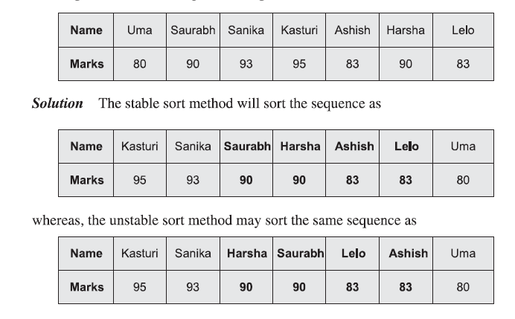
General Sort Concept
Stability

Slide 45
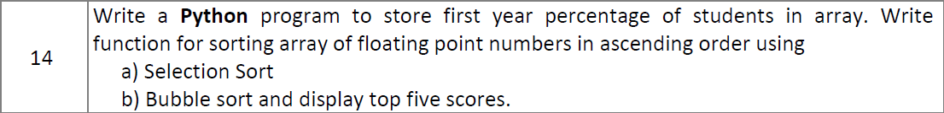
Bubble Sort and Selection Sort

Slide 46
Sorting
Sorting takes an unordered collection and makes it an ordered one.
1 2 3 4 5 6
77
42
35
12
101
5
1 2 3 4 5 6
5
12
35
42
77
101

Slide 47
"Bubble Sort”
Traverse a collection of elements
  Move from the front to the end
  “Bubble” the largest value to the end using pair-wise comparisons and swapping
1 2 3 4 5 6
77
42
35
12
101
5

Slide 48
"Bubbling Up" the Largest Element
Traverse a collection of elements
  Move from the front to the end
  “Bubble” the largest value to the end using pair-wise comparisons and swapping
Swap
1 2 3 4 5 6
42
77
77
42
35
12
101
5

Slide 49
"Bubbling Up" the Largest Element
Traverse a collection of elements
  Move from the front to the end
  “Bubble” the largest value to the end using pair-wise comparisons and swapping
1 2 3 4 5 6
Swap
35
77
42
77
35
12
101
5

Slide 50
"Bubbling Up" the Largest Element
Traverse a collection of elements
  Move from the front to the end
  “Bubble” the largest value to the end using pair-wise comparisons and swapping
1 2 3 4 5 6
Swap
12
77
42
35
77
12
101
5

Slide 51
"Bubbling Up" the Largest Element
Traverse a collection of elements
  Move from the front to the end
  “Bubble” the largest value to the end using pair-wise comparisons and swapping
1 2 3 4 5 6
42
35
12
77
101
5
No need to swap

Slide 52
"Bubbling Up" the Largest Element
Traverse a collection of elements
  Move from the front to the end
  “Bubble” the largest value to the end using pair-wise comparisons and swapping
1 2 3 4 5 6
Swap
5
101
42
35
12
77
101
5

Slide 53
"Bubbling Up" the Largest Element
Traverse a collection of elements
  Move from the front to the end
  “Bubble” the largest value to the end using pair-wise comparisons and swapping
1 2 3 4 5 6
101
42
35
12
77
5
Largest value correctly placed

Slide 54
Bubble Sort - Iterations
1 2 3 4 5 6
42
35
12
77
5
101
1 2 3 4 5 6
35
12
42
5
77
101
1 2 3 4 5 6
N - 1
12
35
5
42
77
101
1 2 3 4 5 6
12
5
35
42
77
101
1 2 3 4 5 6
5
12
35
42
77
101

Slide 55
Reducing the Number of Comparisons
1 2 3 4 5 6
77
42
35
12
101
5
1 2 3 4 5 6
42
35
12
77
5
101
1 2 3 4 5 6
35
12
42
5
77
101
1 2 3 4 5 6
12
35
5
42
77
101
1 2 3 4 5 6
12
5
35
42
77
101

Slide 56
def bubbleSort(array):
# loop to access each array element
for i in range(len(array)):
# loop to compare array elements
for j in range(0, len(array) - i - 1):
# compare two adjacent elements
# change > to < to sort in descending order
if array[j] > array[j + 1]:
# swapping elements if elements
# are not in the intended order
temp = array[j]
array[j] = array[j+1]
array[j+1] = temp
data = [-2, 45, 0, 11, -9]
bubbleSort(data)
print('Sorted Array in Ascending Order:')
print(data)

Slide 57
Summary
“Bubble Up” algorithm will move largest value to its correct location (to the right)
Repeat “Bubble Up” until all elements are correctly placed:
  Maximum of N-1 times
  Can finish early if no swapping occurs
We reduce the number of elements we compare each time one is correctly placed
Notes:
<number>

Slide 58
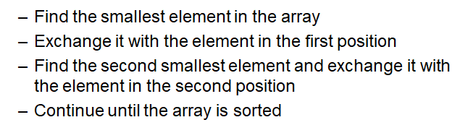
Selection Sort

Slide 59
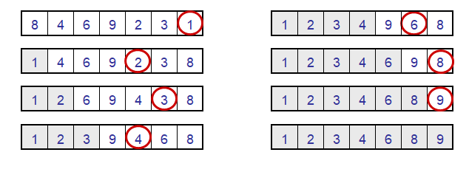
Selection Sort

Slide 60
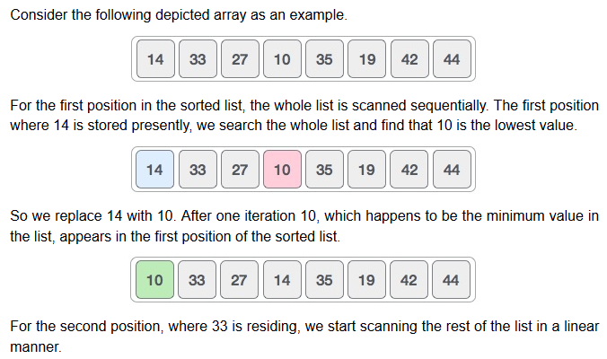
Selection Sort

Slide 61
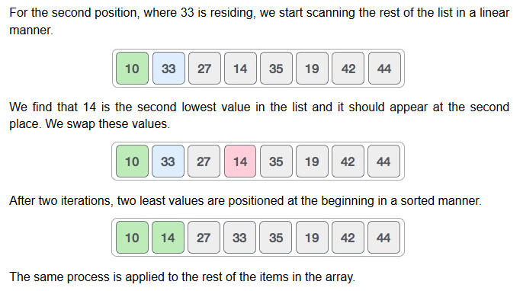
Selection Sort

Slide 62
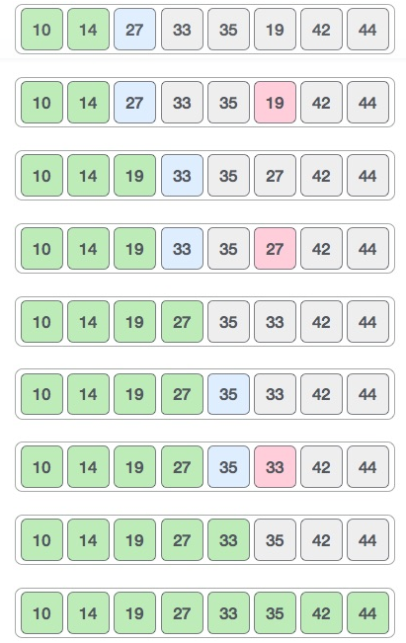
Selection
Sort

Slide 63
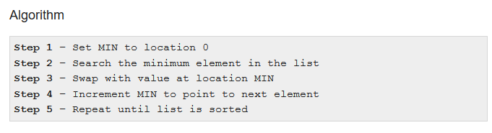
Selection Sort

Slide 64
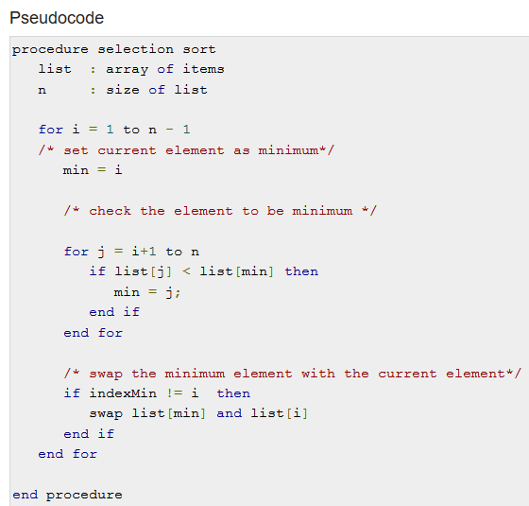
Selection
Sort

Slide 65
Write C++/ Python program for Selection Sort

Slide 66
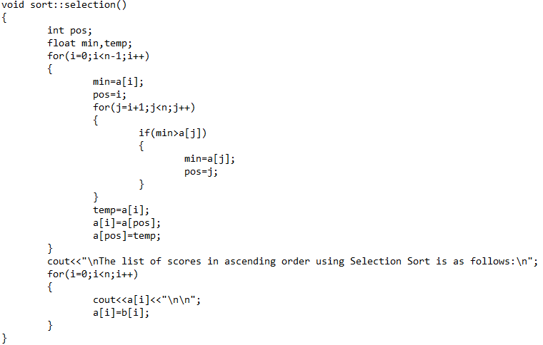

Slide 67
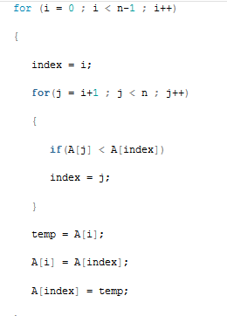
Selection Sort

Slide 68

Selection Sort Example
Notes:
<number>

Slide 69
Insertion Sort
Insertion sort is a simple sorting algorithm that works similar to the way you sort playing cards in your hands. The array is virtually split into a sorted and an unsorted part. Values from the unsorted part are picked and placed at the correct position in the sorted part.
Characteristics of Insertion Sort:
This algorithm is one of the simplest algorithm with simple implementation
Basically, Insertion sort is efficient for small data values
Insertion sort is adaptive in nature, i.e. it is appropriate for data sets which are already partially sorted.

Slide 70
Consider an example:
arr[]: {16,15,4,13,2,1}

Slide 71
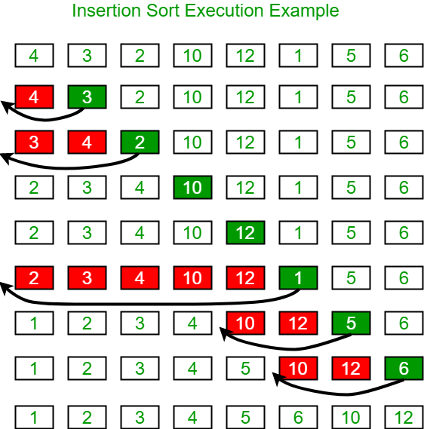

Slide 72
void insertionSort(int arr[], int n)
{
int i, key, j;
for (i = 1; i < n; i++)
{
key = arr[i];
j = i - 1;
// Move elements of arr[0..i-1],
// that are greater than key, to one
// position ahead of their
// current position
while (j >= 0 && arr[j] > key)
{
arr[j + 1] = arr[j];
j = j - 1;
}
arr[j + 1] = key;
}
}

Slide 73
def insertionSort(arr):
# Traverse through 1 to len(arr)
for i in range(1, len(arr)):
key = arr[i]
# Move elements of arr[0..i-1], that are
# greater than key, to one position ahead
# of their current position
j = i-1
while j >= 0 and key < arr[j] :
arr[j + 1] = arr[j]
j -= 1
arr[j + 1] = key
# Driver code to test above
arr = [12, 11, 13, 5, 6]
insertionSort(arr)
for i in range(len(arr)):
print ("% d" % arr[i])

Slide 74

Insertion Algorithm - Example

Slide 75
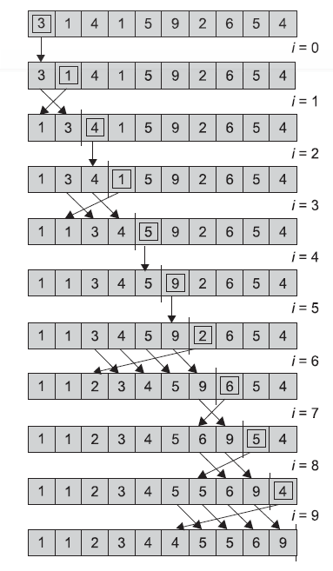

Slide 76
UNIT III Searching and Sorting

Slide 77
Quick Sort
Divide and conquer strategy
Initially select an element called Pivot
Pivot- Right Position with respect to sorted sequence
Reduces unnecessary swaps and moves of the elements

Slide 78
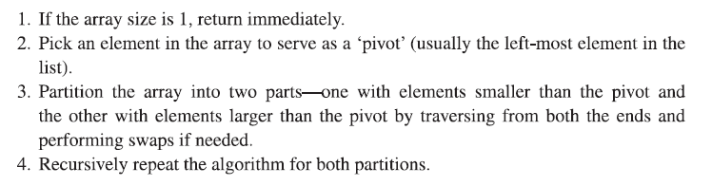
Quick Sort – Basic Steps

Slide 79
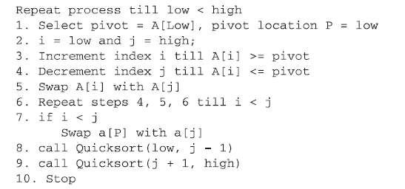
Quick Sort – Algorithm

Slide 80
# Quick sort in Python
# function to find the partition position
def partition(array, low, high):
# choose the rightmost element as pivot
pivot = array[low]
# pointer for greater element
i = low - 1
# traverse through all elements
# compare each element with pivot
for j in range(low, high):
if array[j] <= pivot:
# if element smaller than pivot is found
# swap it with the greater element pointed by i
i = i + 1
# swapping element at i with element at j
(array[i], array[j]) = (array[j], array[i])
# swap the pivot element with the greater element specified by i
(array[i + 1], array[high]) = (array[high], array[i + 1])
# return the position from where partition is done
return i + 1

Slide 81
# function to perform quicksort
def quickSort(array, low, high):
if low < high:
# find pivot element such that
# element smaller than pivot are on the left
# element greater than pivot are on the right
pi = partition(array, low, high)
# recursive call on the left of pivot
quickSort(array, low, pi - 1)
# recursive call on the right of pivot
quickSort(array, pi + 1, high)
data = [8, 7, 2, 1, 0, 9, 6]
print("Unsorted Array")
print(data)
size = len(data)
quickSort(data, 0, size - 1)
print('Sorted Array in Ascending Order:')
print(data)

Slide 82

Quick Sort – Basic Steps

Slide 83
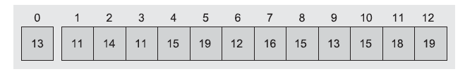
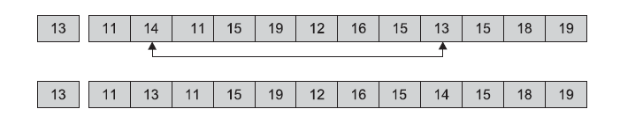


Quick Sort – Example

Slide 84



Quick Sort – Example

Slide 85

Quick Sort – Time Complexity
Worst case - O(n^2)
Average Case - O(n log n)

Slide 86
Time Complexities
Worst Case Complexity [Big-O]: O(n2)
It occurs when the pivot element picked is either the greatest or the smallest element.
This condition leads to the case in which the pivot element lies in an extreme end of the sorted array. One sub-array is always empty and another sub-array contains n - 1 elements. Thus, quicksort is called only on this sub-array.
However, the quicksort algorithm has better performance for scattered pivots.
Best Case Complexity [Big-omega]: O(n*log n)
It occurs when the pivot element is always the middle element or near to the middle element.
Average Case Complexity [Big-theta]: O(n*log n)
It occurs when the above conditions do not occur.
2. Space Complexity
The space complexity for quicksort is O(log n).

Slide 87
Quick Sort – Example

Slide 88
UNIT III Searching and Sorting

Slide 89
Shell Sort
Inventor – Donald Shell
Improved version of Insertion Sort
The element at a fixed distance are compared
Later, this distance decremented
Gap – Fixed distance
Initial Gap – n/2
Gap – 1 it becomes an ordinary Insertion sort

Slide 90
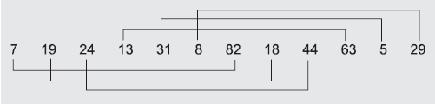
Shell Sort – Example

Slide 91
Shell Sort – Example

Slide 92
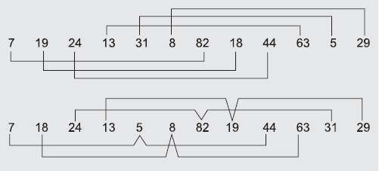
Shell Sort – Example

Slide 93
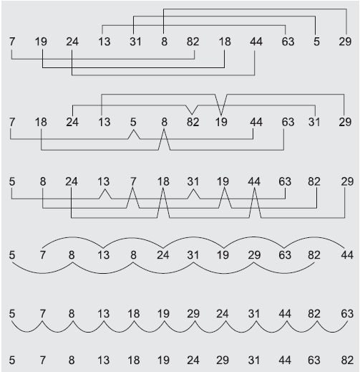
Shell Sort – Example

Slide 94
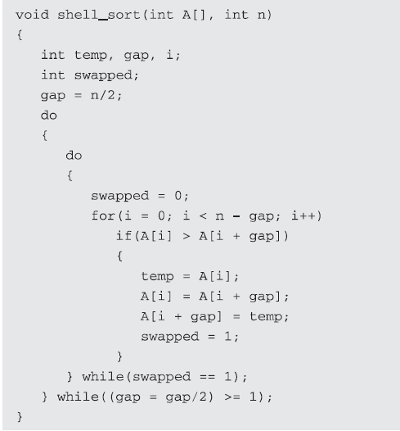
Shell Sort – Function

Slide 95

Shell Sort – Example

Slide 96
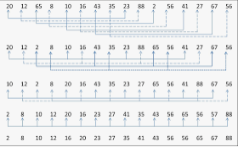
Shell Sort – Example

Slide 97
UNIT III Searching and Sorting

Slide 98
Non-comparison Based Sorting Methods:
Radix Sort,
Bucket Sort

Slide 99
Bucket Sort Algorithm
Bucket Sort is a sorting algorithm that divides the unsorted array elements into several groups called buckets. Each bucket is then sorted by using any of the suitable sorting algorithms or recursively applying the same bucket algorithm.
Finally, the sorted buckets are combined to form a final sorted array.
Scatter Gather Approach
The process of bucket sort can be understood as a scatter-gather approach. Here, elements are first scattered into buckets then the elements in each bucket are sorted. Finally, the elements are gathered in order.

Slide 100
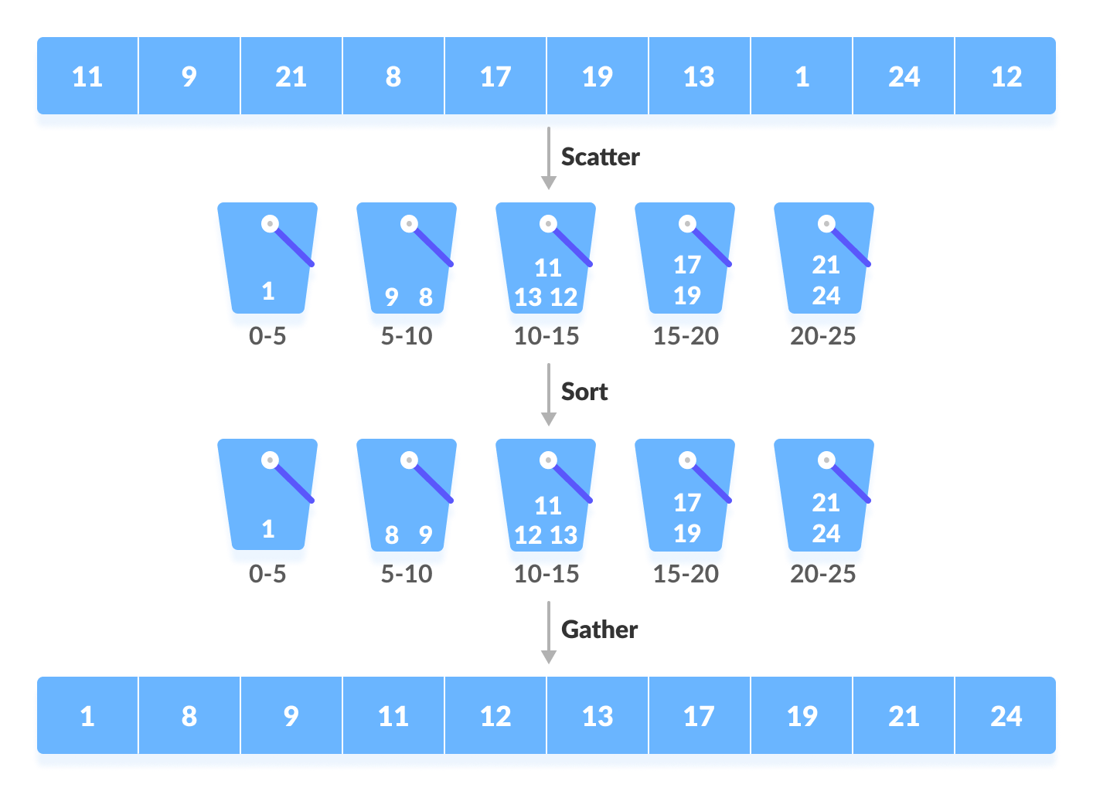

Slide 101
Bucket Sort Algorithm
bucketSort()
create N buckets each of which can hold a range of values
for all the buckets
initialize each bucket with 0 values
for all the buckets
put elements into buckets matching the range
for all the buckets
sort elements in each bucket
gather elements from each bucket
end bucketSort

Slide 102
# Bucket Sort in Python
def bucketSort(array):
bucket = []
# Create empty buckets
for i in range(len(array)):
bucket.append([])
# Insert elements into their respective buckets
for j in array:
index_b = int(10 * j)
bucket[index_b].append(j)
# Sort the elements of each bucket
for i in range(len(array)):
bucket[i] = sorted(bucket[i])
# Get the sorted elements
k = 0
for i in range(len(array)):
for j in range(len(bucket[i])):
array[k] = bucket[i][j]
k += 1
return array
array = [.42, .32, .33, .52, .37, .47, .51]
print("Sorted Array in descending order is")
print(bucketSort(array))

Slide 103
Worst Case Complexity: O(n2)
When there are elements of close range in the array, they are likely to be placed in the same bucket. This may result in some buckets having more number of elements than others.
It makes the complexity depend on the sorting algorithm used to sort the elements of the bucket.
The complexity becomes even worse when the elements are in reverse order. If insertion sort is used to sort elements of the bucket, then the time complexity becomes O(n2).
Best Case Complexity: O(n+k)
It occurs when the elements are uniformly distributed in the buckets with a nearly equal number of elements in each bucket.
The complexity becomes even better if the elements inside the buckets are already sorted.
If insertion sort is used to sort elements of a bucket then the overall complexity in the best case will be linear ie. O(n+k). O(n) is the complexity for making the buckets and O(k) is the complexity for sorting the elements of the bucket using algorithms having linear time complexity at the best case.
Average Case Complexity: O(n)
It occurs when the elements are distributed randomly in the array. Even if the elements are not distributed uniformly, bucket sort runs in linear time. It holds true until the sum of the squares of the bucket sizes is linear in the total number of elements.

Slide 104
Radix Sort
The idea of Radix Sort is to do digit by digit sort starting from least significant digit to most significant digit. Radix sort uses counting sort as a subroutine to sort.
The Radix Sort Algorithm
Do the following for each digit I where I varies from the least significant digit to the most significant digit. Here we will be sorting the input array using counting sort (or any stable sort) according to the i’th digit.

Slide 105
# Python program for implementation of Radix Sort
# A function to do counting sort of arr[] according to
# the digit represented by exp.
def countingSort(arr, exp1):
n = len(arr)
# The output array elements that will have sorted arr
output = [0] * (n)
# initialize count array as 0
count = [0] * (10)
# Store count of occurrences in count[]
for i in range(0, n):
index = arr[i] // exp1
count[index % 10] += 1
# Change count[i] so that count[i] now contains actual
# position of this digit in output array
for i in range(1, 10):
count[i] += count[i - 1]
# Build the output array
i = n - 1
while i >= 0:
index = arr[i] // exp1
output[count[index % 10] - 1] = arr[i]
count[index % 10] -= 1
i -= 1
# Copying the output array to arr[],
# so that arr now contains sorted numbers
i = 0
for i in range(0, len(arr)):
arr[i] = output[i]
# Method to do Radix Sort
def radixSort(arr):
# Find the maximum number to know number of digits
max1 = max(arr)
# Do counting sort for every digit. Note that instead
# of passing digit number, exp is passed. exp is 10^i
# where i is current digit number
exp = 1
while max1 / exp >= 1:
countingSort(arr, exp)
exp *= 10
# Driver code
arr = [170, 45, 75, 90, 802, 24, 2, 66]
# Function Call
radixSort(arr)
for i in range(len(arr)):
print(arr[i],end=" ")
# This code is contributed by Mohit Kumra
# Edited by Patrick Gallagher

Slide 106
Counting Sort
Counting sort is a sorting technique based on keys between a specific range. It works by counting the number of objects having distinct key values (kind of hashing). Then do some arithmetic to calculate the position of each object in the output sequence.
Characteristics of counting sort:
Counting sort makes assumptions about the data, for example, it assumes that values are going to be in the range of 0 to 10 or 10 – 99 etc, Some other assumptions counting sort makes are input data will be all real numbers.
Like other algorithms this sorting algorithm is not a comparison-based algorithm, it hashes the value in a temporary count array and uses them for sorting.
It uses a temporary array making it a non In Place algorithm.

