Slide 1
LINKED LIST

Slide 2
INTRODUCTION
The linked list is a very effective and efficient dynamic data structure
Data items can be stored anywhere in memory in a scattered manner
To maintain the specific sequence of these data items we need to maintain link(s) with successor (and/ or predecessor)
It is called as a linked list

Slide 3
INTRODUCTION
A linked list is an ordered collection of data in which each element contains minimum two values, data and link(s) to its successor (and/ or predecessor)
The list with one link field using which every element is associated to either its predecessor or successor is called as singly linked list
In a linked list, before adding any element to the list, memory space for that node must be allocated
A link is kept with each item to the next item in the list

Slide 4

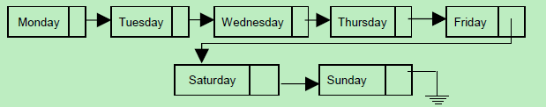
Fig: 2 (a): A linked list of n elements
Fig: 2 (b) : A linked list of weekdays

Slide 5
Each node of the linked list has minimum two elements :
The data member(s) being stored in the list
A pointer or link to the next element in the list
The last node in the list contains a NULL (or -1) pointer to indicate that it is the end or tail of the list

Slide 6
Linked Organization
Element can be placed anywhere in the memory
Dynamic allocation (size need not be known in advance) i.e. space allocation as per need can be done during execution.
As objects are not placed at fixed distance apart, random access to elements is not possible.
Insertion and deletion of objects do not require any data shifting.
Space efficient for large objects and large quantity with often insertions and deletions
Each element in general is a collection of data and a link. At least one link field is must.
Every element keeps address of its successor element in a link field.

Slide 7
Some more operations, which are based on above basic operations are:
    Searching a node
    Updating node.
    Printing the node or list.
    Counting length of the list.
    Reverse the list.
    Sort the list using pointer manipulation.
    Concatenate two lists.
    Merge two-sorted list into third sorted list

Slide 8
The Linked List ADT
  Data Structure of Node
  Insertion of a Node
  Linked List Traversal
Non-Recursive Method
Recursive Traversal Method

Slide 9
Types of Linked List
Singly linked list
Doubly linked list
Circular linked list

Slide 10
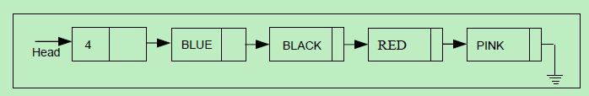
Singly Linked List
  A linked list in which every node has one link field, to provide information about where the next node of list is, is called as singly linked list

Slide 11
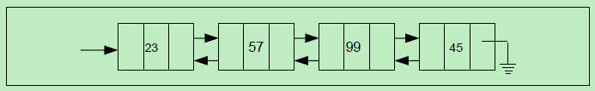
Doubly linked list
  In doubly linked list, each node has two link fields to store information about who is the next and also about who is ahead of the node
  Hence each node has knowledge of its successor and also its predecessor.
  In doubly linked list, from every node the list can be traversed in both the directions.

Slide 12
Circular linked list
Although a linear linked list is a useful and popular data structure, it has some shortcomings.
  For example, consider a singly linked list.
  Given a pointer A to a node in a linear list, we cannot reach any of the nodes that precede the node to which A is pointing.
  This disadvantage can be overcome by making a small change. This change is without any additional data structure.
  The link field of last node is set to NULL in linear list to mark end of list. This link field of last node can be set to point first node rather than NULL. Such a linked list is called a circular linked list.

Slide 13

Circular linked list

Slide 14
class node
{
int data; // data
node* next; // pointer to next
public:
node* create();
void display(node*);
node* beg_del(node*);
node* end_del(node*);
node* mid_del(node*);
node* beg_add(node*);
node* end_add(node*);
node* mid_add(node*);
node* total(node*);
};

Slide 15
node* node::create()
{
node* head,*p;
head=NULL;
cout<<"Enter the number of members"<<endl;
cin>>n;
for(i=0;i<n;i++)
{
if(head==NULL)
{
head=new node;
cout<<"Enter the roll number and name of the member"<<endl;
cin>>head->rno;
cin>>head->name;
head->next=NULL;
p=head;
}
else
{
p->next=new node;
p=p->next;
cout<<"Enter the roll number and name of the member"<<endl;
cin>>p->rno;
cin>>p->name;
p->next=NULL;
}
}
return head;
}

Slide 16
void node::display(node *head)
{
for(p=head;p!=NULL;p=p->next)
{
cout<<"Roll No:"<<p->rno<<" ";
cout<<"Name:"<<p->name<<endl;
}
}

Slide 17
Inserting a new node
Possible cases of InsertNode
  Insert into an empty list
  Insert in front
  Insert at back
  Insert in middle
But, in fact, only need to handle two cases
  Insert as the first node (Case 1 and Case 2)
  Insert in the middle or at the end of the list (Case 3 and Case 4)

Slide 18
node* node::beg_add(node* head)
{
p=new node;
cout<<"Enter the roll number and name of the member"<<endl;
cin>>p->rno;
cin>>p->name;
p->next=NULL;
p->next=head;
head=p;
return head;
}
node* node::end_add(node* head)
{
p=new node;
cout<<"Enter the roll number and name of the member"<<endl;
cin>>p->rno;
cin>>p->name;
p->next=NULL;
for(q=head;q->next!=NULL;q=q->next);
q->next=p;
return head;
}

Slide 19
node* node::mid_add(node* head)
{
p=new node;
cout<<"Enter the roll number and name of the member"<<endl;
cin>>p->rno;
cin>>p->name;
p->next=NULL;
cout<<"Enter the value after which you want to insert the member";
cin>>y;
for(q=head;q->rno==y && q!=NULL;q=q->next);
if(q==NULL)
{
cout<<"Data not found";
}
else
{
p->next=q->next;
q->next=p;
}
return head;
}

Slide 20
Deleting node
Possible cases of InsertNode
  Delete from front
  Delete from back
  Delete middle element

Slide 21
node* node::beg_del(node* head)
{
p=head;
head=head->next;
delete p;
return head;
}
node* node::end_del(node* head)
{
for(p=head;p->next->next!=NULL;p=p->next);
q=p->next;
p->next=NULL;
delete q;
}

Slide 22
node* node::mid_del(node* head)
{
cout<<"Enter the roll number of the member which you want to delete";
cin>>y;
if( head==NULL)
{
cout<<"linked list is empty";
return(head);
}
for(p=head;p->next->rno==y && p->next!=NULL;p=p->next)
{
p->next=p->next->next;
delete p->next;
}
return head;
}

Slide 23

Polynomial Manipulations
A node will have 3 fields, which represent the coefficient and exponent of a term and a pointer to the next term

Slide 24
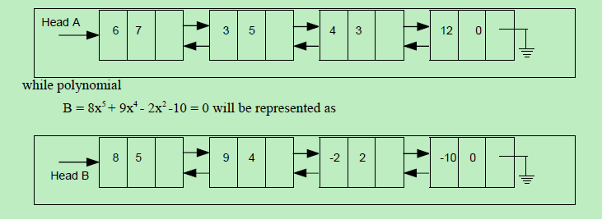
  For instance, the polynomial, say A = 6x7 + 3x5 + 4x3 + 12 would be stored as :

Slide 25
Operations on Polynomials
Polynomial evaluation
Polynomial addition
Multiplication of two polynomials
Representation of sparse matrix using linked list
Linked list implementation of the stack
Generalized linked list

Slide 26
Garbage Collection : An Application Of Linked List
  Overflow : Sometimes new data node is to be inserted into data structure but there is no available space i.e. free-pool is empty. This situation is called overflow
  Underflow : This refers to situation where programmer wants to delete a node from empty list
  For good memory utilization, operating system periodically collects all the free blocks and inserts into free-pool
  Any technique that does this collection is called garbage collection

Slide 27
Summary
  There are two implementation of linked linear list; array and pointers
  There is a need is of such a data structure which can dynamically shrink and grow
  Hence the popular implementation us using pointers and dynamic memory management
  Singly linked lists are useful data structures, especially if you need to automatically allocate and de-allocate space in a list
  The basic operation are create list, transverse the list, insert and delete a node
  There are two variation of linked list singly and doubly linked list. Both linked list can be circular lists
  The linked could be with or without head node. Head node is used to store some information about the list, so that it can be accessed without traversing the same

Slide 28
Summary
  In doubly linked list, each node has two link fields to store information about who is the next and also about who is ahead of the node
  Hence each node has knowledge of its successor and also its predecessor.
  In doubly linked list, from every node the list can be traversed in both the directions.
  Information could be like total number of nodes in the list and similarly any other Linked list is the most popular data structure used. It has many application such as process queue, print queue, garbage collection etc

Slide 29
Sequential organisation
Provides static allocation, which means space allocation is done by compiler once cannot be changed during execution and size has to be known in advance.
As individual objects are stored at fixed distance apart, we can access any element randomly.
Insertion and deletion of objects in between the list requires a lot of data movement.
Space inefficient for large objects and large quantity with often insertions and deletions
Element need not know/store keep address of its successive element.

