Slide 1
Fundamentals of Data Structures
UNIT V Stack
V Stack

Slide 2
Revision
Basic concept of stack
Stack as an ADT
Representation of stack using Array
Application of Stack
Infix to Postfix

Slide 3
Revision of Last Lecture
Application of Stack
Postfix Evaluation
Linked Stack and Operations
Recursion and Variants

Slide 4
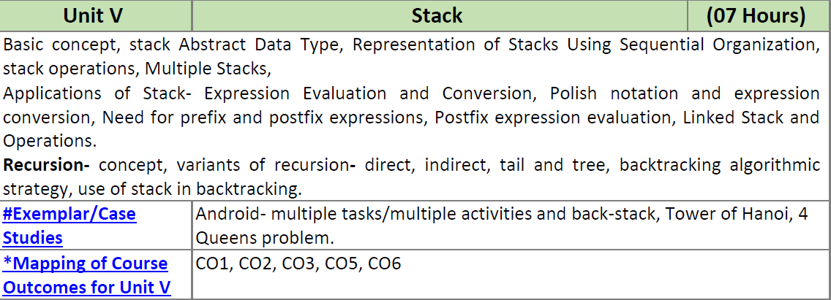
UNIT V Stack

Slide 5


Data
Notes:
<number>

Slide 6
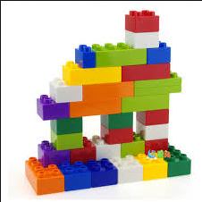
Data Structure
Notes:
<number>

Slide 7
What is Data Structures?
Data structure is a representation of data and the operations allowed on that data.
  A data structure is a way to store and organize data in order to facilitate the access and modifications.
  Data Structures are the method of representing of logical relationships between individual data elements related to the solution of a given problem.
Notes:
<number>

Slide 8
Stack Data Structures
Notes:
<number>

Slide 9
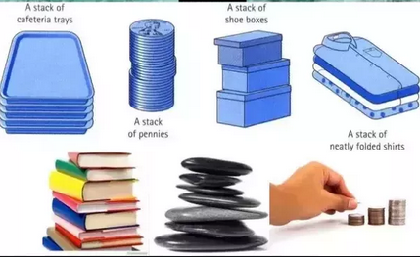


Stack Data Structures
Notes:
<number>

Slide 10
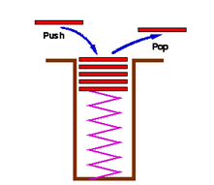
Stack – Basic Concept
Stack is a LIFO (last in first out) structure.
It is an ordered list of the same type of elements.
A stack is a linear list where all insertions and deletions are permitted only at one end of the list.
List of operations -
  Initialize
  Push
  Pop
  IsEmpty
  IsFull

Slide 11
Stack – Basic Concept
Push: Adds an item in the stack. If the stack is full, then it is said to be an Overflow condition.
Pop: Removes an item from the stack. The items are popped in the reversed order in which they are pushed. If the stack is empty, then it is said to be an Underflow condition.
Peek or Top: Returns top element of stack.
isEmpty: Returns true if stack is empty, else false.
isFull: Returns true if stack is full, else false.

Slide 12
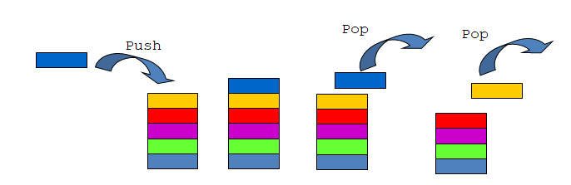
Stack – Basic Concept
Push: Adds an item in the stack.
Pop: Removes an item from the stack.

Slide 13
Stack – Example
Describe the output of the following series of stack operations
  Push(8)
  Push(3)
  Pop()
  Push(2)
  Push(5)
  Pop()
  Pop()
  Push(9)
  Push(1)

Slide 14
Stack – Example
#include<iostream>
#include<ctype.h>
using namespace std;
class stack
{
int top;
char data[20];
public:
stack() {top=-1;}
}

Slide 15
Stack – Example
void push(int x)
{
top++;
data[top]=x;
}
int pop()
{
char x;
x=data[top];
top--;
return x;
}

Slide 16
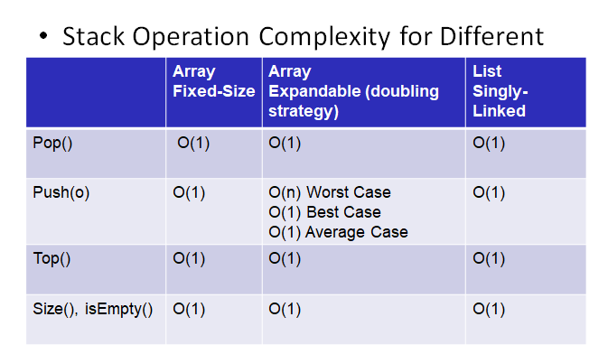
Stack

Slide 17
Applications of Stack
Infix to Postfix /Prefix conversion
Reversing a string
Balancing of symbols
Redo-undo features at many places like editors, photoshop.
Forward and backward feature in web browsers
Used in many algorithms like Tower of Hanoi, tree traversals,
stock span problem, histogram problem.
Other applications can be Backtracking, Knight tour problem, rat
in a maze, N queen problem and sudoku solver
In Graph Algorithms like Topological Sorting and Strongly
Connected Components

Slide 18
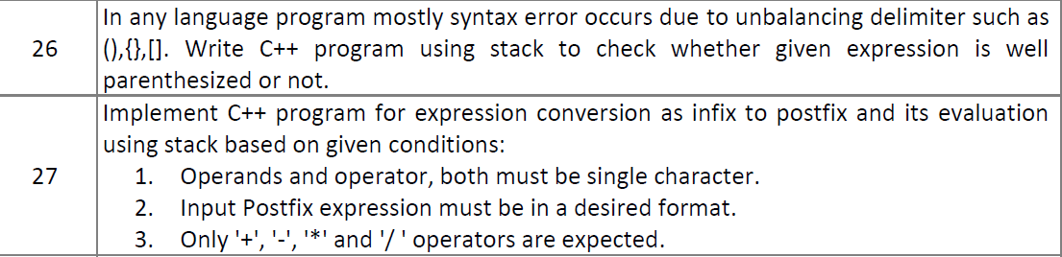
DSL Group - D

Slide 19
Infix to Postfix Conversion
Read Infix expression left to right one character at a time
If input symbol operand then place it in postfix expression
If input Symbol ( - Push onto the stack
If input Symbol operator - Push onto the stack
  Check if Priority of operator in stack is grater than the priority of incoming operator then place it in postfix expression. Repeat step till ….
  Otherwise Push operator onto the stack
  If ) – pop all operator till (
Finally pop all element
Print postfix expression as a result

Slide 20
Infix to Postfix Conversion
Infix Expression - A*B+C
Input | Action | Stack | Output/ Postfix
- | - | Empty | -
A | Print A | - | A
* | Push * | * | A
B | Print B | * | AB
+ | Push + | + | AB*
C | Print C | + | AB*C+

Slide 21
Infix to Postfix Conversion
Infix Expression –
(A+B)*(C-D)
Input | Action | Stack | Output/ Postfix
- | - | Empty | -
- | - | - | -
- | - | - | -
- | - | - | -
- | - | - | -
- | - | - | -
- | - | - | -
- | - | - | -
- | - | - | -

Slide 22
Infix to Postfix Conversion
Infix Expression
(a+b)*d+e(f+a*d)+c
(a+(b*c/d)-e)

Slide 23
Infix to Postfix Conversion
Infix Expression
(a+b)*d+e(f+a*d)+c
ANS - ab+d*e+fad*+c+
(a+(b*c/d)-e)
ANS –abc*d/+e-

Slide 24
Input | Action | Stack | Output/ Postfix
( | Push ( | ( | (
a | Print a | ( | a
+ | Push + | (+ | a
b | Print b | (+ | ab
) | Pop all until ( & print all the content | - | ab+
* | Push * | * | ab+
d | Print d | * | ab+d
+ | Push + & Pop | + | ab+d*
e | Print e | + | ab+d*e
( | Push ( | (+ | ab+d*e
f | Print f | (+ | ab+d*ef
+ | Push + | (++ | ab+d*ef
a | Print a | (++ | ab+d*efa
* | Push * | Push * | Push *
Infix to Postfix
Conversion
Infix Expression
(a+b)*d+e(f+a*d)+c

Slide 25
Infix to Postfix Conversion
Post fix expression is:
ab+d*efad*++c+

Slide 26
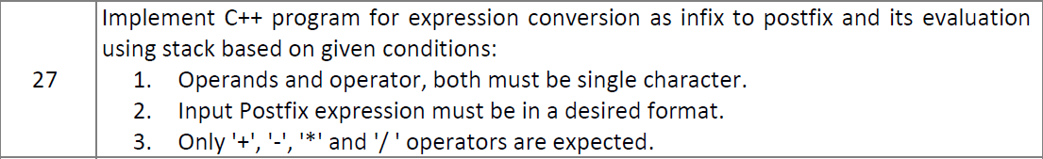
Infix to Postfix Conversion
Group - D

Slide 27
Infix to Postfix Conversion
int main()
{
stack s;
char infix[20],postfix[20];
cout<<"Enter the infix expression";
cin>>infix;
s.conversion(infix,postfix);
cout<<"Post fix expression is: "<<postfix;
return 0;
}

Slide 28
Infix to Postfix Conversion
#include<iostream>
#include<ctype.h>
using namespace std;
class stack
{
int top;
char data[20];
public:
stack()
{
top=-1;
}

Slide 29
Infix to Postfix Conversion
void conversion(char infix[20],char postfix[20])
{
int j=0,i;
char e,token,x;
for(i=0;infix[i]!='\0';i++)
{
token=infix[i];
if(isalnum(token))
{
postfix[j]=token;
j++;
}

Slide 30
Infix to Postfix Conversion
else
{
if(token=='(')
push(token);
else if(token==')')
{
while((x=pop())!='(')
{
postfix[j]=x;
j++;
}
}

Slide 31
Infix to Postfix Conversion
else{
e=topmost();
while(precedence(token)<=precedence(e) && !empty())
{
x=pop();
postfix[j]=x;
j++;
}
push(token);
}} }
while(!empty())
{
x=pop();
postfix[j]=x;
j++;
}
postfix[j]='\0';}

Slide 32
Infix to Postfix Conversion
void push(int x)
{
top++;
data[top]=x;
}
int pop()
{ char x;
x=data[top];
top--;
return x;
}
char topmost()
{
char e;
e=data[top];
return e;
}

Slide 33
Infix to Postfix Conversion
int precedence(char x)
{
if(x=='(')
return 0;
if(x=='+'|| x=='-')
return 1;
if(x=='*'|| x=='/' ||x=='%')
return 2;
else
return 3;
}
int empty()
{
if(top==-1)
return 1;
else
return 0;
}
};

Slide 34
UNIT V Stack

Slide 35

Infix to Postfix Conversion

Slide 36
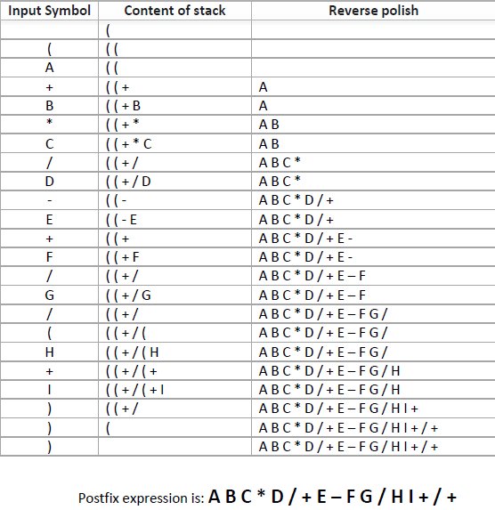
Infix to Postfix Conversion

Slide 37
Infix to Postfix Conversion

Slide 38
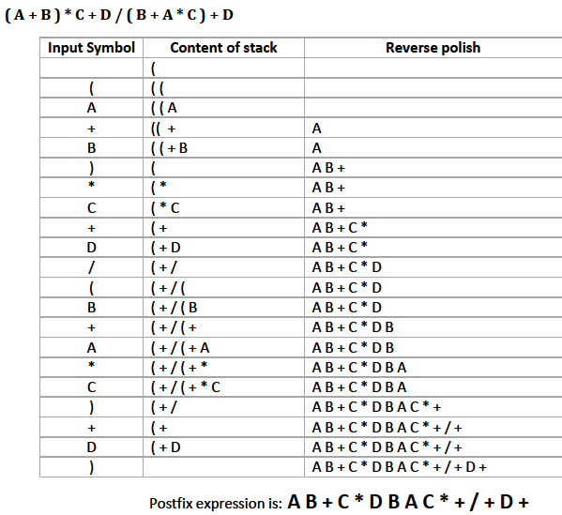
Infix to Postfix Conversion

Slide 39
Fully Parenthesized Expression
A FPE has exactly one set of Parentheses enclosing each operator and its operands.
Which is fully parenthesized?
( A + B ) * C
( ( A + B) * C )
( ( A + B) * ( C ) )
Notes:
<number>

Slide 40
Infix to Prefix Conversion
Move each operator to the left of its operands & remove the parentheses:
( ( A + B) * ( C + D ) )
Notes:
<number>
Start with Fully parenthesized expression. Move each operator to the left of its operands and remove the set of parentheses.

Slide 41
Infix to Prefix Conversion
Move each operator to the left of its operands & remove the parentheses:
( + A B * ( C + D ) )
Notes:
<number>
Start with Fully parenthesized expression. Move each operator to the left of its operands and remove the set of parentheses.

Slide 42
Infix to Prefix Conversion
Move each operator to the left of its operands & remove the parentheses:
* + A B ( C + D )
Notes:
<number>
Start with Fully parenthesized expression. Move each operator to the left of its operands and remove the set of parentheses.

Slide 43
Infix to Prefix Conversion
Move each operator to the left of its operands & remove the parentheses:
* + A B + C D
Order of operands does not change!
Notes:
<number>
Start with Fully parenthesized expression. Move each operator to the left of its operands and remove the set of parentheses.

Slide 44
Infix to Postfix
( ( ( A + B ) * C ) - ( ( D + E ) / F ) )
A B + C * D E + F / -
Operand order does not change!
Operators are in order of evaluation!
Notes:
<number>

Slide 45
Computer Algorithm
FPE Infix To Postfix
Assumptions:
Space delimited list of tokens represents a FPE infix expression
Operands are single characters.
Operators +,-,*,/
Notes:
<number>

Slide 46
FPE Infix To Postfix
Initialize a Stack for operators, output list
Split the input into a list of tokens.
for each token (left to right):
if it is operand: append to output
if it is '(': push onto Stack
if it is ')': pop & append till '('
Notes:
<number>

Slide 47
FPE Infix to Postfix
( ( ( A + B ) * ( C - E ) ) / ( F + G ) )
stack: <empty>
output: []
Notes:
<number>

Slide 48
FPE Infix to Postfix
( ( A + B ) * ( C - E ) ) / ( F + G ) )
stack: (
output: []
Notes:
<number>

Slide 49
FPE Infix to Postfix
( A + B ) * ( C - E ) ) / ( F + G ) )
stack: ( (
output: []
Notes:
<number>

Slide 50
FPE Infix to Postfix
A + B ) * ( C - E ) ) / ( F + G ) )
stack: ( ( (
output: []
Notes:
<number>

Slide 51
FPE Infix to Postfix
+ B ) * ( C - E ) ) / ( F + G ) )
stack: ( ( (
output: [A]
Notes:
<number>

Slide 52
FPE Infix to Postfix
B ) * ( C - E ) ) / ( F + G ) )
stack: ( ( ( +
output: [A]
Notes:
<number>

Slide 53
FPE Infix to Postfix
) * ( C - E ) ) / ( F + G ) )
stack: ( ( ( +
output: [A B]
Notes:
<number>

Slide 54
FPE Infix to Postfix
* ( C - E ) ) / ( F + G ) )
stack: ( (
output: [A B + ]
Notes:
<number>

Slide 55
FPE Infix to Postfix
( C - E ) ) / ( F + G ) )
stack: ( ( *
output: [A B + ]
Notes:
<number>

Slide 56
FPE Infix to Postfix
C - E ) ) / ( F + G ) )
stack: ( ( * (
output: [A B + ]
Notes:
<number>

Slide 57
FPE Infix to Postfix
- E ) ) / ( F + G ) )
stack: ( ( * (
output: [A B + C ]
Notes:
<number>

Slide 58
FPE Infix to Postfix
E ) ) / ( F + G ) )
stack: ( ( * ( -
output: [A B + C ]
Notes:
<number>

Slide 59
FPE Infix to Postfix
) ) / ( F + G ) )
stack: ( ( * ( -
output: [A B + C E ]
Notes:
<number>

Slide 60
FPE Infix to Postfix
) / ( F + G ) )
stack: ( ( *
output: [A B + C E - ]
Notes:
<number>

Slide 61
FPE Infix to Postfix
/ ( F + G ) )
stack: (
output: [A B + C E - * ]
Notes:
<number>

Slide 62
FPE Infix to Postfix
( F + G ) )
stack: ( /
output: [A B + C E - * ]
Notes:
<number>

Slide 63
FPE Infix to Postfix
F + G ) )
stack: ( / (
output: [A B + C E - * ]
Notes:
<number>

Slide 64
FPE Infix to Postfix
+ G ) )
stack: ( / (
output: [A B + C E - * F ]
Notes:
<number>

Slide 65
FPE Infix to Postfix
G ) )
stack: ( / ( +
output: [A B + C E - * F ]
Notes:
<number>

Slide 66
FPE Infix to Postfix
) )
stack: ( / ( +
output: [A B + C E - * F G ]
Notes:
<number>

Slide 67
FPE Infix to Postfix
)
stack: ( /
output: [A B + C E - * F G + ]
Notes:
<number>

Slide 68
FPE Infix to Postfix
stack: <empty>
output: [A B + C E - * F G + / ]
Notes:
<number>

Slide 69
Infix to Postfix
Initialize a Stack for operators, output list
Split the input into a list of tokens.
for each token (left to right):
if it is operand: append to output
if it is '(': push onto Stack
if it is ')': pop & append till '('
if it in '+-*/':
while peek has precedence ≥ it:
pop & append
push onto Stack
pop and append the rest of the Stack.
Notes:
<number>

Slide 70
Conversion
Infix to Postfix Conversion
Postfix to Infix Conversion
Postfix to Prefix Conversion
Infix to Prefix Conversion
Prefix to Infix Conversion
Prefix to Postfix Conversion

Slide 71
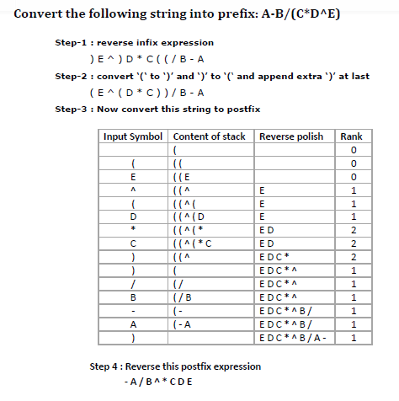
Infix to Prefix

Slide 72
Infix to Prefix

Slide 73
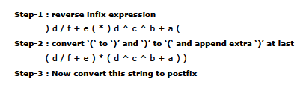
Infix to Prefix

Slide 74
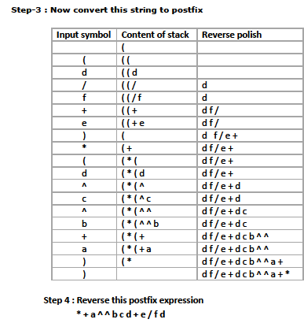
Infix to Prefix

Slide 75
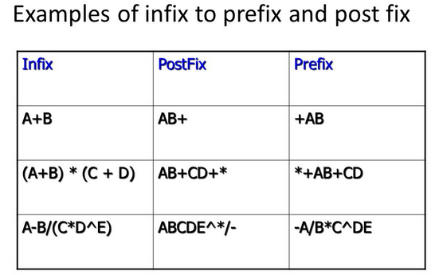
Infix to Prefix and postfix

Slide 76
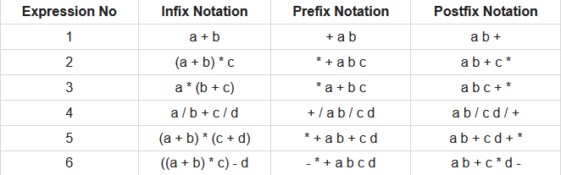
Infix to Prefix and postfix

Slide 77
Postfix to Infix
pqr-+st-xy-z+/*

Slide 78
Postfix to Prefix
pqr-+st-xy-z+/*

Slide 79
Prefix to Infix
*+p-qr/-st+-uvw

Slide 80
Prefix to Infix
*+p-qr/-st+-uvw
(p+q-r)*(s-t)/(u-v+w)

Slide 81
Prefix to Postfix
*+a-bc/-de+-fgh

Slide 82
Prefix to Postfix
*+a-bc/-de+-fgh
abc-+de-fg-h+/*

Slide 83
UNIT V Stack

Slide 84
Applications of Stack
Infix to Postfix /Prefix conversion
Reversing a string
Balancing of symbols
Redo-undo features at many places like editors, photoshop.
Forward and backward feature in web browsers
Used in many algorithms like Tower of Hanoi, tree traversals,
stock span problem, histogram problem.
Other applications can be Backtracking, Knight tour problem, rat
in a maze, N queen problem and sudoku solver
In Graph Algorithms like Topological Sorting and Strongly
Connected Components

Slide 85
DSL Group - D

Slide 86
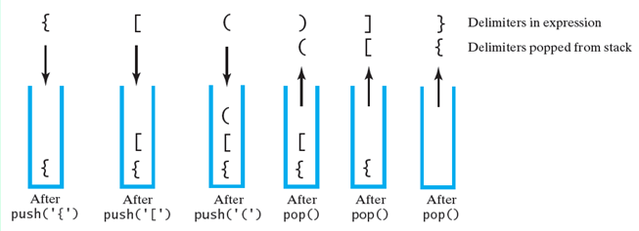
Balancing of symbols
The contents of a stack during the scan of an expression that contains the balanced delimiters { [ ( ) ] }

Slide 87
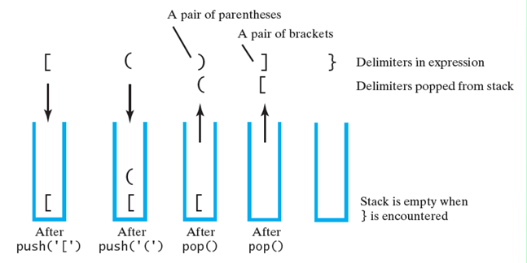
Balancing of symbols
The contents of a stack during the scan of an expression that contains the unbalanced delimiters [ ( ) ] }

Slide 88
DSL Group - D

Slide 89
Need for Prefix and Postfix Expressions
Operators are no longer ambiguous with respect to the operand
Order of operations within prefix and postfix expressions is completely determined by only the position of the operator
During compilation of expression, infix expression is converted to postfix form first and then it is evaluated

Slide 90
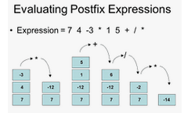
Postfix Expression Evaluations

Slide 91
Postfix Expression Evaluations
AB+C-BA+C$-
  For A=1, B=2, C=3

Slide 92
Postfix Expression Evaluations
ABC+*CBA-+*
  For A=1, B=2, C=3

Slide 93
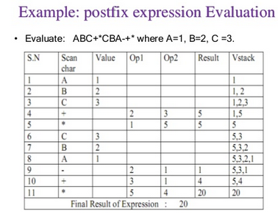
Postfix Expression Evaluations

Slide 94
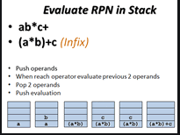
Postfix Expression Evaluations

Slide 95
UNIT V Stack

Slide 96
Linked Stack and Operations
Stack by using Linked List
Size of stack
Node structure for linked stack
Struct node
{
Int data
Struct node *next
}node;

Slide 97
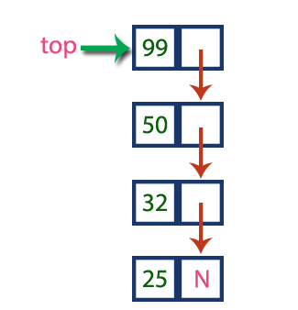
Linked Stack and Operations
Struct node
{
Int data
Struct node *next
}node;

Slide 98
Linked Stack and Operations
Write C++ Program for implementation of Stack using Linked List

Slide 99
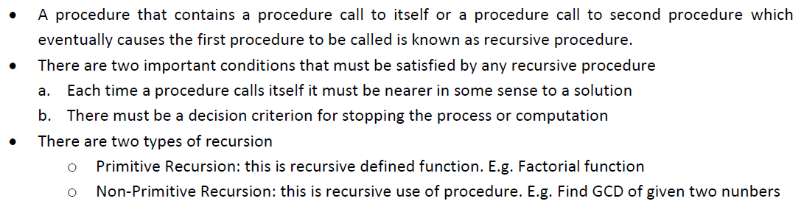
Recursion

