Slide 1
UNIT VI QUEUE

Slide 2
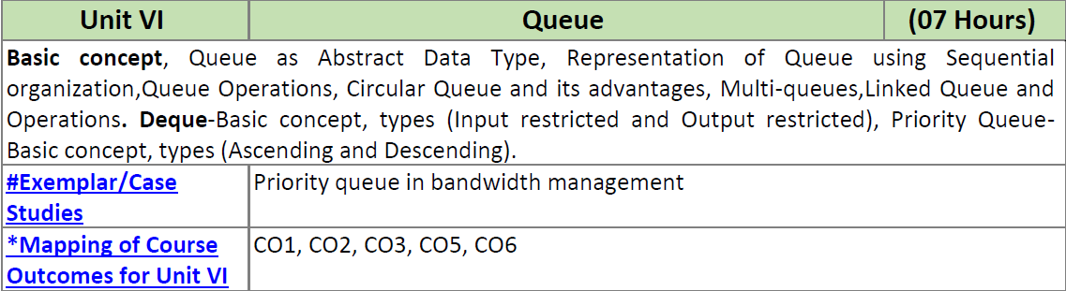
UNIT VI QUEUE

Slide 3
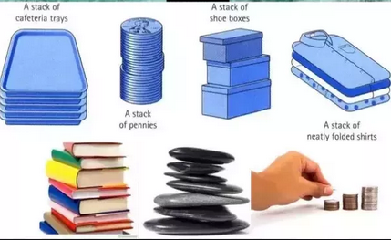
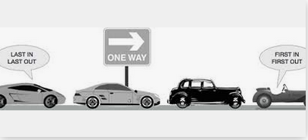
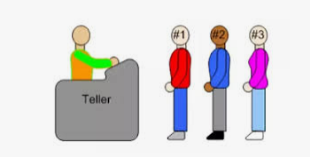
Queue Data Structures
Notes:
<number>

Slide 4
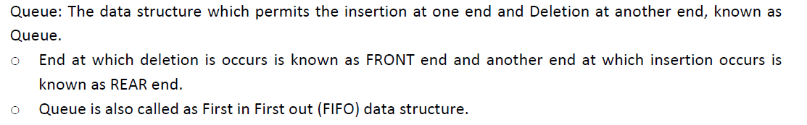
QUEUE – Basic Concept
FIFO
Insertion - Front
Deletion - Rear

Slide 5
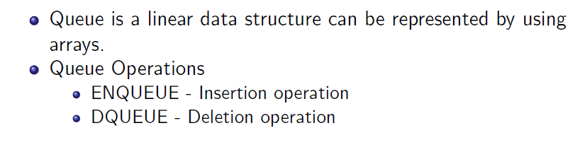
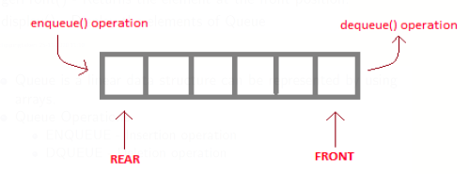
QUEUE – Basic Concept

Slide 6
Queue (Linear Queue)
It is a linear data structure consisting of list of items.
In queue, data elements are added at one end, called the rear and removed from another end, called the front of the list.
Two basic operations are associated with queue:
1. “Insert” operation is used to insert an element into a queue.
2. “Delete” operation is used to delete an element from a queue.
FIFO list
Example:
Queue: AAA, BBB, CCC, DDD, EEE
7
6
EEE
5
1
2
3
4
5
6
7
DDD
4
AAA
BBB
CCC
DDD
EEE
CCC
3
BBB
2
Front
Rear
AAA
1
Rear
Front
09/10/08
<number>

Slide 7
Algorithms for Insert and Delete Operations in Linear Queue
For Insert Operation
Insert-Queue(Queue, Rear, Front, N, Item)
Here, Queue is the place where to store data. Rear represents the location in which the data element is to be inserted and Front represents the location from which the data element is to be removed. Here N is the maximum size of the Queue and finally, Item is the new item to be added.
1. If Rear = N then Print: Overflow and Return. /*…Queue already filled..*/
2. Set Rear := Rear +1
3. Set Queue[Rear] := Item
4. Return.
09/10/08
<number>

Slide 8
For Delete Operation
Delete-Queue(Queue, Front, Rear, Item)
Here, Queue is the place where data are stored. Rear represents the location in which the data element is to be inserted and Front represents the location from which the data element is to be removed. Front element is assigned to Item.
1. If Front = N+1 then Print: Underflow and Return. /*…Queue Empty
2. Set Item := Queue[Front]
3. Set Front := Front + 1
4. Return.
09/10/08
<number>

Slide 9
Example: Consider the following queue (linear queue).
Rear = 4 and Front = 1 and N = 7
10
50
30
40
1
2
3
4
5
6
7
(1) Insert 20. Now Rear = 5 and Front = 1
(2) Delete Front Element. Now Rear = 5 and Front = 2
(3) Delete Front Element. Now Rear = 5 and Front = 3
(4) Insert 60. Now Rear = 6 and Front = 3
09/10/08
<number>

Slide 10
Example: Consider the following queue (linear queue).
Rear = 4 and Front = 1 and N = 7
10
50
30
40
1
2
3
4
5
6
7
(1) Insert 20. Now Rear = 5 and Front = 1
10
50
30
40
20
1
2
3
4
5
6
7
(2) Delete Front Element. Now Rear = 5 and Front = 2
50
30
40
20
1
2
3
4
5
6
7
(3) Delete Front Element. Now Rear = 5 and Front = 3
30
40
20
1
2
3
4
5
6
7
(4) Insert 60. Now Rear = 6 and Front = 3
30
40
20
60
1
2
3
4
5
6
7
09/10/08
<number>

Slide 11
#include<iostream> using namespace std; class queue { int data[20]; int f,r; public: queue() { f=-1; r=-1; } | int isempty() { if(f==-1) return 1; else return 0; } int isfull() { if(r>=20) return 1; else return 0; }

Slide 12
void enqueue(int x) { if(isfull()) { cout<<"job queue is full"; } else { if(f==-1) f++; r++; data[r]=x; } } | void dequeue() { int x; if(isempty()) cout<<"job queue is empty"; else { x=data[f]; f++; cout<<x<<" Job deleted !\n"; } }

Slide 13
void disp() { cout<<"job queue is as :"; for(int i=f;i<=r;i++) { cout<<data[i]<<" "; } } };

Slide 14
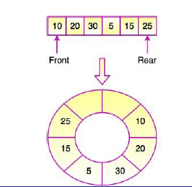
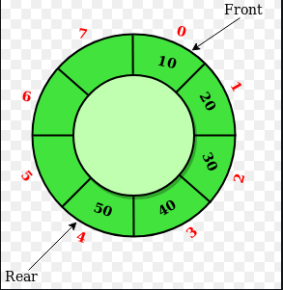
CIRCULAR QUEUE
Linear data structure in which the operations are performed based on FIFO
The last position is connected back to the first position to make a circle.
It is also called 'Ring Buffer'.

Slide 15

Why CIRCULAR QUEUE
Drawback of Linear Queue
Once the queue is full, even though few elements from the front are deleted and some occupied space is relieved, it is not possible to add anymore new elements, as the rear has already reached the Queue’s rear most position.

Slide 16
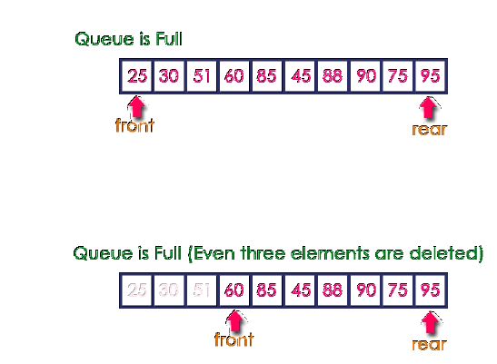
Why CIRCULAR QUEUE
Drawback of Linear Queue

Slide 17
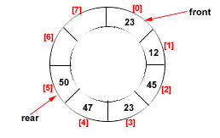
CIRCULAR QUEUE
Circular Queue
Its structure can be like the following figure:
In circular queue, once the Queue is full the
"First" element of the Queue becomes the
"Rear" most element, if and only if the "Front" has moved forward. otherwise it will again be a "Queue overflow" state.
Figure: Circular Queue having
Rear = 5 and Front = 0

Slide 18
Algorithms for Insert and Delete Operations in Circular Queue
For Insert Operation
Insert-Circular-Q(CQueue, Rear, Front, N, Item)
Here, CQueue is a circular queue where to store data. Rear represents the location in which the data element is to be inserted and Front represents the location from which the data element is to be removed. Here N is the maximum size of CQueue and finally, Item is the new item to be added. Initailly Rear = 0 and Front = 0.
1. If Front = 0 and Rear = 0 then Set Front := 1 and go to step 4.
2. If Front =1 and Rear = N or Front = Rear + 1
then Print: “Circular Queue Overflow” and Return.
3. If Rear = N then Set Rear := 1 and go to step 5.
4. Set Rear := Rear + 1
5. Set CQueue [Rear] := Item.
6. Return

Slide 19
For Delete Operation
Delete-Circular-Q(CQueue, Front, Rear, Item)
Here, CQueue is the place where data are stored. Rear represents the location in which the data element is to be inserted and Front represents the location from which the data element is to be removed. Front element is assigned to Item. Initially, Front = 1.
1. If Front = 0 then
Print: “Circular Queue Underflow” and Return. /*..Delete without Insertion
2. Set Item := CQueue [Front]
3. If Front = N then Set Front = 1 and Return.
4. If Front = Rear then Set Front = 0 and Rear = 0 and Return.
5. Set Front := Front + 1
6. Return.

Slide 20
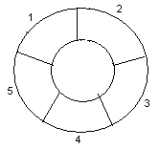
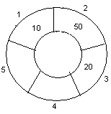
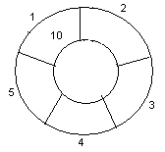
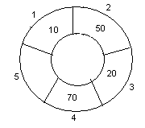
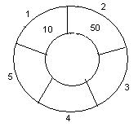
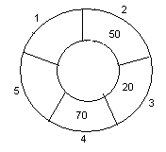
Example: Consider the following circular queue with N = 5.
1. Initially, Rear = 0, Front =0.
4. Insert 20, Rear = 3, Front = 0.
Front
Rear
2. Insert 10, Rear = 1, Front = 1.
5. Insert 70, Rear = 4, Front = 1.
Rear
Front
Front
Rear
3. Insert 50, Rear = 2, Front = 1.
6. Delete front, Rear = 4, Front = 2.
Front
Rear
Front
Rear
For 1 Rear = Rear % MAX
For 0 Rear = Rear+1 % MAX

Slide 21
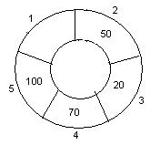
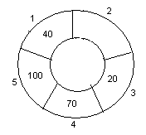
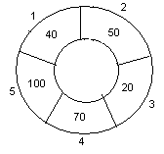
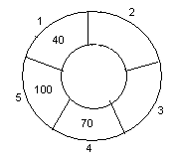
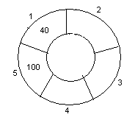
7. Insert 100, Rear = 5, Front = 2.
10. Delete front, Rear = 1, Front = 3.
Front
Rear
Front
Rear
8. Insert 40, Rear = 1, Front = 2.
11. Delete front, Rear = 1, Front = 4.
Rear
Rear
Front
Front
9. Insert 140, Rear = 1, Front = 2.
As Front = Rear + 1, so Queue overflow.
12. Delete front, Rear = 1, Front = 5.
Rear
Rear
Front
Front

Slide 22
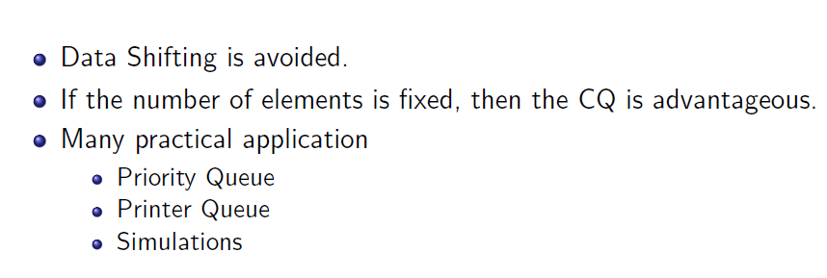
CIRCULAR QUEUE AND ITS ADVANTAGES

Slide 23
DSL – E 32 CIRCULAR QUEUE

Slide 24
DSL – E 32 CIRCULAR QUEUE
#include<iostream> #define max 20 using namespace std; class queue { int r,f; int data[max]; public: queue() { f=-1; r=-1; } | int isempty() { if(f==-1 && r==-1) return 1; else return 0; } int isfull() { if(((r+1)%max)==f) return 1; else return 0; }

Slide 25
DSL – E 32 CIRCULAR QUEUE
void enqueue(int x,int maximum) {int i; if(isempty()) { r=f=0; data[r]=x; } else if(isfull()) { cout<<"The queue is full"; } | else { r=(r+1)%max; data[r]=x; } } void display() { int i; cout<<"Placed orders are:"; for (i=f;i<=r;i++) cout<<data[i]<<endl; }};

Slide 26
DSL – E 32 CIRCULAR QUEUE
int main() { queue q; int maximum,d,x; cout<<"Enter maximum no. of orders that can be placed"; cin>>maximum; cout<<"Place the order"; | for(int i=0;i<maximum;i++) { cin>>d; q.enqueue(d,maximum); } q.display(); return 0; }

Slide 27
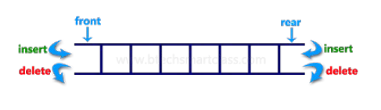
DEQUE
A deque (double ended queue ) is a linear list in which insertion and deletion are performed from the either end of the structure.

Slide 28
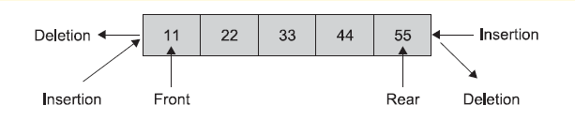
DEQUE

Slide 29
DEQUE
A deque (double ended queue ) is a linear list in which insertion and deletion are performed from the either end of the structure.

Slide 30
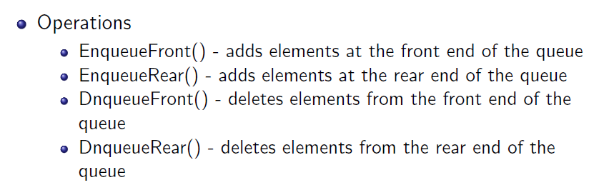
DEQUE as ADT

Slide 31
Types of DEQUE
Input restricted deque
- allows insertion at only one end (In input-restricted, deletion can be done from both the ends but insertion can be done only at the rear end of the queue.)
Output restricted deque
- allows deletion from only one end (n the output-restricted queue, insertion can be done from both the ends but deletion is done only at one end i.e. the front end of the queue.)

Slide 32
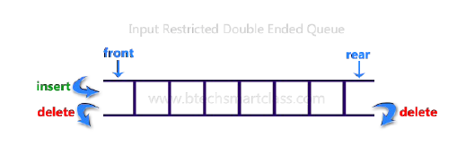
Types of DEQUE
Input restricted dqueue
- allows insertion at only one end

Slide 33
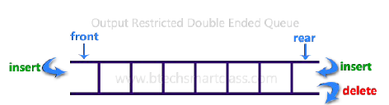
Types of DEQUE
Output restricted deque
- allows deletion from only one end

Slide 34
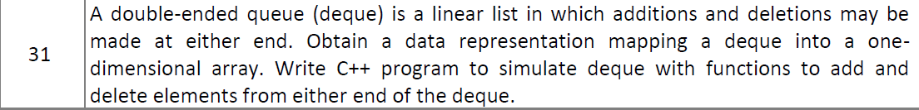
Group E

Slide 35
UNIT VI QUEUE

Slide 36
PRIORITY QUEUES

Slide 37
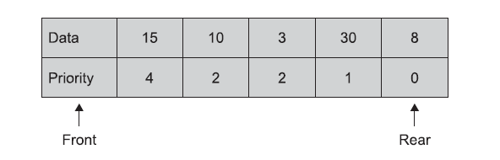
PRIORITY QUEUES

Slide 38
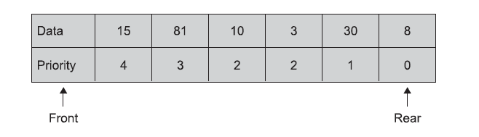
PRIORITY QUEUES

Slide 39
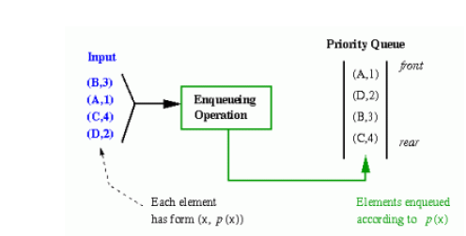
PRIORITY QUEUES
fig. represent a priority queue of jobs waiting to use a computer.

Slide 40
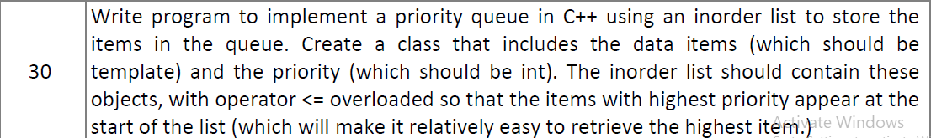
Group E

Slide 41
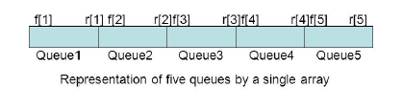
MULTIQUEUES
If more number of queue is required to be implemented then Multi-queues data structure is used.
Large space will be wasted due to less size of queue
There exists a trade off between the number of overflows and the space.
To reduce this trade-off, we can represent more than one queue in the same array of sufficient size.
It is possible to utilize all the available space in a single array.

Slide 42
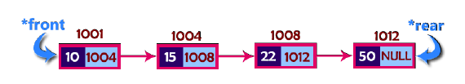
LINKED QUEUES
Queue using an array is not suitable when we don't know the size of data
The queue which is implemented using a linked list can work for an unlimited number of values.
In linked list implementation of a queue, the last inserted node is always pointed by 'rear' and the first node is always pointed by 'front'.
Operations

