Slide 1


ONE DAY ONLINE SYLLABUS IMPLEMENTATION FACULTY DEVELOPMENT PROGRAM
ON
Data Structures and Algorithms
UNIT 1
HASHING
Mrs. Shalaka P. Deore
M.E.S. College of Engineering, Pune.

Slide 2
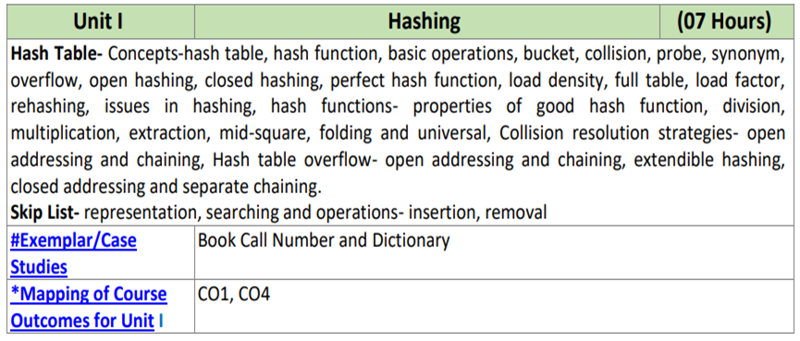
Unit 1 Hashing: Syllabus

Slide 3
Unit 1 Hashing: objective and outcome
OBJECTIVE:
To understand advanced data structures like Hash tables, Skip list to solve complex problems in various domains.
To study various hash functions.
To understand various collision resolution techniques.
OUTCOME:
Identify and articulate the complexity goals and benefits of a good hashing scheme for real-world applications.
Analyze the algorithmic solutions for resource requirements and optimization

Slide 4
Need of hashing
Suppose we want to design a system for storing students records and we want to perform following operations efficiently:
Insert, Search and Delete operations on the basis of student Id.
class Studentinfo
{
long Id; // Unique Student Id
String name; // Student name
String class; // Student class
}
Possible data structure options and their respective time complexity
A array implementation would take O(log n)time if binary search is used.
A linked list implementation would take O(n) time.
Is there an alternative to get O(1) access time ?
Notes:
<number>

Slide 5
Hashing
Hashing is the process of indexing and retrieving element in a data structure to provide faster way of finding the element using the hash key.
(With hashing we get O(1) search time on average (under reasonable assumptions) and O(n) in worst case.)
Duration : 1 Hour
Reference :
“Fundamentals of Data Structures in C++” by Horowitz, Sahani, Dinesh Mehata
https://www.geeksforgeeks.org/hashing-data-structure/#basicHashing

Slide 6
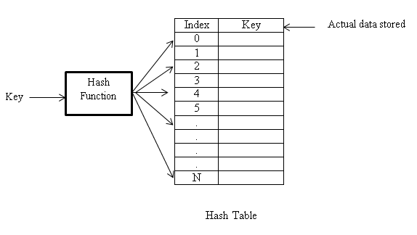
Basic concepts : hash table
Hash table is a data structure used for storing and retrieving data quickly.
All data is inserted into hash table based on hash key value. It is used to map the data with the index in the hash table.
Notes:
<number>

Slide 7
Other basic concepts of hashing
Buckets: A bucket in a hash file is unit of storage (typically a disk block) that can hold one or more records.The hash table consists of b buckets and each bucket consists of s slots. (Usually s = 1)
Collision: Collision is situation in which hash function returns the same address for more than one record.
Probe: Alternative list of location produces after collision occurs.
Synonym: The set of keys that hash to the same location are called as synonyms.

Slide 8
Other basic concepts of hashing
Overflow: When hash table becomes full and new record needs to be inserted then it is called overflow. An overflow occurs when we hash a new identifier into a full bucket
Perfect hash function: It is a function that maps distinct key elements into hash table with no collision
Load factor or Load density of hash table:
lo = n/m
n = no. of elements stored in the table
m = size of the table

Slide 9
Hash Functions
A good hash function should:
· Minimize collisions.
· Be easy and quick to compute.
· Distribute key values evenly in the hash table.
· Use all the information provided in the key.
Duration : 1 Hour
Reference :
“Fundamentals of Data Structures in C++” by Horowitz, Sahani, Dinesh Mehat
https://www.tutorialspoint.com/Hash-Functions-and-Hash-Tables
Notes:
<number>

Slide 10
Division Method
Idea:
  Computes hash value from key using the % operator.
  Map a key k into one of the m slots by taking the remainder of k divided by m
h(k) = k mod m
Example: k=1276, n=10,
h(1276) = 1276 mod 10 = 6
Advantage: fast, requires only one operation
Disadvantage:
  Certain values of m are not good choice, e.g.,
    power of 2 : Table size that is a power of 2 like 32 and 1024 should be avoided, for it leads to more collisions.
    non-prime numbers : Generally a prime number is a best choice which will spread keys evenly. Prime numbers not close to powers of 2 are better table size values.
Notes:
<number>

Slide 11
Multiplication Method
Idea:
Multiply key k by a constant A, where 0 < A < 1
Extract the fractional part of kA and multiply the fractional part by m
Take the floor of the result
h(k) = ⎣m (k A mod 1)⎦
Example: k=123, m=100, A=0.618033
h(123) = 100 (123 * 0.618033 mod 1)
= 100 (76.018059 mod 1)
= 100 (0.018059) = 1
Advantage: Value of m is not critical and it can work with any value of A
Disadvantage: Slower than division method
fractional part of kA = kA - ⎣kA⎦

Slide 12
Digit Extraction method
Idea
Selected digits are extracted form the key and used as address
Address = selected digits from key
Example: If six digit employee number is 379245 then select first digit as the index so 379 is the key address.
Disadvantages:
· May not evenly distribute key values in the hash
table

Slide 13
Folding
Idea
It involves splitting keys into two or more parts and then combining the parts to form the hash addresses.
To map the key 25936715 to a range between 0 and 9999, we can:
· split the number into two as 2593 and 6715 and
· add these two to obtain 9308 as the hash value.
Very useful if we have keys that are very large.
Advantage:
· Fast and simple especially with bit patterns
· It is ability to transform non-integer keys into integer values.

Slide 14
Mid-square method
Idea
The key is squared and the middle part of the result taken as the hash value.
To map the key 3121 into a hash table of size 1000, we square it 3121² = 9740641 and extract 406 as the hash value.
Advantage : Works well if the keys do not contain a lot of leading or trailing zeros.
Disadvantage:
· Selection of middle part
· Non-integer keys have to be pre-processed to obtain corresponding integer values.

Slide 15
Universal hashing
Idea
For any hash function if the table size m is much smaller than universe size U, then for any hash function h, there is some large subset of U that has the same hash value.
So we need set of hash functions and select hash function random.
0
U
(universe of keys)
h(k₁)
h(k₄)
k₁
K
(actual
keys)
k₄
k₂
h(k₂) = h(k₅)
k₅
k₃
h(k₃)
m - 1
<number>

Slide 16
Collision handling techniques
Separate chaining
Open addressing
-Linear Probing
-Quadratic Probing
-Double Probing
Duration : 3 Hour
Reference :
“Fundamentals of Data Structures in C++” by Horowitz, Sahani, Dinesh Mehata
https://courses.cs.washington.edu/courses/cse326/00wi/handouts/lecture16/sld025.htm

Slide 17
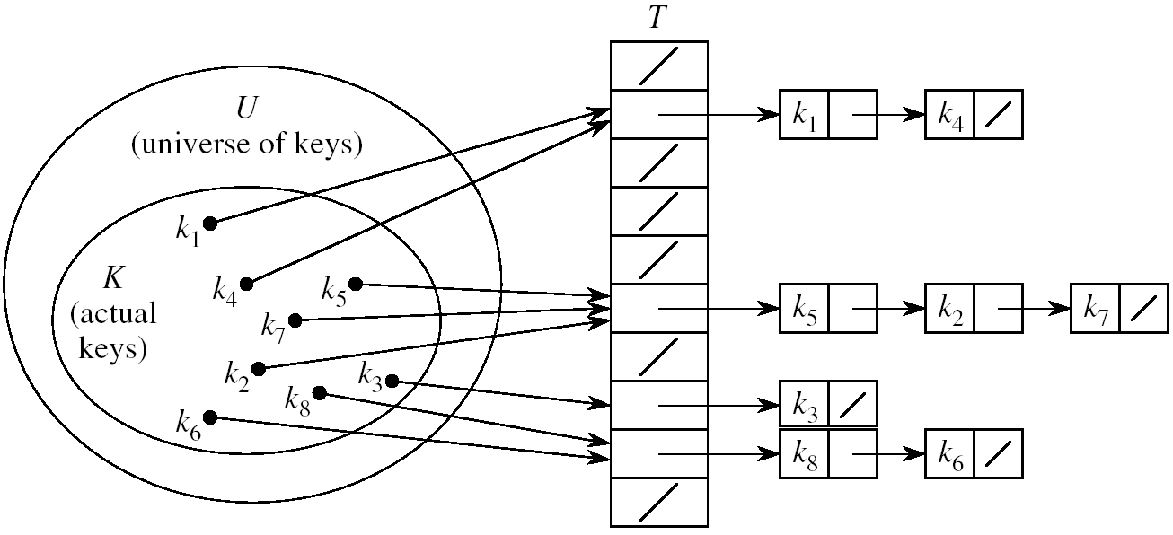
Separate chaining
Maintain array of linked list
Separate list is maintained for all elements mapped to the same value

Slide 18
Separate chaining: pros and cons
PROS:
Collision resolution is simple
No problem of load factor can hold more number of elements
Table size need not be prime number
CONS:
Implementation of separate data structure (linked list) required for chains
The main cost of chaining is the extra space required for linked list

Slide 19
Open addressing : Linear probing
Table remains a simple array of size m
On insert(x),
First compute h(x)= x mod m,
if the collision occur,
find another location by sequentially searching for the next available slot
Go to h(x)+1, h(x)+2 etc..

Slide 20
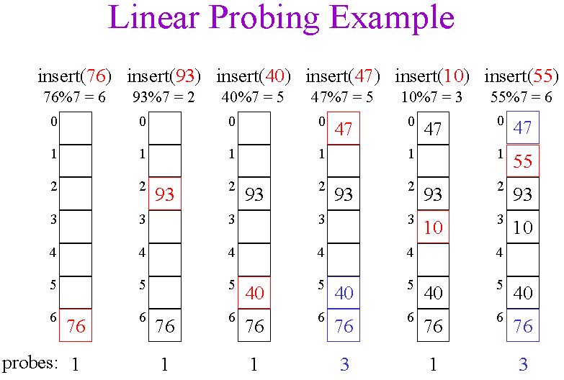
Insert following keys into hash table using linear probing where table size m=7 and h(x)= x mod m, keys={ 76,93,40,47,10,55}

Slide 21



Types of linear probing
Linear probing with chaining (without replacement)
Excessive collision when occurs it becomes very difficult to maintain indexes of same hash key
Extra field is added to maintain chain Key Chain
Example: Let M = 10 , H(X)= X MOD M, 0
KEYS={0,1,4,71,64,89,11,33} 1
2
3
4
5
6
7
8
9
0 | -1
1 | 2
71 | 3
11 | -1
4 | 5
64 | -1
33 | -1
 | -1
 | -1
89 | -1

Slide 22

Types of linear probing
Linear probing with chaining (with replacement)
Problem of misplaced starting location of the chain is handled.
Extra field is added to maintain chain Key Chain
Example: Let M = 10 , H(X)= X MOD M, 0
KEYS={0,1,4,71,64,89,11,33} 1
if add 22 : 1->11->71 2
3
4
5
6
7
8
9
0 | -1 | 0 | -1
1 | 2 | 1 | 3
71 | 3 | 22 | -1
11 | -1 | 11 | 7
4 | 5 | 4 | 5
64 | -1 | 64 | -1
33 | -1 | 33 | -1
 | -1 | 71 | -1
 | -1
89 | -1

Slide 23
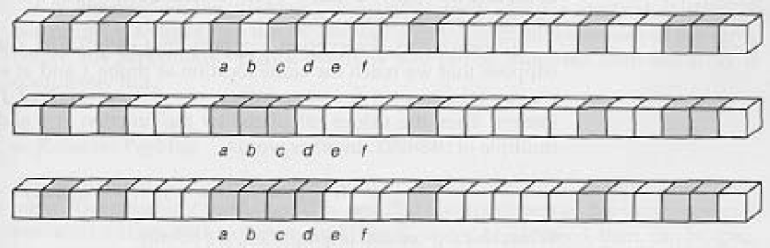

Primary clustering problem
Long chunks of occupied slots are created
Increases search time

Slide 24
Quadratic hashing
It is one of the ways to reduce “Primary clustering problem”
Resolve collisions by examining certain cells away from the original probe point
Collision policy:
- Start from original hash location i
- If collision occur search for i+1², i+2², i+3²…..
Hash function :
h_{i}(x) = (h(x) + i ²) mod m
where i = 0,1,2,3…….

Slide 25
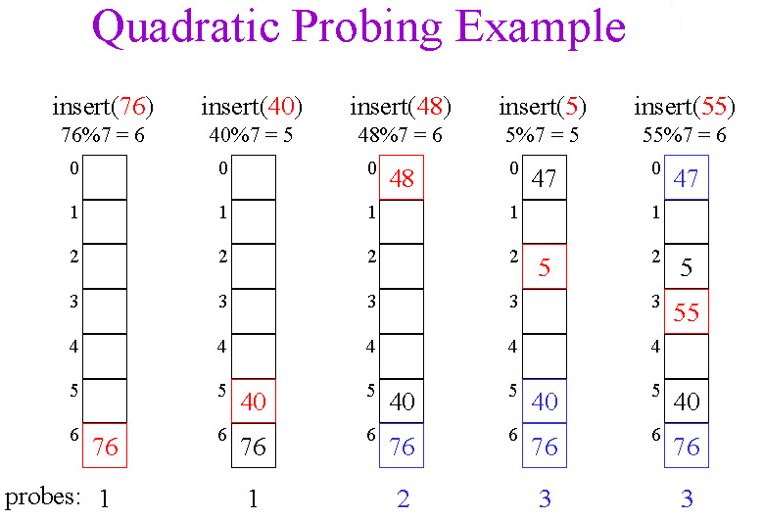
Insert following keys into hash table using quadratic probing where table size m=7 and h(x)= x mod m, keys={ 76,40,48,5,55}

Slide 26
Double hashing
It reduces clustering in a better way
Use primary hash function h₁ (k) to determine the first slot
Use a second hash function h₂ (k) to determine the increment for the probe sequence
h(k,i) = (h₁(k) + i h₂(k) ) mod m, i=0,1,...
Initial probe: h₁(k)
Second probe is offset by h₂(k) mod m, so on ...
Advantage: avoids clustering

Slide 27
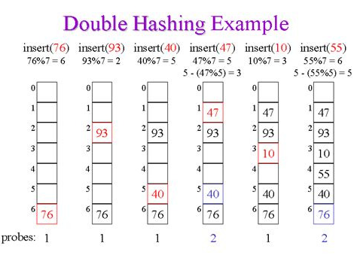
Insert following keys into hash table using quadratic probing where table size m=7 and h1(x)= x mod m, H2(x)= 5- (x mod 5),keys={76,40,48,5,55}

Slide 28
Open addressing: pros and cons
PROS:
All data items are stored in the hash table itself no need of separate data structure
More efficient storage-wise
CONS:
Dependent on choosing a proper table size
The keys of the objects to be hashed must be distinct

Slide 29
Hash table overflow
An overflow occurs when the home bucket for a new pair (key, element) is full.
We may tackle overflows by searching the hash table in some systematic manner for a bucket that is not full.
Linear probing (linear open addressing).
Quadratic probing.
Random probing.
Eliminate overflows by allowing each bucket to keep a list of all pairs for which it is home bucket.
Array linear list.
Chain.
Open addressing is performed to ensure that all elements are stored directly into the hash table

Slide 30
Extendible hashing
Dynamic hashing method
Bulky data : Disk accesses increased
Extendible hashing reduces disk accesses while retrieving the data
It handle large amount of data
It required to convert data into binary format
Directories: The directories store addresses of the buckets in pointers. An id is assigned to each directory which may change each time when Directory Expansion takes place.
Buckets: The buckets are used to hash the actual data.
Duration : 1 Hour
Reference:
https://www.geeksforgeeks.org/extendible-hashing-dynamic-approach-to-dbms/

Slide 31
Extendible hashing
Global depth: It is associated with the directories. They denote the number of bits which are used by the hash function to categorize the keys.
Global depth = Number of bits in directory id.
Local depth: Local depth is associated with the buckets. Local depth in accordance with the global depth is used to decide the action that to be performed in case an overflow occurs. Local depth is always less than or equal to the Global depth.
Bucket splitting: When the number of elements in a bucket exceeds a particular size, then the bucket is split into two parts.
Directory expansion: Directory expansion takes place when a bucket overflows.

Slide 32
Example:
Elements: 16,4,6,22,24,10,31,7,9,20,26.
Bucket Size: 3 (Assume)
Hash Function: Suppose the global depth is X. Then the Hash Function returns X LSBs.
{16- 10000, 4- 00100, 6- 00110, 22- 10110, 24- 11000,
10- 01010,31- 11111,7- 00111,9- 01001,20- 10100 }

Slide 33
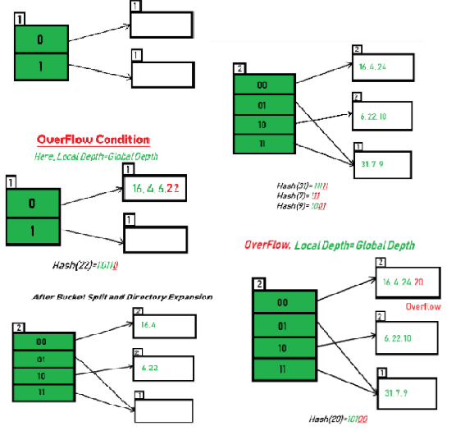
{16- 10000, 4- 00100, 6- 00110, 22- 10110, 24- 11000, 10- 01010,31- 11111,7- 00111,9- 01001,20- 10100 }

Slide 34
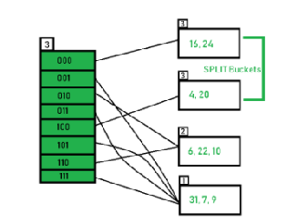

Slide 35
Some Applications of Hash Table
Database systems: Specifically, those that require efficient random access. Generally, database systems try to optimize between two types of access methods: sequential and random. Hash tables are an important part of efficient random access because they provide a way to locate data in a constant amount of time.
Data dictionaries: Data structures that support adding, deleting, and searching for data. Although the operations of a hash table and a data dictionary are similar, other data structures may be used to implement data dictionaries. Using a hash table is particularly efficient.
Symbol tables: The tables used by compilers to maintain information about symbols from a program. Compilers access information about symbols frequently. Therefore, it is important that symbol tables be implemented very efficiently.
Notes:
<number>

Slide 36
Some Applications of Hash Table
Network processing algorithms: Hash tables are fundamental components of several network processing algorithms and applications, including route lookup, packet classification, and network monitoring.
File System : The hashing is used for the linking of the file name to the path of the file. To store the correspondence between the file name and path, and the physical location of that file on the disk, the system uses a map, and that map is usually implemented as a hash table.
Password Verification: Cryptographic hash functions are very commonly used in password verification
Pattern Matching: The hashing is also used to search for patterns in the strings. Rabin-karp algorithm is use hashing for the searching of a pattern in a string The pattern matching is also used to detect plagiarism.

Slide 37
Problems for which hash tables are not suitable
Problems for which data ordering is required.
- Hash table is an unordered data structure, certain
operations like iterating through the keys in order efficiently
Problems having multidimensional data.
Problems in which the data does not have unique keys.
- Open-addressed hash tables cannot be used if the data does not have unique keys. An alternative is use separate-chained hash tables.
Notes:
<number>

Slide 38
Skip list: Randomized Data Structure
Duration : 2 Hour
Reference :
“Advanced Data Structures”, by Peter Brass
https://courses.cs.washington.edu/courses/cse326/00wi/handouts/lecture16/sld025.htm

Slide 39
Introduction of Skip list
A skip list is a probabilistic data structure and an extended version of the linked list.
The skip list is used to store a sorted list of elements or data with a linked list and very useful for concurrently accessing element.
In one single step, it skips elements of the entire list, hence referred as skip list.
It allows the user to search, remove, and insert the element very quickly.

Slide 40
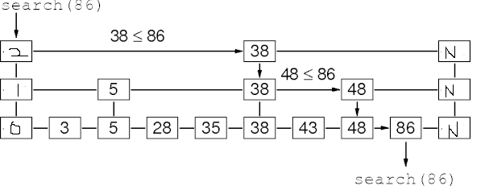
There are the following operations:
Insertion operation: It is used to add a new node
Deletion operation: It is used to delete a node in a specific situation.
Search Operation: The search operation is used to search a particular node in a skip list.
Average case time complexity of all above operations is O(logn)
Head
Head
[https://www.youtube.com/watch?v=UGaOXaXAM5M&ab_channel=ShusenWang ]
Applications of the Skip list
It is used in distributed applications. In distributed systems, the nodes of skip list represents the computer systems and pointers represent network connection

Slide 41
Case Study: Book call number and dictionary
Report writing points:
- Dictionary concepts with phone book call number
example
- Explain Dictionary as ADT
- Types of Dictionaries :
· Ordered Dictionaries
· Unordered Dictionaries
- Comparison with other data structures

Slide 42
References
Horowitz, Sahani, Dinesh Mehata, “Fundamentals of Data Structures in C++”, Galgotia Publisher, ISBN: 8175152788, 9788175152786.
Peter Brass, “Advanced Data Structures”, Cambridge University Press, ISBN: 978-1-107- 43982-5
https://www.geeksforgeeks.org/hashing-data-structure/#basicHashing
https://www.tutorialspoint.com/Hash-Functions-and-Hash-Tables
https://courses.cs.washington.edu/courses/cse326/00wi/handouts/lecture16/sld025.htm
https://www.geeksforgeeks.org/extendible-hashing-dynamic-approach-to-dbms/
https://iq.opengenus.org/skip-list/
https://www.youtube.com/watch?v=UGaOXaXAM5M&ab_channel=ShusenWang
https://www.cscjournals.org/manuscript/Journals/IJEA/Volume5/Issue1/IJEA-45.pdf
https://www.researchgate.net/publication/277409678_Efficient_hash_tables_for_network_applications
Notes:
<number>

Slide 43
Thank you
shalaka.deore@mescoepune.org

