Slide 1
Course Objective6:
To understand the advanced technologies in cloud computing

Slide 2
Unit VI
Advanced Techniques in Cloud Computing

Slide 3
Points to cover
Part I: Future Trends in cloud Computing
Mobile Cloud
Automatic Cloud Computing: Comet Cloud.
Multimedia Cloud: IPTV
Energy Aware Cloud Computing
Jungle Computing

Slide 4
Points to cover
Part II:
Distributed Cloud Computing Vs Edge Computing
Containers, Docker, and Kubernetes
Introduction to DevOps.

Slide 5
Points to cover:
Part III: IOT and Cloud Convergence
The Cloud and IoT in your Home
The IOT and cloud in your Automobile
PERSONAL: IoT in Healthcare

Slide 6
10 Emerging Future Trends In CC
A large businesses will conceive personal cloud systems
Cloud security will become more trusted and normalized
Cloud adoption will have an upward trend
More applications will proceed into the cloud
Compression methods will be significant in reducing storage charges
Analytics will become a large-scale cloud characteristic
Cloud computing will adjust and shrink IT agencies
Cloud computing will become more customizable
Large cloud databases will centralize gigantic allowances of data
Mobile apparatus will take benefit of offloaded computing

Slide 7
NGN & Services
Next Generation Networking (NGN)
  key architectural changes in telecommunication core and access networks
  one network transports all information and services (voice, data, and all sorts of media such as video) by encapsulating these into IP packets.
Next Generation Services
  Ubiquitous, real-time, multi-media communications.
  More ‘personal intelligence’ circulated all through the network.
  More ‘network intelligence’ circulated all through the network.
  More ease for users.
  Personal service customization and management.
  Intelligent data management.

Slide 8
Mobile Cloud
Mobile Cloud Computing (MCC) combines mobile computing and cloud computing
Not fully developed

Slide 9
Growth of CC
CC becomes a significant topic in the scientific and industrial communities and is the major application system in the era of the Internet.
CC is described as a different range of services provided by an Internet-based cluster system.
CC represents a huge opportunity for the mobile industry as a whole.
ABI Research analyzed that there will an increase in subscribers for MCC worldwide, over the next 6 years.

Slide 10
Mobile Computing
Ubiquity and mobility : main features in the NGN
NGN offers a different range of personalized network services through various network terminals and modes of accessing.
The key technology of CC is centralized computing, services and particular applications as a utility to be sold, such as water, gas or electricity to users.
Thus, MCC is a mixture of a ubiquities mobile network and cloud.

Slide 11
Recent Development of MCC
Resources are virtualized and assigned in different groups of various distributed computers rather than in local computers or servers
Virtualized resources are provided to mobile devices such as mobiles, portable terminals and so on.
At the same time, various applications based on MCC have been developed and provided to users.
Ex. : Google’s Gmail, Maps and Navigation systems for mobile, voice search and some applications on an Android platform, MobileMe from Apple, Live Mesh from Microsoft and MotoBlur from Motorola.

Slide 12
Mobile Cloud Computing
Currently mobile devices are upgraded with latest hardware and software.
Some smart phones such as iPhone, Android mobiles, Windows Mobile serials and Blackberry are no longer just traditional mobile phones used for conversation, SMS, Email and website browsing, but are daily necessities to users.
At the same time, these smart phones include various sensing modules like navigation, optics, gravity and orientation creating an easy and intelligent mobile experience to users.

Slide 13
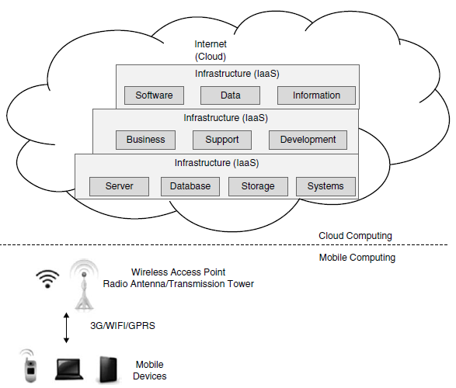
Diagram:
Architecture of Mobile Cloud Computing

Slide 14
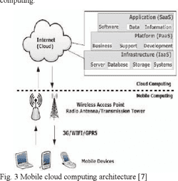

Slide 15
Mobile Cloud Computing
Divided into cloud computing and mobile computing
Mobile devices such as laptops, PDA and Smartphone are connecting with a hotspot or base station by 3G, WIFI or GPRS (General Packet Radio Service).
The requirement for mobile devices in computing is limited as major processing phases are shifted to cloud.
MCC can be achieved by using some low-cost mobile devices or even non-Smartphone with cross-platform middleware.
When the PCs or standalone machines are changed to mobile devices for acting as the client in MCC, the main concept is still cloud computing.
Mobile users use web browser to send the service requests to the cloud.

Slide 16
A ubiquitous mobile cloud will benefit the telecom industry as a whole, by making it much more attractive for application service providers to create new services, or to enrich existing services that use capabilities, information and intelligence provided by mobile and fixed telecoms operators.
Avoiding fragmentation will result in a much higher addressable market of ASPs, resulting in increased service innovation, customer satisfaction and new income sources for the companies as a whole and consequently for individual operators.

Slide 17
Key Requirements For Mobile CC
In addition to the basic requirements for exposing network services, there are some important features of MCC that make it possible to execute seamless service delivery in a cross-network environment.
According to the perspective of the enterprise solution provider or web/mobile application developer, the aims of the MCC platform :
  Clear and simple API for transparent access, without the knowledge of underlying network.
  Capability of using single SLA for deploying applications in multiple networks.
  Maintaining of specific network policy.

Slide 18
What is mobile cloud computing (MCC)?
What are the major features of MCC?
Draw and explain Mobile cloud computing architecture in detail.

Slide 19
Autonomic Cloud Engine
Autonomic computing is a computing form of self-managing.
The objective of autonomic computing is in enabling systems that execute themselves and have high-level performance.
The aim of autonomic computing is to conceive schemes that run themselves, adept of high-level functioning while holding the system’s complexity unseen to the user.
Autonomic Computing is one of the construction blocks of Pervasive Computing.

Slide 20
As per IBM….
Autonomic systems are self-managed systems in both physical and software form.
They self-learn from their environments and dynamically modify their own algorithms in real-time
  to optimize their actions in various complex ecosystems.
They optimize performance and defend against attacks without human intervention.
While autonomic systems are mostly software-based, humanoid robots are also emerging.
The basic features of an autonomic system put forth by IBM (next slide)

Slide 21
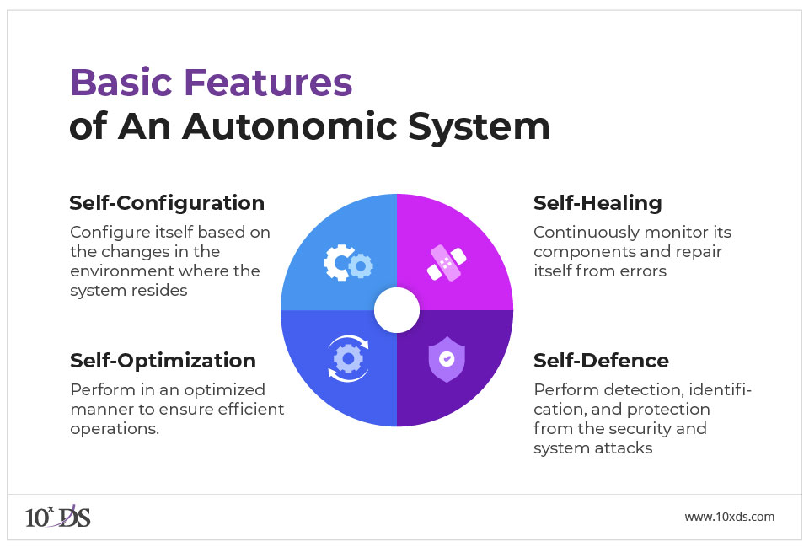
https://www.ibm.com/docs/en/db2/11.5?topic=overview-automatic-features

Slide 22
8 Vital Components of Autonomic Computing
According to IBM, there are eight vital components in an Autonomic Computing scheme, they are as follows:
It should sustain complete and exact information about all its elements.
It should have the proficiency to self-configure to match changing and probably unpredictable situations.
It should certainly supervise itself for optimal functioning.
It should be self-healing and adept to find alternate modes to function when it comes across difficulties.
It should be trained to notice risks and defend itself from them.
It should be adept to adjust to ecological situations.
It should be founded on open measures other than proprietary technologies.
It should predict demand while continuing clear to the user.

Slide 23
An autonomic scheme makes conclusions on its own using high-level policies, it will certainly ascertain and optimize its rank and mechanically adjust itself to altering conditions.
An Autonomic Computing structure is created of autonomic constituents (AC) combining with each other.
An AC can be modeled in periods of two major command loops (local and global) with sensors (for self-monitoring), effectors (for self-adjustment), information and planners/ adapters for exploiting principles founded on self and natural environment awareness.

Slide 24
AUTONOMIC SYSTEM
The Autonomic Computing Initiative (ACI) aspires at supplying the base for autonomic systems.
It is motivated by the autonomic tense scheme of the human body.
In a self-managing autonomic scheme, the human operator takes on a new function rather than commanding the scheme exactly, he/she characterizes general principles and directions that direct the self-management process.
For this method, IBM characterized the next four purposeful areas: self-configuration, self-healing, self-optimization and self-protection.

Slide 25
IBM characterized 5 evolutionary grades for the autonomic deployment form
  Level 1 is the elementary grade that presents the current position where schemes are vitally organized manually.
  Levels 2 through 4 insert progressively automated administration purposes
  Level 5 comprises the supreme aim of autonomic, self-managing systems.

Slide 26
The Autonomic Computing Initiative (ACI) aspires at delivering the foundation for autonomic systems.
IBM identified four purposeful areas in Autonomic Computing: (i) self-configuration, (ii) self-healing, (iii) self-optimization and (iv) self-protection.
IBM identified five evolutionary levels, for the autonomic deployment configuration.
Autonomic administration capabilities can be identified as any kind that without the client having to explicitly notify the system to supervise it.

Slide 27
Points to covered
Part I: Future Tends in cloud Computing
Mobile Cloud
Automatic Cloud Computing
Comet Cloud
Multimedia Cloud: IPTV
Energy Aware Cloud Computing
Jungle Computing

Slide 28
CometCloud
Autonomic Computing motor for the cloud and grid environments is CometCloud.
Founded on the Comet decentralized coordination substrate/ layer
Carries highly heterogeneous and dynamic cloud/grid infrastructures, integration of public/private clouds and autonomic cloudbursts.
Presents a distributed coordination space over the Chord overlay mesh and diverse kinds of programming paradigms, for example, Master/Worker, Workflow and MapReduce/ Hadoop.

Slide 29
CometCloud carries autonomic cloudbursts and autonomic cloud-bridging on a virtual cloud which incorporates localized computational environments and public cloud services on-the-fly.
Also, it carries real-world technical and technology applications.

Slide 30
Comet
Aim: to recognize a virtual computational cloud with resizable computing capability, which incorporates localized computational environments and public cloud services on-demand and supply abstractions and means to support a variety of programming paradigms and submissions requirements.
Specifically, CometCloud provides policy-based autonomic cloud spanning and cloud bursting.
Autonomic cloud spanning gives on-the-fly integration of localized computational environments (data centres, grids) and public cloud services (such as Amazon EC2 and Eucalyptus) and autonomic cloud bursting gives dynamic submission scale-out to address dynamic workloads, spikes in claims and other farthest requirements.
Notes:
Cloud spanning is a type of cloud delivery model in which an application is deployed and executed over multiple simultaneous cloud platforms and infrastructure. Cloud spanning enables a cloud application to distribute its computations and components across one or more cloud environments.

Slide 31
What is a CometCloud adept of?
Support centre programming paradigms for real-world facts and numbers and compute intensive submissions.
Enable autonomic cloudbursts and cloud-bridging and on-demand scale-out and scale-in, propelled by dynamic principles, financial forms, QoS constraints, etc.
Programming scheme support deployment of native (Java as well as non-Java) applications with and without change.
Current deployments encompass a virtual cloud integrating Amazon EC2, Eucalyptus, localized clusters and the TeraGrid.
Incorporate means for fault-tolerance to handle node and connection flops and recovery.

Slide 32
Features of CometCloud
Pull-based task utilization
Policy-based autonomic cloudbursts
Cloud-bridging
Support for multi-core processors
Support MapReduce with naïve computer disk writing
Master throttling
Multiple masters
Task update
Garbage collection
Distributed task lifetime by workers
Fault-tolerance by duplicating task space

Slide 33
Points to covered
Part I: Future Tends in cloud Computing
Mobile Cloud
Automatic Cloud Computing
  Comet Cloud
Multimedia Cloud: IPTV
Energy Aware Cloud Computing
Jungle Computing

Slide 34
What is Autonomic Computing?
What is the future of Autonomic Computing?
What are the crucial elements in an Autonomic Computing System?
What are the components of Autonomic System?

Slide 35
Multimedia Cloud
Cloud Computing opened the opportunity for media operators who serve content providers, IPTV (Internet Protocol Television) operators and multimedia players.
When we consider multimedia players, adopting cloud computing is often one of the important priorities in the coming years.
Some media players, for example, companies like media post-production, already utilize these kinds of cloud computing–based service capabilities for managing the digital delivery.

Slide 36
In the future, multimedia companies will use cloud computing first, who started looking to move their storage requirements into cloud computing.
The cost and the investment return for these kinds of services have accelerated the growth of cloud computing services market.

Slide 37
Because of different offerings by IaaS (Infrastructure as a Service), many telecom companies already distributed the content.
The relationships between the media and content value chain are more exposed because of cloud computing.
For example, HBO and Verizon are now using content delivery via cloud computing.

Slide 38
Companies those who have invested in media business now have the opportunity to use those things to other players, for example, to content providers.
The different types of services that can be proposed are as follows:
Using hosted hardware
Content access securely
Sharing the content
Transcoding services
Delivery of content
Notes:
Transcoding is the direct digital-to-digital data alteration of one encoding to another, for example, movie data files or audio files.

Slide 39
IPTV
Internet Protocol Television
offers a revenue opportunity for media operators looking to use cloud computing services.
For using this service, normally we need a set-top box called STB.
To reduce costs, the processing power and graphic capabilities of STBs are limited.
Providers are not able to take the benefit from the latest technology, which has powerful STBs, offered at low cost.
The reason is due to the installation base is not economically cost effective, as a result, the low cost and less capable STB offers less service and the innovation in delivery of media to TV is limited.

Slide 40
IPTV providers have to overcome the barriers because of the low capable STBs, in terms of limited processing power, in order to:
  Deliver very good service with graphics quality
  Be competitive with other emerging video service providers using new STBs

Slide 41
By adopting cloud computing services to manage the STB, IPTV
  provides customers with services and applications which are not available in STB, and
  also provides applications that are more resource intensive than the latest STBs.
This kind of approach results in low cost, compared with replacing old STBs.
The reasons are as follows:
  Resources are shared
  The cost involved by using cloud servers is much lower than replacing old STBs
  Moving complexity simplifies operations at the customer end

Slide 42
When deploying cloud exploitation, they may impose some challenges.
  video editing systems cannot be addressed because of technical constraints, especially because of more bandwidth demands.
A significant increase in revenue generation remains while adopting cloud exploitation.
Many operators started to invest in the concept of private cloud for rendering media services.
They now need community cloud architecture to make use of these media market opportunities and can render services to a greater number of customers.
Exposing media cloud capabilities does not require major investment.
Using cloud computing services, this can be achieved cost effectively.
An example is the Alcatel-Lucent Cloud Application Enabler

Slide 43
Energy Aware Cloud Computing
Cloud Computing Energy Efficiency:
CC has been recently attracted as a promising approach for delivering advanced technology services by utilizing the data centre resources.
Cloud-based computing can reduce IT capital costs, labour costs, enhance productivity and also be remarkably efficient.
One of the analyses shows that a particular organization or company that switched to the cloud has saved around 68–87% energy for its office computing and carbon emission has been reduced.

Slide 44
Growth in cloud computing has some consequences because of Greenhouse Gas (GHG) emissions and sustainability.
Clouds are utilized better and are less expensive to operate than the traditional data centres.
Only the large organizations both government and commercial will have the capital and expertise to achieve a similar level of efficiency at a lower cost.
Because of this, most of the work done in internal data centres can be outsourced to the cloud in the coming years, resulting in reductions in energy consumption, energy expenses and emissions from data centre operations.

Slide 45
The study examines the drivers and technical developments related to cloud computing.
Market forecasts include a quantification of energy savings and reduction possibilities under a cloud computing scenario.

Slide 46
Key issues
Cost-wise advantage of public cloud computing providers over traditional data centres.
Objectives for computing by business providers of cloud.
Strategies among cloud computing providers regarding energy efficiency.
Improvement of sustainability while shifting to the cloud.
Kind of ROI that the cloud computing delivered from an energy efficiency perspective.
Impact of using cloud computing on carbon emission from the data centre operations.

Slide 47
Three points stand out :
First, by migrating to the cloud, industries can achieve significant energy savings and reduced pollution, in addition to savings from reduced server purchases and maintenance.
Second, the reduction in energy consumption was larger and not by a reduced number of servers. This was due to two factors: usage of server is lower, power consumed is less and forming the servers in subset based on PUE (power usage effectiveness), reduces the energy consumption.
Third, the results do not reflect the energy consumed by the client devices.

Slide 48
Migration to Google Apps
Reduces direct energy for servers by 70–90%
Reduces energy for server cooling by 70–90%
From the use of Google servers and heavy network traffic, the energy increased by 2–3%

Slide 49
Points to covered
Part I: Future Tends in cloud Computing
Mobile Cloud
Automatic Cloud Computing
Comet Cloud
Multimedia Cloud: IPTV
Energy Aware Cloud Computing
Jungle Computing

Slide 50
The application of high-performance and Distributed Computing in scientific practice has become more important among the most available platforms such as clusters, grids and cloud systems.
These infrastructures are now undergoing many changes due to the integration of core technologies, providing speed improvements for selected compute kernels.
As distributed and high-performance computing is becoming more heterogeneous and hierarchical, complexity in programming is increased.
Further, these complexities arise due to an urgent desire for scalability and issues like data distribution, heterogeneity in software and hardware availability.
Scientists were forced to use multiple platforms simultaneously for the above issues (e.g., clusters, grids and clouds used concurrently).

Slide 51
JUNGLE COMPUTING
A Distributed Computing paradigm
Emerged out of the plethora of available distributed resources
Provides the user to use all computing resources available in this environment
  Contains clusters, clouds, grids, desktop grids, supercomputers, stand-alone machines and mobile devices

Slide 52
Reasons to use Jungle Computing Systems
To run an application in a single system is not possible, because it may need more computing power than available.
A single system may not support all the requirements from different parts of an application, because the computational requirements differ in some part of an application.

Slide 53
A Jungle Computing System
All resources are equal in some way
Contains some amount of processing power, memory and storage, etc.
For the end-users, no need to consider about the resource located in a remote cloud or down the hall in a cluster
The compute resource run their application effectively
Heterogeneous because the properties of the resources differ in processor architecture, memory capacity and performance
In the absence of central administration of these unrelated systems, software systems like libraries and compilers may differ

Slide 54
Example
if a permanent stand-alone system is available then grid resources have to be reserved, whereas a cloud requires a credit card to get access.
Also, using different interfaces, the middleware used to access a resource will differ.

Slide 55
Limitations of Jungle Computing
It is hard to run the applications on several resources due to the heterogeneity of Jungle Computing Systems.
The application have to be re-compiled or even partially re-written for each used resource is to handle the changes available software and hardware resources.
A different middleware interface is required to use different middleware client software for each resource.
Jungle Computing Systems lack in terms of connectivity between resources.
This aspect reduces the usage of Jungle Computing.

Slide 56
JUNGLE COMPUTING SYSTEM
The main aim of introducing Grid Computing :
  to provide efficient and transparent wall-socket computing over a distributed set of resources.
Other distributed computing paradigms have been introduced such as
  peer-to-peer computing,
  volunteer computing and
  Cloud Computing
These paradigms allocate the majority of targets of grid computing to supply end-users with controlled, distributed resources with as few actions as possible.
These novel paradigms lent towards a diverse bundle of resources available for innovation in computing research, which incorporate stand-alone systems, clusters, grids and clouds, etc.

Slide 57
It is very difficult for scientists to program and use clusters, grids and clouds being equipped with multi-core processors and many-core ‘add-ons’.
Despite the fact that the programming and efficient use of many-cores is known to be hard, this is not the only problem.
Even the programmers must care about the potential for parallelism at all levels of granularity.
Even now the problem is more severe, because the use of a single high-performance computing environment is not sufficient while increasing the desire for speed and scalability in most scientific research domains.

Slide 58
The need to access multiple platforms concurrently from within a single application often is due to the impossibility of reserving a sufficient number of compute nodes at once in a single multi-user system.
Also, the nature of consumers consisting different platforms is another issue.

Slide 59


Slide 60
Points covered
Part I: Future Tends in cloud Computing
Mobile Cloud
Automatic Cloud Computing
Comet Cloud
Multimedia Cloud: IPTV
Energy Aware Cloud Computing
Jungle Computing

Slide 61
Points to cover
Part II:
Distributed Cloud Computing Vs Edge Computing
Containers, Docker, and Kubernetes
Introduction to DevOps.

Slide 62
Edge Computing
A distributed computing architecture that brings computing and data storage closer to the source of data.
Data processing takes place at the network’s edge, adjacent to the device that generated the data, as opposed to a central location, such as a data center.
Reduced latency and bandwidth needs are desired outcomes of edge computing when transferring large amounts of data to a processing center.
Edge computing facilitates real-time decision-making by processing data close to the edge and accelerating data transfer to and from the cloud.
IoT devices, automated vehicles, and augmented reality/virtual reality (AR/VR) systems require low latency benefits, particularly from edge computing.
Applications that produce a lot of data, such as those used in industry, video and image analysis, and intelligent

Slide 63
Advantages of Edge Computing
Reduced Latency: Edge Computing makes it possible to process and analyze data more quickly at the point of origin, which cuts down on the time it takes for data to be transported to the cloud and back. Due to the huge reduction in latency, this is perfect for real-time decision-making applications like robotics, industrial automation, and automated cars.
Increased Security: By enabling data processing and analysis close to the data’s origin and reducing the quantity of data that must be transferred to the cloud, edge computing can increase security. As a result, it is more difficult for hackers to hack the system because the attack surface and potential vulnerabilities are reduced.
Greater Bandwidth Efficiency: By enabling local data processing and analysis, edge computing can lessen the quantity of data that needs to be transported to the cloud. Better bandwidth efficiency as a result can lower data transmission costs and enable quicker processing.

Slide 64
Disadvantages of Edge Computing
Low Processing Power: With compare to cloud computing infrastructure, edge computing devices often have less processing power and storage space. The types of apps that can be used on edge devices may be constrained as a result.
Increased Complexity: Edge computing implementation can be trickier than standard cloud computing strategies. This is due to the requirement of edge computing, which can be difficult to manage and maintain, to install processing and storage resources closer to the source.
Increased Costs: In terms of hardware and maintenance costs, edge computing can be more expensive than cloud computing. This is because Edge Computing necessitates the deployment of processing and storage resources across several numbers which can be more expensive to set up and maintain.

Slide 65
Difference between Edge Computing and Cloud Computing

Slide 66
Parameter | Edge Computing | Cloud Computing
Definition | Edge Computing is a distributed computing architecture that brings computing and data storage closer to the source of data. | Cloud Computing is a model for delivering information technology services over the internet.
Location of Processing | Processing is done at the edge of the network, near the device that generates the data. | Data Analysis and Processing are done at a central location, such as a data center.
Bandwidth Requirements | Low bandwidth is required, as data is processed near the source. | Higher bandwidth is required as compared to edge computing, as data must be transmitted over the network to a central location for processing.
Costs | Edge Computing is more expensive, as specialized hardware and software may be required at the edge. | Cloud Computing is less expensive, as users only pay for the resources they actually use.

Slide 67
Parameter | Edge Computing | Cloud Computing
Scalability | Scalability for Edge Computing can be more challenging, as additional computing resources may need to be added at the edge. | Easier, as users can quickly and easily scale up or down their computing resources based on their needs.
Use Cases | Applications that require low latency and real-time decision-making, such as IoT devices, autonomous vehicles, and AR/VR systems. | Applications that do not have strict latency requirements, such as web applications, email, and file storage.
Data Security | Data security can be improved, as data is processed near the source and is not transmitted over the network. | Data Security is more challenging, as data is transmitted over the network to a central location for processing.

Slide 68
What are containers?
Containers effectively virtualize the host operating system (or kernel) and isolate an application’s dependencies from other containers running on the same machine.
Before containers, if you had multiple applications deployed on the same virtual machine (VM), any changes to shared dependencies could cause strange things to happen—so the tendency was to have one application per virtual machine
The solution of one application per VM solved the isolation problem for conflicting dependencies

Slide 69
But……
wasted a lot of resources (CPU and memory)
This is because a VM runs not only your application but also a full operating system that needs resources too, so less would be available for your application to use.

Slide 70
Solution???
Containers
Containers solve this problem with two pieces: a container engine and a container image, which is a package of an application and its dependencies.
The container engine runs applications in containers isolating it from other applications running on the host machine.
This removes the need to run a separate operating system for each application, allowing for higher resource utilization and lower costs.

Slide 71
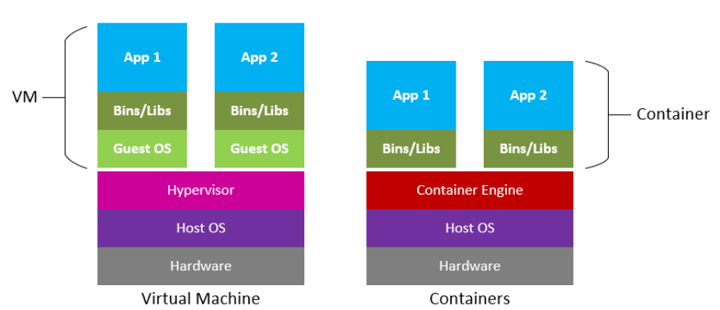

Slide 72
What is Docker?
Docker was first introduced to the world—with no pre-announcement and little fan‐ fare—by Solomon Hykes, founder and CEO of dotCloud, in a five-minute lightning talk at the Python Developers Conference in Santa Clara, California, on March 15, 2013.
At the time of this announcement, only about 40 people outside dotCloud been given the opportunity to play with Docker.

Slide 73
Docker is a tool that promises to easily encapsulate the process of creating a distributable artifact for any application, deploying it at scale into any environment, and streamlining the workflow and responsiveness of agile software organizations.

Slide 74
Responsible for revolutionizing container technology by providing a toolset to easily create container images of applications.
The underlying concept has been around longer than Docker’s technology, but it was not easy to do until Docker came out with its cohesive set of tools to accomplish it.
Docker consists of a few components:
  a container runtime (called dockerd),
  a container image builder (BuildKit), and
  a CLI that is used to work with the builder, containers, and the engine (called docker).

Slide 75
Process Simplification
Docker can simplify both workflows and communication, and that usually starts with the deployment story. Traditionally, the cycle of getting an application to production often looks something like the following (illustrated in Figure 2-1):

Slide 76
1. Application developers request resources from operations engineers.
2. Resources are provisioned and handed over to developers.
3. Developers script and tool their deployment.
4. Operations engineers and developers tweak the deployment repeatedly.
5. Additional application dependencies are discovered by developers.
6. Operations engineers work to install the additional requirements.
7. Loop over steps 5 and 6 N more times.
8. The application is deployed.

