Slide 1
Course Objective :
To understand the implementation of Virtualization in Cloud Computing

Slide 2
Unit III
Virtualization in Cloud Computing

Slide 3
Topics to cover
Part I : Introduction
Definition of Virtualization
Adopting Virtualization
Types of Virtualization
Virtualization Architecture and Software
Virtual Clustering
Virtualization Application
Pitfalls of Virtualization
Reading Material :
Srinivasan, J. Suresh, “Cloud Computing: A Practical Approach for Learning and Implementation”, Chap 8, pg 99 - 119

Slide 4
Topics to cover
Part II : Grid, Cloud and Virtualization
Virtualization in Grid
Virtualization in Cloud
Virtualization and Cloud Security
Reading Material :
Srinivasan, J. Suresh, “Cloud Computing: A Practical Approach for Learning and Implementation”, Chap 9, pg 123 - 128

Slide 5
Topics to cover
Part III : Virtualization and Cloud Computing
Anatomy of Cloud Infrastructure
Virtual infrastructures
CPU Virtualization
Network and Storage Virtualization
Exemplar/Case Studies: Xen: Para virtualization, VMware: Full Virtualization, Microsoft Hyper-V
Reading Material :
Srinivasan, J. Suresh, “Cloud Computing: A Practical Approach for Learning and Implementation”, Chap 10, pg 130 - 135

Slide 6
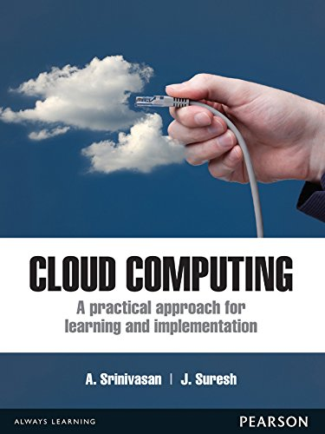

Slide 7
Definition of Virtualization
Virtualization is a methodology
  for dividing the computer resources into more than one execution environment
  by applying more concepts like partitioning, time-sharing, machine simulation and emulation

Slide 8
Virtualization
a brand new trend in IT
includes autonomic computing and utility computing
helps the IT environment to manage itself
every available resource is seen as a utility
a client pays per use
reduces the burden of workloads of users
  by centralizing the administrative tasks
  improving the scalability and workloads
Diagram: an illustration of the concept of virtualization

Slide 9
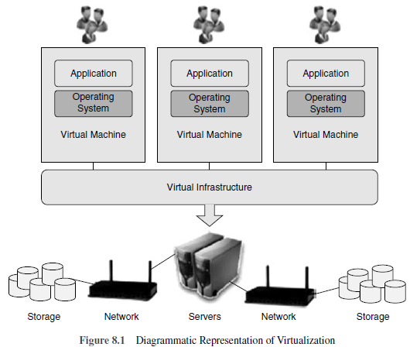

Slide 10
It contains three layers:
  layer 1 comprising of network,
  layer 2 comprising of virtual infrastructures and
  layer 3 contains virtual machines where different operating system and applications are deployed.

Slide 11
A single virtual infrastructure can support more than one virtual machine, that is, more than one OS and application can be deployed.
Physical resources of multiple machines of entire infrastructure are shared in virtual environment.
Resources of a single computer are shared across many virtual machines for maximum efficiency.
By optimizing resource, flexibility and reduced costs in capital and operations are achieved.
A virtual infrastructure consists of the following components: hyper visors, virtual infrastructure services and automated solutions to optimize IT process.

Slide 12
Virtualization
A method in which multiple independent operating systems run on a physical computer
Maximizes the usage of available physical resources.
By adopting one can achieve high server usage.
Increases the total computing power
Decreases the overhead.
exploit it to increase the number of logical operating systems in a single host, which in turn reduces the hardware acquisition and maintenance cost for an organization.

Slide 13
Reasons for using virtualization (1)
Virtual machines (VM) combine the workloads of under-utilized servers. Because of this one can save on hardware, environmental costs and management.
To run legacy applications, VM is used.
VM provides a secured sandbox for running an untrusted application.
VM helps in building secured computing platform.
VM provides an illusion of hardware.
VM simulates networks of independent computers.
VM supports to run distinct OS with different versions.

Slide 14
Reasons for using virtualization (2)
VMs are used for performance monitoring. OSs can be checked without disturbing the productivity.
VM provides fault and error containment.
VM tools are good for research and academic experiments.
VM can encapsulate the entire state of a system by saving, examining, modifying and reloading.
VM enables to share memory in multiprocessor architecture.
VM makes the job easier for the administrative staff in migration, backup and recovery.

Slide 15
ADOPTING VIRTUALIZATION
A perfect solution for small to medium-scale enterprises.
Not suitable for high-performance applications
  Possible to add overheads, complexity and reduce the performance.
the IT industry has a high CPU utilization number indicating optimum usage of hardware
  based on this number one should not come to the conclusion about the application usage.
By using virtualization, CPU utilization during peak hours will shoot up to 50% and it should not override the SLA (service level agreement) of an organization.
At present, in virtualization, the CPU and I/O overhead for storage and networking throughput are minimal
Avoid using VM when high storage or more hardware I/O requirements are needed.

Slide 16
Topics to cover
Part I : Introduction
Definition of Virtualization
Adopting Virtualization
Types of Virtualization
Virtualization Architecture and Software
Virtual Clustering
Virtualization Application
Pitfalls of Virtualization

Slide 17
3.Types of Virtualization
Examples
Virtual Machines Programming Languages
Server Virtualization
OS Virtualization
Storage Virtualization
Network Virtualization

Slide 18
Types of Virtualization
very powerful tool
drives significant benefits for cost, agility and the environment
Types / Forms:
  server virtualization
  client/ desktop/application virtualization
  storage virtualization
  service/application infrastructure virtualization
Diagram : various types of virtualization
A broad mixture of virtualization technology :
  conceptualized, developed and enhanced
An end-to-end virtualization strategy impacts all features of the IT infrastructure.
This gives the consumer flexibility, greater efficiencies and cost-effectiveness

Slide 19
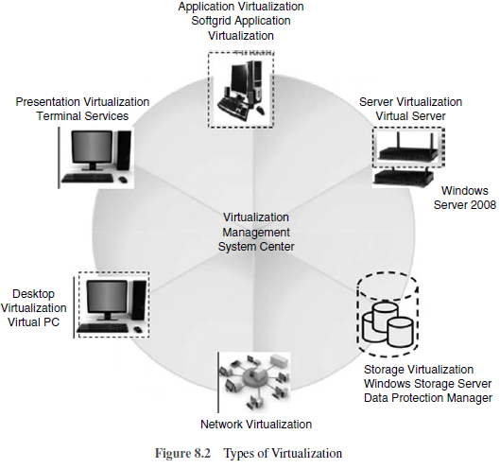

Slide 20
Server Virtualization
used for masking of server resources
includes number of physical servers, processors and operating systems
Aim / Intention:
  to spare the complicated server resources
  increasing the sharing, utilization
  maintaining the capacity of servers

Slide 21
Network Virtualization
a method where network resources are combined
based on available bandwidth
Each channel is assigned to a particular server.
a true complexity of network is hidden
managed like partitioning the hard drive
Outcome:
  lower Total Cost of Ownership [TCO]
  higher return of investment
  security
  dynamic computing

Slide 22
Storage Virtualization
a pool of physical storage from different network of storage devices
appears as a single storage device
Usually adopted in SAN (storage area networks)
Advantages:
  disaster recovery
  business continuity
  lower TCO
  higher return of investment
  dynamic computing
  Security
  testing and development

Slide 23
Desktop Virtualization
supports various computing
  utility and dynamism
  Testing
  development and security

Slide 24
Application Virtualization
allows server consolidation, application and desktop deployment, and business continuity
Apart from this, recovery when disaster, lower TCO with higher ROI, dynamic computing, testing and development are possible

Slide 25
Management Virtualization
allows variety of features :
server consolidation
centralized policy-based management
business continuity and disaster recovery
lower TCO with higher ROI
utility and dynamic computing
testing and development and security

Slide 26
3.1. Examples
Virtualization provides multiple environments for execution termed as virtual machine.
Each virtual machine :
  looks like an actual machine to its user,
  but it is isolated
  is in virtualized form of running the existent machine
  under the supervision of a virtual machine monitor (VMM)
Some frameworks using virtualization:
  Wine, FreeBSD, Hive, Microsoft Virtual Server, Nemesis, SimOS

Slide 27
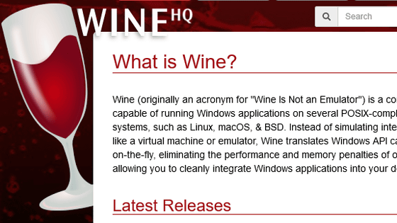

Slide 28

Wine
Initially released on 4th July 1993
Wine is Not an Emulator
a software, where the user can execute windows applications on FreeBSD, Linux and Solaris
developed with x86 architecture
does not emulate as a processor
Diagram : x86-based virtualization architecture

Slide 29
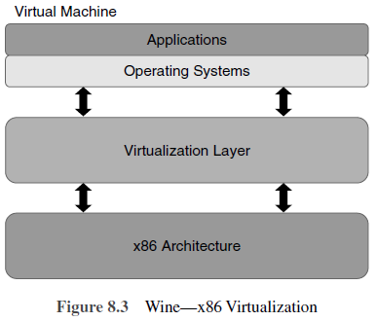

Slide 30
WINE Architecture
consists of four layers with x86 as a base layer acts as base infrastructure
  for deploying virtualization
  above the virtualization layer where virtual machine is deployed
Various OSs installed in VMs & applications executed using available OS
Virtualization : a common trend for IT organizations, acceptance in the data centres and then spread to clients and applications
An OS + application = to form a VM created on PM
Virtual machines are also known as ‘guests’.
All guests hosted on a physical server running on a host operating system
The concept of VM contained both OS and applications operating independently of OS on the standalone server.
enables many VMs to run on a single standalone server, providing isolation and security

Slide 31
FreeBSD
The FreeBSD operating system allows the user to create an isolated environment through software.
uses a command chroot and each one has its own ‘root’
chroot : Change root directory
This feature is implemented by making various components of the FreeBSD kernel, such as the tty driver, the system call API, the TCP/IP stacks and so on

Slide 32
Hive
an internally distributed system which has multiple independent kernels
improves the reliability and does not affect the running processes.
each memory page has a little write permission
helps the system to throw away the damaged pages after fault detection

Slide 33
Microsoft Virtual Server
Microsoft’s Windows NT had several subsystems using virtualization
  virtual DOS machine (VDM)
  Windows with Win32 virtual machine for 16-bit
  OS/2 subsystem
  POSIX
  Win32 subsystem
OS/2, POSIX and Win32 subsystems are server processes
DOS Win16 are client processes
Applications of Microsoft and many enterprise software vendors are virtualized.
Microsoft’s SQL Server 2000 has multiple instance capabilities like
  Microsoft’s Exchange Server
  IIS Server
  File/Print Servers
  Terminal Server

Slide 34
Nemesis
an operating system tool designed and supported by the computer laboratory of University of Cambridge
Its kernel is extremely small and lightweight and its codes are executed in the application process itself.
A scheduler and a monitor is present in the kernel to take care of CPU.
Apart from the global page table, a separate table is allotted for each process.
The scope for wrong process in applications is very least, due to the less contributions of a kernel.

Slide 35
SimOS
a machine simulator developed at Stanford
It has a feature of modelling complete computer systems such as CPU, caches, multiprocessor memory buses, network devices, disk drives and other I/O devices
it allows controlling the level of simulation

Slide 36
Virtual Machines Programming Languages
Programming languages are implemented for getting the benefits of isolation and portability using virtual machines.
UCSD P-System and JVM are the two examples for virtual machines languages.
The UCSD P-System was very popular in late 1970s and early 1980s.
It was a virtual machine running byte-code, is the most popular programming language with UCSD PASCAL.
The Java Virtual Machine (JVM) is an abstract computer and it includes register set, a stack, a heap, a method area and an instruction set.
Implementing JVM in micro-code or even directly in silicon is also possible, but JVM can be used only as single-user virtual machine.

Slide 37
Server Virtualization
newest major technology trend in the data center
impacts on corporate power, cooling expenses and data center capacity
helps to extend the life time of data centers
forced some huge organizations to close some of their data centers

Slide 38
Server Virtualization
a physical server can be partitioned into multiple virtual servers
Each virtual server :
  its own OS and applications
  acts as an individual server
one can complete his development using more OSs on one server, supporting multiple business forms
stacks multiple virtual workloads such as servers, applications that run on a single physical host
To do so, server virtualization softwares such as Hyper-V or VMware encapsulates an OS and its applications
  to run in isolated processors and memory spaces of the host
Diagram : concept of virtualization software

Slide 39
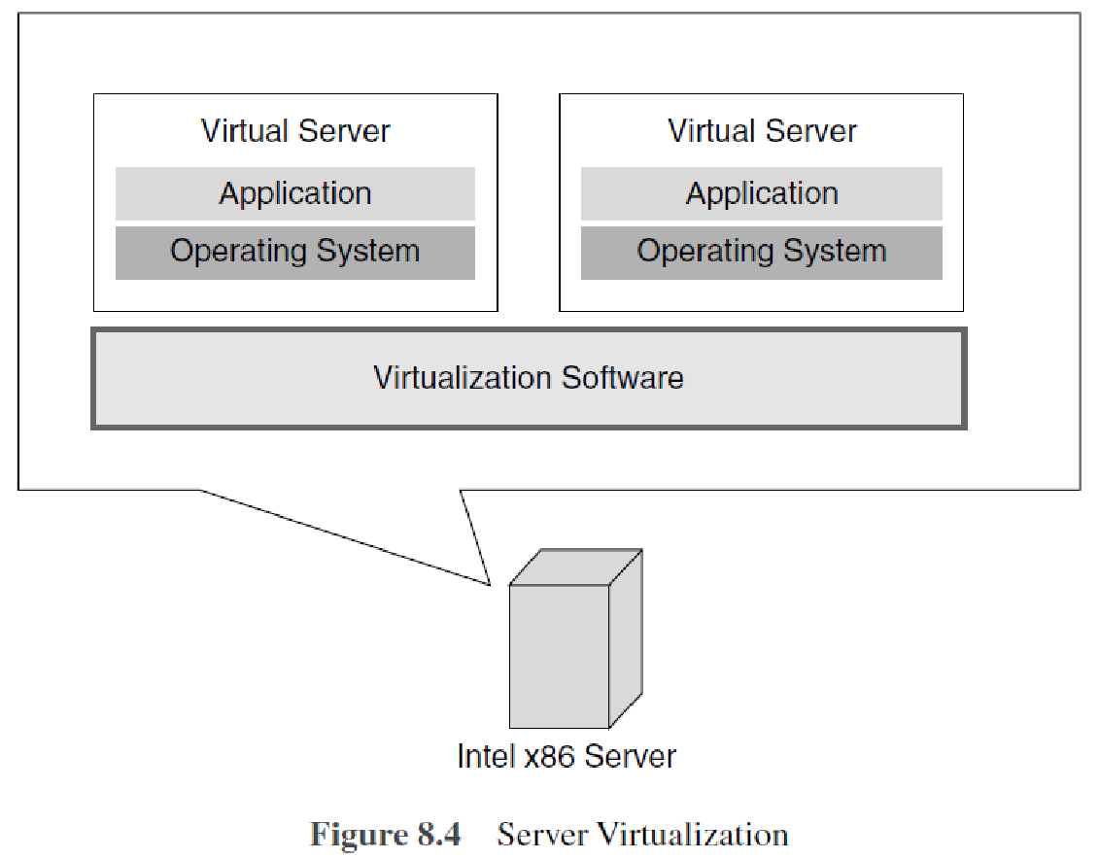

Slide 40
many virtual servers and many operating systems and applications installed on it
In the old design, there will be one server/one application and has one line and all the applications have to use that single line to access the services.
In the new design, using virtualization software, servers are virtualized
all the applications share them and are more efficient

Slide 41
Server Virtualization
masks the server resource which includes the servers, processors and OSs from the server users
Server administrator isolates the application into many
virtual environments.
The virtual environments are called as guests, instances, containers or emulations.
It allows multiple applications to run on one server with equal importance.
It permits one application to utilize resources across the company network.
Virtualization can allow applications to dynamically move from one physical server to another when the demands and resource availabilities vary, without service disturbance.

Slide 42
Importance of Server Virtualization
cost cutting incurred in IT industry
helps organizations to increase the utilization of their server up to 80%

Slide 43
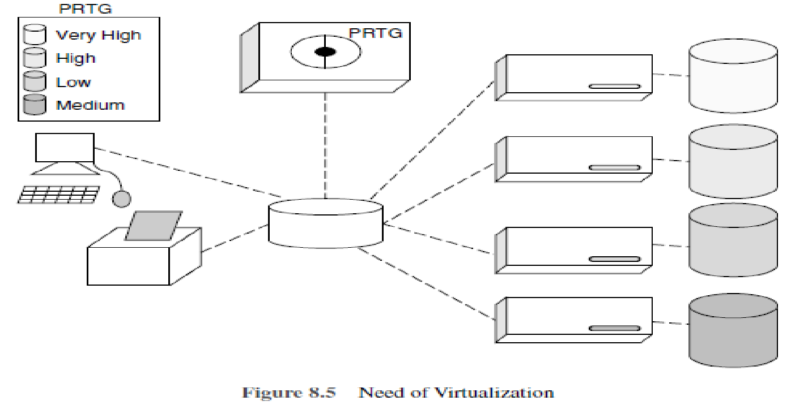
Paessler Router Traffic Grapher, a network monitoring software, 2003
an organization which uses server virtualization
It contains a single server which is virtualized into four virtual machines and different OS are installed.
When there is more access to the server, the virtual machines will take care and jobs are handled efficiently and thus increase in productivity.
Notes:
Paessler Router Traffic Grapher (PRTG) Network Monitor

Slide 44
Note….
PRTG (Paessler Router Traffic Grapher ) is a network monitoring software developed by Paessler GmbH.
It monitors system conditions like bandwidth usage or uptime and collect statistics from miscellaneous hosts such as switches, routers, servers, and other devices and applications.
It was initially released on May 29, 2003 by the German company Paessler GmbH which was founded by Dirk Paessler in 2001.
The software is available in three versions:
  a classic standalone solution (PRTG Network Monitor),
  one for large and distributed networks (PRTG Enterprise Monitor) and
  a SaaS-version (PRTG Hosted Monitor)
Source of info: https://en.wikipedia.org/wiki/Paessler_PRTG

Slide 45
Smaller organizations can be benefited by using virtualization, particularly, when they need to upgrade their servers.
One large server is less expensive to buy, operate and maintain than a small population of small servers.
An up-coming new approach, ‘application virtualization,’ presents a more efficient result in these cases and allows numerous virtualized applications to share a single copy of an operating system.
Servers are capable of host files and applications on networks.
Network administrators allocate an individual application to a server depending upon its requirements.

Slide 46
Problems
Allocating applications to peculiar machines has the
following problems:
First, it does not use the latest technology in processing power and most of its resources will be in idle state
Second, as the server occupies larger user space, data center will be overcrowded with racks of servers producing heat and consuming lots of power.

Slide 47
Solution
Server virtualization attempts to address both issues.
By using software, administrators can change one physical server into multiple virtual machine instances.

Slide 48
Need for Server Virtualization
The need for server virtualization is consolidation, redundancy, legacy systems and migration.
Server virtualization reduces space through consolidation. For IT organizations that have large number of servers, the need for single physical space can decrease the workload.
Server virtualization supports redundancy without purchasing more hardware.
Legacy systems using server virtualization the outdated systems services can be virtualized, hence the programs work as if it is executed in old systems.
Migration is a new trend in server virtualization. Migration moves a server environment from one place to another. With the help of suitable hardware and software, it is possible to migrate a virtual server from one physical machine to another in a network.

Slide 49
Three Kinds of Server Virtualization
Visualizing a single physical server as multiple logical servers is called server virtualization.
3 ways to create virtual servers
  Full virtualization
  Paravirtualization
  OS-level virtualization
Host is the physical server.
Guests are the virtual servers.
The virtual servers are like stand-alone machines.

Slide 50
Full Virtualization
Hypervisor:
  Software utilized by Full virtualization
  The connection point between server’s CPU and its storage space
  serves as a platform for the virtual server’s OS
  Monitoring of the physical server’s resources
  Allocation of resources to virtual server
  Virtual servers operate independently
    not aware of other virtual servers using hypervisor
  own processing requirements
  physical server reserves processing power and resources
    to be executed by the hypervisor application
  impact the overall server performance
  slow down applications

Slide 51
Full virtualization has proven highly successful for:
sharing a computer system among multiple users;
isolating users from each other (and from the control program);
emulating new hardware to achieve improved reliability, security, and productivity.

Slide 52
Paravirtualization
Different approach
The virtual servers are aware of each other
A paravirtualization hypervisor uses less processing power to manage virtual OS
If the administrator wants to install different OS, then paravirtualization is the best option
Popular than full virtualization

Slide 53
Advantages of Server Virtualization
Cost reduction in infrastructure such as hardware and its maintenance
Utilization of resource to the fullest
Increased efficiency of server
Increased security
Space saving in data centres

Slide 54
Limitations of Server Virtualization
Virtualization is not a good choice for servers with applications demanding high processing power
  divides the processing power among the virtual servers
Too many virtual servers will reduce the server’s ability in storing the data.
Migration

Slide 55
Note…..
Many organizations are investing in server virtualization in spite of its limitations.
As server virtualization technology move forward, the need for massive data centres could decline.
As a green initiative, investing in server virtualization results in power utilization and heat reduction.
Virtual servers could lead to a complete revolution in the computing industry and this will give a wide opening to researchers to develop high end tools and to use it in Server Virtualization.

Slide 56
OS Virtualization
Different from server virtualization
Easiest model
the host runs a single OS kernel and exports different operating system functionalities to every guest
In this model, common binaries and libraries are shared on the same physical machine
permits an OS level virtual server to serve huge number of guests
the physical computer system runs a standard unchanged operating system such as Linux, Windows, MacOS-X or Unix
Running an application is same as any other application
Virtualization software in full control
  For starting, stopping and managing every virtual machine
  access control on physical hardware resources on behalf of the individual virtual machines

Slide 57
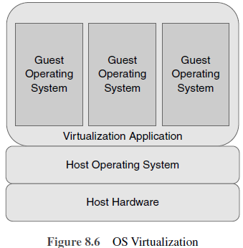

Slide 58
OS Virtualization
Diagram
guest OS-based virtualization
the guest operating systems work in virtual machines inside the virtualization application
  runs on top of the host operating system similar to any other application
Advantages :
no modifications required to either host or guest OS
no particular CPU hardware virtualization support required

Slide 59
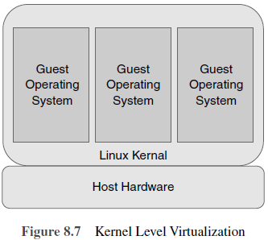

Slide 60
Kernel Level Virtualization
Diagram
overview of the kernel level virtualization architecture
the host operating system operates on a specially customized kernel
includes extensions designed to manage and control several virtual machines
each VM has a guest operating system
each guest operates its own kernel
Limitation:
  Guest operating systems must have been compiled for the same hardware as the kernel in which they are running.
Examples :
  User Mode Linux (UML)
  Kernel-based Virtual Machine (KVM)

Slide 61
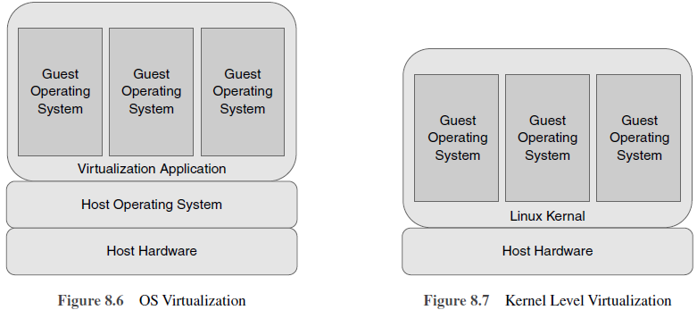

Slide 62
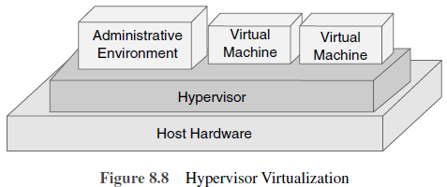

Slide 63
Hypervisor Virtualization
the host operating system contains an administrative environment
  to manage and control multiple VMs
each VM containing a guest operating system
An administrative operating system and/or management console also runs on top of the hypervisor in addition to the VMs
  allows the virtual machines to be administered by a system administrator
Hypervisor-based virtualization solutions include Xen, VMware ESX Server and Microsoft’s Hyper-V technology.

Slide 64
OS Virtualization
All tasks runs from the network using a virtual disk.
this virtual disk is just an image file stored on a distant server, SAN or NAS.
The client will be connected to this virtual disk through the network and it will boot with the operating system available in the virtual disk.
2 types of virtual disks in most implementations :
  Private virtual disk
  Shared/common virtual disk

Slide 65
1. Private virtual disk
acts as a key for a client
he can use it to store information
  based on the rights assigned to him
when the client’s disk is restarted, the settings are retained
  just like working with a physical local hard disk

Slide 66
2. Shared/common virtual disk
Multiple clients use a shared virtual disk simultaneously
During access, changes are stored in to a special cache.
The cache content will be cleared when the client is shut down or restarted.

Slide 67
Working of OS Virtualization
The components for using OS virtualization in the infrastructure :
  OS virtualization Server
    the first component
    initializes virtual disk
  Client :
    the second component
    establishes link with first component to run the OS

Slide 68
Server :
The first component
OS virtualization server
initializes virtual disk
establishes the connection with the client
can host the storage for the virtual disk locally or
the server is connected to the virtual disks via a SAN or File Share

Slide 69
Virtual disk have an image of a physical disk from a system which mirrors the configuration of those systems and also the settings.
The disk needs to be assigned to the client which uses this disk to start when the virtual disk is created.
When a client has a disk assigned, the machine can be started with the virtual disk using the following steps:

Slide 70
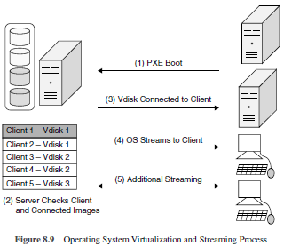

Slide 71
PXE (Preboot Execution Environment)
PXE is a network protocol that allows a computer to boot and load its operating system using resources from a network server instead of a local storage device like a hard drive.
It enables network booting by leveraging the Dynamic Host Configuration Protocol (DHCP) and Trivial File Transfer Protocol (TFTP).
With PXE, a computer (known as the client) sends out a DHCP request to the network, and the DHCP server responds with an IP address and additional configuration information, including the location of the network boot server.
The client then contacts the boot server and retrieves the necessary files, typically including the bootloader and operating system image, using TFTP.
Once the files are downloaded, the client can proceed to boot and load the operating system.

Slide 72
OS Virtualization and Streaming Process
Step 1—Connecting to the OS virtualization server:
Start the machine and set up a connection with the OS virtualization server.
Step 2—Connecting the virtual disk:
During connection establishment between the client and the server, the server goes through its database to check whether the client is known and checks if the virtual disk(s) are allocated to the client. If a disk is allocated, this disk will be associated to the client in the next step.

Slide 73
OS Virtualization and Streaming Process (1)
Step 3—VDisk connected to the client:
Once the preferred virtual disk is chosen, it is connected to the client through the OS virtualization server.

Slide 74
OS Virtualization and Streaming Process (2)
Step 4—OS is ‘streamed’ to the client:
Once the disk is connected to the server, it starts streaming the content of the virtual disk. Many OS provide several approaches to cache this information, for example, the client memory, on the disk of the OS virtualization server and locally on the hard disk of client.
Step 5—Additional streaming:
Once the first part streaming is over, operating system starts as expected (e.g., starting an application which is there within the virtual disk).

Slide 76
OS Virtualization Pros
Flexible provisioning: It is very simple and easy to connect different virtual disks to a system through OS virtualization. Starting another operating system or any other application can be done easily by the client.
Rapid software deployment: Adding a new server or workstation happens within few seconds. Using deployment tools to install and configure the system or doing it manually takes at least a few hours, with a few steps the client is allocated to a virtual disk and can be used in production.
Easy and efficient implanting updates and hot fixes of the operating system and applications: In OS virtualization, it is enough to add an update to the virtual disk image and not to all servers.
Easy rollback scenarios: Rollback to previous state is easy in OS virtualization.

Slide 77
OS Virtualization Cons
No work off-line capability: OS virtualization products must be connected to the virtualization server for using the operating system virtually.
High-speed LAN recommended: A high-speed LAN is needed as the virtual disk is connected to the OS virtualization server through the network.
Limited numbers of operating systems are supported: Limited number of OS supports virtualization. Some Linux distributions do not support the OS virtualization technique.
Imaging disadvantages apply to this technique: Virtual disk is created using image-based techniques. All disadvantages of imaging techniques are also applicable for the OS virtualization component.

Slide 78
OS Virtualization: Sample Scenarios
Citrix XenApp/terminal servers: Citrix XenApp/terminal server-based infrastructures OS virtualization is a good solution. After each reboot the terminal server is back in its default state and changes are applied to all servers by using the shared virtual disks.
VDI/DDI solutions: Virtual desktop infrastructure solutions are also becoming increasingly fashionable today. With the OS virtualization, the same virtual disk can be used by virtual machine and no expensive disk space is required on the SAN.
Back-up servers: Back-up servers are used only for few hours a day, and the hardware is idle most of the time. Therefore, the hardware can be used for other roles during business hours and it can also be assigned to the back-up server role.
Notes:
DDI is shorthand for the integration of DNS, DHCP, and IPAM (IP Address Management) into a unified service or solution. DDI comprises the foundation of core network services that enables all communications over an IP-based network.

Slide 79
OS Virtualization: Sample Scenarios (1)
Development/test environments: OS virtualization can easily provide the machines to run development and test tasks on virtual hardware by flexible provisioning.
Educational environments: Using OS virtualization, multiple virtual disks can be created and assigned with multiple OS environment. The user can select the required environment using the boot menu.
Secure environments: OS Virtualization can be used for secure environments, as no data is available on that machine.

Slide 80
Storage Virtualization (SV)
a new concept under virtualization
used by Storage systems
for better functionality & more features within the storage system
storage array, disk array or filer
Storage systems :
  use special hardware and software
    provides fast and reliable storage for computing and processing data
  complex and specially designed to accommodate storage capacity with data protection
  provide block and file accessed storage
  Examples for block accessed : Fibre Channel, iSCSI, SAS, FICON;
  Examples File accessed :NFS and CIFS

Slide 81
Types of SV
Block virtualization separates the logical and physical storage. This gives greater flexibility for the administrators in managing storage for consumers.
To eliminate the dependencies between the facts and numbers accessed at the document level and the position where the documents are retained, file virtualization method is utilized. This method optimizes usage of storage and server consolidation.

Slide 82
Storage virtualization contributes high in traffic mirroring, and migrates LUNs [Logical Unit Numbers] from one disk array to another without downtime.
Virtualization pools multiple physical storage as a single storage device that can be managed from a central console. The managing storage devices can be tiresome and timeconsuming.

Slide 83
SV…..
Structure of storage virtualization will be in the form of what are created, where the virtualization is done and how it is implemented.
3 Ways of SV structuring:
1. Host-based: Traditional device handles physical drives.
2. Storage device-based: Pooling and managing metadata.
3. Network-based: Device which uses fibre channel.

Slide 84
Benefits of Storage Virtualization
Non-disruptive data migration: Ability to migrate data without disturbing concurrent I/O access.
Improved utilization: Utilization can be increased by pooling and migration. When all storage media are pooled, the administrator can easily maintain the devices and also assign disks for the users.

Slide 85
Risks and Complexities
Risks in block virtualization are:
Backing out a failed implementation
Interoperability and vendor support Complexity affects several areas, they are:
  Management of environment
  Infrastructure design
  The software or device itself
  Performance and scalability

Slide 86
Network Virtualization
The procedure of blending the accessible assets in a n/w by dividing up the accessible bandwidth into channels
all subscribers can access all the resources of the network using a single computer
A VM can be configured with one or more virtual Ethernet adapters.
Virtual switches which permit VMs on the same virtualization hardware host to communicate with everyone through the same protocols that would be used over physical switches, without the need for extra hardware.

Slide 87
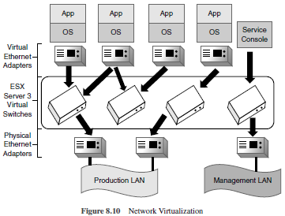

Slide 88
Wiki……
Elastic Sky X , Sep 2004
Where i stands for Integrated
VMware ESXi (formerly ESX) is an enterprise-class, type-1 hypervisor developed by VMware, a subsidiary of Broadcom, for deploying and serving virtual computers.
As a type-1 hypervisor, ESXi is not a software application that is installed on an operating system (OS);
  instead, it includes and integrates vital OS components, such as a kernel.

Slide 89
Network Virtualization
Network management : a time-consuming process
can improve productivity and efficiency
  by performing tasks automatically
sharing or reallocation of storage space among the servers
Easy to add or reassign the storage media such as hard drives and tape drives
Optimization of network speed, reliability, flexibility, scalability and security
Two main scenarios focused by network virtualization:
A shared experimental facility, i.e., running multiple experiments at the same time.
Long-term solution for the future Internet.

Slide 90
Network Virtualization Types
Based on the implementation given by vendors that support the technology.
External network virtualization: In this situation, to achieve the objective of improving the efficiency of a large corporate network or data centre by combining one or more local networks or subdivided into virtual networks.
Internal network virtualization: A single system is configured with containers using Xen/KVM domain and combined with hypervisor control programs, for example, VNIC (Virtual Network Interface Card) to create a ‘network in a box’.
  Examples of internal network virtualization : NetworkStack project, OpenSolaris network and Microsoft virtual server

Slide 91
Topics to cover
Part I : Introduction
Definition of Virtualization
Adopting Virtualization
Types of Virtualization
Virtualization Architecture and Software
Virtual Clustering
Virtualization Application
Pitfalls of Virtualization

Slide 92
4. VIRTUALIZATION ARCHITECTURE AND SOFTWARE
The Virtualization Architecture

Slide 93
The Virtualization Architecture
MultiNet Protocol Driver (MPD)
to implement virtualization of wireless adapter and placed as an intermediate layer between MAC and IP.
Diagram :How MPD can be used to share a wireless network adaptor and its MAC
MPD sits between IP layer and physical layer (MAC).
When an application wants to use more than one network than using TCP/IP,
  the path is sent to MPD,
  MPD is responsible for switching and allocating the network and appropriate MAC address.
MPD exposes the wireless LAN media adapter as always active.
IP stack checks the adapters, whether they are active always, even though only one is connected at a given time.
Switching and buffering of packets across networks is done by MPD.

Slide 94
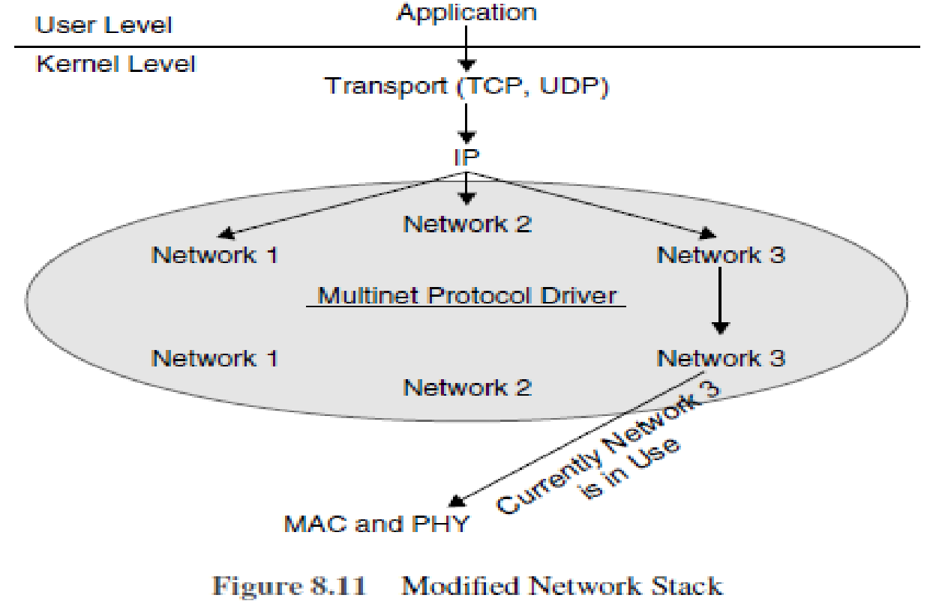

Slide 95
Diagram : Modified N/w Stack
the virtualization of a WLAN card
  where a user needs to connect to three networks (wireless)
The MPD represents three virtual adapters, and everything appears active to IP even though only Network 3 is active at the moment (diagram).
IT organizations are validating the benefits of desktop and server virtualization, from energy efficiency to better resource utilization.
If we want to split big money for the technology, there are low-cost and no-cost models to try the virtualization.
Freebies for virtualization tools are available from Microsoft and VMware and they are from the open source community.

Slide 96
Virtualization Tools
OpenVZ
Q
QEMU
VMware Server, Player and Converter

Slide 97
1.OpenVZ
This is a Linux-based software where the administrator can create protected virtual environments.
Every virtual server can be rebooted separately.
SWsoft supported this project and markets this in the name of ‘Virtuozzo’.

Slide 98
2. Q
It is a FOSS kind of software for running other programmers on Macintosh.
It enables the users to exchange files between host operating system and the guest OS.
Q is based on the QEMU open source CPU emulator.

Slide 99
3. QEMU
QEMU can run operating systems and programs developed for one machine on a different machine.
Only restriction for QEMU is host and the guest machine must use x86-compatible processors.
QEMU is a generic and open source machine emulator and virtualizer.
When used as a machine emulator, QEMU can run OSes and programs made for one machine (e.g. an ARM board) on a different machine (e.g. your own PC). By using dynamic translation, it achieves very good performance.
When used as a virtualizer, QEMU achieves near native performance by executing the guest code directly on the host CPU. QEMU supports virtualization when executing under the Xen hypervisor or using the KVM kernel module in Linux. When using KVM, QEMU can virtualize x86, server and embedded PowerPC, 64-bit POWER, S390, 32-bit and 64-bit ARM, and MIPS guests.

Slide 100
4. VMware Server, Player and Converter
VMware Server is VMware’s starter kit for Windows and Linux server virtualization.
It can host Windows, Linux, NetWare and Solaris as guest operating systems.

Slide 101
Topics to cover
Part I : Introduction
Definition of Virtualization
Adopting Virtualization
Types of Virtualization
Virtualization Architecture and Software
Virtual Clustering
Virtualization Application
Pitfalls of Virtualization

Slide 102
5. VIRTUAL CLUSTERING
Introduction to Cluster
Definition of Clustering
Benefits of Clustering
Virtual Cluster Description

Slide 103
Introduction to Cluster
The theoretical definitions of clusters and cluster-based developments are ambiguous.
According to the economic theory,
  clusters are defined as collection of organizations and institutions, co-located in a geographic entity and linked by interdependencies in order to provide a product and/or service.

Slide 104
Definition of Clustering
According to the book titled In Search of Clusters,
Cluster is defined as ‘a type of parallel or distributed system that consists of a collection of interconnected computers and is used as a single, unified computing resource’.
Forming a cluster refers to a collection of computers bound together to form a common resource pool.
A task or job can be executed on all computers or a particular computer in the cluster.

Slide 105
Benefits of Clustering
Scientific applications: Applications running on supercomputers can be migrated to Linux cluster (which is more cost effective).
Large ISPs and E-commerce enterprise with large database: Internet service providers or e-commerce web site that requires high availability and load balancing and scalability.
Graphics rendering and animation: Film industry is benefited because of clustering, in particular for rendering quality graphics and animation scenes. Examples include Titanic, True Lies and Interview with the Vampire.

Slide 106
Benefits of Clustering (2)
Fail-over clusters: Using clusters, network services are increased in terms of availability and serviceability and when a server fails, its services are migrated to another system. For example, failover servers are database servers, mail servers and file servers.
High availability load balancing clusters: Application can run on all computers and can host multiple applications. Individual computers are hidden to the outside world as they interact only with the clusters. This kind of clustering produces best results with stateless application and when executed concurrently.

Slide 107
Virtual Cluster Description
A virtual workspace is composed of workspace metadata,
  Metadata : represented as an XML Schema and implementation-specific information like pointer to the image in VM which implement a given workspace.
    Aim: to capture workspace requirements in terms of virtual resource, software configuration and features.
  the addition to the workspace metadata and implementation
  necessary to characterize a new type of workspace called a virtual cluster.
2 types of nodes in virtual clusters: Head nodes and worker nodes
A head node differs from worker nodes in principle and configuration, particularly in software and operational setup.
Though worker node configurations are similar, they may be given different names or their position may be different.

Slide 108
Topics to cover
Part I : Introduction
Definition of Virtualization
Adopting Virtualization
Types of Virtualization
Virtualization Architecture and Software
Virtual Clustering
Virtualization Application
Pitfalls of Virtualization

Slide 109
VIRTUALIZATION APPLICATION
Application virtualization describes a new software technology has a technical edge over improving portability, compatibility and manageability of various applications by encapsulating them from its base OS, on which they are executed.
A virtualized application is not installed as in case of any other software/application, but it is executable as it is installed.
We make the application at runtime so that it directly interfaces with the required OS and resources it needs.
Here the virtualization refers to ‘encapsulated application’, whereas in hardware virtualization is referred as ‘abstracted hardware’.

Slide 110
Technology Types Under Application Virtualization
Application streaming
Desktop virtualization/virtual desktop infrastructure (VDI)

Slide 111
Benefits of Application Virtualization
Non-native applications can be executed (i.e., windows applications in Linux)
Protection for the operating system
Lesser resources are used
Able to run applications with bugs (i.e., accessing read-only system owned location for storing user data)
Incompatible applications can be executed with lesser regression testing
Migration of various operating systems is simplified
Faster application deployment and on-demand application streaming
Security is improved as applications are isolated from operating systems
Enterprises can easily track license usage
Tracking license usage is done easily for applications
No need to install the applications, as it can be imported from portable media to client computers

Slide 112
Limits for Application Virtualization
All softwares cannot be virtualized.
  Examples include device driver and 16-bit applications.
Anti-virus packages require direct OS integration, these packages cannot be virtualized.
For legacy applications, file and registry level compatibility issues can be resolved using virtualization in newer operating systems. For example, Windows Vista applications will not run where they don’t manage the heap correctly. For this reason, application compatibility fixes are needed.

Slide 113
PITFALLS OF VIRTUALIZATION
Definition
‘Using virtualization organizations are able to cut cost, utilize assets and reduce time for implementation and complexity, which are more important for now-a-day environment.’
—Alan Dayley, Gartner

Slide 114
Introduction: Virtualization Benefits
In the technology category, virtualization has been in the field for about a decade, but it is only been in the past few years that it has become a core technology for more organizations.
Though there are many technologies that come under the broader classification of virtualization, the prime focus has been on server virtualization, since it has multifaceted value proposition.

Slide 115
Virtualization Benefits (1)
If deployed correctly, server virtualization will serve the following purposes:
Improve the server’s utilization: When non-virtualization, servers utilization is about 25%. After deploying virtualization utilization increases to 70% and goes close to 90%.
Reduce the number of physical servers: It is typical to see consolidation of servers be in the ratio of 5:1 up to 10:1 range.
Contribute to corporate ‘green’ initiatives: Number of servers can be reduced through server virtualization. It will not only require less physical data centre floor space but also use a lesser power and need fewer cooling machines for the same workloads.
Give a fast return on investment (ROI): Business leaders demand one year of less time for ROI. According to survey, a new technology should give ROI immediately (56%) and in a span time of one year (44%). It shows its speed in the field. Another 44% indicated an ROI ranging from one month to one year, a necessary condition for technology deployments today.

Slide 116
Best Practices in Setting Virtualization
Virtual servers are deployed in more businesses to save money on equipment and time for system maintenance.
Because of reduced overhead, the management can free up resources, which in turn can be applied towards innovation and other projects which will benefit the organization.
However, virtualization does have its drawback.
Creation of new virtual servers can easily lead to uncontrollable server sprawl.
Keeping a lot of applications on one node can leave them contending for resources.
And managing your virtual resources among your physical machines can get complicated, especially for IT people managing only one application per physical server.

Slide 117
Tips to help you to tackle some common challenges of virtualization

Slide 118
Avoid Monopoly
Getting started with virtualization is not always simple or predictable as it needs new skills, tools and new ways of viewing the available IT infrastructure.
The first important step in virtualization standards and best practices is to employ an experienced partner to work for the organization.

Slide 119
Proactively Engage Stakeholders
In a conventional server environment, business units expect maximum use of whole server box which generally provides more than adequate capacity, making it seem like a bottomless resource.
But the dynamic nature of virtualization means that resources are shared, as well as the cost of organizing or obtaining them.
Without clear strategy and support from the rest of the organization, there is a chance for conflicting requests to virtualize certain assets.
Involve business stakeholder and get help to manage the transition to virtualization and ensure that it supports the overall business goals.
Be proactive about instructing all affected stakeholders and users about how resources will be assigned, shared and also clarify about the benefits of moving the business to virtualization.

Slide 120
Balance Resource Needs
Increased resource utilization is one of the major advantages of virtualization.
But too many applications requesting for the same resources may leave those applications contending for inadequate RAM, processor capacity, disk I/O or network bandwidth.
Take stock of your applications and their computing requirements before moving everything to a virtual server

Slide 121
Do not Overload Physical Servers
Getting your virtual assets to function smoothly and jointly is one objective.
They still exist in a physical host server, which also needs periodical maintenance and upgrades.
If you are operating multiple physical hosts, ensure that you distribute your mission critical applications strategically.
So that while taking a single host server down for maintenance, multiple mission critical applications are not down at the same time.
Also keep in mind that virtual servers like physical servers have cyclical resource needs that can spike dramatically when business processes are most demanding, whether it be weekly or once in four months.

Slide 122
Prevent Virtual Server Sprawl
Scalability is one of virtualization’s major strengths, but if managed badly can wreak chaos.
New virtual machines can be created so simply and rapidly, that it can feel like a free and limitless resource.
They can quickly hit the highest capacity of your physical hosts and turn server administration into a complicated chaos when too numerous virtual servers are added.
Found standard practices and requirements to justify and control the design of new virtual servers.

Slide 123
Pitfalls of Virtualization: Adoption and Strategies
Introduction of virtualization has brought additional complexity into compliance and security efforts.
The understanding and management is the key for achieving security and realizing the benefits of virtualization.

Slide 124
Pitfalls of Virtualization Adoption and Strategies
Religious battles: Choosing platforms based on requirements and standards that can be created.
Procurement and business changes: As a first step, adopt and train the business people only by using resources such as memory, CPU, network and storage. Do not use by server. Then virtualize it. Offer the business people by saying, ‘I can get you a physical server and storage for few thousands of rupees with a 3 or more year lease or I can get you virtual assets that we can bill month by month based on utilization and scale up or down depending on when you need to scale up or down’.

Slide 125
Pitfalls of Virtualization Adoption and Strategies (2)
Myopic virtualization strategy: Virtualization begins in server consolidation. Server, desktop, application, presentation and management are the five facets of virtualization.
Physical cost recovery models: Practice real numbers and resource-based cost recovery. Practice a base building block as a cost unit and drive from that point.
Physical asset-based security: Virtualization unlocks some new security challenges. At the same time, it also provides solution to some challenges.
Over-virtualization: Virtualizing everything is wrong. It is not everything must be virtualized. Virtualization is not a shiny gunshot. Virtualization is attached with a great ecosystem, appropriate operational processes and organization itself.

Slide 126
Pitfalls in Server Virtualization
Everyone speaking about virtualization and server consolidation nowadays and many companies are taking action, with large enterprises in the top.
Server consolidation over virtualization is a recognized way to save money in numerous ways such as a smaller amount of hardware, lesser power consumption, less floor space, etc.
Apart from server virtualization to obtain significant economic and performance benefits, there are data centre virtualization, application virtualization and desktop virtualization.
No doubt, virtualization is the future of computing, since it decouples computing operating systems and applications from the hardware, offering massive flexibility and agility to an enterprise’s computing system.

Slide 127
Pitfalls in Server Virtualization (1)
Poor preparation: Any virtualization project is almost the first step towards a completely virtualized network that is going to be much different than the tried and tested hardware-centric system. Adding virtual OS to boost computing power may create problems.
Insufficient server capacity: Virtualization does not increase the computing resources, but only the usage. Substantial processing power, input/output capacity, memory and disk capacity needed when multiple operating systems are virtualized.
Mismatched servers: When multiple servers are virtualized which uses different chip technologies (Intel and AMD), there will be various problems while migrating VMs between them. It is recommended to standardize servers on a single chip technology.

Slide 128
Pitfalls in Server Virtualization (2)
Slow network communications: One of the main objectives of virtualization and its main advantage is an enormous bound in computing capacity for a specified amount of hardware. However, latency and network bandwidth can give away much of the proposed gain. Upgradation of network’s communications capabilities are required.
Slow mechanical disks: Present disk technology cannot retain with the read/write demands of multiple servers in high-demand peak hours, you will face some latency. Storage caching is solution to this problem, whereby repeatedly accessed data is served from faster memory instead of disks. Another solution is solid state disks, which ensures read/write speeds up to 30 times quicker than spinning-disk technology.

Slide 129
Pitfalls in Server Virtualization (3)
Uneven workload distribution: Finetuning the distribution of processing requirements across all physical servers is needed to maximize usage of data centre computing power. It means, there is need to monitor usage of application to detect daily, weekly or monthly highest usage and control response times and so on. This will permit you to assign applications accordingly.
Security risks: Virtualization does not improve network security by itself. Firewalls, antivirus needs to be installed and keep them repaired and updated. And also virtualization applications are updated and patched. Finally, design of virtualized infrastructure is required to separate significant data as much as possible.

Slide 130
Topics covered
Part I : Introduction
Definition of Virtualization
Adopting Virtualization
Types of Virtualization
Virtualization Architecture and Software
Virtual Clustering
Virtualization Application
Pitfalls of Virtualization

Slide 131
Topics to cover
Part II : Grid, Cloud and Virtualization
Virtualization in Grid
Virtualization in Cloud
Virtualization and Cloud Security

Slide 132
2.1.Grid Computing
The main focal point in grid computing lies in secure resource sharing in accessing computers, software and data in a dynamic atmosphere.
Sharing of those resources has to be fine-tuned and handled in a highly controlled manner.
3 points to describe a grid :
Nontrivial / imp qualities of service delivery
Practice of using standards in all places
Resources coordination

Slide 133
2.2. Grid Computing and Virtualization
Virtualization :
  a trend
  not a solution for enterprises to manage their resources
  provides richer capabilities in managing and moving the OS in different hardware
  helps to run multiple workloads in a single machine with clear distinction between them
  can do suspending, resuming and migrating images in run-time
Instead of having more hardware to meet peak demands, organizations can use virtualization approaches to get better utilization out of the existing under utilized hardware.
Also virtualization is possibly becoming a mainstream approach in managing network resources.

Slide 134
2.3. Using Virtualization in Grid Computing
Virtualization integration and grid computing can be encouraged at various levels.

Slide 135
2.4. Grid Computing Level

Slide 136
gLite
gLite is a middleware computer software project for grid computing used by the CERN LHC experiments and other scientific domains.
  CERN : European Organization for Nuclear Research
  LHC : Large Hadron Collider
It was implemented by collaborative efforts of more than 80 people in 12 different academic and industrial research centers in Europe.
gLite provides a framework for building applications tapping into distributed computing and storage resources across the Internet.
The gLite services were adopted by more than 250 computing centres, and used by more than 15000 researchers in Europe and around the world.

Slide 137
2.4. Grid Computing Level
The gLite Middleware has strong dependencies to Scientific Linux as OS which is used by the LHC (Large Hadron Collider) Computing Grid High Energy Physics Virtual Organizations (VO).
Making gLite to work with other OSs is not a easy task.
Resource providers can support the VOs with minimal effort by encapsulating the Grid Middleware into a virtual appliance.
The only requirement is support of a virtualization platform like XEN or VMware.
Grid Middlewares can be packaged as virtual appliances similar to the gLite Middleware.
Then resource providers no longer want to consign to a designated grid middleware, but can setup middleware on demand.
User-based dynamic deployment of the middleware services is the most preferable approach.
This makes the resource providers’ interference in the deployment of process and he no longer has to deal with software administration and application requirements.

Slide 138
LRMS Level
The key research work in grid computing is to use virtualization in resource management system locally.
When virtualization is adopted locally, it supports job managements and migration for virtual machines instead of jobs.
Virtualization exhibits with live and delayed migration of virtual machines even on added feature.
Merging the LRMS features (suspension, check pointing) with migration, helps the LRMS in varying the current resource allocation dynamically.
In addition, alteration of resources (e.g. number of CPUs, RAM) allocated to a virtual machine is possible and also it allows dynamic updating in service quality that can be done on-the-fly or by suspending and resuming depending on the virtualization platform.

Slide 139
Virtual Machines
Virtual machines can check the execution of applications and also they are useful tool for grid system administrators.
VMs can easily manage the systems in terms of isolating and partitioning the amount of resources needed.
Diagram : Dynamic Provisioning of Computational Services in Grid

Slide 140
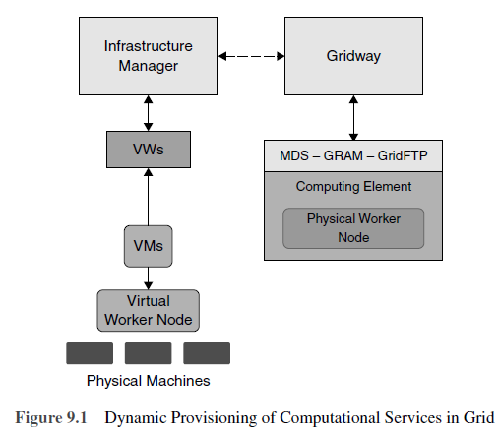

Slide 141
the architecture developed for dynamic provisioning of computational services in grid
It also explains, how computational services can be deployed virtually in grid.
The architecture consists of
  physical machines
  physical worker nodes
  infrastructure manager
  GridWay
  virtual workspace service (VWS)
  grid middleware components such as
    monitoring and discovery of services (MDS)
    grid resource allocation manager (GRAM)
    GridFTP

Slide 142
Working
User’s requests are submitted to GridWay (meta-scheduler).
Depending on the policies, SLAs and the grid load, an infrastructure manager deploys it in worker nodes (VO-specific).
The deployment of the VMs supporting the worker node is done through the virtual workspace service (VWS).
When worker node is up, it registers the information stored in information service (MDS).
Now GridWay can detect the slot and jobs are submitted through GRAM.

Slide 143
Topics to cover
Part II : Grid, Cloud and Virtualization
Virtualization in Grid
Virtualization in Cloud
Virtualization and Cloud Security

Slide 144
VIRTUALIZATION IN CLOUD
Virtualization
  a tool for system administrators, which has many technical uses than a cloud
  allows IT organizations to perform multiple operations using a single physical hardware
  Multiple OS instances running on single device is cost-effective than multiple servers for each task.
Cloud computing
  is accessed through the WWW
  takes advantage of virtualization
  can also be used without virtualization

Slide 145
Combination
CC and virtualization will modernize IT organizations.
By combining them, companies can run their applications without the need of running updates and backups, as they all will be done by the provider.
Virtualization and cloud computing can go hand in hand.
Virtualizing everything started a year ago when processing power, software and servers are virtualized.
Now-a-days virtualization means cloud computing.
Cloud computing refers to IT organizations using remote servers for storing data and accessing information from anywhere.
This is done in three ways—public cloud, private cloud and hybrid cloud.

Slide 146
Virtualization
Virtualization has various forms, for example
one can virtualize a desktop which means, that the desktop is stored virtually in the clouds and that can be accessed from anywhere.
We can virtualize an operating system, that is running Mac OS in the latest Windows OS.
Virtualization got more familiar in 2009 and 2010 because of the recession.
IT organizations used virtualization to save infrastructure cost.

Slide 147
Cloud
Cloud was implemented as outsource model first and then gradually was implemented within the enterprise firewall as an architecture.
On the other hand, virtualization was started within the limitations of enterprise firewall and then was operated in hosted environments.
Even if there are differences and similarities, many people in the industry use them interchangeably.

Slide 148
Cloud computing and virtualization are two different technologies that work independently.
Although cloud computing is better utilized if desktop virtualization is done first it requires multiple virtual servers and storage devices, that is multi-tenancy.
Virtualization saves on their infrastructures, that is resources are virtualized.
  For example, server X is only utilized by 20% and server Y is utilized only by 45%.
  These two can be combined using virtualization, that is Server X in Server Y.
Table : the similarities between cloud computing and virtualization

Slide 149
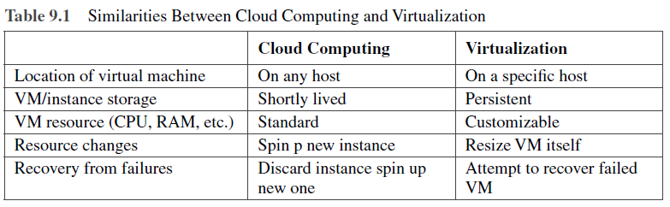

Slide 150
Virtualization splits the link between processing and physical machines.
Cloud computing facilitates the use of scalable processing services offered by online providers, through virtualization.
From an architectural point of view, the question of what is supposed to run, where it should run and a clear understanding of the relative cost of processing is necessary.
Diagram : the cloud computing adoption model

Slide 151
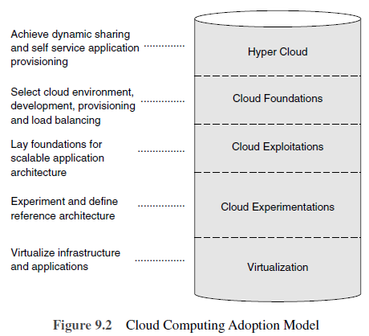

Slide 152
Cloud computing adaptation model consists of layers such as:
Hyper cloud where dynamic sharing and self-service application provisioning are done.
Cloud foundations where cloud environments, deployments ways, load balancing are done.
Cloud exploitation where foundations for scalable application architecture are carried out.
Cloud experimentations where architectures are experimented.
Virtualization where infrastructure and applications are virtualized

Slide 153
Virtualization as an Element of Cloud Computing
Cloud computing is a technology.
Private cloud does not adopt virtualization.
It uses technologies that are highly flexible and provide multiple services.
Virtualization and cloud computing are associated closely.
VMware, Microsoft and Citrix Systems are the major hypervisor vendors trying to adopt it in the cloud.
They modified their products with tools (i.e. hypervisor), promoting the usage of private cloud computing.

Slide 154
Need of Virtualization in CC:
Benefits of Virtualization and CC
CC has the ability to deliver resources on demand.
Users can choose and pay for the services consumed.
A cloud service can act as an infrastructure for applications, data storage and as a development platform which can be received on demand from the provider.
The primary technology in cloud is virtualization.

Slide 155
Need of Virtualization in CC:
Benefits of Virtualization and CC
Virtualization has the ability to save cost in infrastructure, isolates OS and application from the hardware, which can be delivered as an on demand cloud services.
Adopting virtualization lowers TCO, simplifies management and SLAs.
Virtualization can play a vital role in cloud computing.
It is the technology that make service providers to deliver low-cost hosting environments to IT organizations including SMBs.
Virtualization has enabled us to consolidate the servers and do more with fewer infrastructures.

Slide 156
2.3. VIRTUALIZATION AND CLOUD SECURITY
Security in the cloud is achieved due to virtualization.
Since virtualization combines all physical components as a single unit, the complexity of monitoring these components is made easier.
Trust zones are created and personalized by the IT administrator.
These zones watch workloads in terms of information, application and endpoints.
Zones created are watched through the cloud by means of infrastructure virtualization.
Automated SLAs can then evaluate risk and instigate remediation when security troubles arise instantaneously.

Slide 157
Topics to cover
Part II : Grid, Cloud and Virtualization
Virtualization in Grid
Virtualization in Cloud
Virtualization and Cloud Security

Slide 158
Topics to cover
Part III : Virtualization and Cloud Computing
Anatomy of Cloud Infrastructure
Virtual infrastructures
CPU Virtualization
Network and Storage Virtualization

Slide 159
3.1. ANATOMY OF CLOUD INFRASTRUCTURE
Anatomy of Cloud Computing
Cloud Stack
Cloud Consumers

Slide 160
1. Anatomy of Cloud Computing
CC is changing itself to meet the demands of customers in terms of software and hardware.
These changes have benefitted developments in web-based applications and facilitated decisions-making in business.
  Thomas J. Watson of IBM has said ‘there may be a demand for five in world market for computers.’
  IBM designed computers for 20 companies, expecting to get orders only from five companies.
  Surprisingly, IBM got order for 18 companies for the IBM 701 system.
Operations in terms of hardware and data are the main players and they are not cost effective.
Cloud’s on-demand infrastructure will make it cheaper and efficient.

Slide 161
1. Anatomy of Cloud Computing (2)
Microsoft and Google are the new players using cloud computing technology.
Microsoft’s Windows Azure platform will provide best results for C# and ASP.Net development.
Google’s App Engine and its Python language has powered distributed web applications.
The most famous cloud computing provider is Amazon’s EC2.
AMI (Amazon Machine Image) is the block used in EC2 virtualization and is the point of interaction to users of Amazon’s EC2.

Slide 162
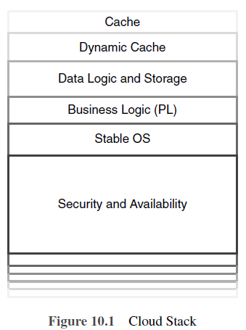
2. Cloud Stack

Slide 163
2. Cloud Stack
Infrastructure stack for delivering web applications by the providers of CC.
Diagram : Cloud Stack
The managed cloud stack consisting of two parts:
consists of cache, dynamic code and attached storage and logic for the dynamic code;
consists of stable and efficient OS, security features and business logic written using some programming language.
CC environment separates the computing environment away from the developers and helps them focus on improving their application.

Slide 164
Every cloud platform includes a virtual machine language and a gateway for web services.
Language functions are closely linked with parent OS and their native libraries are taken away.
External tools and ordinary compilers will not function in the cloud language layer.
Cloud services always bundles language runtime dynamically for efficient interpretation across many application instances.

Slide 165
Dynamic applications resides in application state and logic through database and file storage.
In CC, the database and the file server are placed inside cloud services, which are operated in an isolated and specialized layer.
This isolation layer makes the storage layer inter-changeable from cloud stack.

Slide 166
Static files are categorized based on their size.
File> 1 MB need to be chopped into parts for an easier and sequenced download.
Static cloud storage can be broken up according to their file size and type, thus providing best solution for storage and delivery.

Slide 167
3. Cloud Consumers
Web Application Developers
New small web applications may experience exponential growth.
Web developers use CC stack for faster web performance and their applications.
Enterprise applications have deployed different cloud models.
SMBs and large-sized IT companies are replacing their in-house maintenance and relying on IaaS.
Project management, employee tracking, payroll and some common functions are deployed as SaaS.
Windows Azure, Salesforce’s Force.com and Google App Engine has strong support for back office add-ons.
Microsoft and Google support Exchange Online and Google Apps, respectively.
Force.com tied to the popular Salesforce CRM application for sales and marketing teams.
Companies such as Aptana, CohesiveFT, RightScale are some examples for cloud hosting providers.

Slide 168
Topics to cover
Part III : Virtualization and Cloud Computing
Anatomy of Cloud Infrastructure
Virtual infrastructures
CPU Virtualization
Network and Storage Virtualization

Slide 169
3.2. Virtual Infrastructures
In the present scenario, the Internet provides services such as research, mining, e-mail and maps.
In the near future, it will converge communication and computation as a single service.
Hence the Internet cannot be considered as a huge shared and unreliable communication enabling data exchanges between users.
Instead, it will become a pool of interconnected resources that can be shared.
Grid’5000, an experimental facility, gathers clusters and gives access to nearly 5,000 CPUs distributed over remote sites and inter-connected by super fast networks.
Virtualization abstracts services and physical resources.
It simplifies the job of managing the resources and offers a great flexibility in resource usage.

Slide 170
The Virtual Machine
Provides an environment where non-trusted applications can be run
Adopts isolation techniques
Allows dynamic deployment of application (portability)
Applied optimization in OS
Manages as a single service

Slide 171
Topics to cover
Part III : Virtualization and Cloud Computing
Anatomy of Cloud Infrastructure
Virtual infrastructures
CPU Virtualization
Network and Storage Virtualization

Slide 172
3.3. CPU VIRTUALIZATION
Virtualizing a CPU is an easy job.
For virtualizing a CPU, the following points are to adhered:
  Privileged instructions runs only in privileged mode.
  Control sensitive instructions that tend to change memory mappings, communicating with other devices.
  Behavior-sensitive instructions that tend to change resource configuration.

Slide 173
By adopting CPU virtualization, two separate CPUs resemble a single CPU, i.e., two systems running in a single system.
By adopting this concept, user can run two OS in a single system.
The most important part of the computer is the central processing unit(CPU).
The main objective of CPU virtualization is to make a CPU function similar to that of two separate CPUs.
CPU virtualization allows the users to run different operating systems simultaneously.
For example, Apple Mac can be virtualized to run Windows as well.

Slide 174
CPU virtualization is not multitasking or multi-threading.
Multitasking is concept of running multiple applications at a time.
Multi-threading is where more than one CPUs can run applications in a way that carries out two actions at the same time.

Slide 175
Topics to cover
Part III : Virtualization and Cloud Computing
Anatomy of Cloud Infrastructure
Virtual infrastructures
CPU Virtualization
Network and Storage Virtualization

Slide 176
Course Outcome CO3:
Analyze virtualization technology and install virtualization software

