Slide 1
CLOUD COMPUTING
ELECTIVE – II
310254(C)
DR. (MISS) REVATI M WAHUL

Slide 2
Course Objective 4:
To learn the application and security on cloud computing

Slide 3
Unit IV
Cloud Platforms and Cloud Applications

Slide 4
Points to cover
Part I : Amazon Web Services (AWS)
Amazon Web Services and Components
Amazon Simple DB
Elastic Cloud Computing (EC2)
Amazon Storage System
Amazon Database services (Dynamo DB)
Reading Material :
Srinivasan, J. Suresh, “Cloud Computing: A Practical Approach for Learning and Implementation”,
Chap 31, pg 336 – 343

Slide 5
Points to cover
Part II : Microsoft Cloud Services
Azure core concepts
SQL Azure
Windows Azure Platform Appliance.
Reading Material :
Rajkumar Buyya, Christian Vecchiola, S. Thamarai Selvi, “Mastering Cloud Computing Foundations and Applications Programming”, Chap 9, pg 341– 350

Slide 6
Points to cover
Part III : Cloud Computing Applications
Healthcare: ECG Analysis in the Cloud
Biology: Protein Structure Prediction
Geosciences: Satellite Image Processing
Business and Consumer Applications:
  CRM and ERP
  Social Networking
Google Cloud Application: Google App Engine. [T1]
Overview of OpenStack architecture. [Additional Material]
T2
T2
Reading Material :
T2.Rajkumar Buyya, Christian Vecchiola, S. Thamarai Selvi, “Mastering Cloud Computing Foundations and Applications Programming”, Chap 9, pg 353– 370
T1. Srinivasan, J. Suresh, “Cloud Computing: A Practical Approach for Learning and Implementation”, Chap 30, pg 329 - 334

Slide 7
Amazon Web Services (AWS)
Commenced in the year 2006
A general cloud initiative
Examples:
  Amazon Elastic Compute Cloud (EC2)
  Amazon Simple Storage Service (S3)
  Amazon Aurora
  Amazon DynamoDB
  Amazon RDS
  Amazon Lambda
  Amazon VPC
  Amazon Lightsail
  Amazon SageMaker

Slide 8
1. Understanding Amazon Web Components And Services
CC adopts scalable computing assets supplied as a service on pay-per-usage basis
Any time, from any where over Internet
User is unaware of the details
CC is also utility computing or grid computing
CC : a paradigm move in how we architect and consign scalable applications.

Slide 9
Earlier
Heavy investment in construction infrastructure
Approach:
  Left large tracts of unused computing capability that took up space in large-scale data hubs
  Needed somebody to babysit the servers
  Had affiliated power costs
The unused computing power trashed away, with no way to impel it out to other businesses or users who might be eager to pay for added compute cycles.
With CC, surplus computing capability can be put to use and be profitably traded to consumers.

Slide 10
Amazon Web Services (AWS)
Give programmatic entry to Amazon’s ready-to-use computing infrastructure.
The robust computing podium that was assembled and enhanced by Amazon is now obtainable by anyone who has entry to the internet.
Amazon gives numerous web services, building-blocks that fulfill some of the quintessence requirements of most systems: storage, computing, messaging and datasets.

Slide 11
Amazon Web Services can aid us to architect scalable procedures by providing:
Reliability: The services run in Amazon’s battle-tested, highly obtainable data centres that run Amazon’s own business.
Security: Basic security and authentication methods are obtainable out of the packing box and customers can enhance them as wanted by layering his/her application-specific security on apex of the services.
Cost benefits: No fastened charges or support costs.
Ease of development: Simple APIs allow us to harness the full power of this virtual infrastructure and libraries, obtainable in most extensively employed programming languages.

Slide 12
Elasticity: Scale the computing supplies based on demand.
Cohesiveness: The four quintessence building-blocks using which services (storage, computing, messaging and datasets) are created from scratch currently work well and give a whole result through a large type of request for paid job domains.
Community: Tap into the vibrant and dynamic customer community that is propelling the extensive adoption of these web services and is bringing ahead sole requests for paid jobs assembled on this infrastructure.

Slide 13
AWS
There are two grades of supports accessible for users of Amazon Web Services:
1. Free forum-based support
2. Paid support packages
Amazon publishes the well-being rank of all its web services in a dashboard (accessible publicly) that is revised with any issues about the services.
Amazon presents standards-based SOAP and REST interfaces for combining with each of the services.
Developer libraries either from Amazon or third parties are accessible in multiple languages, encompassing Ruby, Python, Java, Erlang and PHP, for broadcasting with these services.

Slide 14
Amazon S3 (Storage): Simple Storage Service
Presents a web service interface for the storage and retrieval of data.
Any data can be retained and accessed from any location over the internet.
Users can shop an unlimited number of things in S3, and the dimensions of each retained object can vary from 1 byte to 5 GB.
The data is retained securely utilizing the identical data storage infrastructure Amazon values to power its worldwide mesh of e-commerce websites.
Limited access limits for each S3 object via HTTP requests.

Slide 15
Amazon S3 (Storage)
Simple Storage Service
Absolutely relieves from its concern about storage space, get access to data or protecting the data.
Amazon double-checks high accessibility of the documents, so they are accessible when we require them.
The service-level affirmation supplied by Amazon for S3 commits to a 99.9% uptime, assessed monthly.
https://aws.amazon.com/s3/pricing/

Slide 16
Amazon EC2 (Elastic Computing)
A web service that permits us to use virtual machines within minutes and effortlessly scale the capability up or down founded on demand.
These instances are based on Linux and can run any submission or software.
The EC2 natural environment itself is constructed on the peak of the open source Xen hypervisor.
Amazon permits us to conceive Amazon Machine Images (AMIs) that act as templates for the instances.

Slide 17
Amazon EC2 (Elastic Computing)
Access to these can be controlled by identifying the permissions.
Presents factual web-scale computing, which makes it so straightforward to scale computing assets up and down.
Amazon presents five kinds of servers.
  These servers vary from product single-core x86 servers to eight-core x86_64 servers.

Slide 18
AmazonSQS (Simple Queue Service)
Presents get access to the dependable messaging infrastructure utilized by Amazon.
Users can send and receive messages from any location utilizing direct REST-based HTTP requests.
The message is retained by Amazon over multiple servers and data hubs to supply the redundancy and reliability required from a messaging system.
Each message can comprise up to 8 KB of text data.

Slide 19
Amazon Simple Queue Service (SQS)
Incorporates very well with the other Amazon Web Services.
Presents a large way to construct a decoupled framework where EC2 instances can communicate with each other by dispatching a message to SQS and coordinating the workflow.
One can also use the queue for constructing a self-healing, auto-scaling EC2-based infrastructure for their application.

Slide 20
Amazon SimpleDB (SDB)
A web service for saving, processing and querying, organized datasets.
It is not a relational database in the customary sense, but it is a highly accessible schema, with a less-structured data shop in the cloud.
Simple to use and presents most of the purposes of a relational database.
The maintenance is much easier than a usual database.
Administrative tasks are taken care of by Amazon.
The data is mechanically indexed by Amazon and is accessible to us anytime from anywhere.
A key benefit of not being guarded to schemas is the proficiency to inject data on the fly and add new columns or keys dynamically.

Slide 21
2. Elastic Compute Cloud (EC2)
A most important component of Amazon.com’s cloud computing platform, Amazon Web Services.
Permits scalable deployment of applications by supplying a web service.
Clients can use an AMI to conceive a virtual machine, encompassing any software programs desired.
A client can conceive, launch and terminate server instances as required, giving time for active servers, therefore the period ‘ elastic’.
Presents users with command over the geographical position of instances that permits for latency optimization and high grades of redundancy.

Slide 22
Amazon’s features
A service grade affirmation for EC2
Microsoft Windows in beta pattern on EC2
Microsoft SQL Server in beta pattern on EC2
Designs for an AWS administration console
Designs for load balancing, auto-scaling and cloud supervising services
Amazon Elastic Compute Cloud (Amazon EC2) is a world wide web service that presents resizable computing capability that is utilized to construct and host software systems.

Slide 23
Major Constituents of EC2
Amazon Machine Images and Instances
Storage
Amazon S3
Databases
Amazon CloudWatch

Slide 24
Amazon Machine Images and Instances
A template that comprises a software program configuration (e.g., functioning scheme, submission server and applications).
From an AMI, a client can launch instances, which are running exact replicates of the AMI.
Also he/she can launch multiple instances of an AMI
Diagram

Slide 25
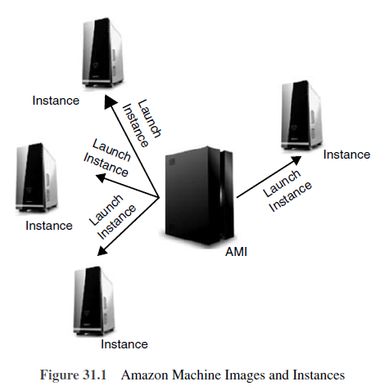

Slide 26
Amazon Machine Images and Instances
Instances hold running until the client halts or terminates them, or until they fail.
If an instance falls short, it can be commenced from the AMI.
One can use a single AMI or multiple AMIs counting on needs.
From a single AMI, distinct types of instances can be launched.
An instance type is vitally a hardware archetype.
Amazon publishes numerous AMIs that comprise widespread program configurations for public use.
In supplement, constituents of the AWS developer community have released their own made-to-order AMIs.

Slide 27
Storage
When utilizing EC2, data have to be stored.
The two most routinely utilized storage kinds are:
1. Amazon Simple Storage Service (Amazon S3)
2. Amazon Elastic Block Store (Amazon EBS) volumes

Slide 28
Amazon S3
storage for the internet
Presents a open World Wide Web service interface that provides us to shop and get any amount of data from any location on the web.
Amazon EBS presents the instances with continual, block-level storage.
Amazon EBS volumes are vitally hard computer disks that can adhere to a running instance.
Volumes are particularly matched for submissions that need a database, a document system or get access to raw block-level storage.
One can adhere multiple volumes to an instance.
To hold exact duplicate, a client can conceive a snapshot of the volume.
The user can also detach a volume from an instance and adhere it to a distinct one.

Slide 29
Databases
The submission running on EC2 might require a database.
Following are two well-known modes to apply a database for the application:
Use Amazon Relational Database Service (Amazon RDS), which provides us to effortlessly get an organized relational database in the cloud.
Launch an instance of a database AMI and use that EC2 instance as the database.
Amazon RDS boasts the benefit of managing the database administration jobs, for example, patching the programs, endorsing, saving backups, etc.

Slide 30
Amazon CloudWatch
A web service that presents real-time supervising to Amazon’s EC2 clients on their asset utilization, such as CPU, computer disk and network.
Does not supply any recollection, computer disk space or load average metrics.
The data is aggregated and supplied through the AWS administration console.
It can additionally be accessed through online tools and web APIs.
The metrics assembled by Amazon CloudWatch provide auto scaling characteristics to dynamically add or eliminate EC2 instances.
The clients are recognized by the number of supervising instances.

Slide 31
3.Amazon Storage System S3
A service from Amazon permits the users to store documents into dependable isolated storage at a very comparable price.
Utilized by businesses to store photographs and videos of their clients, back up their own data and more.
Presents API for both SOAP and REST.
Manages objects and buckets.
An object agrees to a retained file.
Each object has an identifier, an owner and permissions.
Objects are retained in a bucket.
A bucket has an exclusive name that should be well-trained with internet domain calling policy.
The object identifier consists of a filename with its relative path.
With this, S3 storage can emerge as a normal file system with folders and subfolders.

Slide 32
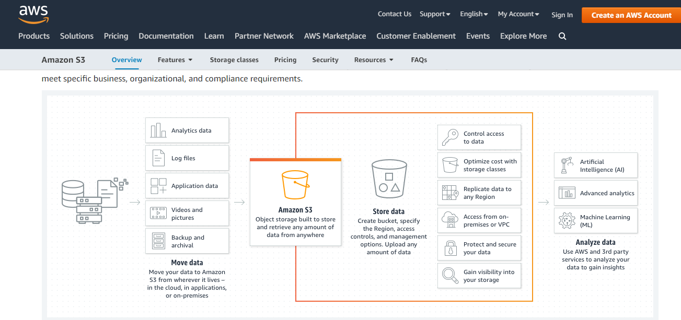

Slide 33
S3
S3 stores random things (computer files) up to 5 terabytes in dimensions, each escorted by up to 2 kilobytes of metadata.
Objects are coordinated into buckets and recognized inside each bucket by an exclusive, user-assigned key.
Amazon Machine Images (AMIs) are changed in the Elastic Compute Cloud (EC2) that can be bundled to export to S3.

Slide 34
Amazon S3 is required for those who have the following issues:
Running out of bandwidths: Amazon S3 presents unlimited bandwidth and clients can be assisted with any amount of bandwidth the location needs.
Better scalability: Amazon S3 utilizes cloud hosting and assisting is somewhat fast. Separating them away from the usual HTTP demand will decisively lessen the server burden and therefore assures better stability.
Store documents online: Instead of endorsing up files in CDs/DVDs to save more computer hard disk space, another choice is to store them online. Users have the choice to hold documents with them in a personal account or make them publicly accessible.
Easier documents retrieval and sharing: If a document is online, the client can get access to it from any location as long as there is an internet connection. Amazon S3 furthermore permits one to communicate documents with other associates, purchasers and blog readers in a better way.

Slide 35
4.Amazon Database Services
a worldwide well-known web service
It makes relational database to set up, function and scale in the cloud much simpler.
It presents cost-efficient, resizable capability for multiple industry-standard relational databases and organizes widespread database management tasks.
Amazon RDS guides the users to get access to the capabilities of a well-renowned MySQL or Oracle database server.
Amazon RDS mechanically backs up the database and sustains the database programs that force the DB instance.
Amazon RDS is flexible.

Slide 36
Advantages of Amazon RDS
Accelerated deployment: decreases friction, when going from task development to deployment.
Can use direct API calls to get access to the capabilities of a production-ready relational database without being concerned about infrastructure provisioning or establishing and sustaining database software.
Managed: manages generic database administration tasks.
Compatible: One can easily get native access to a MySQL or Oracle database server with Amazon RDS.
Scalable: With a direct API call, clients can scale the compute and storage assets accessible to the database to meet enterprise desires and submission load.
Reliable: runs on the identical highly dependable infrastructure utilized by other AWS. Its automated backup service mechanically organizes the backup the database and lets us restore at any point.
Secure: presents World Wide Web service interfaces to configure firewall backgrounds that command network get access to the database instances and permits SSL (Secured Socket Layer) attachments to the DB Instances.
Inexpensive: In terms of deployment.

Slide 37
Amazon DynamoDB
Established on the values of Dynamo, a originator of NoSQL.
Adds the influence of the cloud to the NoSQL database world.
It claims the client’s high availability, reliability and incremental scalability, with no restricts on dataset dimensions or demand throughput for a granted table.
Very fast
Runs on the newest in solid-state drive (SSD) expertise and integrates many other optimizations to commit reduced latency at any scale.

Slide 38
Amazon DynamoDB is a NoSQL database service that claims the benefits like:
  Managed
  Scalable
  Fast
  Durable
  Highly available
  Flexible

Slide 39
Points covered
Part I : Amazon Web Services (AWS)
Amazon Web Services and Components
Amazon Simple DB
Elastic Cloud Computing (EC2)
Amazon Storage System
Amazon Database services (Dynamo DB)

Slide 40
Points to cover
Part II : Microsoft Cloud Services
Azure core concepts
SQL Azure
Windows Azure Platform Appliance

Slide 41
Microsoft Azure
A cloud operating system built on top of Microsoft datacenters’ infrastructure
Provides developers with a collection of services for building applications with cloud technology
Services range from compute, storage, and networking to application connectivity, access control, and business intelligence.
Any application that is built on the Microsoft technology can be scaled using the Azure platform, which integrates the scalability features into the common Microsoft technologies such as Microsoft Windows Server 2008, SQL Server, and ASP.NET.

Slide 42
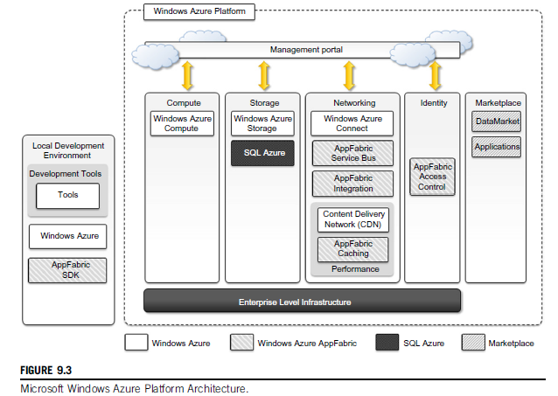

Slide 43
Microsoft Windows Azure Platform Architecture
Diagram: an overview of services provided by Azure
Services managed and controlled through the Windows Azure Management Portal
    acts as an administrative console for all the services offered by the Azure platform

Slide 44
Azure core concepts
The Windows Azure platform is made up of
    a foundation layer and
    a set of developer services to be used to build scalable applications.
AppFabric : middleware that tie together services (compute, storage, networking, and identity management)
This scalable computing environment is hosted within Microsoft datacenters and accessible through the Windows Azure Management Portal.
Alternatively, developers can recreate a Windows Azure environment (with limited capabilities) on their own machines for development and testing purposes.

Slide 45
Overview of the Azure Middleware And its Services
Compute services
Storage services
Core infrastructure: AppFabric
Other services

Slide 46
1.Compute Services
Web role
Worker role
Virtual Machine role

Slide 47
Compute Services
The core components of Microsoft Windows Azure
Delivered by means of the abstraction of roles
Role:
  A runtime environment customized for a specific compute task
  Managed by the Azure operating system
  Instantiated on demand in order to address surges in application demand.
  3 different roles:
      Web role
      Worker role
      Virtual Machine (VM) role

Slide 48
IIS 7 Web Server
a modular, extensible web server that was a complete redesign and rewrite of IIS, shipped with Windows Vista and Windows Server 2008, offering improved performance and secu
Key Benefits:
    Improved performance and reduced memory footprint.
    Customizable installation options.
    Support for HTML websites and optional support for ASP.NET, Classic ASP, and Web server extensions.
    Ability to add or remove modules, and use protocols other than HTTP and HTTP.

Slide 49
Web role
Designed to implement scalable Web applications
Represent the units of deployment of Web applications within the Azure infrastructure
Hosted on the IIS 7 Web Server, which is a component of the infrastructure that supports Azure
When Azure detects peak loads in the request made to a given application, it instantiates multiple Web roles for that application and distributes the load among them by means of a load balancer

Slide 50
Since version 3.5, the .NET technology natively supports Web roles
Developers can directly develop their applications in Visual Studio, test them locally, and upload to Azure.
It is possible to develop ASP.NET (ASP.NET Web Role and ASP.NET MVC 2 Web Role) and WCF (WCF Service Web Role) applications.
Since IIS 7 also supports the PHP runtime environment by means of the FastCGI module, Web roles can be used to run and scale PHP Web applications on Azure (CGI Web Role).
Other Web technologies that are not integrated with IIS can still be hosted on Azure (i.e., Java Server Pages on Apache Tomcat), but there is no advantage to using a Web role over a Worker role.
Notes:
MVC : Model View Controller
WCF : Windows Communication Foundation
FastCGI : A binary protocol for interfacing interactive programs with a web server. It is a variation on the earlier Common Gateway Interface. FastCGI's main aim is to reduce the overhead related to interfacing between web server and CGI programs, allowing a server to handle more web page requests per unit of time.

Slide 51
Worker role
Designed to host general compute services on Azure
Use to quickly provide compute power or to host services that do not communicate with the external world through HTTP.
Common Practice: To provide background processing for Web applications developed with Web roles.
Developing a worker role is like a developing a service.
Web role computation is triggered by the interaction with an HTTP client (i.e., a browser)
A Worker role runs continuously from the creation of its instance until it is shut down.
The Azure SDK provides developers with convenient APIs and libraries that allow connecting the role with the service provided by the runtime and easily controlling its startup as well as being notified of changes in the hosting environment.
As with Web roles, the .NET technology provides complete support for Worker roles, but any technology that runs on a Windows Server stack can be used to implement its core logic.
For example, Worker roles can be used to host Tomcat and serve JSP-based applications.

Slide 52
Virtual Machine Role
Allows developers to fully control the computing stack of their compute service by defining a custom image of the Windows Server 2008 R2 operating system and all the service stack required by their applications.
Based on the Windows Hyper-V virtualization technology which is natively integrated in the Windows server technology at the base of Azure.
Developers can image a Windows server installation complete with all the required applications and components, save it into a Virtual Hard Disk (VHD) file, and upload it to Windows Azure to create compute instances on demand.
Provides finer control of the compute service and resource that are deployed on the Azure Cloud compared to the Worker and Web roles.
An additional administrative effort is required for configuration, installation, and management of services.

Slide 53
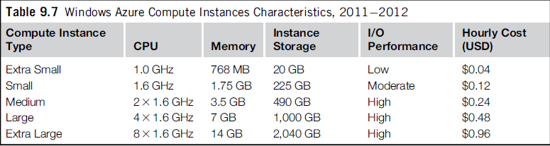

Slide 54
2.Azure Storage Services
Compute resources are equipped with local storage in the form of a directory on the local file system that can be used to temporarily store information that is useful for the current execution cycle of a role.
If the role is restarted and activated on a different physical machine, this information is lost.
? ?
Windows Azure provides different types of storage solutions that complement compute services with a more durable and redundant option compared to local storage.
Compared to local storage, these services can be accessed by multiple clients at the same time and from everywhere, thus becoming a general solution for storage.

Slide 55
Storage services
Blobs
Azure Drive
Tables
Queues

Slide 56
1.Blobs
Azure allows storing large amount of data in the form of binary large objects (BLOBs) by means of the blobs service.
This service is optimal to store large text or binary files.
Two types of blobs are available:
    Block blobs
    Page blobs

Slide 57
Blob Types
Block blobs:
  Composed of blocks and are optimized for sequential access
  Appropriate for media streaming
  Currently, blocks are of 4 MB, and a single block blob can reach 200 GB in dimension.
Page blobs:
  Made of pages that are identified by an offset from the beginning of the blob.
  Can be split into multiple pages or constituted of a single page.
  Optimized for random access and can be used to host data different from streaming.
  Currently, the maximum dimension of a page blob can be 1 TB.

Slide 58
Blobs storage provides users with the ability to describe the data by adding metadata.
It is also possible to take snapshots of a blob for backup purposes.
To optimize its distribution, blobs storage can leverage the Windows Azure CDN so that blobs are kept close to users requesting them and can be served efficiently.
Notes:
CDN : Content Delivery Network

Slide 59
2.Azure drive
Page blobs can be used to store an entire file system in the form of a single Virtual Hard Drive (VHD) file.
This can then be mounted as a part of the NTFS file system by Azure compute resources
To provide persistent and durable storage
A page blob mounted as part of an NTFS tree is called an Azure Drive.
Notes:
NTFS: New Technology File System

Slide 60
3.Tables
Constitute a semi-structured storage solution, allowing users to store information in the form of entities with a collection of properties.
Entities are stored as rows in the table and are identified by a key, which also constitutes the unique index built for the table.
Users can insert, update, delete, and select a subset of the rows stored in the table.
Unlike SQL tables, there are no schema enforcing constraints on the properties of entities and there is no facility for representing relationships among entities.
Tables are more similar to spreadsheets rather than SQL tables.

Slide 61
Tables (2)
The service is designed to handle large amounts of data and queries returning huge result sets.
This capability is supported by partial result sets and table partitions.
A partial result set is returned together with a continuation token, allowing the client to resume the query for large result sets.
Table partitions allow tables to be divided among several servers for load-balancing purposes.
A partition is identified by a key, which is represented by three of the columns of the table.
Currently, a table can contain up to 100 TB of data, and rows can have up to 255 properties, with a maximum of 1 MB for each row.
The maximum dimension of a row key and partition keys is 1 KB

Slide 62
4.Queues
Queue storage allows applications to communicate by exchanging messages through durable queues
To avoid lost or unprocessed messages
Applications enter messages into a queue, and other applications can read them in a first-in, first-out (FIFO) style.

Slide 63
Queues (2)
To ensure that messages get processed, when an application reads a message it is marked as invisible
Hence, it will not be available to other clients.
Once the application has completed processing the message, it needs to explicitly delete the message from the queue.
This two-phase process ensures that messages get processed before they are removed from the queue, and the client failures do not prevent messages from being processed.

Slide 64
Queues (3)
At the same time, the queue does not enforce a strict FIFO model:
  Messages that are read by applications that crash during processing are made available again after a timeout, during which other messages can be read by other clients.
An alternative to reading a message is peeking, which allows retrieving the message but letting it stay visible in the queue.
Messages that are peeked are not considered processed.

Slide 65
Note:
All the services are geo-replicated three times to ensure their availability in case of major disasters.
Geo-replication involves the copying of data into a different datacenter that is hundreds or thousands of miles away from the original datacenter.

Slide 66
Overview of the Azure Middleware And its Services
Compute services
Storage services
Core infrastructure: AppFabric
Other services

Slide 67
Core infrastructure: AppFabric
A comprehensive middleware for developing, deploying, and managing applications on the cloud or for integrating existing applications with cloud services.
Implements an optimized infrastructure supporting scaling out and high availability, sandboxing and multitenancy; state management; and dynamic address resolution and routing.
On top of this infrastructure, the middleware offers a collection of services that simplify many of the common tasks in a distributed application, such as communication, authentication and authorization, and data access.
These services are available through language-agnostic interfaces, thus allowing developers to build heterogeneous applications.
Notes:
Sandbox : a sandbox is a security mechanism for separating running programs, usually in an effort to mitigate system failures and/or software vulnerabilities from spreading.
Sandboxing : Sandboxing is a cybersecurity practice where you run code, observe and analyze and code in a safe, isolated environment on a network that mimics end-user operating environments. Sandboxing is designed to prevent threats from getting on the network and is frequently used to inspect untested or untrusted code.

Slide 68
Core infrastructure: AppFabric
Access control
Service bus
Azure cache
https://download.microsoft.com/download/c/a/7/ca7a9801-736e-421e-a386-16b37c83ffe8/windows-azure-appfabric-pdc10-overview.docx

Slide 69
Access Control
AppFabric provides the capability of encoding access control to resources in Web applications and services into a set of rules that are expressed outside the application code base.
These rules give a great degree of flexibility in terms of the ability to secure components of the application and define access control policies for users and groups.
Access control services also integrate several authentication providers into a single coherent identity management framework.
Applications can leverage Active Directory, Windows Live, Google, Facebook, and other services to authenticate users.
This feature also allows easy building of hybrid systems, with some parts existing in the private premises and others deployed in the public cloud.

Slide 70
Service bus
Establishes the messaging and connectivity infrastructure provided with AppFabric for building distributed and disconnected applications in the Azure Cloud and between the private premises and the Azure Cloud.
Service Bus allows applications to interact with different protocols and patterns over a reliable communication channel that guarantees delivery.

Slide 71
Service Bus (2)
The service is designed
  to allow transparent network traversal and
  to simplify the development of loosely coupled applications,
  without renouncing security and reliability and
  letting developers focus on the logic of the interaction rather than the details of its implementation.
Allows services to be available by simple URLs, which are untied /freed from their deployment location.
It is possible to support publish-subscribe models, full-duplex communications point to point as well as in a peer-to-peer environment, unicast and multicast message delivery in one-way communications, and asynchronous messaging to decouple application components.

Slide 72
Service Bus (3)
In order to leverage these features, applications need to be connected to the bus, which provides these services.
A connection is the Service Bus element that is priced by Azure on a pay-as-you-go basis.
Users are billed :
  on a connections-per-month basis,
  they can buy advance “connection packs,” which have a discounted price, if they can estimate their needs in advance.

Slide 73
Azure cache
Windows Azure provides a set of durable storage solutions that allow applications to persist their data.
These solutions are based on disk storage, which might constitute a bottleneck for the applications that need to gracefully scale along the clients’ requests and dataset size dimensions.

Slide 74
Azure Cache (2)
A service that allows developers to quickly access data persisted on Windows Azure storage or in SQL Azure.
The service implements a distributed in-memory cache
the cache size: dynamically adjusted by applications according to their needs
It is possible to store any .NET managed object as well as many common data formats (table rows, XML, and binary data) and control its access by applications.
Azure Cache is delivered as a service
Easily integrated with applications
  This is a particularly true for ASP.NET applications, which already integrate providers for session state and page output caching based on Azure Cache.
The service is priced according the size of cache allocated by applications per month, despite their effective use of the cache.

Slide 75
Other services
Compute, storage, and middleware services constitute the core components of the Windows Azure platform.
Other services and components simplify the development and integration of applications with the Azure Cloud.
An important area for these services is applications connectivity, including virtual networking and content delivery.
Other Services:
  Windows Azure virtual network
  Windows Azure content delivery network

Slide 76
Windows Azure Virtual Network
Networking services for applications are offered under the name Windows Azure Virtual Network
Includes
  Windows Azure Connect
  Windows Azure Traffic Manager

Slide 77
Windows Azure Connect:
Allows easy setup of IP-based network connectivity among machines hosted on the private premises and the roles deployed on the Azure Cloud.
This service is particularly useful in the case of VM roles, where machines hosted in the Azure Cloud become part of the private network of the enterprise and can be managed with the same tools used in the private premises.

Slide 78
2. Windows Azure Traffic Manager
Provides load-balancing features for services listening to the HTTP or HTTPS ports and
hosted on multiple roles.
It allows developers to choose from three different load-balancing strategies:
  Performance,
  Round-Robin, and
  Failover.

Slide 79
Windows Azure Content Delivery Network
CDN is the content delivery network solution that improves the content delivery capabilities of Windows Azure Storage and several other Microsoft services, such as Microsoft Windows Update and Bing maps.
The service allows serving of Web objects (images, static HTML, CSS, and scripts) as well as streaming content by using a network of 24 locations distributed across the world.
Notes:
CSS : Cascading Style Sheets language

Slide 80
Overview of the Azure Middleware And its Services
Compute services
Storage services
Core infrastructure: AppFabric
Other services

Slide 81
Points to cover
Part II : Microsoft Cloud Services
Azure core concepts
SQL Azure
Windows Azure Platform Appliance
https://learn.microsoft.com/en-us/azure/azure-sql/azure-sql-iaas-vs-paas-what-is-overview?view=azuresql

Slide 82
SQL Azure
A relational database service hosted on Windows Azure and built on the SQL Server technologies
The service extends the capabilities of SQL Server to the cloud and provides developers with a scalable, highly available, and fault-tolerant relational database.
Accessible from either the Windows Azure Cloud or any other location that has access to the Azure Cloud.
Fully compatible with the interface exposed by SQL Server
Thus, applications built for SQL Server can transparently migrate to SQL Azure
The service is fully manageable using REST APIs
Allowing developers to control
  databases deployed in the Azure Cloud as well as
  the firewall rules set up for their accessibility
Diagram: the architecture of SQL Azure

Slide 83
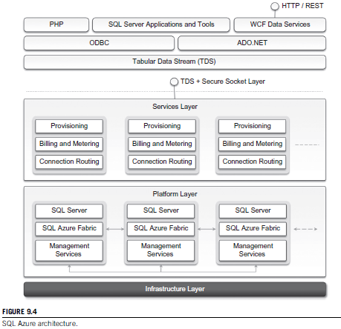

Slide 84
SQL Azure
Access to SQL Azure is based on the TDS
Tabular Data Stream (TDS) protocol: the communication protocol underlying all the different interfaces used by applications to connect to a SQL Server-based installation such as ODBC and ADO.NET.
  ADO.NET: ActiveX Data objects for the .NET Framework that provides communication between relational and non-relational systems through a common set of components.
On the SQL Azure side, access to data is mediated by the service layer, which provides provisioning, billing, and connection-routing services.
These services are logically part of server instances, which are managed by SQL Azure Fabric.
This is the distributed database middleware that constitutes the infrastructure of SQL Azure and that is deployed on Microsoft datacenters.
Notes:
ADO.NET: ActiveX Data objects for the . NET Framework that provides communication between relational and non-relational systems through a common set of components.

Slide 85
Developers have to sign up for a Windows Azure account in order to use SQL Azure.
Once the account is activated, they can either use the Windows Azure Management Portal or the REST APIs to create servers and logins and to configure access to servers.
SQL Azure servers are abstractions that closely resemble physical SQL Servers:
  They have a fully qualified domain name under the database.windows.net (i.e., server-name.database.windows.net) domain name.
  This simplifies the management tasks and the interaction with SQL Azure from client applications.
  SQL Azure ensures that multiple copies of each server are maintained within the Azure Cloud and that these copies are kept synchronized when client applications insert, update, and delete data on them.

Slide 86
The SQL Azure service is billed according to space usage and the type of edition.
Currently, two different editions are available: Web Edition and Business Edition.
The Web Edition is suited for small Web applications and supports databases with a maximum size of 1 GB or 5 GB.
The Business Edition is suited for independent software vendors, line-of-business applications, and enterprise applications and supports databases with a maximum size from 10 GB to 50 GB, in increments of 10 GB.
A bandwidth fee applies for any data transfer trespassing the Windows Azure Cloud or the region where the database is located.
A monthly fee per user/database is also charged and is based on the peak size the database reaches during the month.

Slide 87
Points to cover
Part II : Microsoft Cloud Services
Azure core concepts
SQL Azure
Windows Azure Platform Appliance

Slide 88
Windows Azure Platform Appliance
The Windows Azure platform can also be deployed as an appliance on third-party data centers and constitutes the cloud infrastructure governing the physical servers of the datacenter.
The Windows Azure Platform Appliance includes Windows Azure, SQL Azure, and Microsoft-specified configuration of network, storage, and server hardware.
The appliance is a solution that targets governments and service providers who want to have their own cloud computing infrastructure.

Slide 89
Windows Azure Platform Appliance(2)
Azure already provides a development environment that allows building applications for Azure in their own premises.
The local development environment is not intended to be production middleware, but it is designed for developing and testing the functionalities of applications that will eventually be deployed on Azure.
The Azure appliance is instead a full-featured implementation of Windows Azure.
Goal: to replicate Azure on a third-party infrastructure and make available its services beyond the boundaries of the Microsoft Cloud.
The appliance addresses two major scenarios:
  institutions that have very large computing needs (such as government agencies) and
  institutions that cannot afford to transfer their data outside their premises.

Slide 90
Points covered
Part I : Amazon Web Services (AWS)
Amazon Web Services and Components
Amazon Simple DB
Elastic Cloud Computing (EC2)
Amazon Storage System
Amazon Database services (Dynamo DB)

Slide 91
Points covered
Part II : Microsoft Cloud Services
Azure core concepts
SQL Azure
Windows Azure Platform Appliance

Slide 92
Points to cover
Part III : Cloud Computing Applications
Healthcare: ECG Analysis in the Cloud
Biology: Protein Structure Prediction
Geosciences: Satellite Image Processing
Business and Consumer Applications:
  CRM and ERP
  Social Networking
Google Cloud Application: Google App Engine.
Overview of OpenStack architecture.

Slide 93
Use Cases of Cloud Applications
Scientific Applications
  Health care Analysis in the Cloud
  Biology
Geo Science
Business and Consumer Applications
Productivity
Social Networking
Media Applications
Multiplayer online gaming

Slide 94
Cloud Applications
1.Scientific applications
Healthcare: ECG analysis in the cloud
Biology: protein structure prediction
Geoscience: satellite image processing

Slide 95
Healthcare : ECG Analysis in the Cloud
Healthcare is a domain where computer technology has found several and diverse applications: from supporting the business functions to assisting scientists in developing solutions to cure diseases.
An important application is the use of Cloud technologies for supporting doctors in providing more effective diagnostic processes.
electrocardiogram (ECG) data analysis on the Cloud

Slide 96
Healthcare : ECG Analysis in the Cloud
The development of Internet connectivity and its accessibility from any device at any time has made Cloud technologies an attractive option for developing health-monitoring systems.
Electrocardiogram (ECG) data analysis and monitoring constitutes a case study that naturally fits in this scenario.
ECG is the electrical manifestation of the contractile activity of the heart’s myocardium.
This activity produces a specific waveform that is repeated overtime and that represents the heartbeat.
The analysis of the shape of the waveform is used to identify arrhythmias and it is the most common way for detecting heart diseases.

Slide 97
Healthcare : ECG Analysis in the Cloud (2)
Cloud computing technologies allow the remote monitoring of a patient’s heartbeat data, its analysis in minimum time, and the notification of first-aid personnel and doctors should this data reveal potentially dangerous conditions.
This way a patient at risk can be constantly monitored without going to hospital for ECG analysis.
At the same time, doctors and first-aid personnel can instantly be notified with cases that require their attention.
Diagram : An online health monitoring system hosted in the cloud

Slide 98
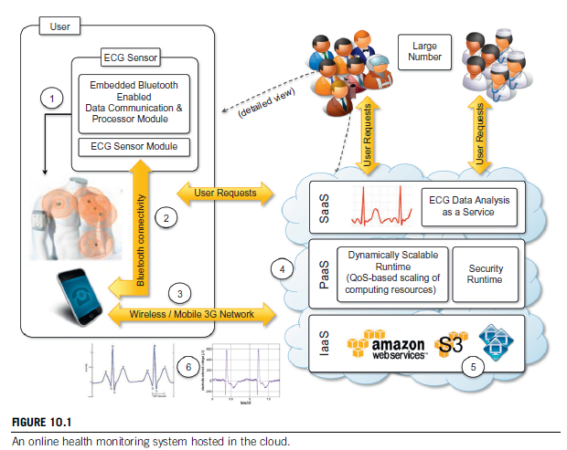

Slide 99
Wearable computing devices equipped with ECG sensors constantly monitor the patient’s heartbeat.
Such information is transmitted to the patient’s mobile device, which will eventually forward it to the cloud-hosted Web service for analysis.
The Web service forms the front-end of a platform that is entirely hosted in the cloud and that leverages the three layers of the cloud computing stack: SaaS, PaaS, and IaaS.
The Web service constitute the SaaS application that will store ECG data in the Amazon S3 service and issue a processing request to the scalable cloud platform.

Slide 100
The runtime platform is composed of a dynamically sizable number of instances running the workflow engine and Aneka [PaaS Platform].
The number of workflow engine instances is controlled according to the number of requests in the queue of each instance, while Aneka controls the number of EC2 instances used to execute the single tasks defined by the workflow engine for a single ECG processing job.
Each of these jobs consists of a set of operations involving the extraction of the waveform from the heartbeat data and the comparison of the waveform with a reference waveform to detect anomalies.
If anomalies are found, doctors and first-aid personnel can be notified to act on a specific patient.

Slide 101
Healthcare : ECG Analysis in the Cloud
Even though remote ECG monitoring does not necessarily require Cloud technologies, CC introduces opportunities that would be otherwise hardly achievable.
The first advantage is the elasticity of the Cloud infrastructure that can grow and shrink according to the requests served. As a result, doctors and hospitals do not have to invest in large computing infrastructures designed after capacity planning, thus making a more effective use of budgets. The second advantage is ubiquity.
Cloud computing technologies have now become easily accessible and promise to deliver systems with minimum or no downtime. Computing systems hosted in the Cloud are accessible from any Internet device through simple interfaces (such as SOAP and REST based web services).
This makes not only these systems ubiquitous but they can also be easily integrated with other systems maintained in the hospital’s premises. Lastly, cost savings constitute another reason.
Cloud services are priced on a pay-per-use basis and with volume prices in case of large numbers of service requests. These two models provide a set of flexible options that can be used to price the service, thus actually charging costs based on effective use rather than capital costs.

Slide 102
Biology: protein structure prediction
Home assignment

Slide 103
Geoscience: satellite image processing
Home Assignment

Slide 104
Business and Consumer applications
Capex to Opex
Ubiquity
Elasticity
The combination of all these elements has made cloud computing the preferred technology for a wide range of applications, from CRM and ERP systems to productivity and social-networking applications.

Slide 105
CRM and ERP
Customer relationship management (CRM) and enterprise resource planning (ERP) applications are market segments that are flourishing in the cloud, with CRM applications the more mature of the two.
Cloud CRM applications create a great opportunity for small enterprises and start-ups to have fully functional CRM software without large up-front costs and by paying subscriptions.
Moreover, CRM is not an activity that requires specific needs, and it can be easily moved to the cloud.
Such a characteristic, together with the possibility of having access to your business and customer data from everywhere and from any device, has fostered the spread of cloud CRM applications.

Slide 106
CRM and ERP
ERP solutions on the cloud are less mature and have to compete with well-established in-house solutions.
ERP systems integrate several aspects of an enterprise: finance and accounting, human resources, manufacturing, supply chain management, project management, and CRM.
Goal : to provide a uniform view and access to all operations that need to be performed to sustain a complex organization.
Because of the organizations that they target, the transition to cloud-based models is more difficult: the cost advantage over the long term might not be clear, and the switch to the cloud could be difficult if organizations already have large ERP installations.
For this reason cloud ERP solutions are less popular than CRM solutions at this time.

Slide 107
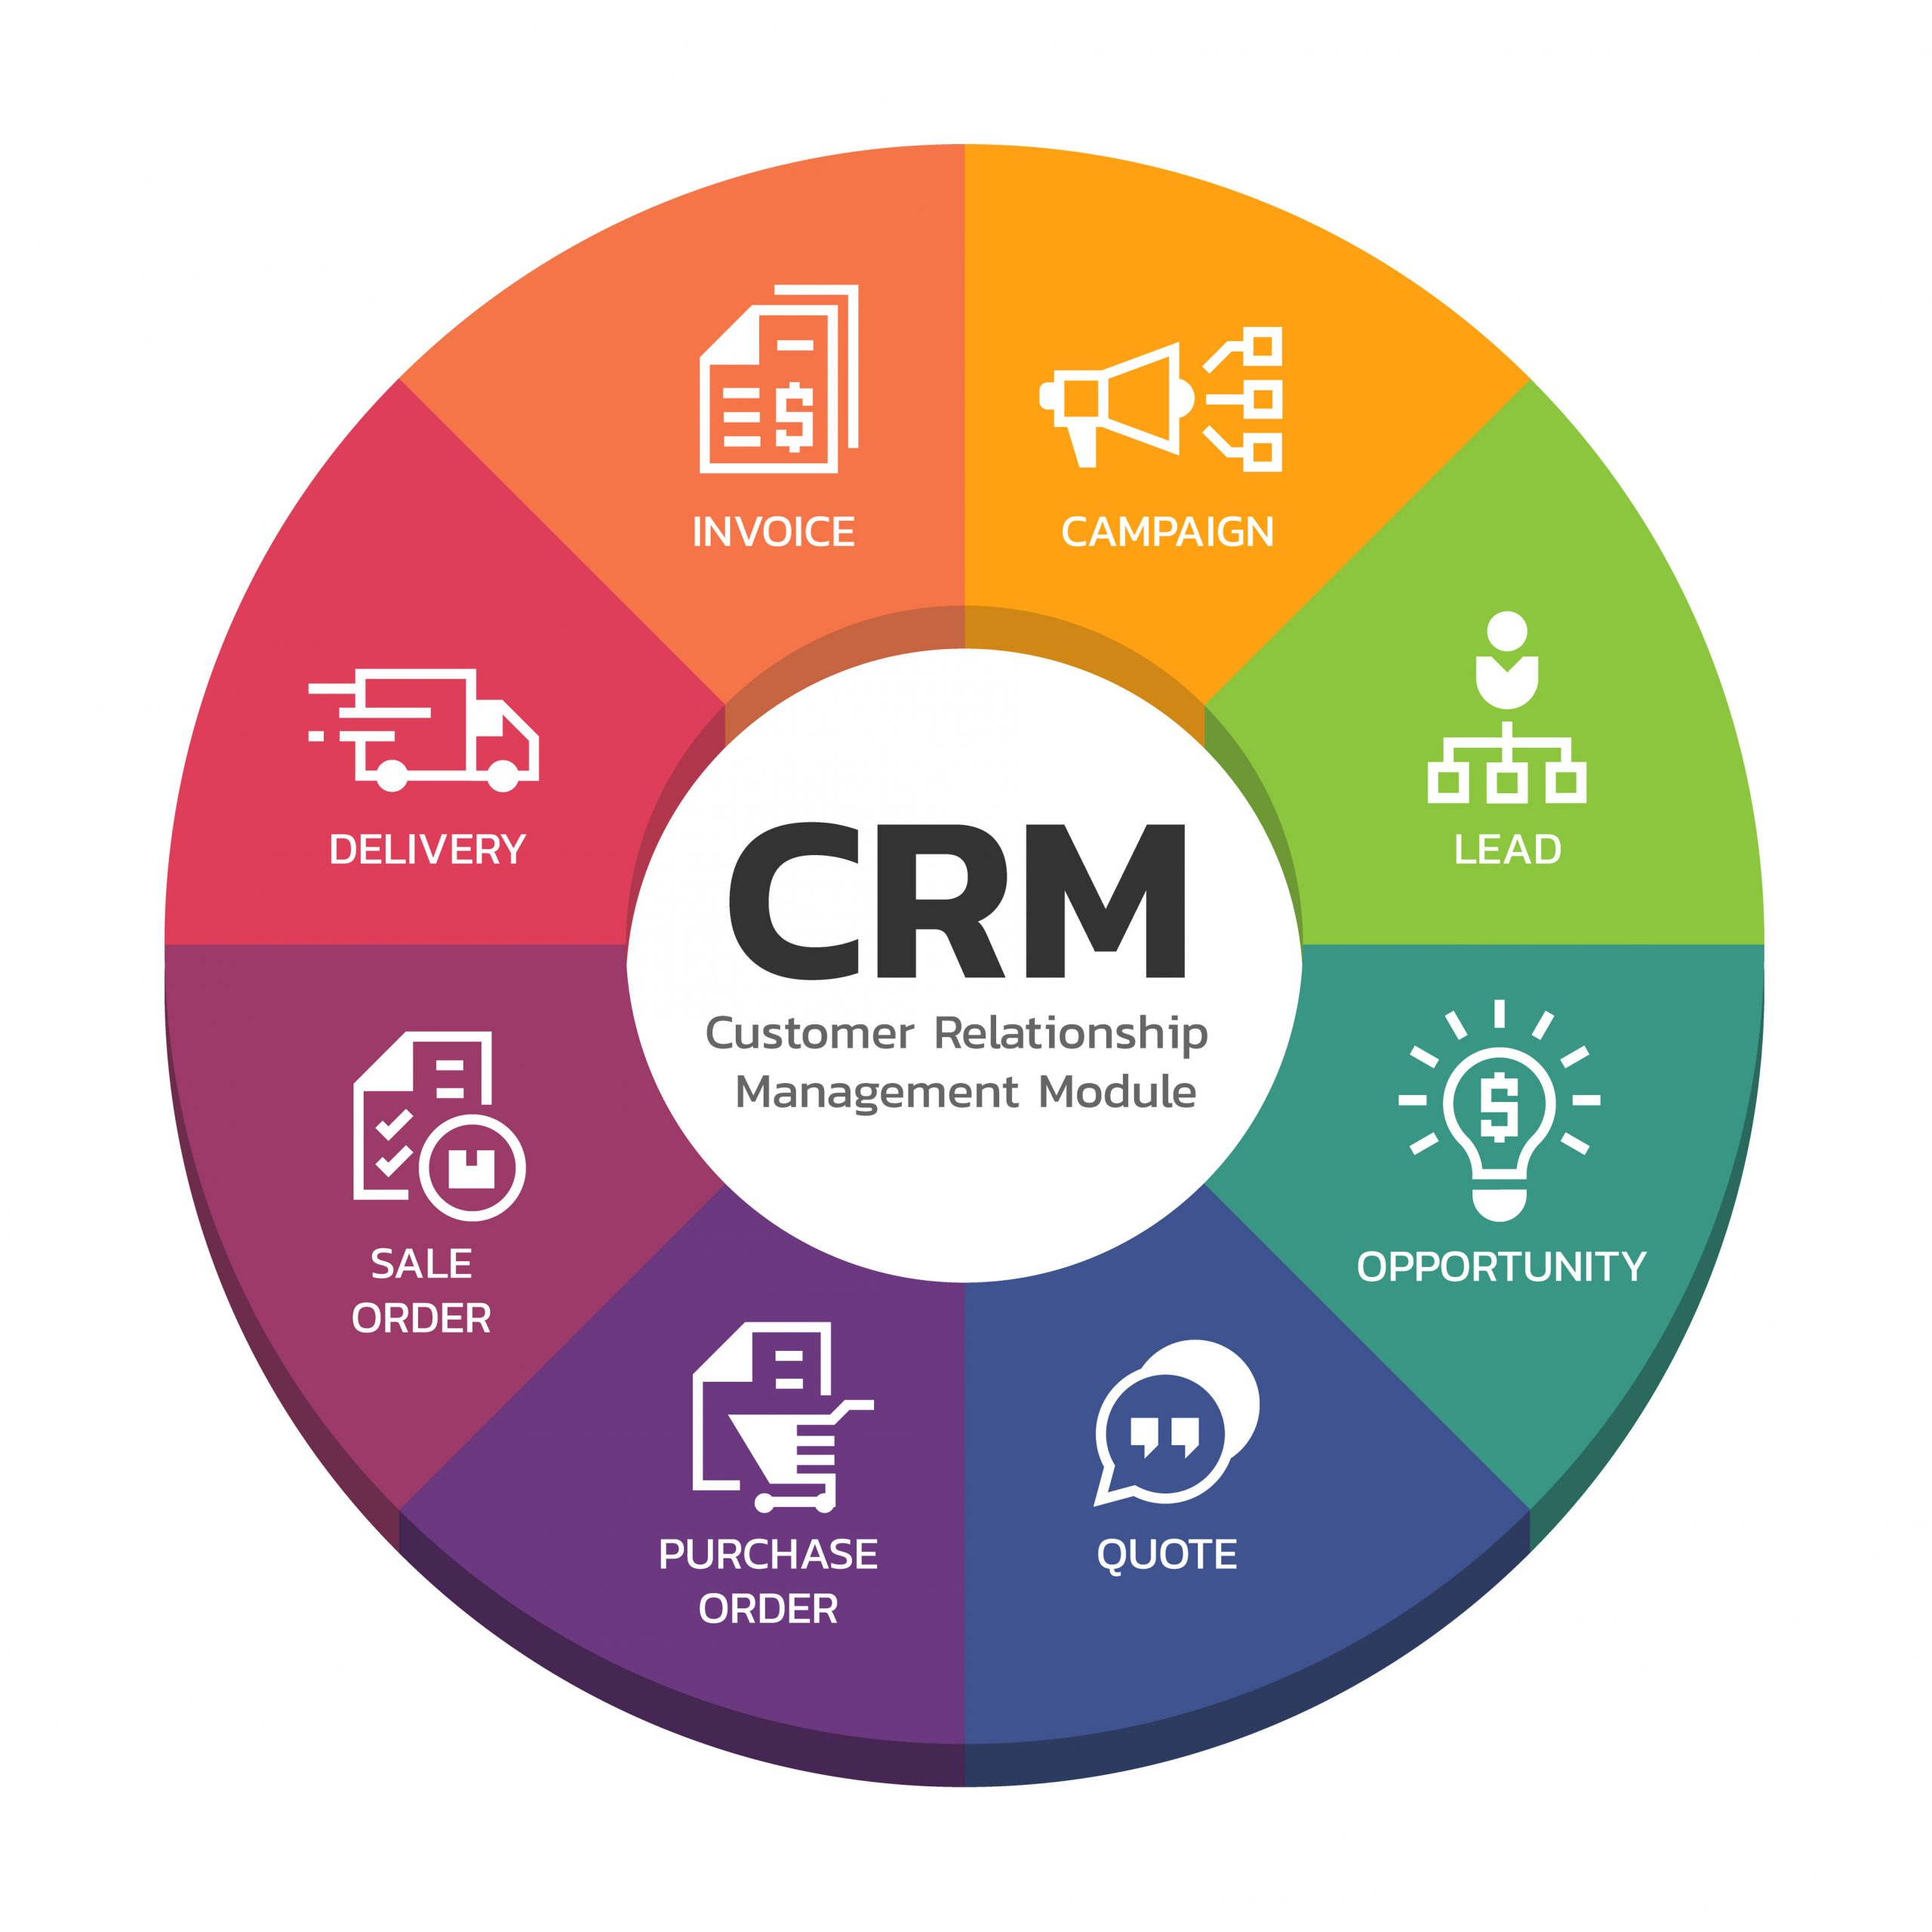

Slide 108
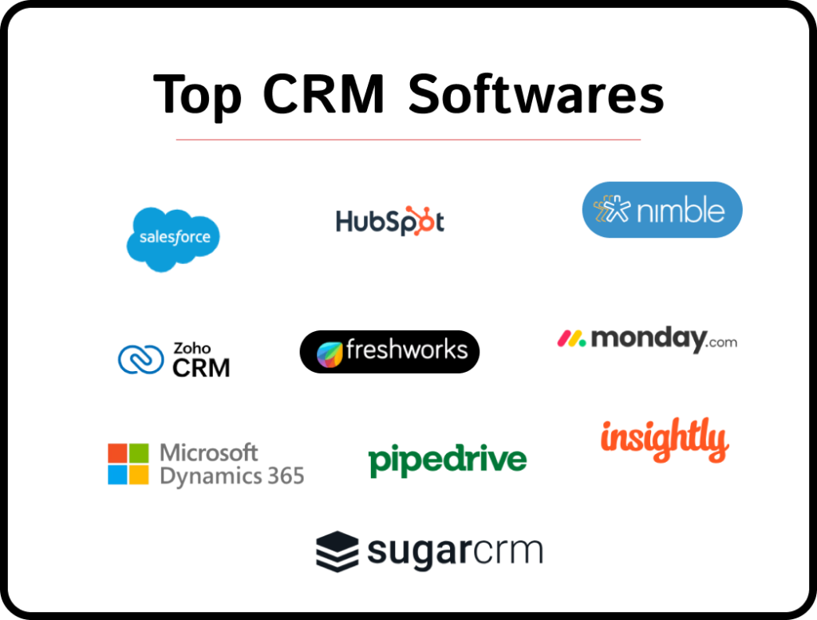

Slide 109
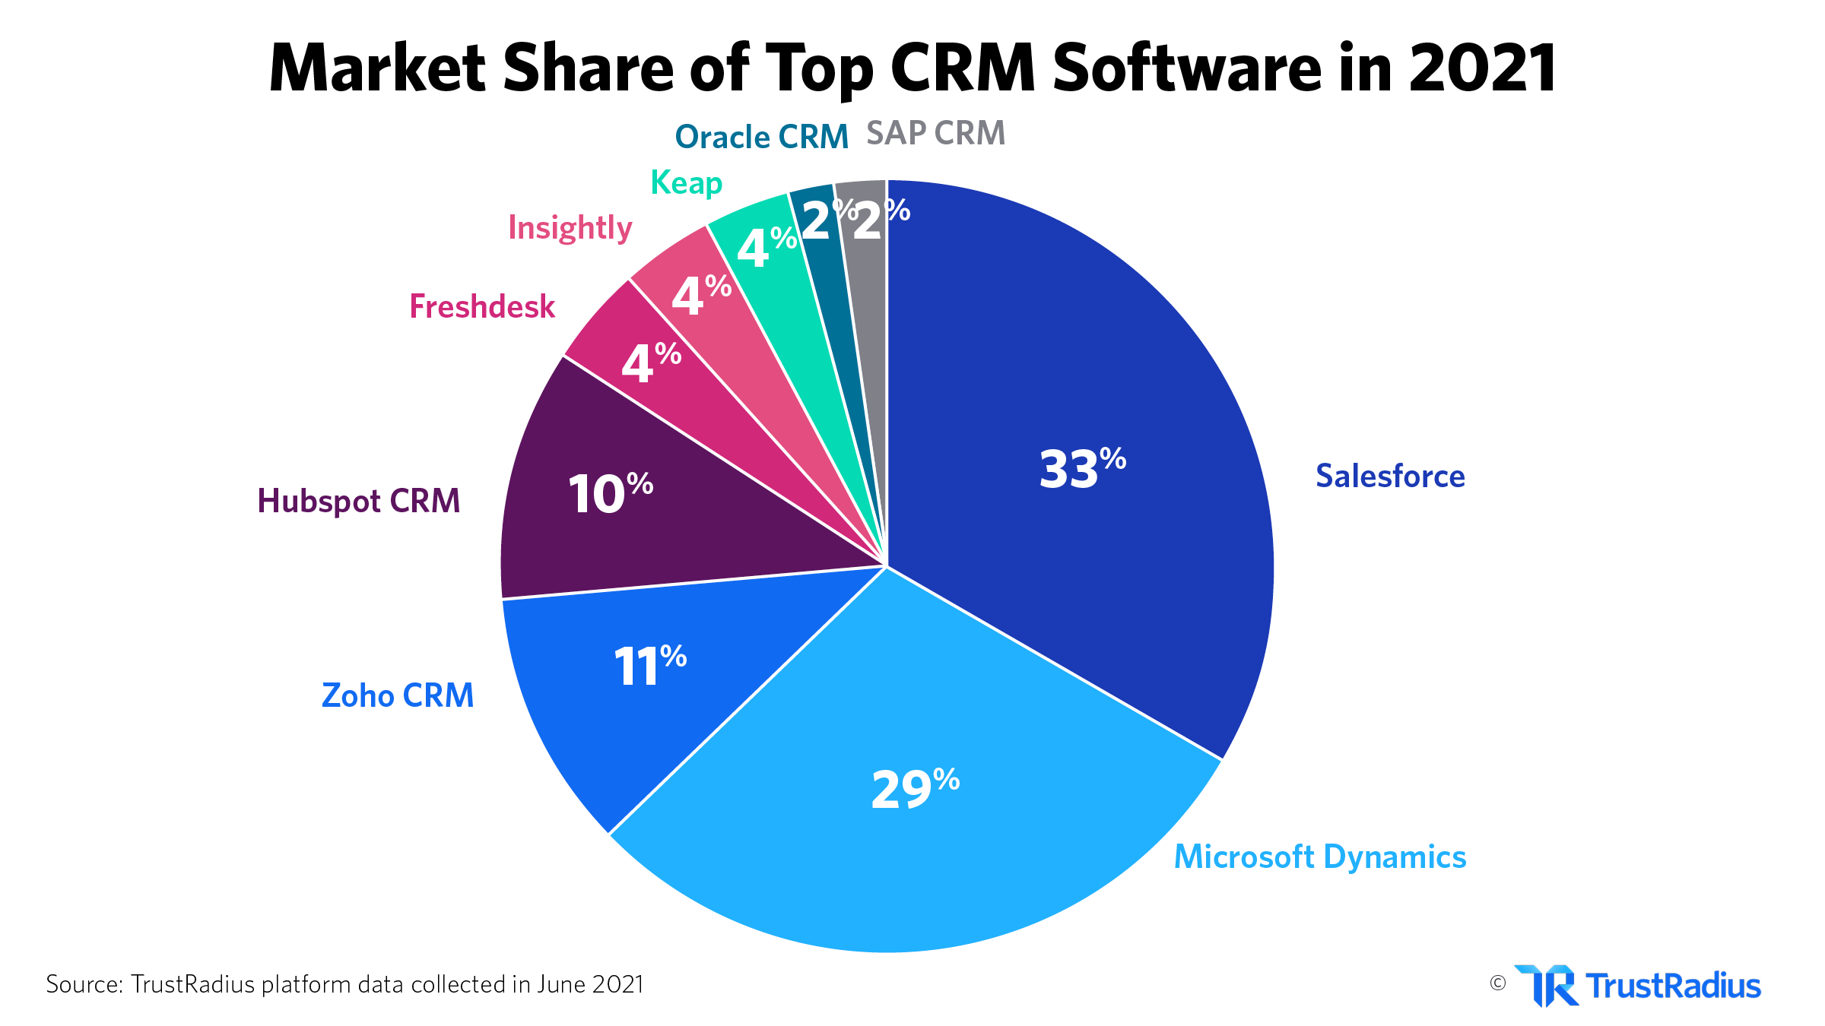

Slide 110
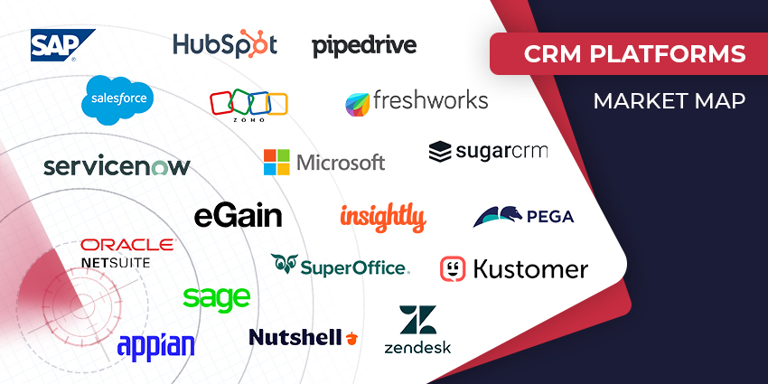

Slide 111
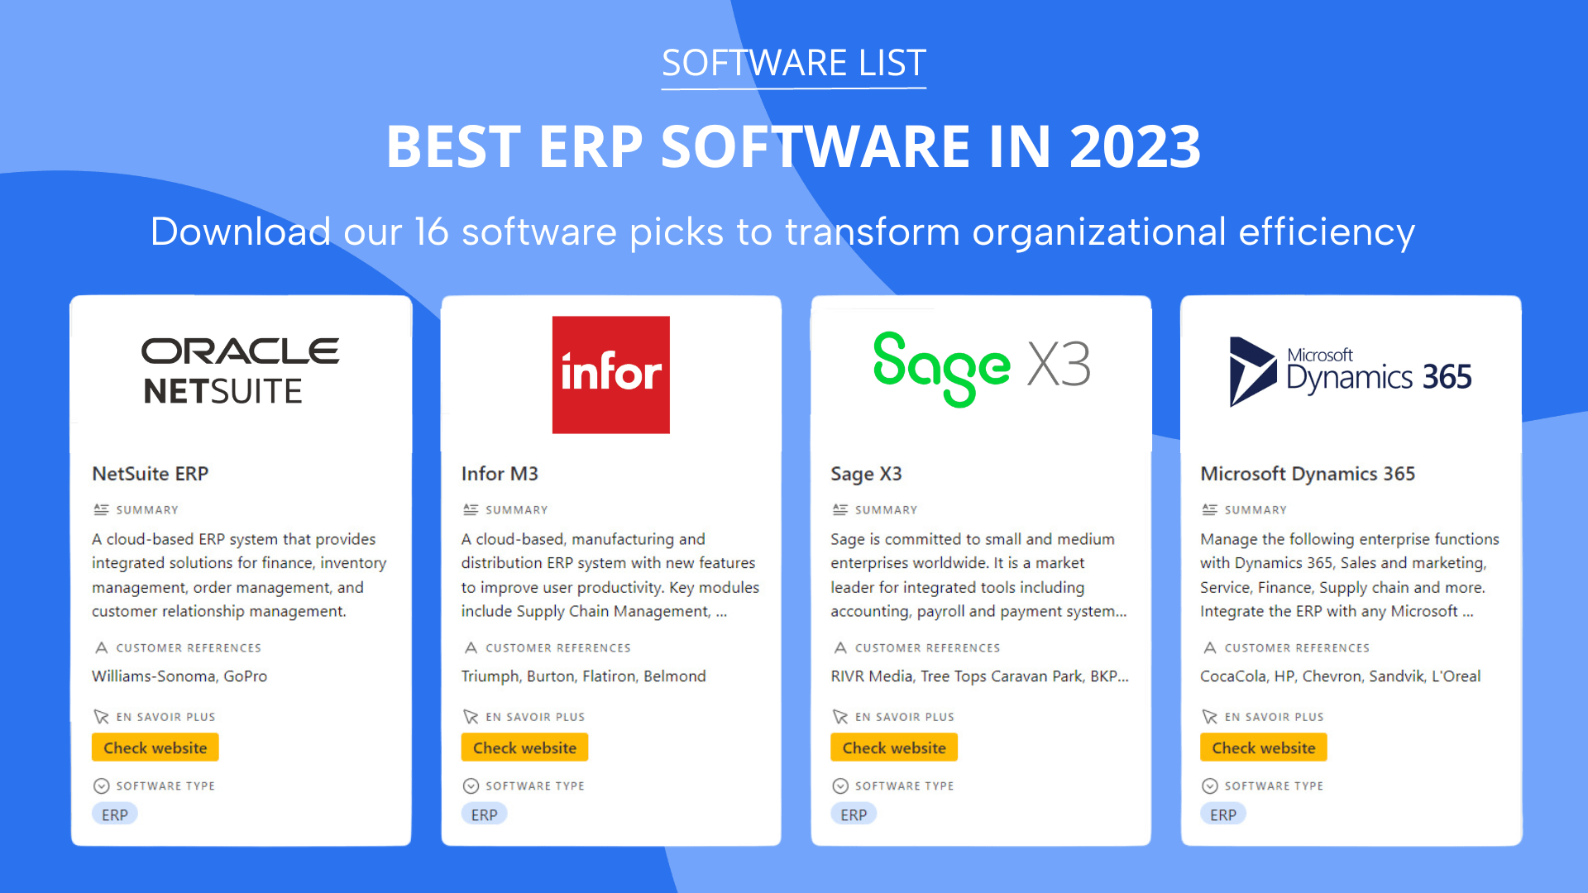

Slide 112
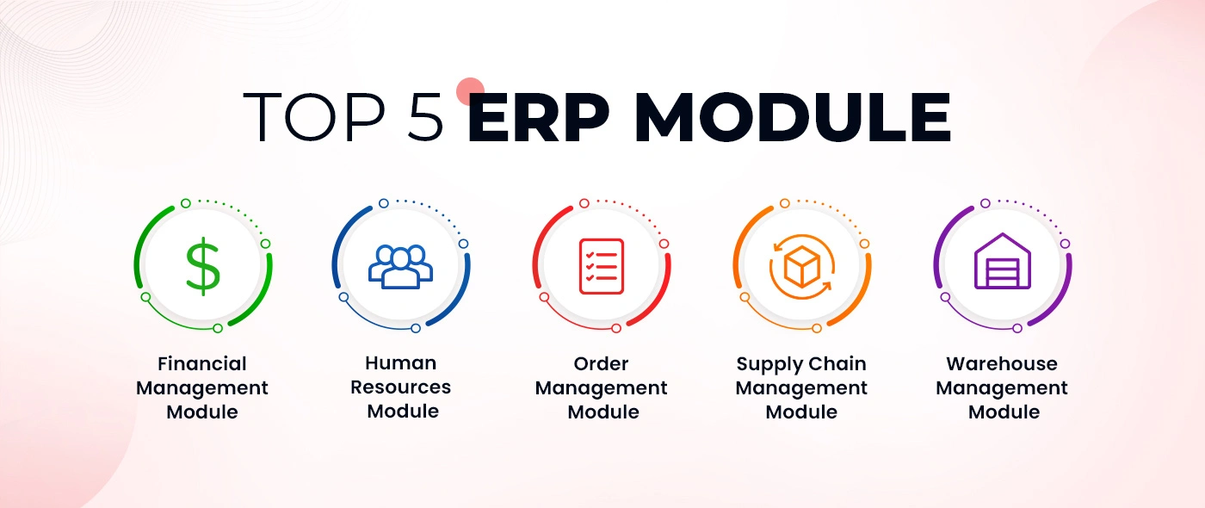

Slide 113
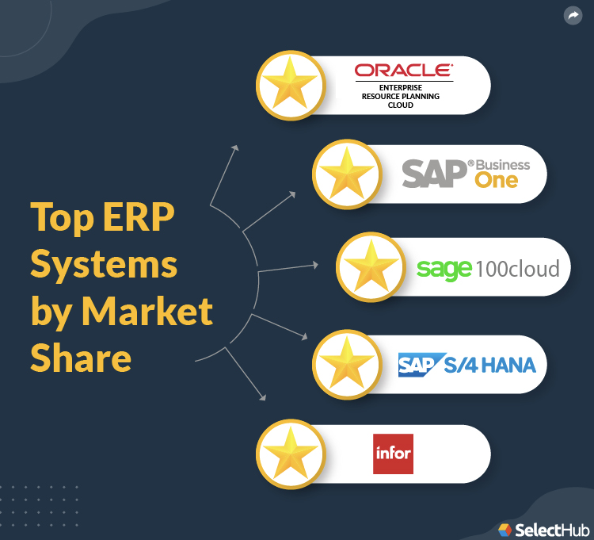

Slide 114
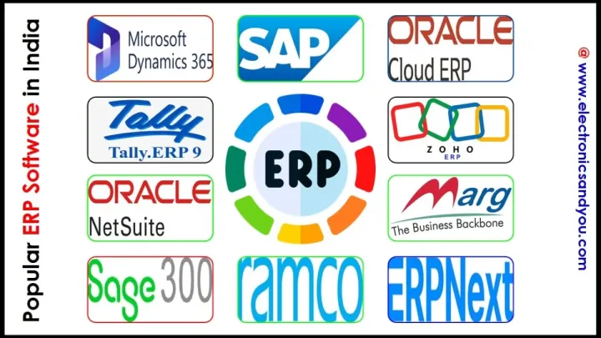

Slide 115
Salesforce.com
Probably the most popular and developed CRM solution available today
More than 100,000 customers have chosen Safesforce.com to implement their CRM solutions.
The application provides customizable CRM solutions that can be integrated with additional features developed by third parties.
Salesforce.com is based on the Force.com cloud development platform.
This represents scalable and high-performance middleware executing all the operations of all Salesforce.com applications.
Diagram : The architecture of the Force.com platform

Slide 116
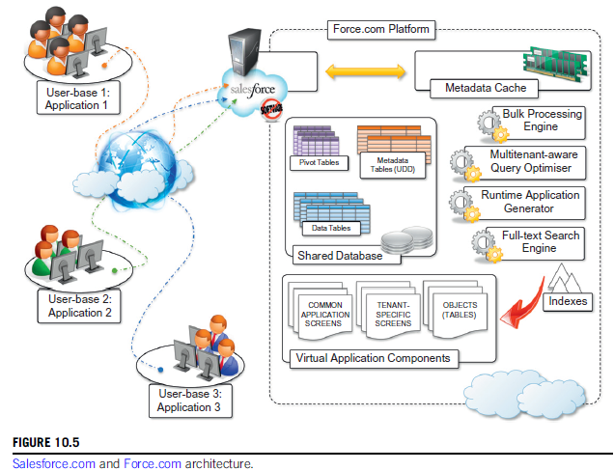

Slide 117
Force.com
Initially designed to support scalable CRM applications, the platform has evolved to support the entire life cycle of a wider range of cloud applications by implementing a flexible and scalable infrastructure.
At the core of the platform resides its metadata architecture, which provides the system with flexibility and scalability.
Rather than being built on top of specific components and tables, application core logic and business rules are saved as metadata into the Force.com store.
Both application structure and application data are stored in the store.

Slide 118
A runtime engine executes application logic by retrieving its metadata and then performing the operations on the data.
Although running in isolated containers, different applications logically share the same database structure, and the runtime engine executes all of them uniformly.
A full-text search engine supports the runtime engine.
This allows application users to have an effective user experience despite the large amounts of data that need to be crawled.
The search engine maintains its indexing data in a separate store and is constantly updated by background processes triggered by user interaction.

Slide 119
APEX
Users can customize their application by leveraging the “native” Force.com application framework or by using programmatic APIs in the most popular programming languages.
The application framework allows users to visually define either the data or the core structure of a Force.com application, while the programmatic APIs provide them with a more conventional way for developing applications that relies on Web services to interact with the platform.
Customization of application processes and logic can also be implemented by developing scripts in APEX.
This is a Java-like language that provides object-oriented and procedural capabilities for defining either scripts executed on demand or triggers.
APEX also offers the capability of expressing searches and queries to have complete access to the data managed by the Force.com platform.

Slide 120
Microsoft Dynamics CRM
The solution implemented by Microsoft for customer relationship management
Available either for installation on the enterprise’s premises or as an online solution priced as a monthly per-user subscription.
The system is completely hosted in Microsoft’s datacenters across the world and offers to customers a 99.9% SLA, with bonus credits if the system does not fulfill the agreement.
Each CRM instance is deployed on a separate database, and the application provides users with facilities for marketing, sales, and advanced customer relationship management.
Online features can be accessed either through a Web browser interface or programmatically by means of SOAP and RESTful Web services.
This allows Dynamics CRM to be easily integrated with both other Microsoft products and line-of-business applications.
Can be extended by developing plug-ins that allow implementing specific behaviors triggered on the occurrence of given events.
Can also leverage the capability of Windows Azure for the development and integration of new features.

Slide 121
Social networking
Social networking applications have grown considerably in the last few years to become the most active sites on the Web.
To sustain their traffic and serve millions of users seamlessly, services such as Twitter and Facebook have leveraged cloud computing technologies.
The possibility of continuously adding capacity while systems are running is the most attractive feature for social networks, which constantly increase their user base.

Slide 122
Points covered
Part III : Cloud Computing Applications
Healthcare: ECG Analysis in the Cloud
Biology: Protein Structure Prediction
Geosciences: Satellite Image Processing
Business and Consumer Applications:
    CRM and ERP
    Social Networking
Google Cloud Application: Google App Engine.
Overview of OpenStack architecture.

Slide 123
Google Cloud Applications
Google Applications Utilizing Cloud
Google App Engine

Slide 124
Google Applications Utilizing Cloud
Google’s domain is constructed on the World Wide Web advertising.
In 2010, 96% of its $29 billion income came from online ads.
Google deals subscriptions to enterprises, applying its web experience to market conventionally controlled by a very distinct kind of Software Company.

Slide 125
Like Google’s search engine, Google Apps is constructed on top of a highly distributed infrastructure that separates both data and code over many servers and data centres.
This consistent back-end is conceived in order that if one data centre goes down, another can directly step into the breach.
Google values custom-built devices that permit it to improve services without taking them.

Slide 126
Google Applications Utilizing Cloud : Gmail
Gmail makes organizing the e-mail system so straightforward and efficient.
Gmail boasts 25 GB of storage per client, mighty spam filtering, BlackBerry and Outlook interoperability and a 99.9% uptime SLA (Service Level Agreement).

Slide 127
Gmail : Why / How?
● E-mail, IM, voice and video chat: Each client gets 25 GB of e-mail and IM storage.
● Anytime, any location, get access to your e-mail: Gmail is securely powered by the WWW, so you can be creative from your table, on the street, at home and on your wireless telephone, even when you are offline.
● Sync with Android, iPhone and BlackBerry: Get the advantages of Apps on premier wireless platforms.
● Search and find e-mails instantly: Spend short time in managing e-mail and locate e-mails quickly with Google-powered search to your inbox.
● Get less spam: Gmail spam is powerful filtering which assists you to concentrate on important ones.

Slide 128
Google Calendar
With Google Calendar, it is so simple to organize tasks all in one place.
● Easily schedule appointments: Join multiple calendars to preview when people are available. Google Calendar drives requests and organizes them.
● Integrate with e-mail system: Google Calendar is incorporated into Gmail and interoperable with popular calendar applications.
● Share task calendars: Calendars can be distributed company-wide or with chosen coworkers. A variety of distributing consent controls assist to sustain security and privacy.
● Access with your wireless device: View and edit happening minutia, add new happenings and ask for visitors on wireless devices like the BlackBerry and iPhone. Even obtain calendar notifications by SMS.
● Publish calendars: Publicize external business happenings by announcing a calendar to make it searchable in the Google Calendar gallery. Easily embed calendars into web pages.

Slide 129
Google Docs
An easy-to-use online word processor, spreadsheet and production reviewer that endows to perceive, store and share instantly and securely and cooperate online in less time.
Users can conceive new articles from the rub or upload living articles, spreadsheets and presentations.
There are no software programs to download and all your work is retained securely online and can be accessed from any computer.

Slide 130
Google Docs
Works over other operating systems: Google Docs works in the browser on PC, Mac and Linux computers and carries well-liked formats, for example, .doc, .xls, .ppt and .pdf.
Easily upload and share files: Files retained on Google Docs are habitually accessible and backed-up online.
Secure access to controls: Administrators can organize document distributing permissions system-wide and article proprietors can share and revoke document access at any time.

Slide 131
Google Sites
Google Sites are the easiest way to make knowledge accessible to the population who want speedy, up-to-date access.
People can work concurrently on a site to add record supplements, knowledge from other Google requests for paid jobs (like Google Docs, Google Calendar, YouTube and Picasa) and new free-form content.
Google Sites are accessible from any internet-bound computer.

Slide 132
Google Sites (2)
● Organize knowledge in a central place: Use Google Sites to centralize written material, spreadsheets, demonstrations, videos, slideshows and more to aid to retain the teams organized.
● Anytime, everywhere access: Google Sites are securely propelled by the web, so you can gather pages from your office desk, on the move, at home and on your portable phone.
● Works through various operating systems: Google Sites work on the browser installed on PC with Mac and Linux computers.
● System and site-level security controls: Administrators can supervise site sharing permissions through the enterprise and authors can share and revoke file access at anytime.

Slide 133
Google Groups
The Google Groups service creates a Google Group which is a user-owned group.
Google Groups not only sanctions us to supervise and record the mailing list, but in addition gives a manner for accurate communication and collaboration with gathered members.
Unlike other free mailing list services, Google Groups bids lavish storage fixes, customizable pages and unique organization options.
Google Groups are all about aiding users to bind with peoples, to access knowledge and convey effectually over computer communication and on the web.
● Fast setup: Create and supervise gatherings without burdening IT.
● Sharing with a group: Employees can share docs, calendars, sites, divided folders and videos with a gathering instead of individuals.
● Searchable archives: Group members can access and explore archives of posted items, conveyed to their e-mail lists to expeditiously find topics of interest.

Slide 134
Google Video
The Google Video index is the most comprehensive on the WWW, comprising millions of videos indexed and obtainable for viewing.
Using Google Video, one can explore and watch an ever-growing accumulation of video presentations, cinema clips, videos tunes, documentaries, private productions and more from all over the web.
● A video channel for your business: Video sharing makes valued communications like inside training and company announcements more engaging and effective.
● Keep videos secured and private: Employees can securely share videos with co-workers without uncovering private information.
● Anytime, everywhere access: Google Video is securely propelled by the web, so you can view videos from your office desk, on the road and at home.
● Works in various operating systems: Google Video works on a browser installed on PC with Mac and Linux OS.

Slide 135
18/04/2024

Slide 136
Points covered
Part I : Amazon Web Services (AWS)
Amazon Web Services and Components
Amazon Simple DB
Elastic Cloud Computing (EC2)
Amazon Storage System
Amazon Database services (Dynamo DB)

Slide 137
Points covered
Part II : Microsoft Cloud Services
Azure core concepts
SQL Azure
Windows Azure Platform Appliance

Slide 138
Points to cover
Part III : Cloud Computing Applications
Healthcare: ECG Analysis in the Cloud
Biology: Protein Structure Prediction
Geosciences: Satellite Image Processing
Business and Consumer Applications:
  CRM and ERP
  Social Networking
Google Cloud Application: Google App Engine.
Overview of OpenStack architecture.

Slide 139
Google App Engine
Google’s stimulating application development and hosting platform in the cloud
With it, the client can construct and establish web applications on Google’s scalable high-traffic infrastructure.
App Engine carries apps written in Python or Java and they will execute on servers that use the identical expertise that forces Google’s websites for pace and reliability.

Slide 140
App Engine applications are simple to construct and scale as the traffic and data grows.
To maintain App Engine, there are no servers available.
It helps the user to upload the application.
Google App Engine devotes you to get access to the identical construction blocks that Google values for its own applications.
It makes it simpler to construct an application that runs reliably, even under a hefty load and with a large amount of data.

Slide 141
The development environment contains the following features:
● Dynamic WWW assisting with full support of extensive web technologies.
● Persistent storage with queries, sorting and transactions that are powered by Bigtable and GFS.
● Scalability and load balancing are done automatically.
● Google APIs for authenticating users and dispatching e-mail.
● Fully boasted localized development environment.
Google App Engine bundles the construction blocks and takes care of the infrastructure stack, departing you more time to aim on composing code and advancing your application.

Slide 142
Google Apps for Business
Powerful cloud-based messaging and collaboration tools are offered by Google Apps for Business, from tiny organizations to huge organizations.
Google Apps is 100% hosted by Google, which decreases IT charges, minimizes up-keeping and management and simplifies primary setup.
With Google Apps for Business, client gets:
● Customized e-mail addresses
● Mobile e-mail, calendar and IM access
● No added hardware or programs
● Industry-leading spam filtering
● 24/7 internet note and telephone support
● 99.9% uptime assurance
● Dramatic cost savings
Choosing Google Apps not only saves money, but also saves an unbelievable amount of time. If the entire IT group focuses on methods and forward-thinking that can really advance the way enterprise operates.

Slide 143
Google Apps for Education
Google Apps for Education boasts worth that is yet to be agreed in the world of cloud-based messaging and collaboration.
For $0/user/year, school, employees and scholars of informative organizations at all levels can leverage this huge set of customizable connection and collaboration tools.
Tools like Google Sites and Google Groups are ready-made for the world of learning, endowing data exchange and direction at solely new levels.
Google Apps adds the newest technologies and establishes best practices for data-centre administration, network application security and data integrity.

Slide 144
Google Apps for Education (1)
Eight ways how Google Apps advantages the campus are listed herewith:
● Students will love you for it
● Free up your IT
● Easy to deploy
● Save money
● Google defends your privacy
● Security as powerful as Google
● Innovation in real-time
● Collaborate globally

Slide 145
Google Apps for Government
Google Apps for Government presents all of the identical advantages that Google Apps for Business does, but with a supplemented level of security that stands up to even the largest levels of government standards.
With Google Apps, the government department benefitted from the scale and redundancy of distributed data centres around the globe.

Slide 146
Points covered
Part III : Cloud Computing Applications
Healthcare: ECG Analysis in the Cloud
Biology: Protein Structure Prediction
Geosciences: Satellite Image Processing
Business and Consumer Applications:
    CRM and ERP
    Social Networking
  Google Cloud Application: Google App Engine.
Overview of OpenStack architecture.

Slide 147
Overview of OpenStack architecture

Slide 148
Open Source Cloud Platforms and Industry Standards
There are several open source cloud management platforms forming and continuously improving in the industry:
    OpenStack and CloudStack
    two most significant in the industry
Some of these cloud management platforms have broad industry support but might lag behind in terms of the features and functionality provided by commercial cloud management platforms.
Organizations that want to evaluate or deploy this class of cloud management system should consider the pros and cons of using open source versus commercially supported software platforms.
Open source’s largest benefit is avoiding software vendor lock-in

Slide 149
OpenStack
An open source project with the largest community, code contributors, and cloud provider and system integrator involvement
Main goal : to support interoperability between cloud services while enabling enterprises to create Amazon-like cloud services.
A combination of modules that you can use to build, host, and operate your own cloud.
OpenStack modules are available to provide IaaS VMs, object and block storage, networking, identity, and many other services.
There is an OpenStack module for cloud management automation and orchestration called Heat
Another module called Horizon that is a customer-facing self-service configuration portal.

Slide 150
Being an open source project, all developed source code is submitted to the OpenStack committee, with the combined code being released to the public free of charge.
Notable founders and adopters of OpenStack include RackSpace, NASA, Hewlett-Packard, and IBM—each adding to and customizing OpenStack for their customer deployments and integration into other cloud management platforms and providers.
Beyond a cloud management platform, OpenStack is also seen as an industry standard for application interfaces, interoperability between cloud providers, and eventually will at least influence software-defined networking and datacenters in the future.
Given the quantity and well-known industry companies that have committed to OpenStack, it is expected to dominate as the industry open source for cloud and API integration between clouds.

Slide 151
OpenStack
A cloud operating system that controls large pools of compute, storage, and networking resources throughout a datacentre, all managed and provisioned through APIs with common authentication mechanisms.
Provides an Infrastructure-as-a-Service (IaaS) solution through a variety of complementary services.
Each service offers an Application Programming Interface (API) that facilitates this integration.

Slide 152
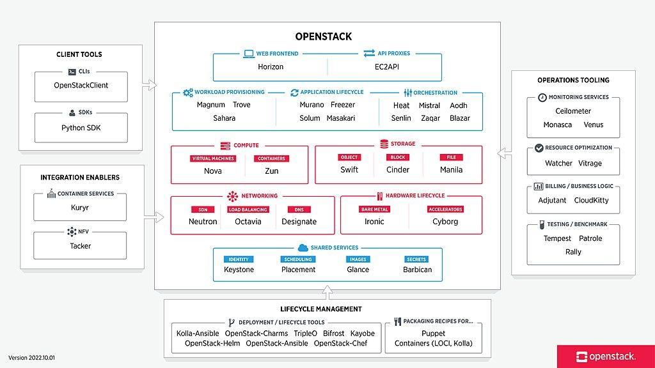

Slide 153
https://www.openstack.org/software/project-navigator/openstack-components#openstack-services
https://docs.openstack.org/contributors/common/introduction.html

Slide 154
IaaS Implementation Using OpenStack
IaaS can be implemented by integrating major components of OpenStack which are as follows:
Horizon: Horizon is a web-based interface for managing OpenStack services. It provides a graphical user interface for operations such as launching instances, managing networking and setting access controls.
Keystone: Keystone is the centralized identity service that provides authentication and authorization for other services. Keystone also provides a central catalog of services running in a particular OpenStack cloud.

Slide 155
IaaS Implementation Using OpenStack (1)
3. Networking (neutron): OpenStack Networking provides connectivity between the interfaces of other OpenStack services, such as Nova. OpenStack Networking is a pluggable architecture, users can create their own networks, control traffic, and connect servers to other networks.
4. Cinder: Cinder is a service that manages storage volumes for virtual machines. This is persistent block storage for the instances running in Nova.

Slide 156
IaaS Implementation Using OpenStack (2)
5. Nova: Compute nodes form the resource core of the OpenStack Compute cloud, providing the processing, memory, network and storage resources to run instances. Nova is a distributed component and interacts with Keystone for authentication, Glance for images and Horizon for web interface.
6. Glance: Glance service that acts as a registry for virtual machine images to allowing users to copy server images for immediate storage. Images can be used as templates when setting up new servers.

Slide 157
7. Swift: Swift service providing object storage which allows users to store and retrieve files. Swift architecture is distributed to allow for horizontal scaling, and to provide redundancy as failure proofing
8. Manila : The OpenStack Shared File Systems service (manila) provides file storage to a virtual machine. The Shared File Systems service provides an infrastructure for managing and provisioning of file shares. The service also enables management of share types as well as share snapshots if a driver supports them.

Slide 158
Trove: d/b management
Sahara: The Data processing service for OpenStack (sahara) aims to provide users with a simple means to provision data processing (Hadoop, Spark) clusters by specifying several parameters like Hadoop version, cluster topology, node hardware details and a few more. After a user fills in all the parameters, the Data processing service deploys the cluster in a few minutes. Sahara also provides a means to scale already provisioned clusters by adding or removing worker nodes on demand.

Slide 159
Course Outcome
CO4: Develop and deploy applications on Cloud

